Slide 1
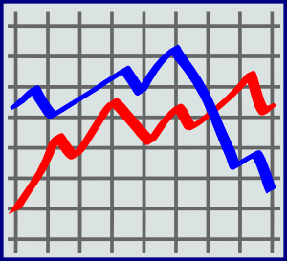
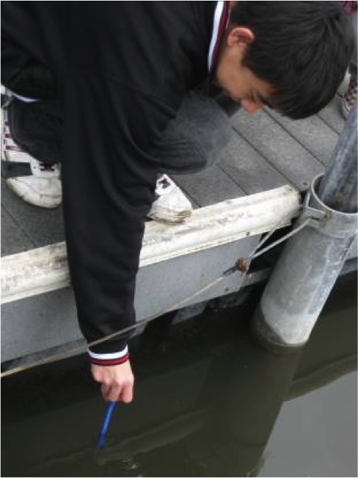
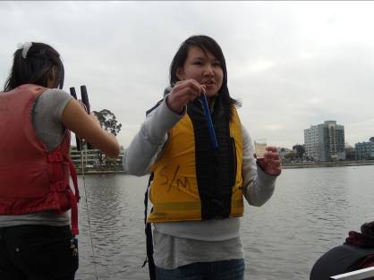
Concise Title of Less Than 15 Words That Summarizes the Study
Collaboration Team Names
School Name
School Logo
Summary
Research Methods
Results
Conclusions
a. The problem
b. Research questions
c. Objectives set
d. Conclusions
Planning Investigations
Describes the planning process
a. There is a direct link provided between the datasets and research question(s)
b. Study site: A map and description of the study site. It should mention area of study, climatic characteristics and basic aspects of land cover
c. Data collection: A description of GLOBE protocols used to answer the research question as well as where and how data was gathered in the field (sampling method: Where, how many samples were measured)
d. Print screen of data entry in the Web page of GLOBE.
e. The data presented are sufficient to answer the research question(s)
Analyzing Data
a. Tables and graphics of data
b. Data support the conclusions
Drawing Conclusions & Next Steps
a. Gives a thorough and insightful explanation as to how the conclusion was reached
b. Put findings in context, stating why they are important or relevant
c. What follow-on research and actions could be taken; future protocols that could be added
d. Impact of working with a project mentor
Research Question
Figure #1
Asking Questions
a. Include why they are important and are of scientific interest
b. Concern some aspect of Earth’s environment (local or global issue)
c. Provide significant insight into both the topic of investigation and the research process
d. Require a thoughtful research plan
e. Are answerable through scientific research appropriate to the scope of the report.
Introduction
Content Knowledge
a. Description of the problem
b. Importance
c. Community relevance
Figure #2
Bibliography
References
a. Materials listed
b. GLOBE materials used
Map of Study Site(s)
Field Photos (requires release forms)

