Slide 1
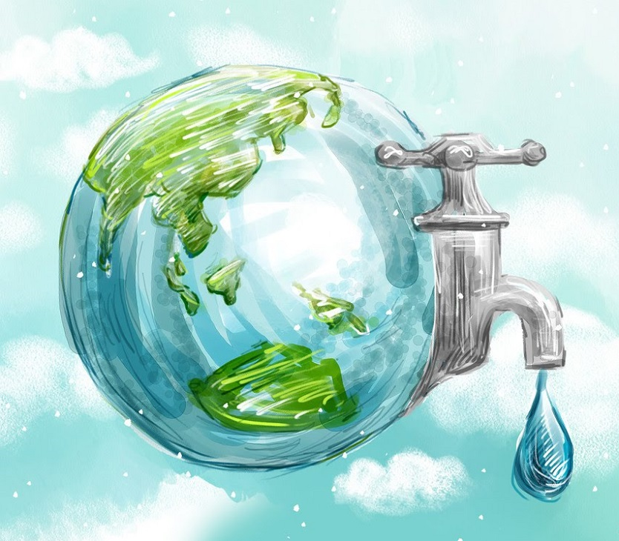
WATER QUALITY OF THE AREA OF RIJEKA-PRIMORSKO GORANSKA COUNTY-CROATIA
Vanda Piškur
Institute of Public Health
Laboratory for Drinking Water and Water in Nature
PRIMORSKO GORANSKA COUNTY
CROATIA

Slide 2
Water resources of the area of Rijeka
The area of Rijeka is rich with water
Abundance exists primarily due to climatic and hydro geological features of the area
Adriatic sea and the Alps have a great influence on climatic features
The Alps influence the air movements wich makes a direct influence on clouding and precipitation in the area of Rijeka
The anual mean precipitation in the area is 1.530 mm
The area of Rijeka is karst area

Slide 3
Water resources of the area of Rijeka
The most important source in the area of Rijeka is the spring Rječina (altitude 325 m above the sea level)
Has a seasonal flow (periods of drying)
During the periods when the water amount of Rječina are insufficient, the water supply shifts to the spring Zvir
Zvir never dries out (1000 l/s and 1500l/s)
Martinšćica and the sources from the Bakar bay (the sources included in the Rijeka’s water supply system
It can be concluded that the area of Rijeka is rich with water resources wich are sufficinet for it needs

Slide 4
Primorsko-goranska county with the main center Rijeka
The main sources of Rijeka water supply system

Slide 5
The spring Rječina

Slide 6
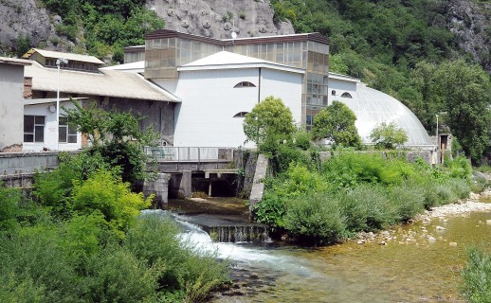
The spring Zvir 1

Slide 7
Water quality
Physical and chemical characteristics
- Very high quality according to the Republic of Croatia National standards
- There is no substantinal distinctions in the chemical composition of the water in any of the sources and the mineral composition is very similar in all of them
- Water has excellent physical and chemical features typical for karst water with hardness between 7 and 8⁰ dH
- An average temperature varying between 7 and 7.5⁰ C
pH between 7,8 and 8,2
Microbiological
characteristics
-The share of bacteria in the water is small to medium, requiring only disinfection with chlorine dioxide
-There is no other pollution because the sources are in the mountainous hinterland with a low population density.
-During heavy rainfalls it is sufficient to chlorinate the water (only possible problem refer to the occasional short-term muddiness)

Slide 8
Water quality
In water predominate calcium bicarbonate (Ca²⁺ = 43,5 - 59,7 mg/l; Mg²⁺ = 5,03 - 6,87 mg/l)

Slide 9
Water quality
Organic matter and total organic carbon in the spring Rječina

Slide 10
Water quality
Nitrite (<0,002 mg NO₂/l - 0,004 mg
NO₂/l)
Nitrate (2,14 - 3,59 mg NO₃/l)
All formes of nitrogen and phosphous are very low
Ammonia (<0,004 mg NH4⁺/l - 0,011 mg NH4⁺/l )

Slide 11
Water quality
In the water 19 metals have to be examinated
The toxic metals: Hg, Cd and Pb are never found
Pesticides, mineral oils, benzen,polycylic aromatic hydrocarbons are also not detected

Slide 12
Water quality
The share of bacteria in the water is small to medium
It is sufficient to chlorinate the water (ClO2)

Slide 13
The Laboratory for Drinking Water and Water in Nature takes care of the quality and the drinkability of water in whole Primorsko goranska county

Slide 14
The quality of water for human consumption in Primorsko goranska county, Croatia in 2016.
Supply system | Number of samples (regular monitoring) | Number of samples (revision monitoring) | Unsuitable samples | The cause of irregularity
 |  |  |  | Number of chemical irregular samples | Number of microbiological irregular samples
Rijeka | 296 | 22 | 0 | 0 | 0
Opatija | 60 | 10 | 0 | 0 | 0
Žrnovnica | 52 | 10 | 0 | 0 | 0
Cres-Lošinj | 39 | 3 | 0 | 0 | 0
Ponikve- Krk | 72 | 11 | 0 | 0 | 0
Vrelo Rab | 30 | 3 | 0 | 0 | 0
Komunalac Delnice | 50 | 16 | 4 | 2 (pH low values- the natural characteristics of some springs | 3 Coliform bacteria, Escherichia coli, Enterococus faecalis, Pseudomonas aeruginosa, UBB)
Komunalac Vrbovsko | 17 | 6 | 1 | 1 (high concentration rez.Cl) | 0
Čabranka Čabar | 23 | 5 | 13 | 2 high concentration rez.Cl muddiness) | 14 (Coliform bacteria, Escherichia coli, Enterococus faecalis)
SUM | 639 | 86 | 18 (2,5%) | 5 (0,7%) | 16 (2,2%)

Slide 15
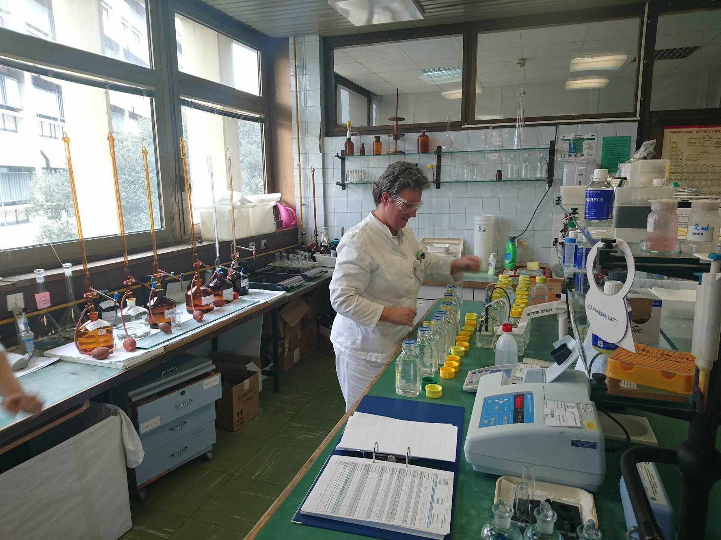

Slide 16
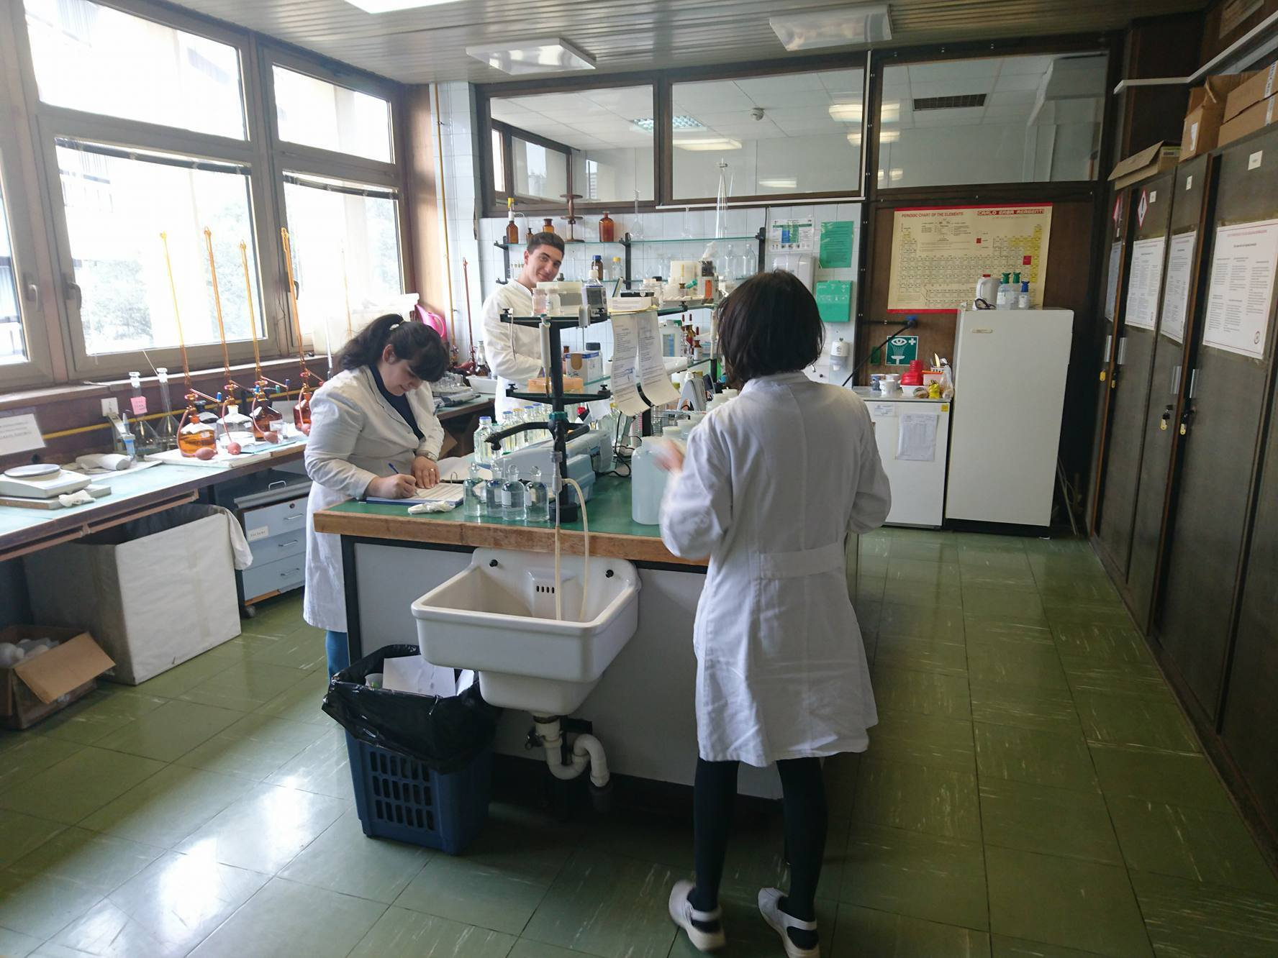

Slide 17
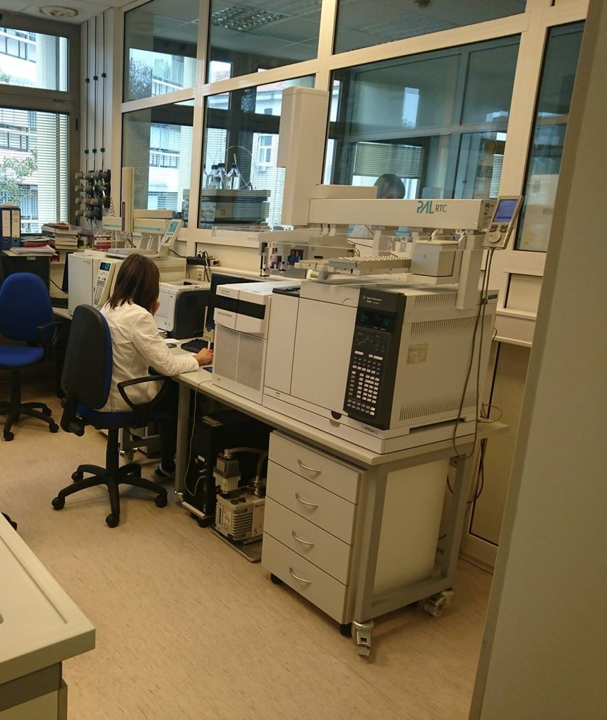

Slide 18
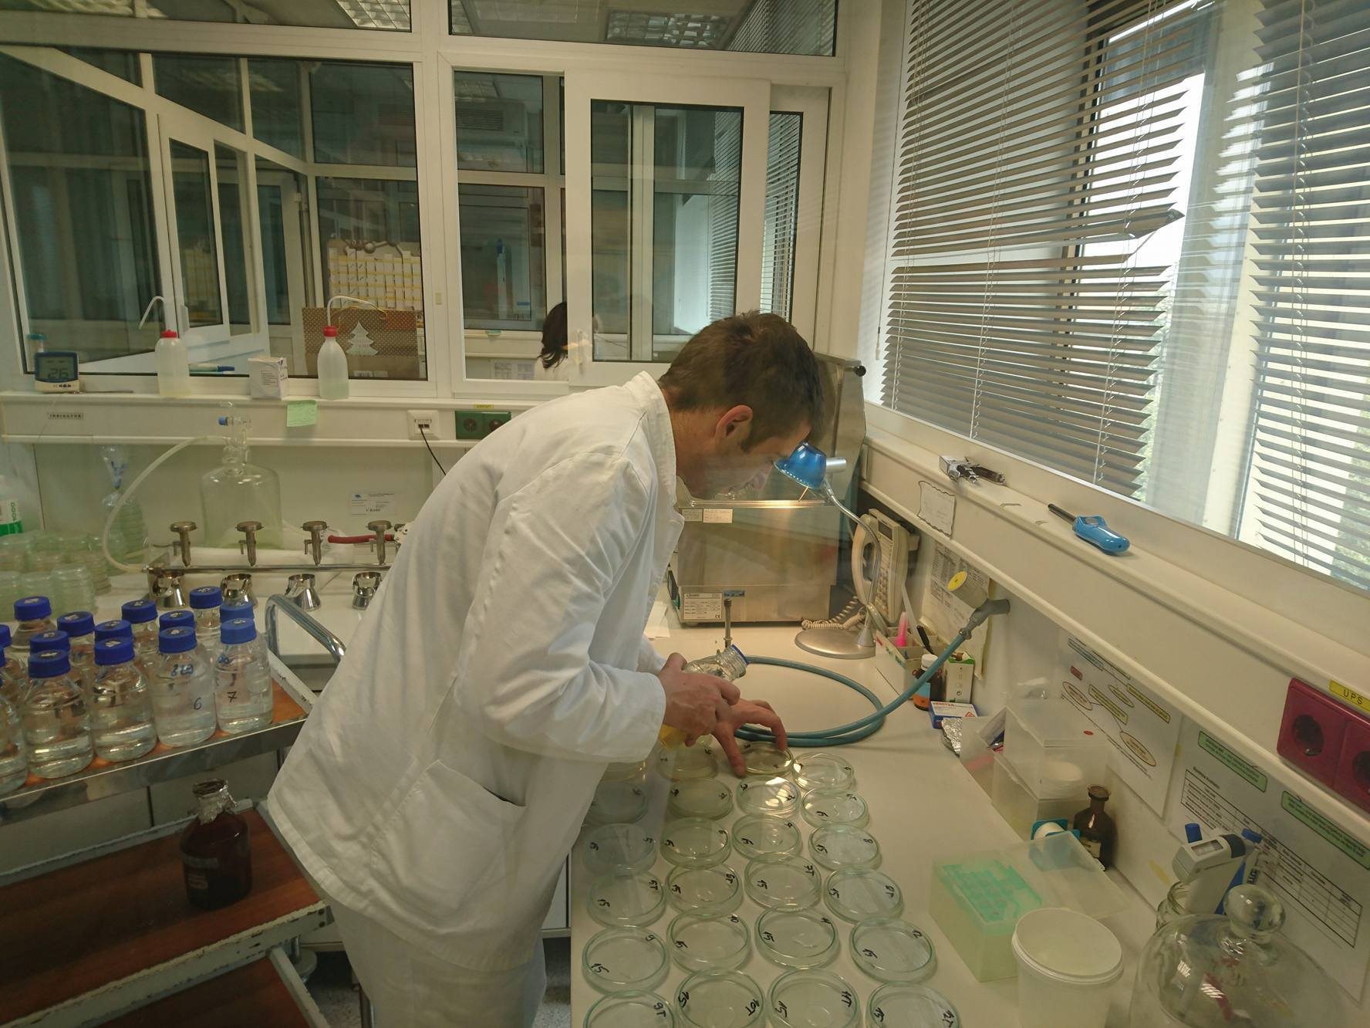

Slide 19
RIJEKA TOWN AND THE RIVER RJEČINA

Slide 20
THANKS FOR YOUR ATTENTION

