Slide 1
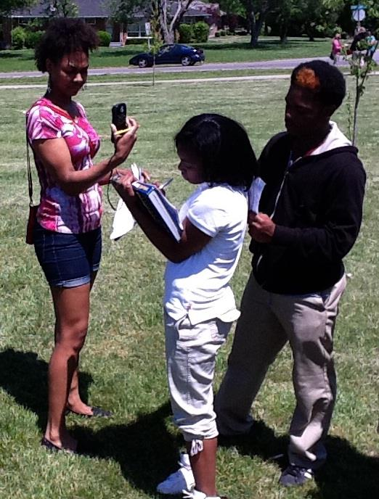
GLOBE Atmosphere and AMS Diversity Program Content to Foster Weather and Climate Science Awareness at HBCUs: A Curriculum Enhancement Model
Dr. David A. Padgett
Associate Professor of
Geography
Tennessee State University
Nashville, Tennessee
Notes:
1

Slide 2
The Global Learning and Observations to Benefit the Environment (GLOBE) Program
Tennessee State University has been a Global Learning and Observations to Benefit the Environment (GLOBE) program Partner Institution since October 2001.
Pre-service teachers enrolled in introductory World Regional Geography (GEOG 1010/1020) courses engage in “hands-on” GLOBE earth science data collection and analysis exercises.
For specific information about GLOBE please visit - www.globe.gov

Slide 4
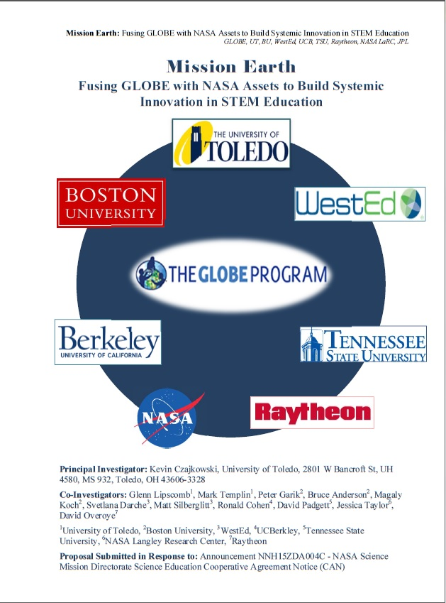
Summer 2016 – Summer 2021 – Mission Earth Project
The TSU Mission Earth project focuses upon the implementation of the GLOBE Program Atmosphere and Weatherbug Protocols with partner high schools. The target population is students who are underrepresented in the STEM and geoscience disciplines.
In Dr. David A. Padgett’s capacity as the TSU GLOBE Trainer, he certifies in-service and pre-service teachers in the GLOBE Atmosphere Protocols.

Slide 5
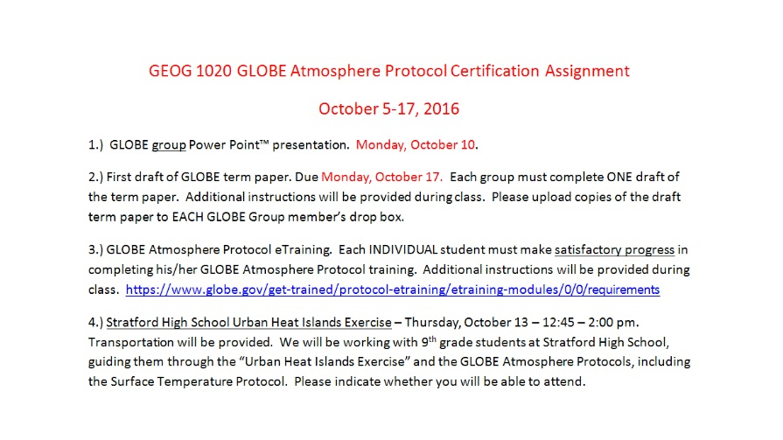
TSU Pre-Service Teacher GLOBE Certification Model Development
Fall 2016 – Pre-Service teachers enrolled in sections of lower-level World Regional Geography (GEOG 1010/1020) are certified in the GLOBE Atmosphere Protocols through a series of exercises.

Slide 6
TSU Pre-Service Teacher GLOBE Certification Model Development
Fall 2016 – Exercise using GLOBE data assigned to pre-service teachers enrolled in sections of lower-level World Regional Geography (GEOG 1010/1020).

Slide 7
TSU Pre-Service Teacher GLOBE Certification Model Development
Fall 2016 – Pre-service teachers enrolled in sections of lower-level World Regional Geography (GEOG 1010) are required to lead high school students in a Surface Temperature Protocol exercise at Stratford STEM Magnet High School as part of their GLOBE certification training.

Slide 8
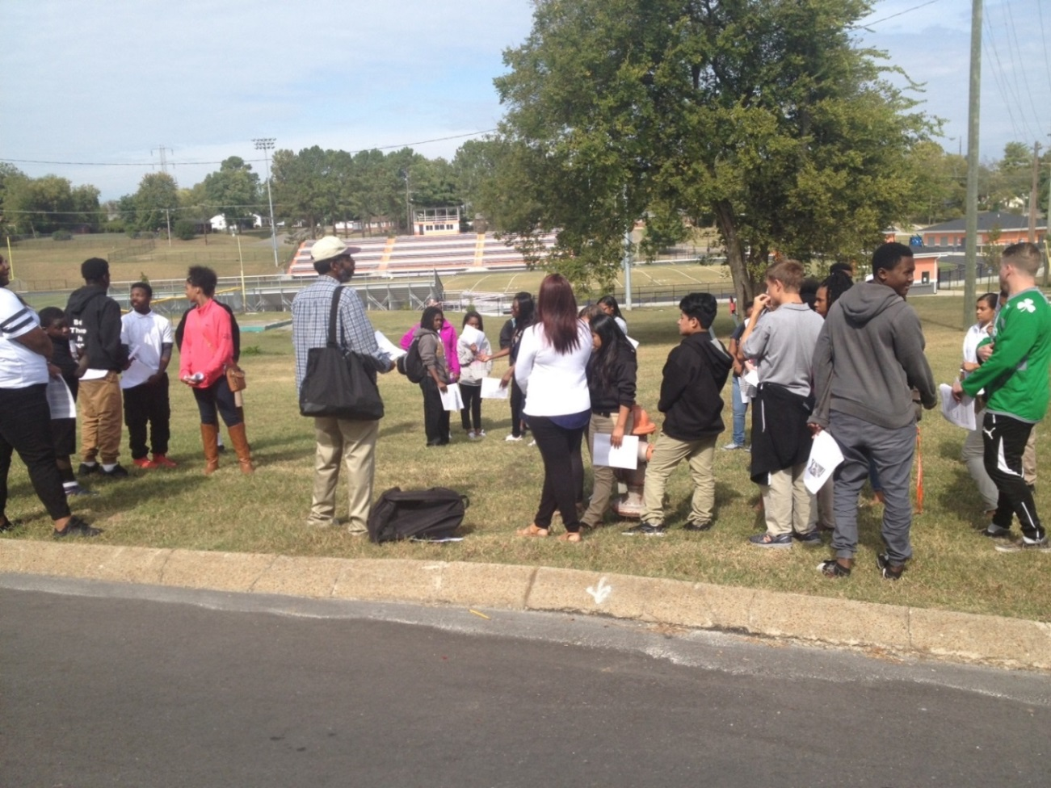
TSU Pre-Service Teacher GLOBE Certification Model Development
Fall 2016 and Spring 2017 - TSU pre-service teachers lead Rodney Donaldson’s Stratford STEM Magnet HS students in GLOBE Surface Temperature Protocol exercise as part of their Certification process. Approximately 10 pre-service teachers were certified in The GLOBE Atmosphere Protocols.
Stratford’s enrollment is 68 percent African American, 6 percent Hispanic with 100 percent of students qualifying for free/reduced price lunch.

Slide 9
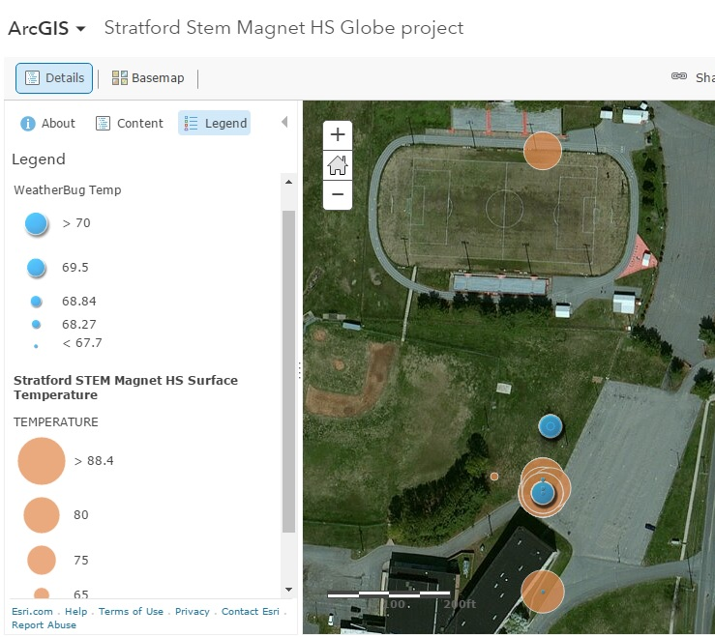
TSU Pre-Service Teacher GLOBE Certification Model Development
Fall 2016 and Spring 2017 -
Pre-service teachers map results of Stratford STEM Magnet HS GLOBE Surface Temperature Protocol exercise using ArcGIS online.

Slide 10
TSU Pre-Service Teacher GLOBE Certification Model Implementation
Fall 2017 – Spring 2021
GLOBE Mission Earth Project – Tennessee State University site - pre-service teacher certification model.
Assignment 1 – Introductory Group Power Point Presentation.

Slide 11
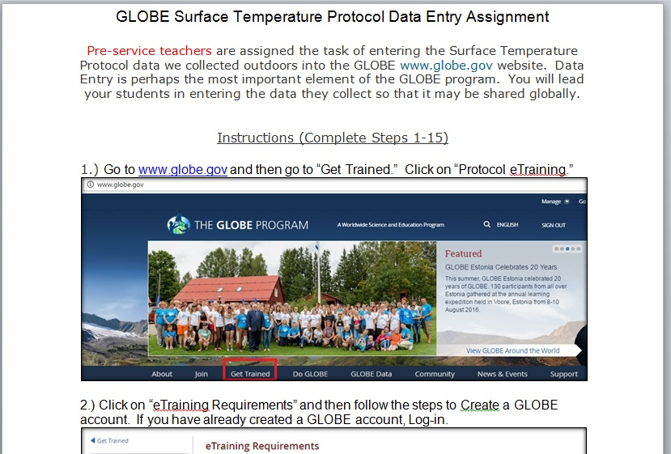
TSU Pre-Service Teacher GLOBE Certification Model Implementation
Fall 2017 – Spring 2021
GLOBE Mission Earth Project – Tennessee State University site - pre-service teacher certification model.
Assignment 2 – GLOBE Surface Temperature Protocol Data Entry

Slide 12
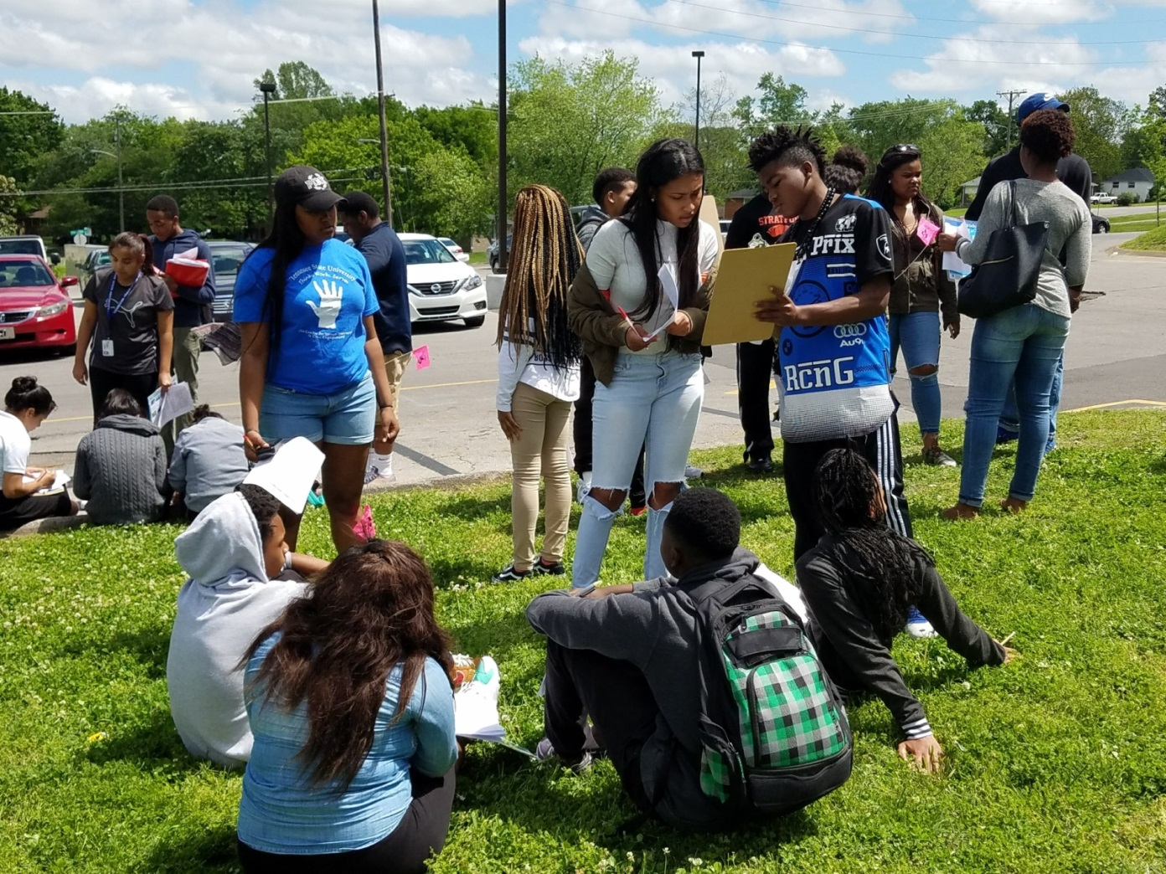
TSU Pre-Service Teacher GLOBE Certification Model Implementation
Fall 2017 – Spring 2021
GLOBE Mission Earth Project – Tennessee State University site - pre-service teacher certification model.
Assignment 3 – Lead partner high school students in GLOBE Surface Temperature Protocol data collection and GIS mapping exercise.

Slide 13
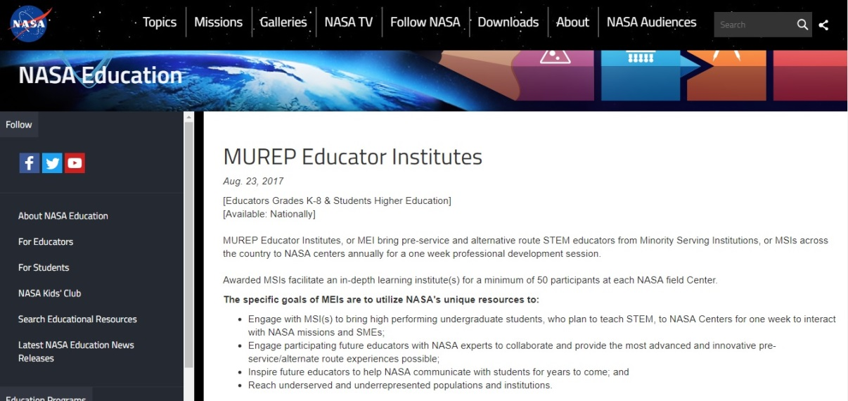
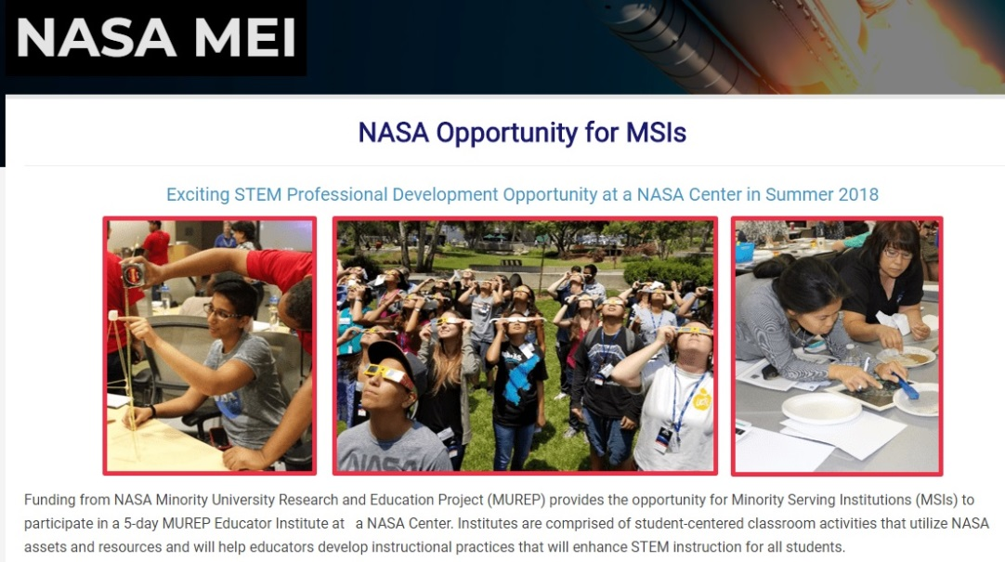
TSU Pre-Service Teacher GLOBE Certification Model Implementation
Spring Semesters 2018 – 2021
Pre-Service teachers successfully earning GLOBE certification will be encouraged to work with College of Education faculty in the NASA Minority Undergraduate Research Experience Program (MUREP) Educator Institutes (MEI).

Slide 14
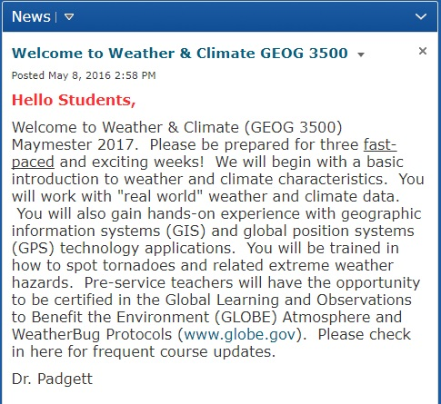
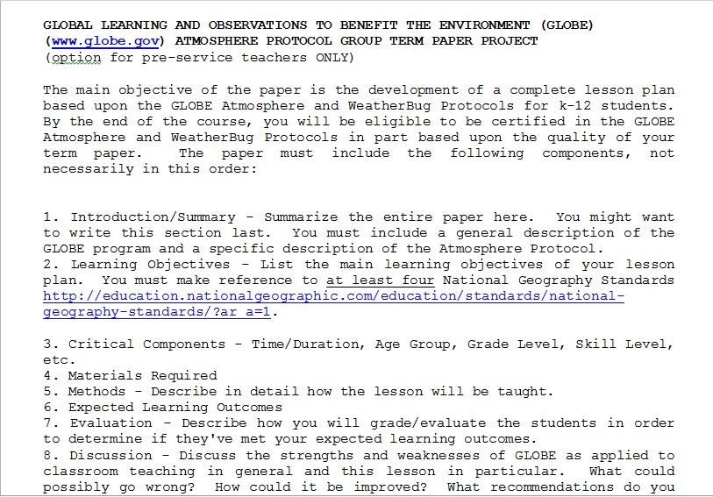
TSU Pre-Service Teacher GLOBE Certification Model Implementation
Summers 2018 – 2021
Pre-Service teachers successfully earning GLOBE certification are encouraged to take Weather and Climate (GEOG 3500) where they will gain more in-depth exposure to atmospheric science.

Slide 15
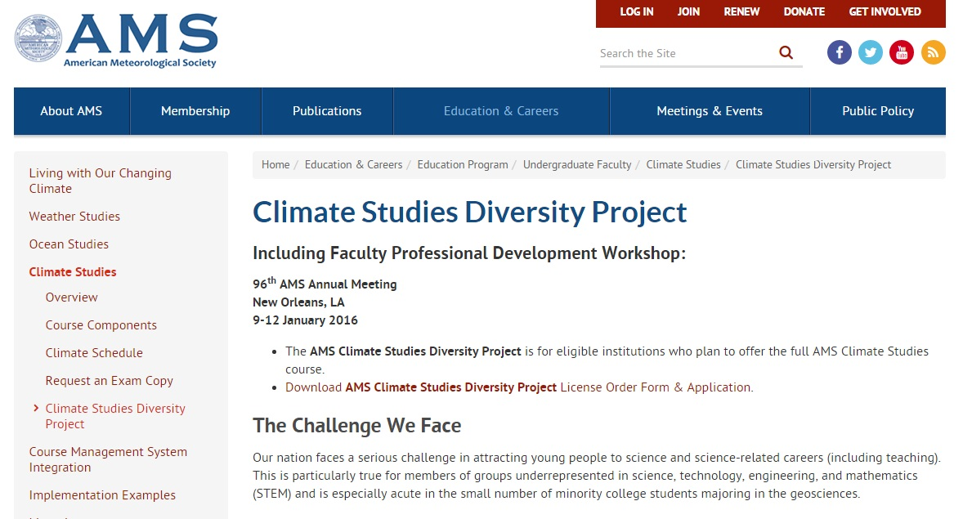
TSU Pre-Service Teacher GLOBE Certification Model Implementation
Summers 2018 – 2021
The Weather and Climate (GEOG 3500) course includes content provided by the American Meteorological Society (AMS) Weather and Climate Studies Diversity Project.

Slide 16
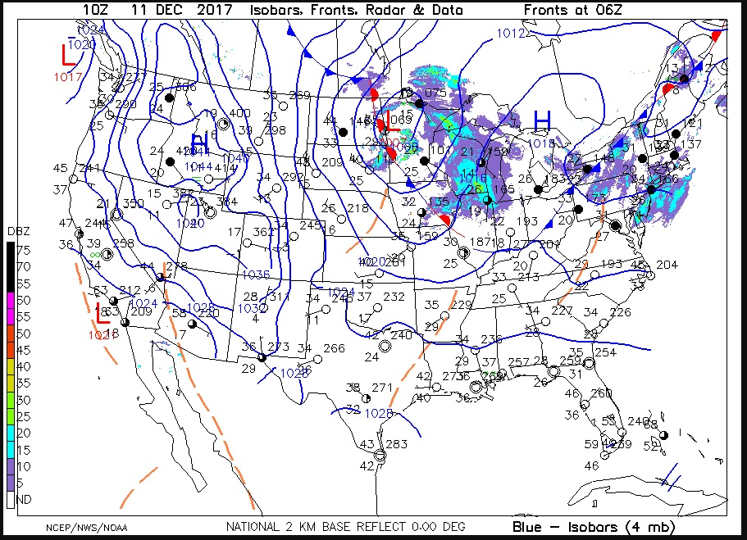
TSU Pre-Service Teacher GLOBE Certification Model Implementation
Summers 2018 – 2021
Pre-service teachers enrolled in Weather and Climate (GEOG 3500) are able to observe and analyze weather in real time via the AMS portal.
Displayed on the right is today’s current weather map (December 11, 2017) acquired from the AMS Datastreme Portal.

Slide 17
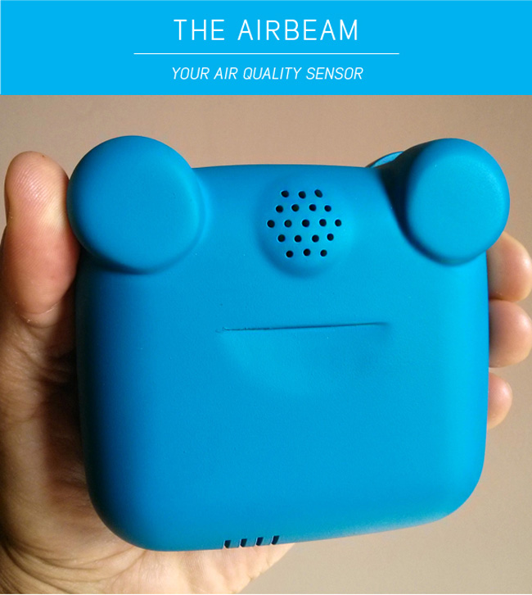
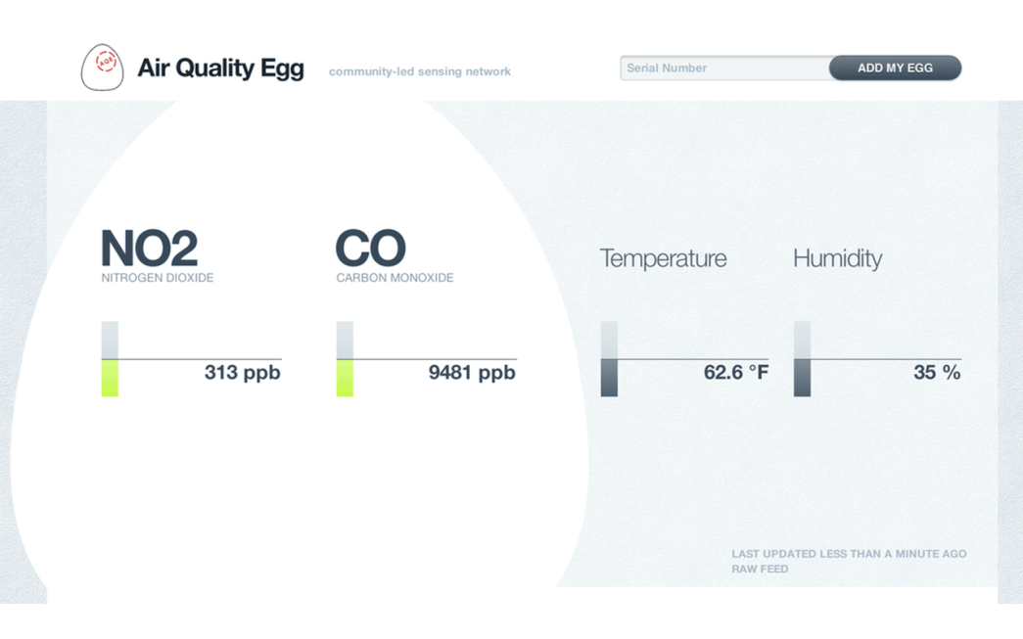
TSU Pre-Service Teacher GLOBE Certification Model Implementation
Summers 2018 – 2021
Pre-service teachers enrolled in Weather and Climate (GEOG 3500) will participate in “citizen science” air quality investigations. They will compare criteria air pollutant sampling results with GLOBE Aerosol Protocol findings

Slide 18
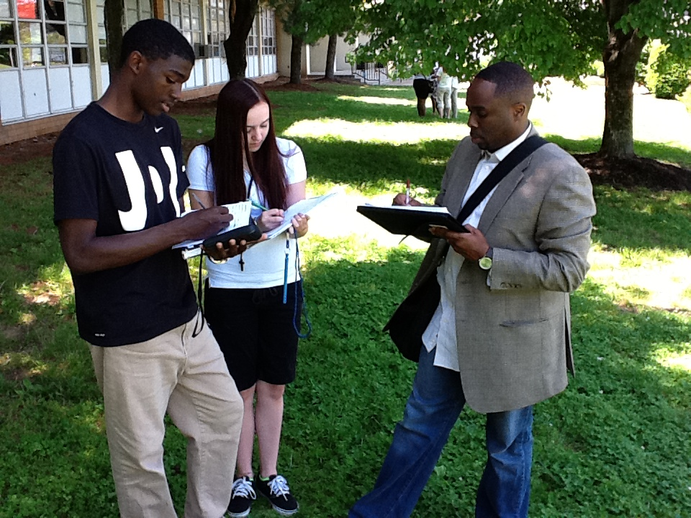
TSU Pre-Service Teacher GLOBE Certification Model Implementation
Summers 2018 – 2021
Ideally, pre-service teachers successfully earning GLOBE certification will be hired by one of our partner high schools and continue to work with the project, as was the case with Rodney Donaldson, below, right.
Rodney is a teacher at Stratford STEM Magnet High School and is the Lead GLOBE teacher at the TSU Mission Earth Site. He was GLOBE certified in the Atmosphere Protocols while enrolled in Weather & Climate (GEOG 3500).

Slide 19
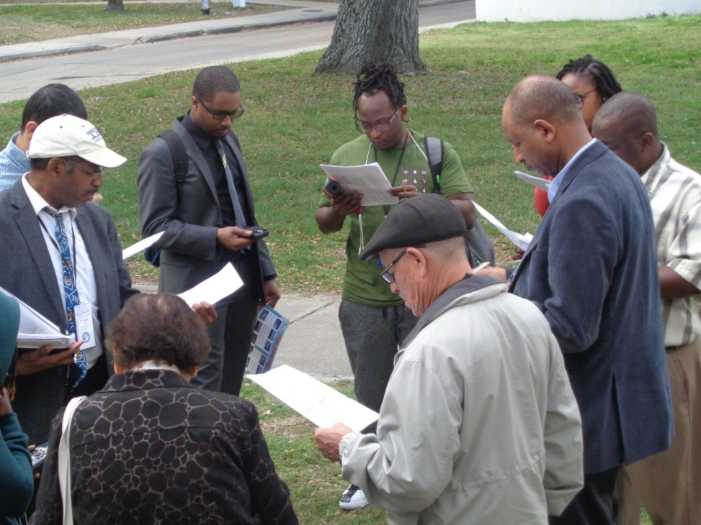
Faculty Preparation for Using GLOBE and AMS Course Materials
In terms of course preparation, the AMS and GLOBE teaching materials are relatively user-friendly and can be incorporated into a wide range of courses, including the social sciences.
Becoming a GLOBE or AMS instructor requires training, some of which may be completed online.
GLOBE training exercise for HBCU faculty led by David A. Padgett

Slide 20
Links to Resources
American Meteorological Society (AMS) Education Program (https://www.ametsoc.org/ams/index.cfm/education-careers/education-program/undergraduate-faculty/)
Global Learning and Observations to Benefit the Environment (GLOBE) (http://www.globe.gov)
Environmental Systems Research Institute (ESRI) ConnectED Program (http://connected.esri.com/)
ESRI ArcGIS Online (www.arcgis.com)
ESRI Story Maps (http://storymaps.arcgis.com/en/)

Slide 21
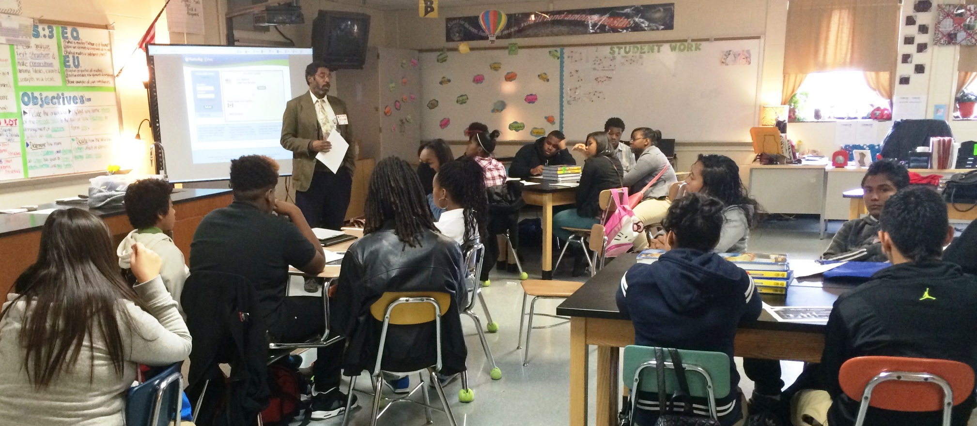
THANK YOU!
For your time and attention.
https://www.globe.gov/web/mission-earth
tsuglobeme@gmail.com

