Slide 1
Alexander Dawson School - Earth Science
Bill Meyers
July 18, 2016

Slide 2
Green-up and Down, Surface Water, Weather, Climate,Soil,
https://youtu.be/kfHp4-GcuKk

Slide 3
GPM-NASA
videos,Satellite Images, Student Activities,
Self Guided Student Online Lessons
https://youtu.be/au2qCGmvLEY

Slide 4
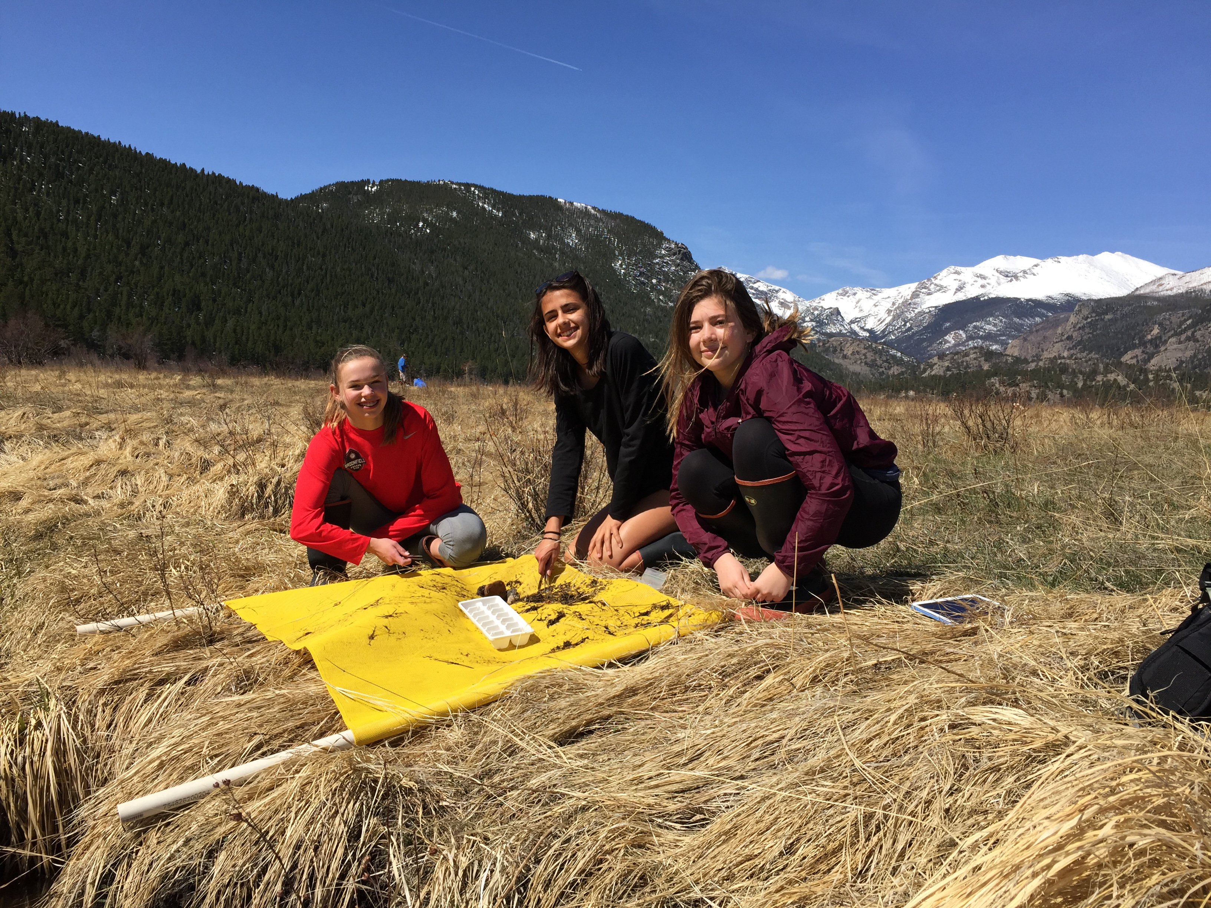
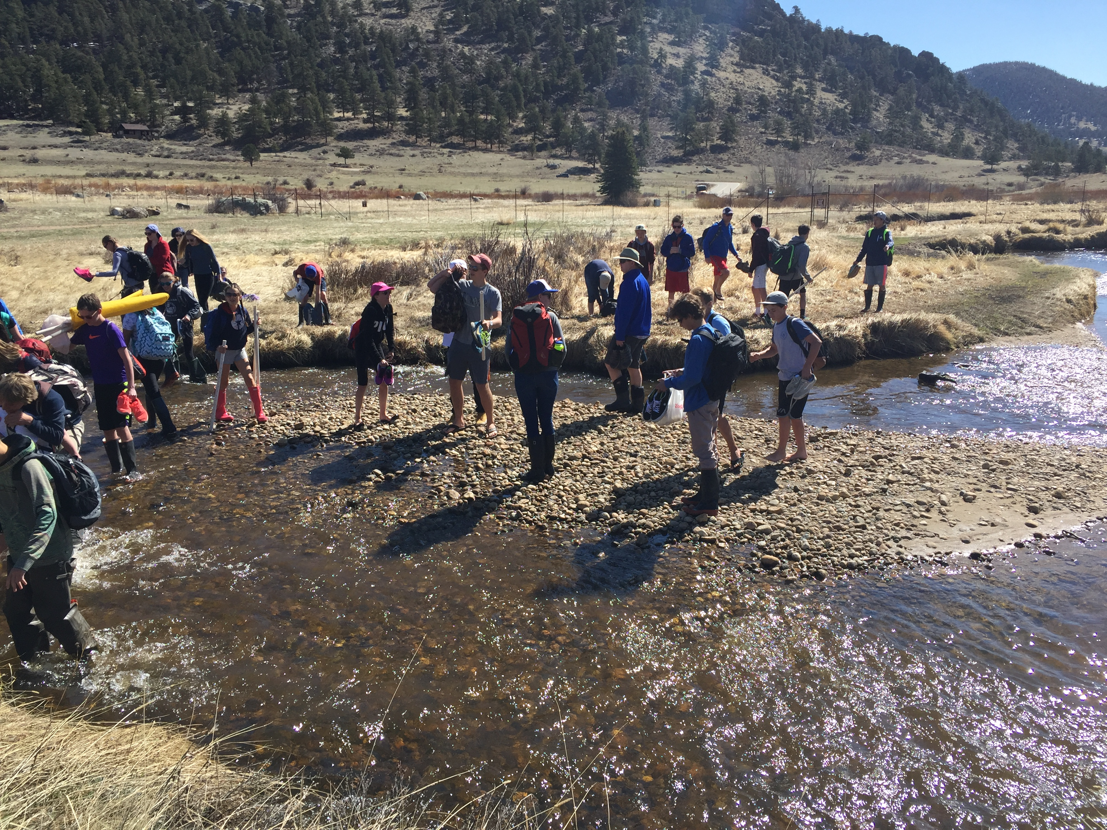
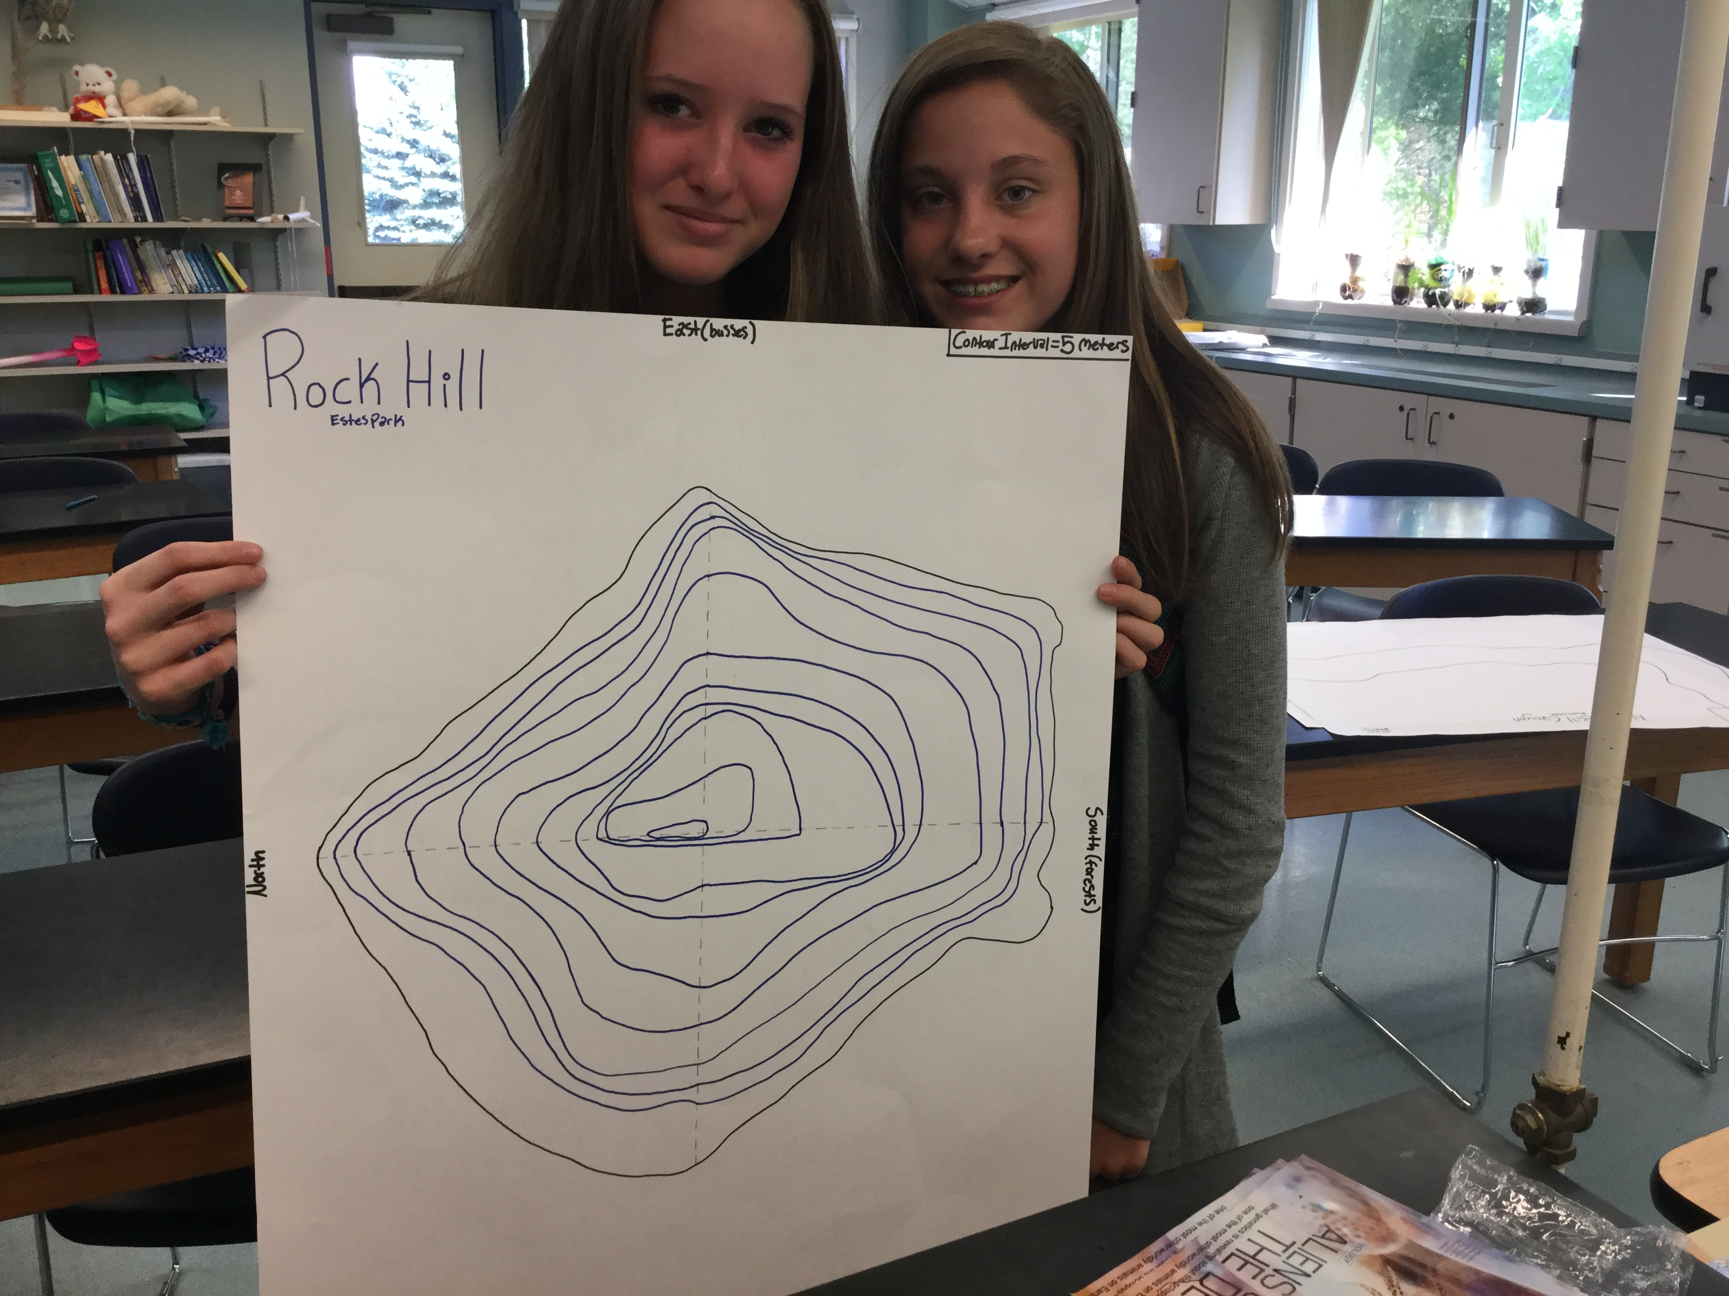
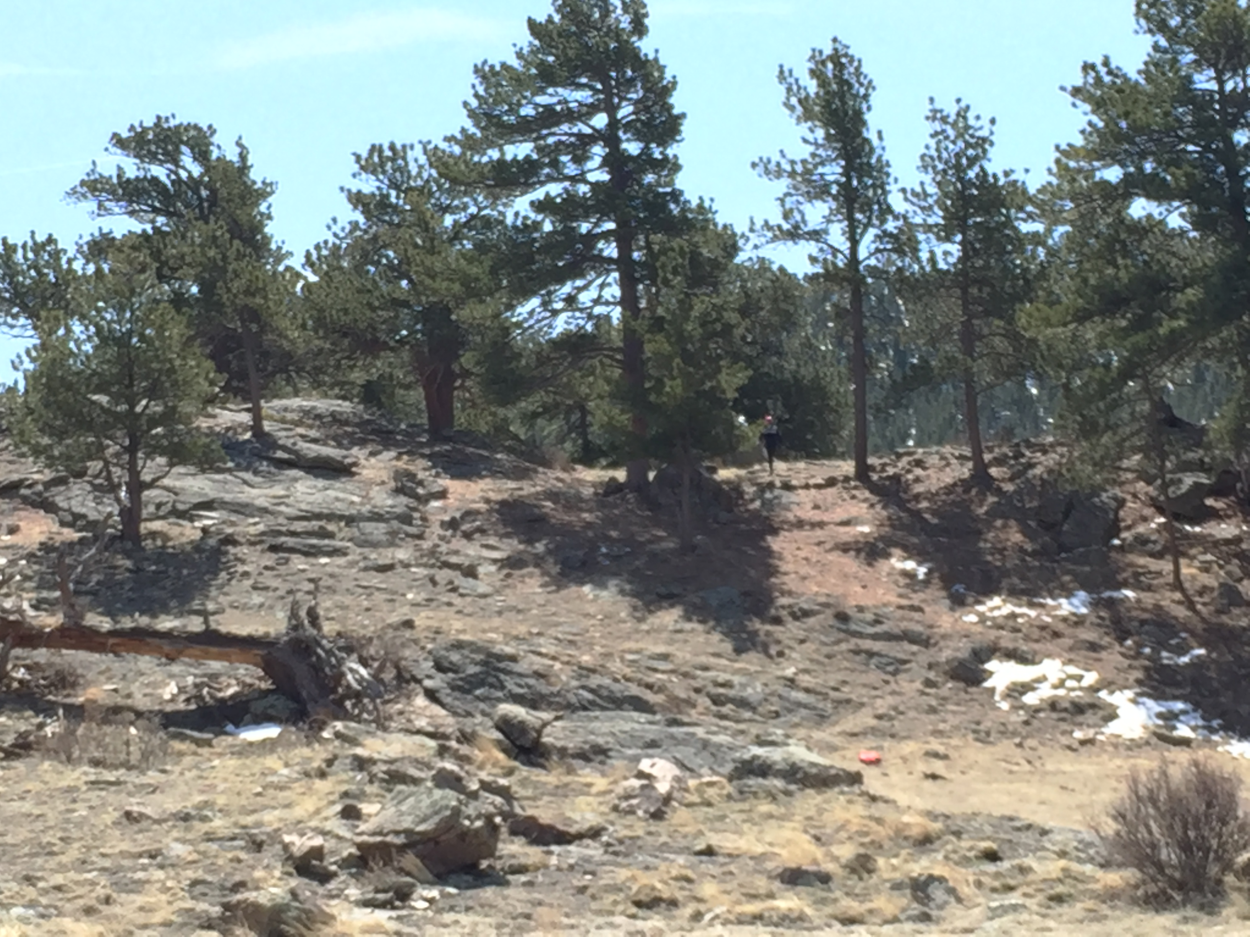
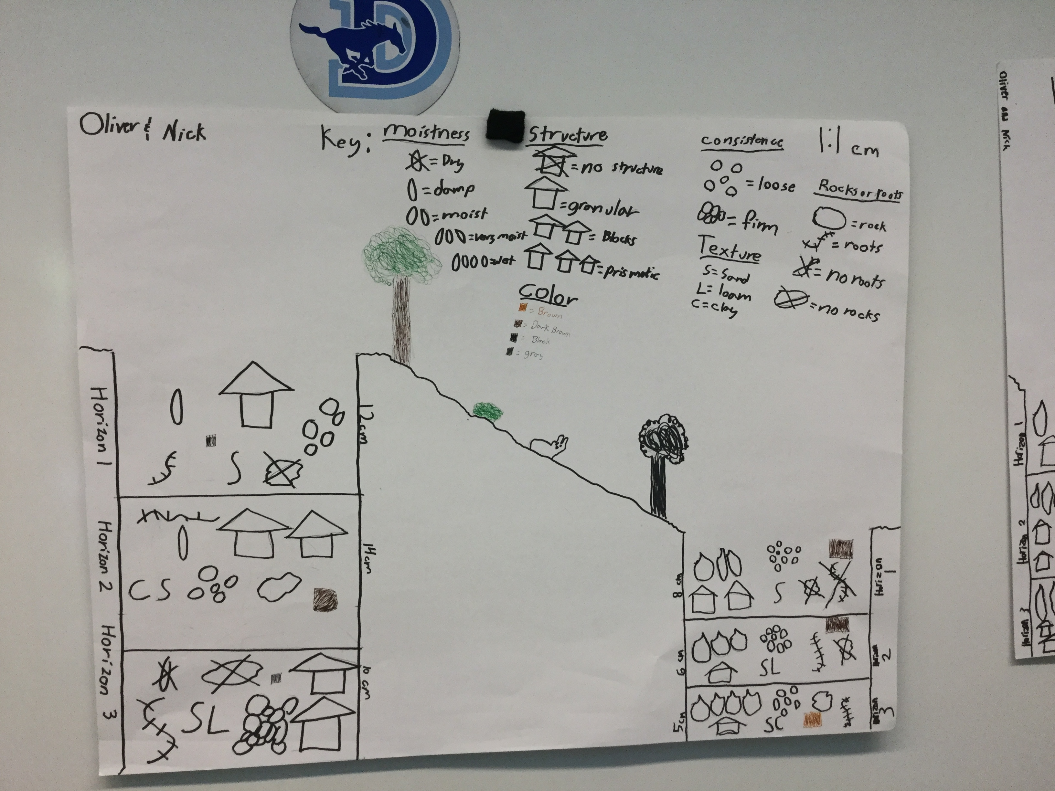
Rocky Mountain National Park
Soil, Macro-Invertebrates, Water Chemistry, Vegetation, Clinometers-Mapping

Slide 5
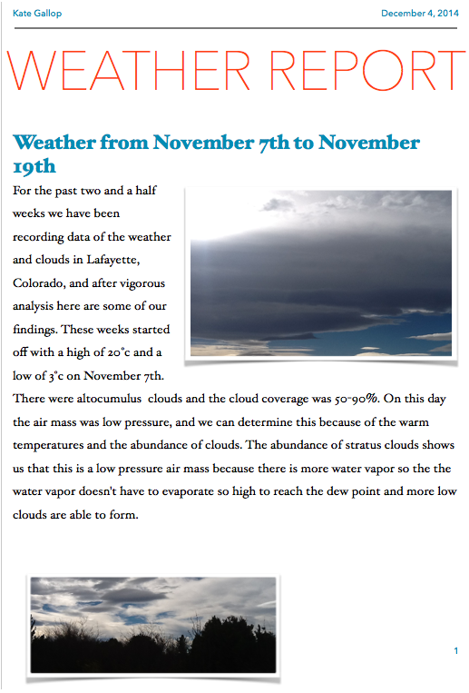
Thank You

