Slide 1
Sheri Potter
@SciStarter
Science we can do together.

Slide 2
We connect
regular people
to
real science
they can do.

Slide 3
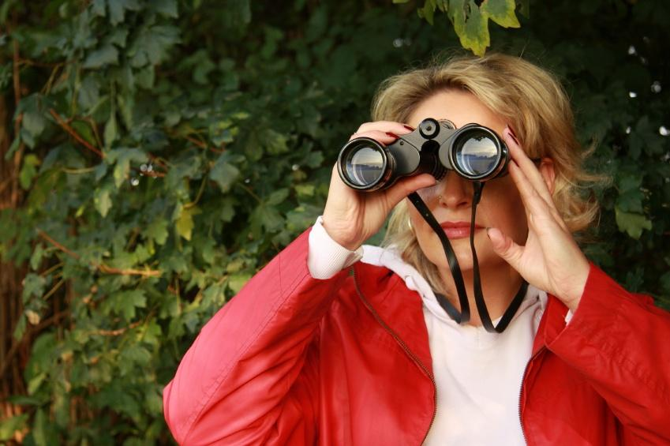
Millions of people enjoy
science & nature.
Thousands of scientists need volunteers.
But they can’t find each other.

Slide 4
We
connect
them
We
connect
them
Scientist image and cit scientist images tk to illustrate “we connect them”

Slide 5
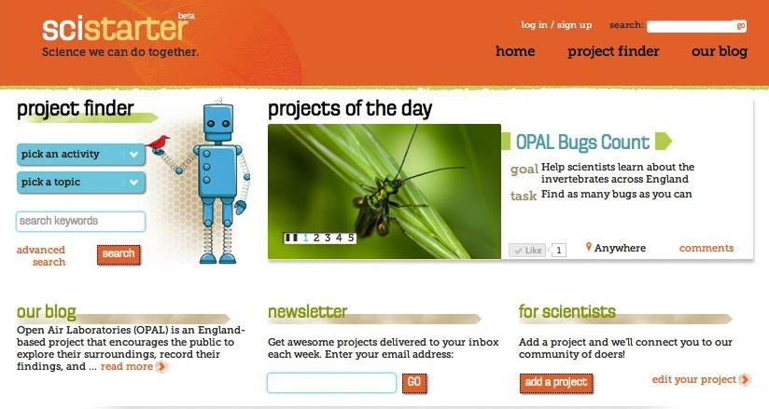
Searchable database of 1600++ projects and events.
To make it easier for people to learn about and get involved in projects.

Slide 6
We’re NOT talking
home chemistry kits.

Slide 7
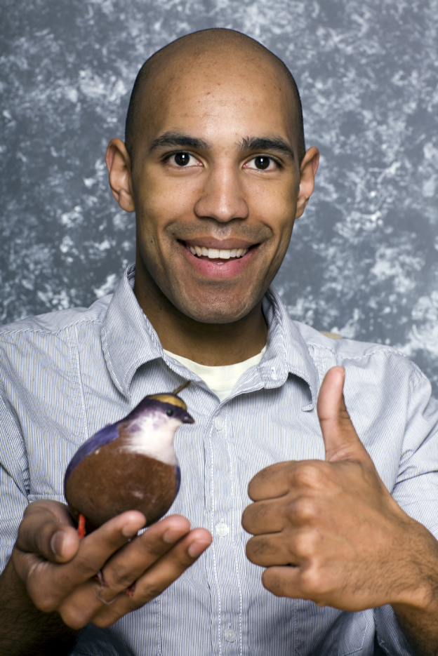
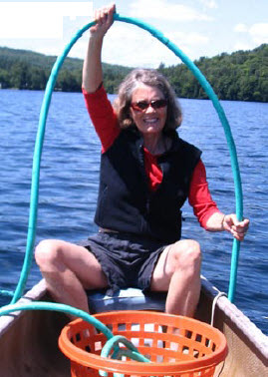
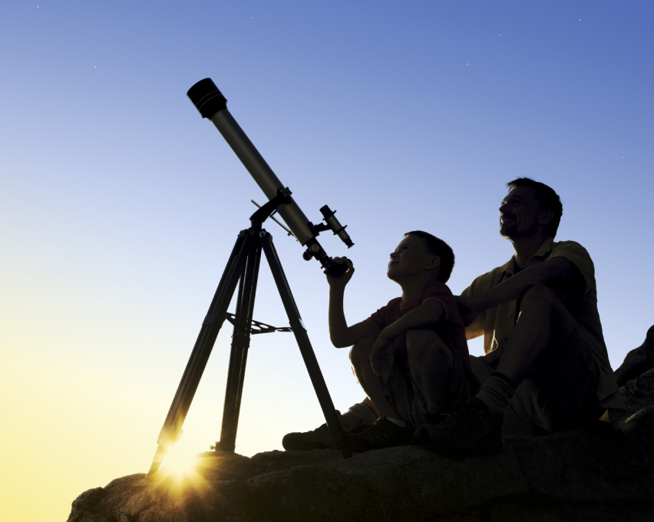
Someone you know is a Citizen Scientist.
eBird
1.5 million
reports
Water testing
1.5 million
monitors
SETI@ home
5 million
volunteers
eBird
1.5 million
reports

Slide 8
Citizen Science is Serious Science.
Evolution MegaLab
Backyard Biofuels
CubeSat
Track if and why snail shell colors change
(predation pressure)
Are wild algae species good biofuel potentials?
Affordable satellite instruments for atmospheric and microgravity science

Slide 9
Citizen Science is Serious Science.
Galaxy Zoo
Audubon
Sound
Citizen
Co authored dozens of peer-reviewed papers
Showed that birds migrate closer to poles due to global warming
Discovered cocaine & hormones in Puget Sound drinking water

Slide 10
Because of Citizen Scientists, we now know:
(Cooper et al. 2014)
Birds are breeding earlier
Climate is changing
Jupiter-sized planet discovered
Invasive mosquito species has arrived in Germany
About 50 types of bacteria live in your navel

Slide 11
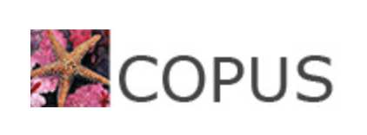
SciStarter and YLACES
Recruit, Train, Equip, Retain
GLOBE Participants.
Reaching new audiences through innovative partnerships.

Slide 12
How do we train and sustain participation?
In-Person Training
Google Hangouts
Pre-recorded, Online
Face-to-face training.
“The best GLOBE training I've ever had was in person.”
Live, synchronous, online training.
“I found the Google hangout and videos to
be very clear and helpful. One downside to these multi- media trainings is that I had to watch a few times to hammer in the details.“
Online training, any time, any place.
“Easy to do on my own time schedule, I don’t have to go anywhere, and it was free.”

Slide 13
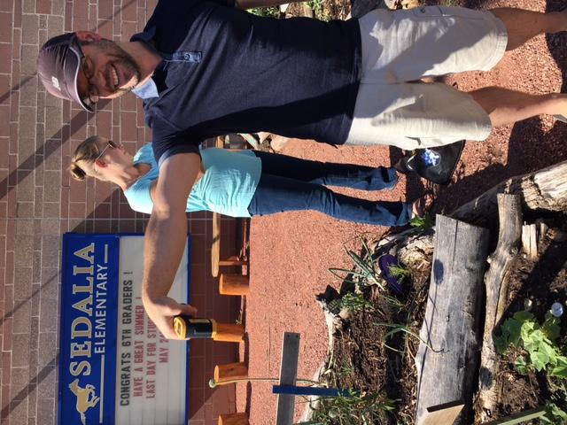
Reviewing the Data
Through these three techniques, roughly 450 people have signed up to learn more.
Initially SMAP, expanding to El Nino campaign: (Cloud protocol, surface temperature, precipitation, and SMAP combined.)
Trained 75 new schools through Eco-School partnership.
Trained retirees, Girl Scouts, citizen scientist, parents, more.
YLACES equipped participants and provided technical support .
SciStarter’s work was made possibly by YLACES.

Slide 14
EcoSchools
SciStarter
YLACES
El Nino Campaign

Slide 15
PARTNER POWERED!!! These partners came together to bring GLOBE to classrooms through an online learning system.

Slide 16
To improve conversion rate, we:
EcoSchools - SciStarter : El Nino Campaign
Reduced barriers to participation (awareness of/ access to project, equipment, training, support, related projects/communities);
Request a commitment to follow through BEFORE sending equipment;
Follow up with registrants and participants at least once a month.
Constantly iterate!

Slide 17
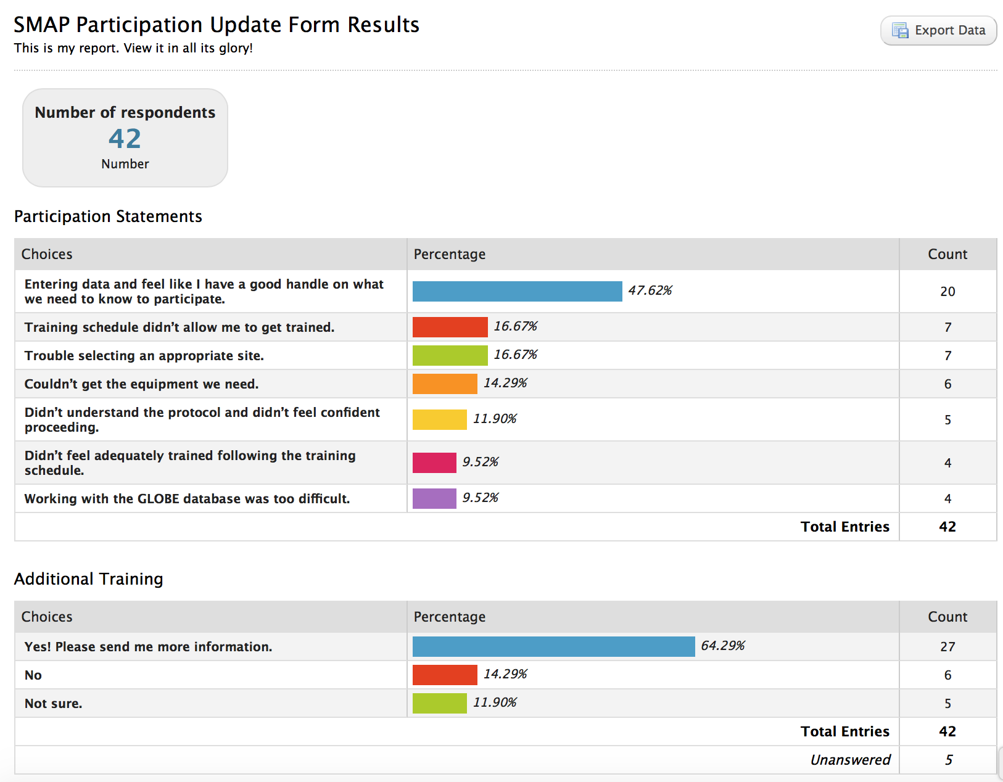
Increase knowledge about barriers and how to overcome them
EcoSchools - SciStarter : El Nino Campaign

Slide 18
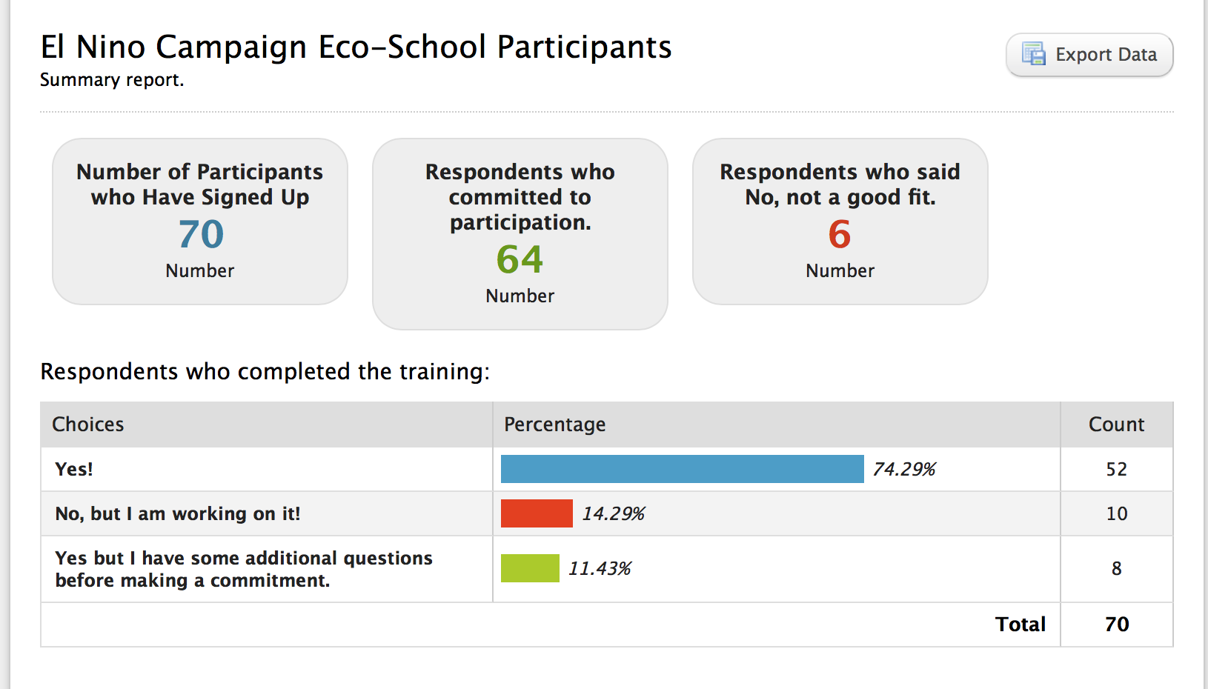
EcoSchools - SciStarter : El Nino Campaign

Slide 19
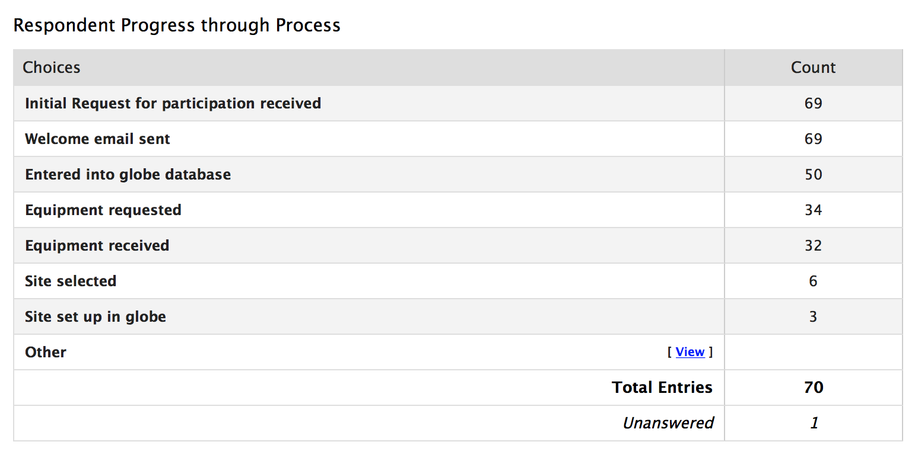
Tracking EcoSchools Sign-ups
EcoSchools - SciStarter : El Nino Campaign

Slide 20
Why so few?
EcoSchools - SciStarter : El Nino Campaign
EcoSchools El Nino program was launched late in school year.
Most participants plan to join in fall.
About half of participants requested equipment through YLACES grant.
Personal support offered to establish GLOBE account and site.
We expect implementation to begin robustly in the fall: conversion rates coming soon!

Slide 21
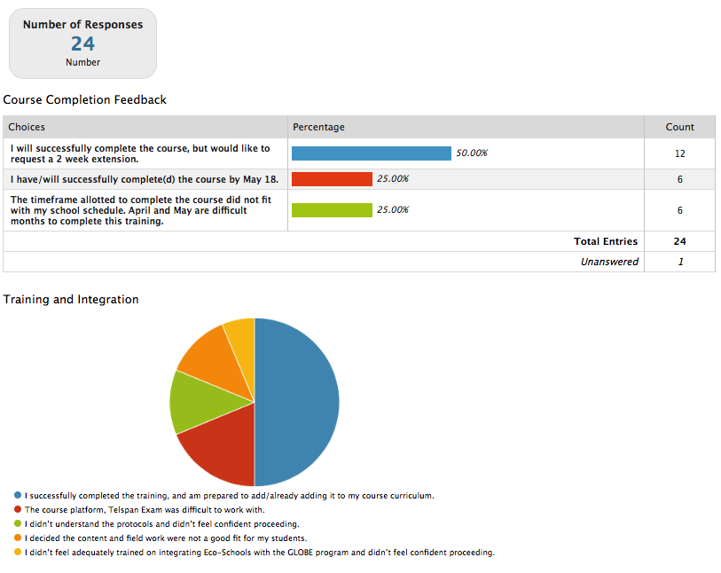
EcoSchools - SciStarter : El Nino Campaign

Slide 22
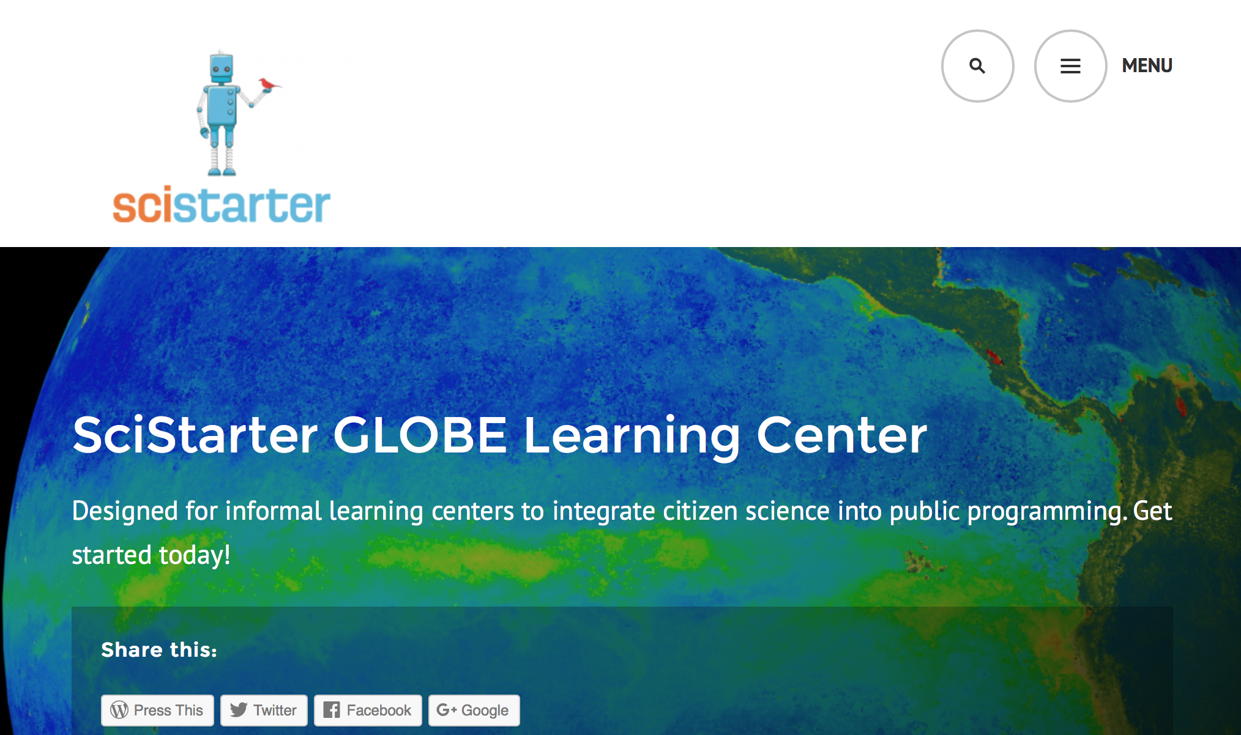
Goal = More participants
SciStarter : GLOBE

Slide 23
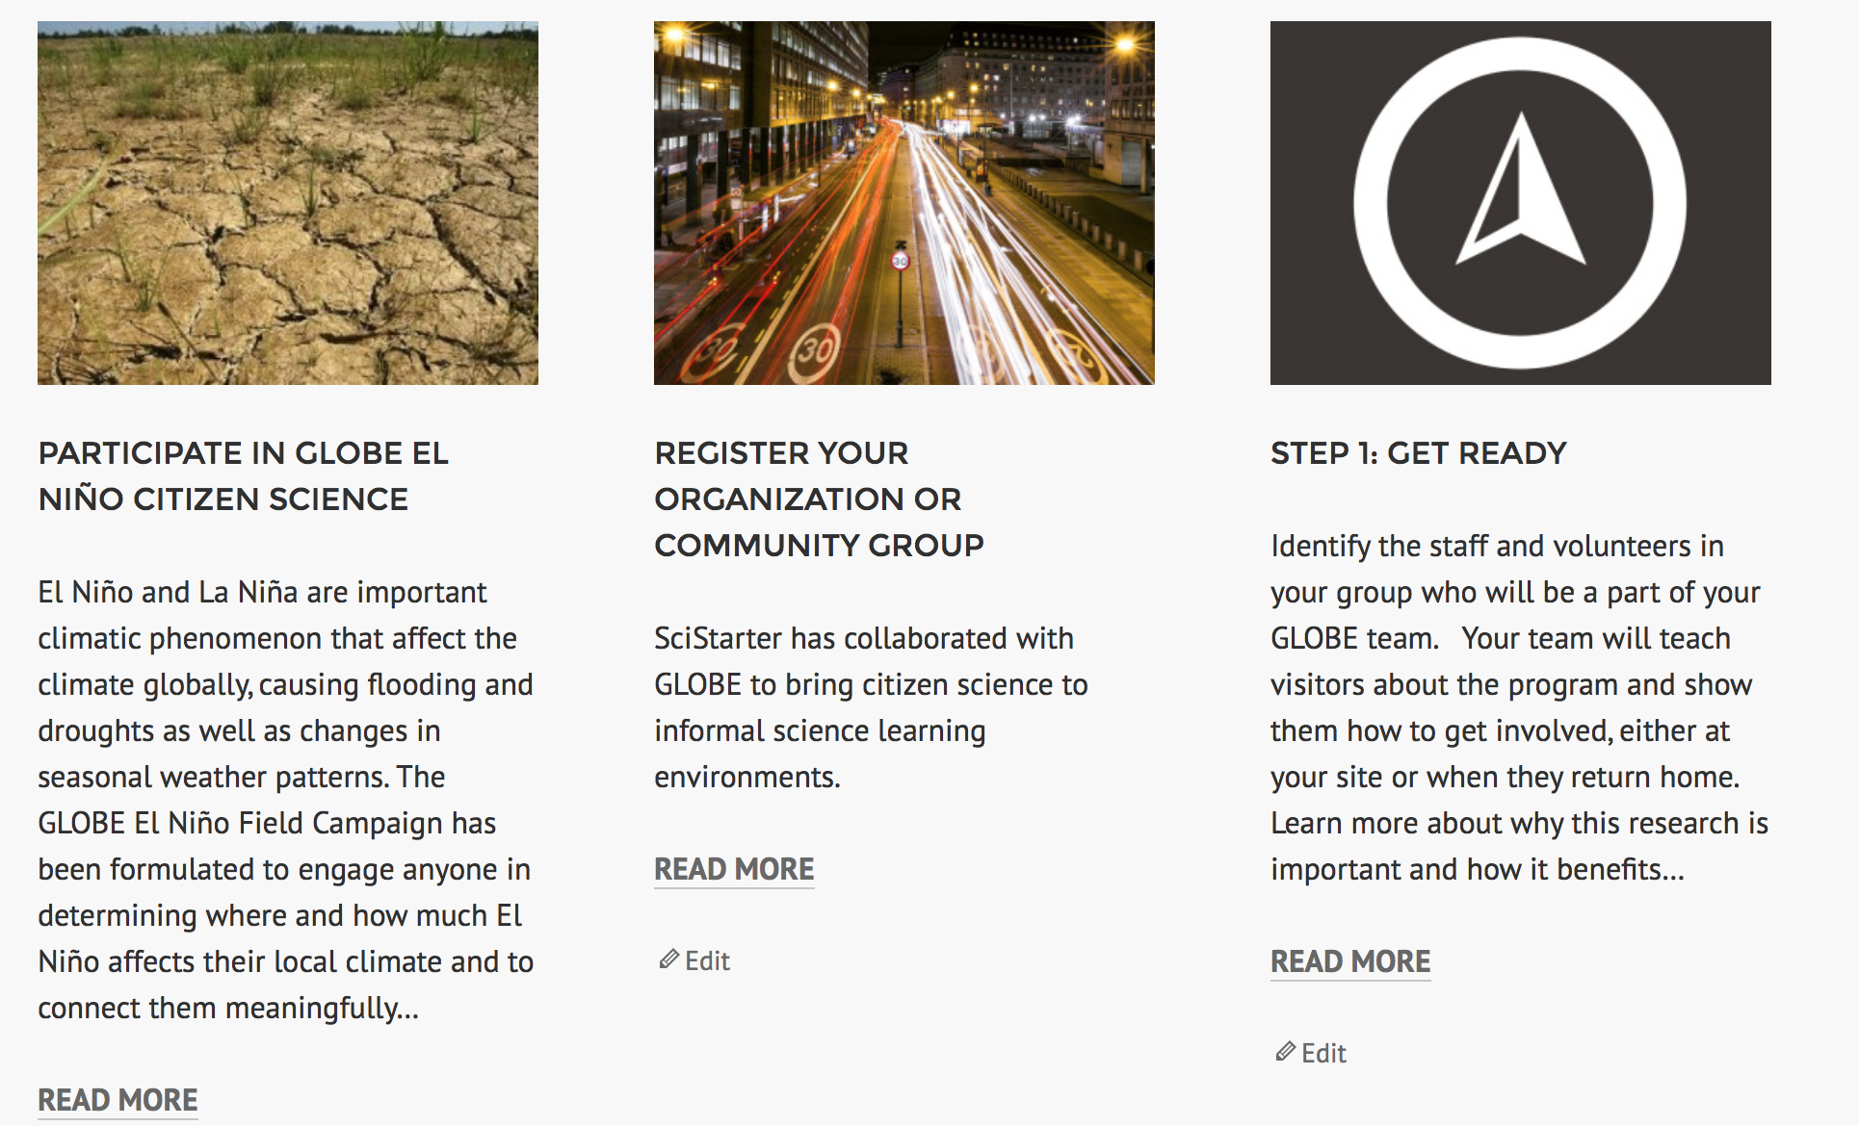
Beta MicroSite to Enlist & Train
Citizen Science Ambassadors SciStarter.wordpress.com
SciStarter : GLOBE

Slide 24
SciStarter : GLOBE
Next Steps for SciStarter:
SciStarter : GLOBE
SciStarter : GLOBE
Microsite to expand GLOBE to new audiences
Lending libraries to allow people to borrow GLOBE participation kits
Sales of low-cost kits
Continue partnership with Eco-Schools

Slide 25
Next Steps for SciStarter:
SciStarter : GLOBE
Programmatic partnerships with science centers, university and public libraries, nature centers to recruit, train, equip, train more participants
Link GLOBE participants to SciStarter e-porfolios to track contributions across projects/platforms (eventually earn microcredits)
“Build, Borrow, Buy” options to access tools

Slide 26
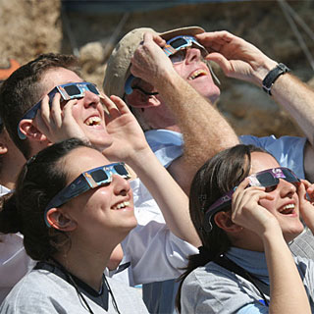
People-
Powered
Science
@SciStarter

