Slide 1
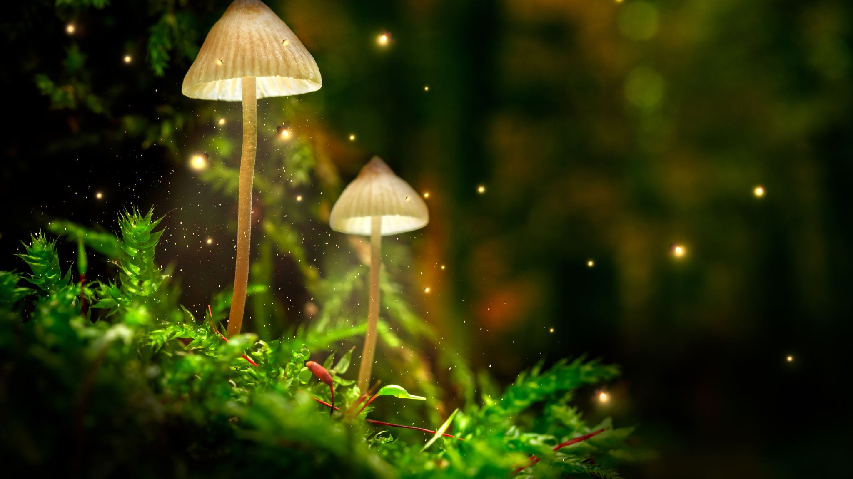
Careers of African Americans in the Study of Nature
Compiled by Sherry S. Herron, Ph.D., 2020

Slide 2
First three African American astronauts to go to space, including Ronald McNair, Guy Bluford and Fred Gregory from the class of 1978 selection of astronauts. There have been 17 Black male astronauts to date.

Slide 3
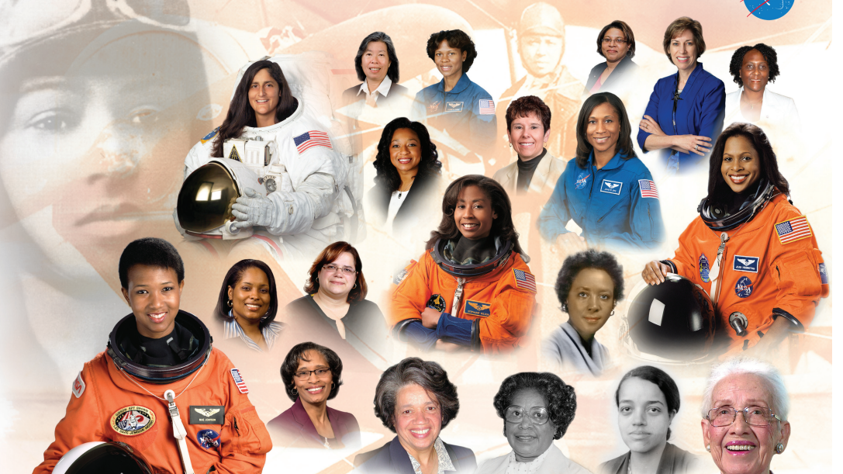

Slide 13
