Slide 1
Maker Workshop 4: NASA-Themed
Credits: Ms. Kunz, ASCEND School, GLOBE Mission EARTH
Notes:
Source for all activities: https://www.nasa.gov/education/materials/

Slide 2
Your NASA Mission
Choose one of the maker activities I’ve linked in the slides below
Try it out! Follow the directions linked to build/draw something, do an experiment, or explore an idea
Answer the questions on slide 10, titled “Reflect Questions”
Turn in this assignment in google classroom, send a photo
Directions

Slide 3
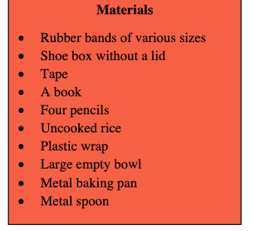
Good Vibrations: Explore Sound
Complete the activity on this link to test out how sound travels
If you don’t have any of the needed materials, improvise! (Find something similar that could work).

Slide 4
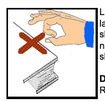
Make a Boomerang
Link with details
Materials:
Index card (or stiff paper)
Scissors
Pencil
Pattern or shape you sketch onto card to cut out
Example pattern

Slide 5
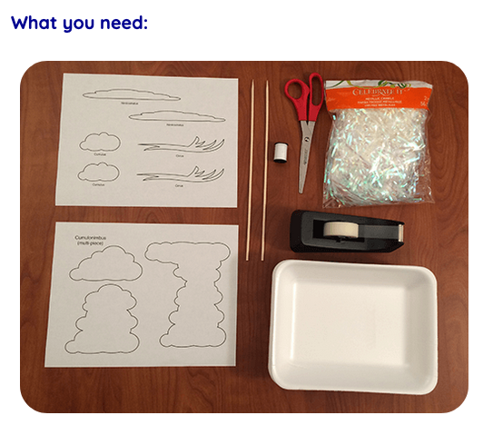
Make a Cloud Mobile
Complete the activity on this link
If you don’t have any of the needed materials, improvise! (Find something similar that could work).

Slide 6
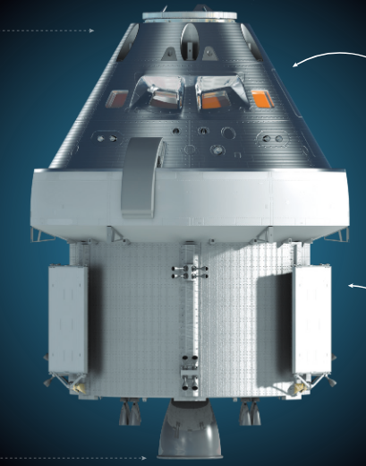
Draw Artemis Spacecraft
If you prefer to do a detailed drawing rather than build something by hand, choose this option!
Link to guide for how to draw the Orion Spacecraft. (Orion is the the craft NASA is designing for the next trip to the moon as part of the Artemis Mission)

Slide 7
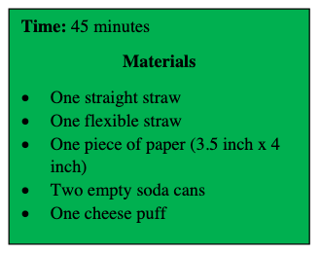
Experiment: Changing Pressure
Complete the activity on this link to test out how pressure affects flight
If you don’t have any of the needed materials, improvise! (Find something similar that could work).

Slide 8
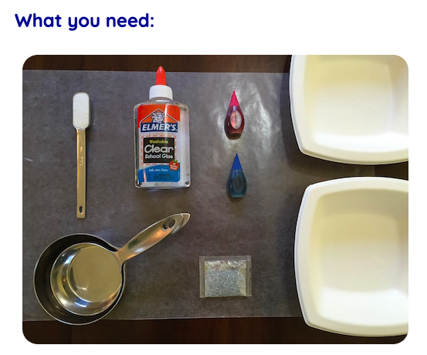
Make “Universe” Slime
Complete the activity on this link to make slime. (link to Spanish directions)
If you don’t have any of the needed materials, improvise! (Find something similar that could work).
Note: This one could get messy so make sure your parents are okay with you making slime

Slide 9
Reflect Questions → Complete after the Activity

Slide 10
Reflect Questions (Answer in complete sentences)
What did you choose to make?
What was the process of trying to make this design like? (challenging, fun, frustrating, rewarding…) Answer in 1-2 sentences.
How did you feel about the approach of following linked directions to try out a design challenge? Was that helpful or not?
What is something you learned in the process of making your design?
Anything else you want to share?

Slide 11
Take a picture what you made and paste it here!
If you can’t figure out how to paste a picture in slides, either text or email your photo to me - jkunz@efcps.net or 408-316-1314
Turn in this assignment in google classroom when you’re finished!

