Slide 1
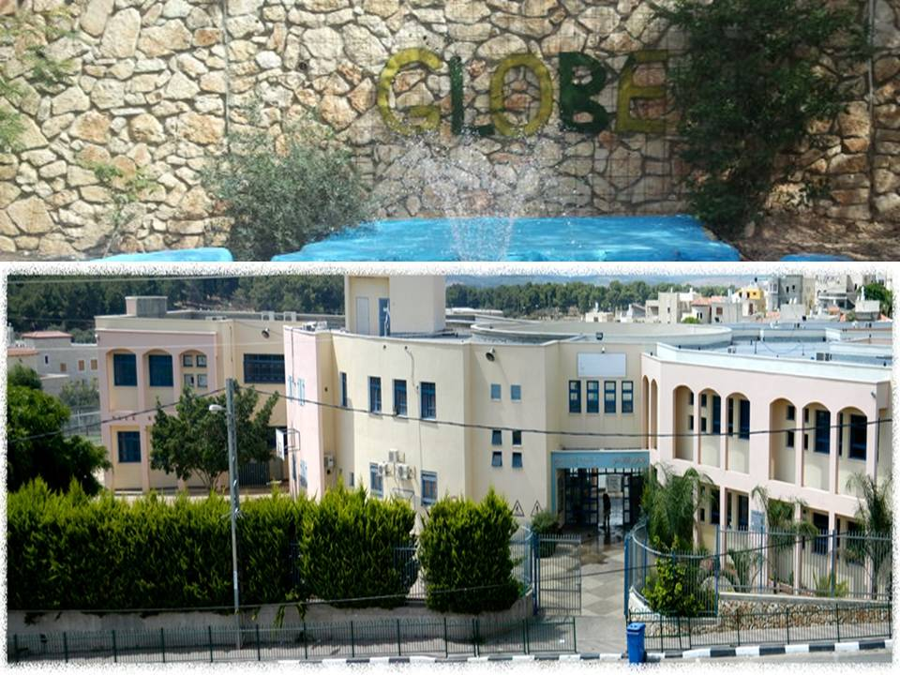
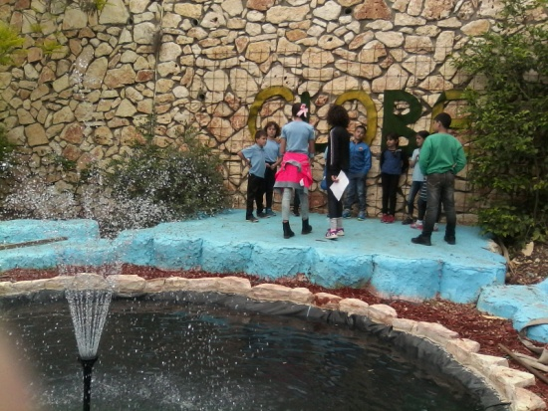
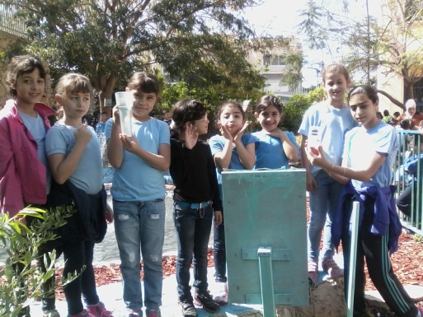
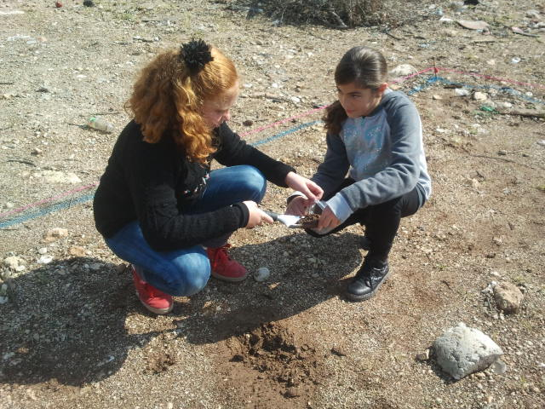
Ministry Of Education
Science & Technology Administration
Albairoony Elementary Schoolבית ספר יסודי אלביירוני טמרה . 15th grade GLOBE Students
City: Tamra
Sector: Arab
District: North Israel
description :
Tamra is an Arab city in the North District of Israel
located in the Lower Galilee 20 kilometres east of the historical city "Acre".
Total population:33,000
Education: There are 16 schools in Tamra(9 elementary schools,
4 junior high schools, 4 high schools)
Our research is about:
The influence of Wi-Fi radiation on plants’ growth.
על הצמיחה של הצמחים Wi-Fi השפעת קרינת
Research Question
What is the influence of WI-FI radiation on the growth of plants ?
מהי השפעת הקרינה WI-FI
על גידול הצמחים؟
Smap project

