Slide 1
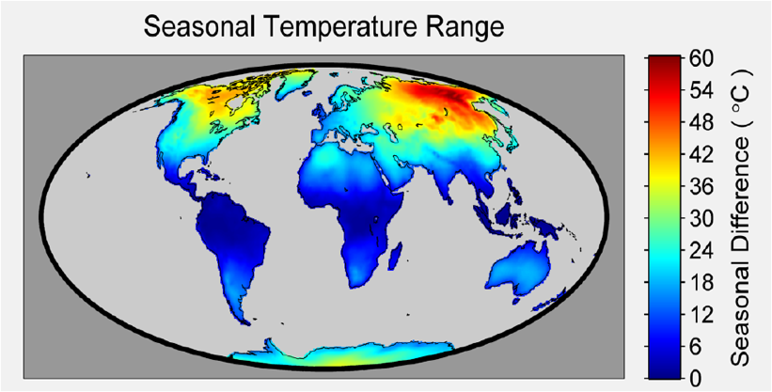
Protocol Training Slides
Air Temperature

Slide 2

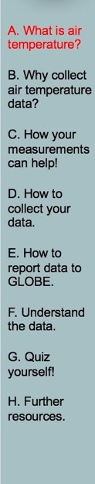
Overview and Learning Objectives
Overview
This module:
Describes how to take air temperature observations
Provides instructions on how to enter your data on the GLOBE website
Learning Objectives
After completing this module, you will be able to:
Describe what air temperature is
List reasons why it is important to collect air temperature data
Determine the correct locations to take air temperature readings
Upload data to the GLOBE website
Visualize data using GLOBE Visualization Site and formulate your own questions about weather
Estimated time to complete module: 1 hour

Slide 3
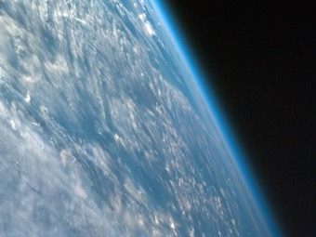
The Atmosphere
Extremely thin blanket of air extending about 300 miles from Earth’s surface to edge of space
Protection from the blasts of radiation emanating from the Sun
Composed of gases such as nitrogen, oxygen, argon, etc.
Image: NASA Goddard
Link to the GLOBE Teacher’s Guide Atmosphere Protocols

Slide 4
Air Temperature
Aerosols
Air Temperature
Albedo
Barometric Pressure
Clouds
Precipitation
Relative Humidity
Surface Ozone
Surface Temperature
Water Vapor
Wind
Measures the heat in the air
Varies: warmest at the surface and decreases with height
Impacts the types of plants and animals that live in a certain location
Impacts soil formation

Slide 5
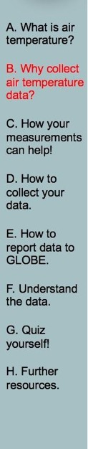
Recording air temperatures is important for many reasons:
To observe patterns in temperature change
To understand seasonal changes in Earth’s air temperatures
To compare temperature changes from year to year
To provide climate change models data to predict future conditions
To better understand Earth’s weather and changing climate over time

Slide 6
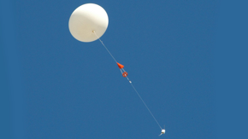
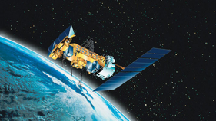
Measuring Earth’s Temperature
Satellites and radiosondes record Earth’s temperatures in the Troposphere and Stratosphere.
Radiosondes measure air temperature using thermometers carried aloft by balloons.
Satellites measure the energy given off by the Earth’s atmosphere, from which scientists calculate the temperature.
NASA Radiosondes
NOAA weather satellite

Slide 7
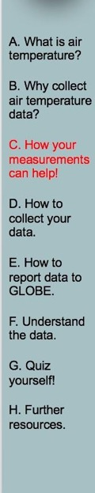
Your observations are valuable contributions to the scientific community and may be used by educators, students, researchers, and the general public to increase environmental awareness and STEM literacy, as well as advance Earth system science.
Weather (the air temperature, rain, relative humidity, cloud conditions, atmospheric pressure)
Climate (the average and extreme conditions of the atmosphere)
Energy Budget (Land-Atmosphere interactions)
Atmospheric Composition (trace gases and particles in the air)

Slide 8
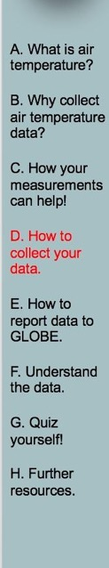
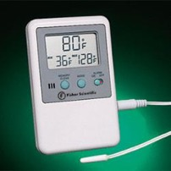
What I Need to Collect Air Temperature Data
Instruments | Max/Min Digital Thermometer or Alcohol-filled Thermometer*
Data Sheet | Atmosphere Investigation Data Sheet
When | Preferably within one hour of local solar noon; OK at other times.
Where | Instrument Shelter (See Documenting your atmosphere study site)
Other | Log book for data collection; Computer with internet connection to enter data.
Digital Thermometer
*Use only for current air temperature

Slide 9
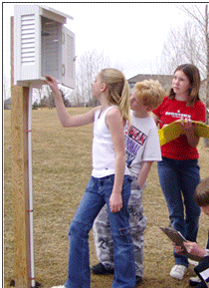
Instrument Shelter
Your digital thermometer is mounted to the rear wall of the instrument shelter.
Your shelter should be located in an open area without obstructions such as trees or buildings and within walking distance.
Your instrument shelter should be clean both inside and out.
Installed Instrument Shelter

Slide 10
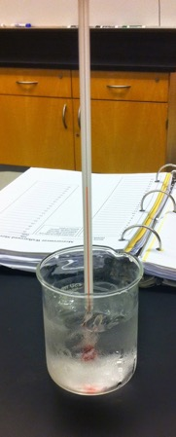
Calibrating your Instrument
Calibration Thermometer
Prepare a mixture of fresh water and crushed ice with more ice than water in a container.
Put the calibration thermometer into the ice-water bath. The bulb of the thermometer must be in the water.
Allow the ice-water bath and thermometer to sit for 10 to 15 minutes.
Gently move the thermometer around in the ice-water bath so that it will be thoroughly cooled.
Read the thermometer. If it reads between -0.5 ̊ C and +0.5 ̊ C, the thermometer is fine.
If the thermometer reads greater than +0.5 ̊ C, check to make sure that there is more ice than water in your ice-water bath.
If the thermometer reads less than -0.5 ̊ C, check to make sure that there is no salt in your ice-water bath.
If the thermometer still does not read between -0.5 ̊ C and +0.5 ̊ C, replace the thermometer.

Slide 11
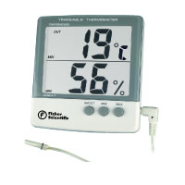
Calibrating Your Max/Min Digital Thermometer
Open the door to the instrument shelter and hang the calibration thermometer, the digital thermometer, and the soil sensor in the instrument shelter (if using it) so that they have air flow all around them and do not contact the sides of the shelter.
Close the door to the instrument shelter.
Wait at least an hour. Open the door to the instrument shelter. Make sure that your digital thermometer is displaying the current temperature(s) (Neither ‘MAX’ or ‘MIN’ symbols should be displayed on the screen. If they are, press the MAX/MIN button until they disappear).
Read the temperatures reported by the air sensor and the soil sensor (if using it) of the digital thermometer and record them on your Max/Min Thermometer Calibration and Reset Data Sheet.
Close the door of the instrument shelter.
Repeat steps 2 to 5 four more times, waiting at least one hour between each set of readings. Try to space out the five sets of readings over as much of a day as possible.

Slide 12
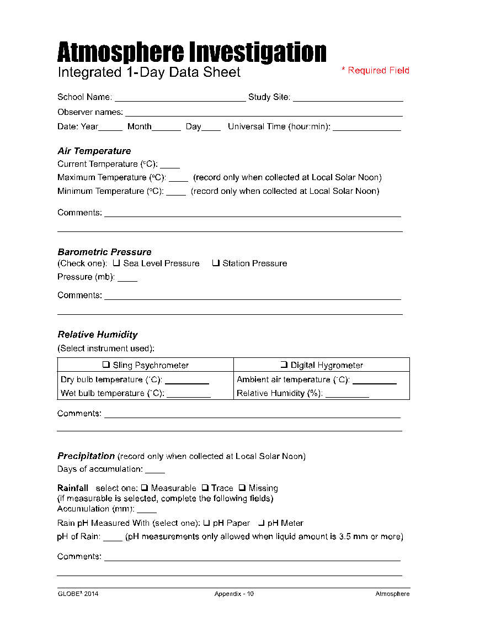
Data Sheet
Enter the data on the Integrated 1-Day Data Sheet
Be sure to fill out the top: School Name, Study Site, Observer Names, Date and Time (local or UTC)
Atmosphere Data Sheet

Slide 13
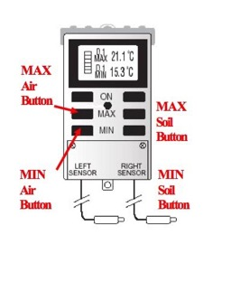
Collecting Data with Max/Min Thermometer
Preferably within an hour of local solar noon open the instrument shelter being careful not to breathe on the thermometer.
Record the time and date on your Atmosphere Data Sheet in both local and UT time. Note: GLOBE Website entry should be UT time.
Make sure that your thermometer is displaying the current temperature(s) (Neither ‘MAX’ or ‘MIN’ symbols should be displayed on the screen. If they are, press the MAX/MIN button until they disappear).
Record the current air temperature on your Data Sheet. If you are taking soil readings, also record the soil temperature.
Press the MAX/MIN button once.
Maximum temperature reading(s) will now be displayed along with the ‘MAX’ symbol on the display screen.

Slide 14
Collecting Data with Max/Min Thermometer-2
Record the maximum air temperature on your Data Sheet. If you are taking soil readings, also record the maximum soil temperature.
Press the MAX/MIN button a second time.
Minimum temperature reading(s) will now be displayed along with the ‘MIN’ symbol on the display screen.
Record the minimum air temperature on your data sheet. If you are taking soil readings, also record the minimum soil temperature.
Press and hold the MAX/MIN button for one second. This will reset your thermometer.
Close the instrument shelter.

Slide 15

When to Collect Data with Alcohol-filled Thermometer
Use only when an instrument shelter is not available and a current temperature measurement is required in support of another GLOBE measurement.
Your thermometer should be calibrated at least every three months as well as before its first use. Follow the procedure in slide 10.

Slide 16
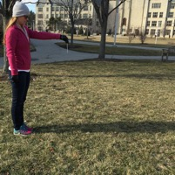
Collecting Data with Alcohol-filled Thermometer
Tie one end of a piece of string securely to the end of the calibration thermometer and the other end to a rubber band.
Slip the rubber band around your wrist so that the thermometer is not broken if it is accidentally dropped on the ground.
Hold the thermometer at chest height, in your shadow, and away from your body for three minutes.
At the end of three minutes, record the temperature reading in your science log.
Hold the thermometer the same way for another minute.
At the end of the minute, record the temperature once again. If the temperature is within 0.5 ̊ C of the previous reading, record the reading on your Data Sheet.
If the two temperature readings differ by more than 0.5 ̊ C, repeat steps 5 and 6 again.
If two consecutive temperature readings are not within 0.5 ̊ C of one another after 7 minutes, record the last measurement on the Data Sheet and report your other four measurements in the comments section along with a note that your reading wasn’t stable after 7 minutes.

Slide 17
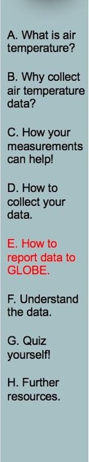
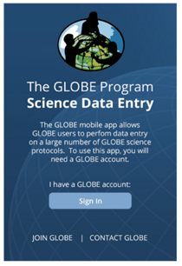
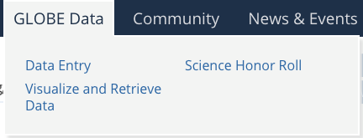
Entering Air Temperature Data-Step 1
  You have 3 options:
1a) Download the Data Entry app from the App Store.
1b) Live Entry: These pages are for entering environmental data – collected at defined sites, according to protocol, and using approved instrumentation – for entry into the official GLOBE science database.
1c) Email Data Entry: If connectivity is an issue, data can also be entered via email.

Slide 18
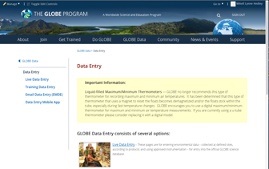
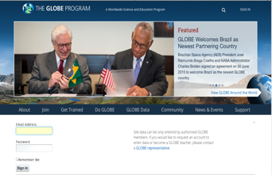
Entering Air Temperature Data-Steps 2 & 3
2) Choose Live Data Entry.
3) Enter Username and Password.

Slide 19
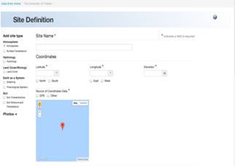
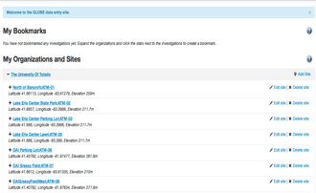
Entering Air Temperature Data-Steps 4 & 5
4) Confirm that an Atmosphere Study Site has been defined, and choose it under My Organizations and Sites list.
5) If Study Site is not defined, define it.

Slide 20
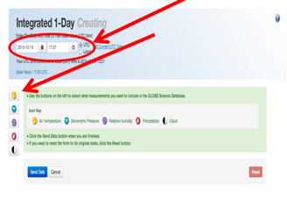
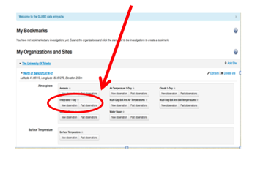
Entering Air Temperature Data-Steps 6 & 7
6 ) Select Integrated 1-Day from the atmosphere data entry site and choose new observation.
7) Enter Date, time, and choose air temperature.

Slide 21
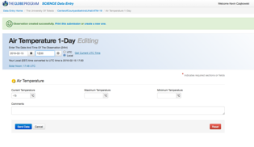
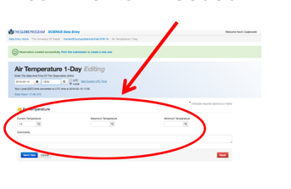

Entering Air Temperature Data-Steps 8 & 9
8) Enter current, maximum and minimum temperatures. Add comments if needed.
9) If you have entered data correctly, you will get a smiley face.

Slide 22
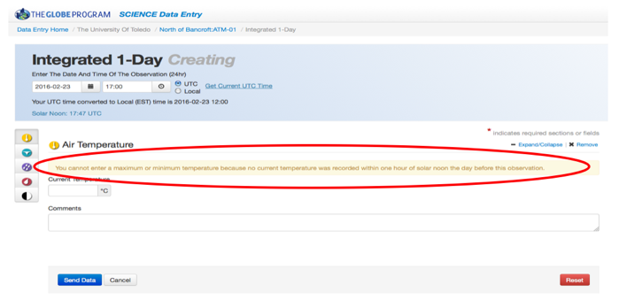
Cautions
The system will not allow you to enter a maximum and minimum air temperature if you haven’t entered data the day before.

Slide 23
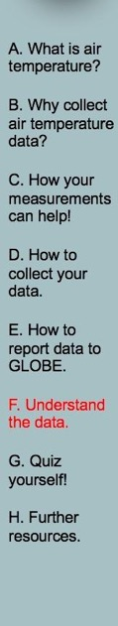
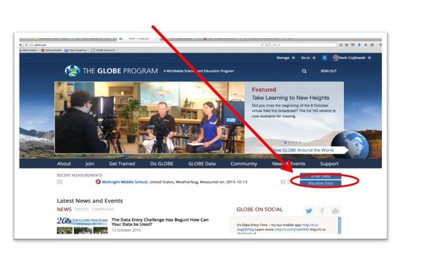
Retrieving Data from the GLOBE Visualization System
Click on Visualize Data
eTraining is available to explore the full power of the visualization system.

Slide 24
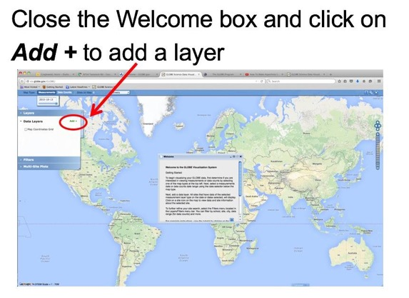
Using the dialogue box, select the parameters you want to view

Slide 25
Questions for YOU to investigate
When does temperature change the most from day to day?
What are the latitudes and elevations of other GLOBE schools with air temperature data similar to yours?
How does vegetation in your area respond to changing temperature?
Is your local environment affected more by average temperature or temperature extremes?
Is there a difference between air temperature readings taken by students and satellites?
How does a large body of water affect air temperature?

Slide 26
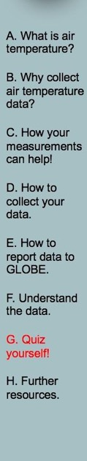
What have YOU learned?
What is air temperature?
Why it is it important to collect air temperature data?
What instrument(s) is/are needed to collect air temperature data?
Where can I purchase the instrument(s)?
Where should I take my air temperature measurements?
What data do I need to collect?
How do I submit my data to GLOBE?
What can I do with the data submitted to GLOBE?

Slide 27
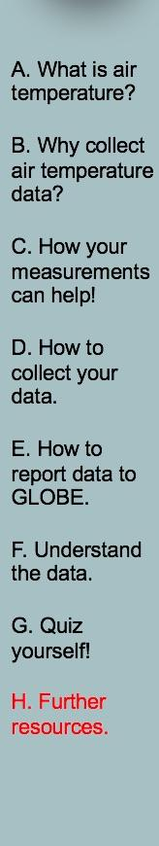
Frequently Asked Questions (FAQs)
1. If we missed reading the maximum/ minimum thermometer for a day or more (over the weekend, holiday, vacation, etc.), can we still report the temperature for today?
You can and should report the current temperature. You may not report the maximum and minimum temperatures as they are the maximum and minimum temperatures for more than one day. Reset the indicators and tomorrow you can report the maximum, minimum, and current temperatures.
2. What should we do if our maximum/ minimum thermometer does not agree with the calibration thermometer and we can not adjust the scales so that they agree?
This is rare, but there are some maximum/ minimum thermometers that cannot be calibrated successfully. In this case, contact the supplier or manufacturer, explain that the calibration of the thermometer is off, and request a new thermometer.

Slide 28
Frequently Asked Questions (FAQs)-2
3. The maximum temperature reading on our thermometer today is less than the current temperature reading yesterday. Is this wrong?
Yes, this is a problem if the difference is more than 0.5 ̊ C. Sometimes the maximum indicator slips. Report your readings anyway so that GLOBE can track these errors. If this problem occurs often (more than one day in 20 or 5% of the time), check to see that your instrument shelter is mounted firmly and securely and that there are no routine sources of vibration shaking the shelter. If your shelter is securely mounted and there are no sources of vibration, contact the supplier and replace your maximum/minimum thermometer and also inform GLOBE of your problem.
4. The minimum temperature reading on our thermometer today is greater than the current temperature reading yesterday. Is this wrong? See #3 answer.

Slide 29
Further Resources
  GLOBE Learning Activities
  NASA Weather and Climate
  For information on purchasing GLOBE supplies go to: link for finding suppliers of GLOBE instruments
  Questions? GLOBE Website

Slide 30


Please provide us with feedback about this module. This is a community project and we welcome your comments, suggestions and edits! Comment here: eTraining Feedback
Questions? Contact help@nasaglobe.org
Credits:
Power point Developers:
Kevin Czajkowski
Janet Struble
Mikell Lynne Hedley
Sara Mierzwiak
Photos unless otherwise identified:
Kevin Czajkowski
Version 12/1/16. If you edit and modify this slide set for use for educational purposes, please note “modified by (and your name and date) “ on this page. Thank you.
Funding Provided by NASA

