Slide 1
Introduction to the GLOBE Atmosphere Protocols

Slide 2
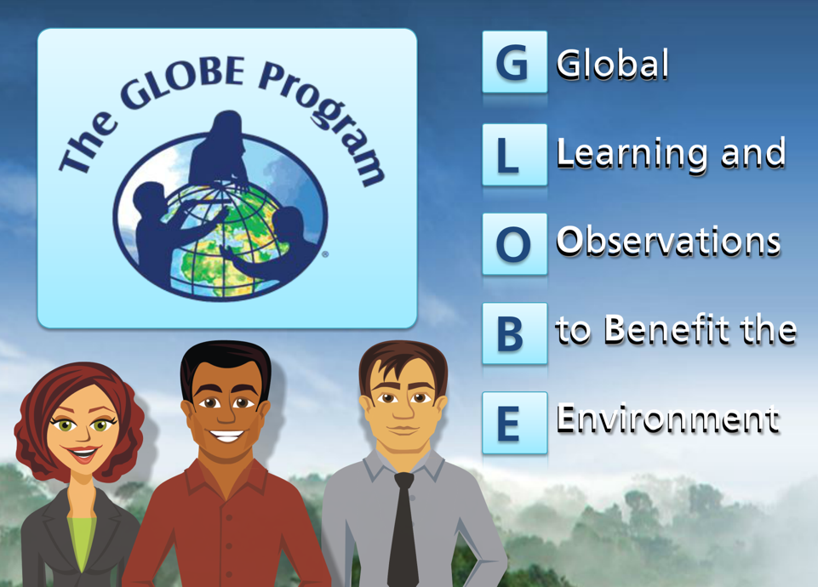
Welcome to GLOBE ‘s Atmosphere Investigations!

Slide 3
Overview and Objectives
This module:
Introduces the GLOBE Atmosphere Investigation Area
Introduces the GLOBE protocols associated with the atmosphere
After completing this module, you will be able to:
Describe the structure and composition of the atmosphere
Explain how differential heating of the Earth’s surface generates winds
Identify the components of the Earth system
Explain the difference between weather and climate
Be familiar with where and when to take atmosphere measurements
Recognize various GLOBE atmosphere investigation protocols
Identify the importance of atmospheric data
Estimated time to complete this module: 1.5 hours

Slide 4
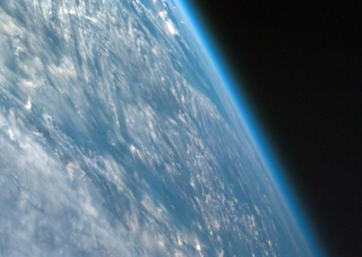
1. What is the Atmosphere?
The Earth's atmosphere is an extremely thin sheet of air extending from the surface of the Earth to the edge of space. The Earth is a sphere with a roughly 8000 mile diameter; the thickness of the atmosphere is about 60 miles.
In this picture, taken from a spacecraft orbiting at 200 miles above the surface, we can see the atmosphere as the thin blue band between the surface and the blackness of space. If the Earth were the size of a basketball, the thickness of the atmosphere could be modeled by a thin sheet of plastic wrapped around the ball!
Image: NASA

Slide 5
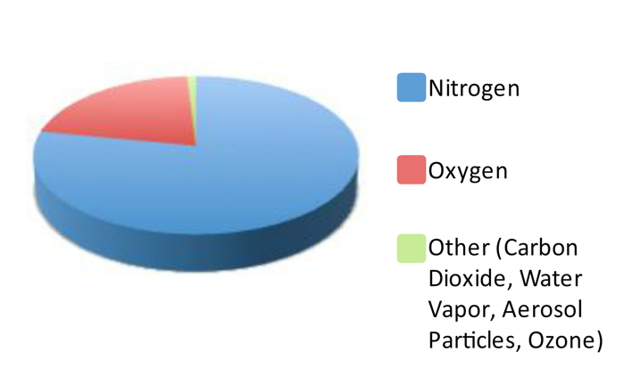
The atmosphere is composed of a mixture of gases
Air is composed of approximately 78% nitrogen, 21% oxygen, and small amounts of other gases.

Slide 6
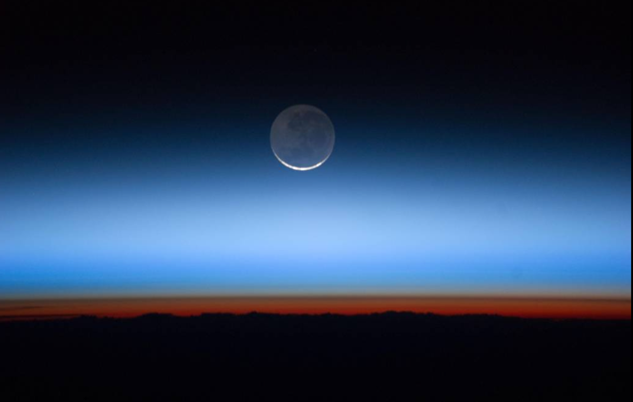
The Atmosphere has Structure
Image Credit: NASA/JSC Gateway to Astronaut Photography of Earth
International Space Station astronauts captured this photo of Earth's atmospheric layers on July 31, 2011, revealing the troposphere (orange-red), stratosphere and above. Satellite instruments allow scientists to better understand the chemistry and dynamics occurring within and between these layers. Let’s look at some of the layers of the atmosphere in the next slides.

Slide 7
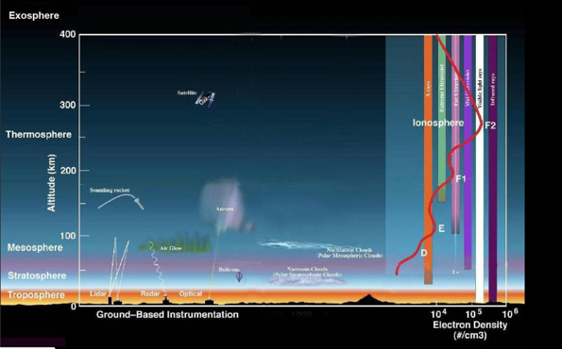
At the Top of the Atmosphere: Exosphere and Ionosphere
Image Credit: NASA Goddard
Exosphere: This is the upper limit of our atmosphere. It extends from the top of the thermosphere up to 10,000 km (6,200 mi). Satellites orbit in this layer.
Ionosphere: The ionosphere is an abundant layer of electrons and ionized atoms and molecules that stretches from about 48 kilometers (30 miles) above the surface to the edge of space at about 965 km (600 mi), overlapping into the mesosphere and thermosphere. This region is what makes radio communications possible.

Slide 8
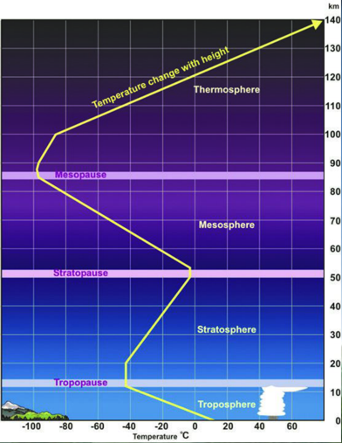
Below the Ionosphere: Thermosphere-Troposphere
Thermosphere: The thermosphere starts just above the mesosphere and extends to 600 kilometers (372 miles) high. Aurora and some other satellites occur in this layer.
Mesosphere: The mesosphere starts just above the stratosphere and extends to 85 kilometers (53 miles) high. Meteors burn up in this layer.
Stratosphere: The stratosphere starts just above the troposphere and extends to 50 kilometers (31 miles) high. The ozone layer, which absorbs and scatters the solar ultraviolet radiation, is in this layer.
Troposphere: The troposphere starts at the Earth's surface and extends 8 to 14.5 kilometers high (5 to 9 miles). This part of the atmosphere is the most dense. Almost all weather is in this region.

Slide 9
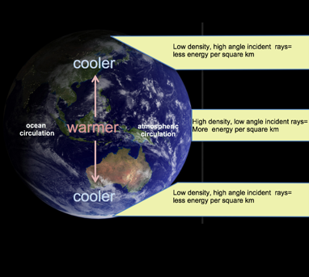
Uneven Heating of the Earth Drives Air and Ocean Circulation
The unequal heating of the Earth’s surface drives air and ocean circulation and causes climate to vary by latitude.
Air and water circulation is initiated at the equator, where insolation is greatest. Masses of air and ocean transport heat energy from areas of high concentration to low concentration.
The movement of these masses of air and ocean establish an equilibrium state of heat distribution which we determine the general climate bands, or zones that we see at different latitudes.
At the higher latitudes, solar energy reaches the Earth as Low density, high angle incident rays, so there is less energy reaching the Earth’s surface per km2, compared to the equator. Image: Blue Marble from NASA Earth Observatory

Slide 10
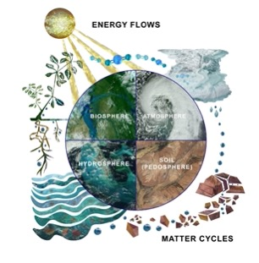
The Atmosphere is part of the Earth System
To summarize, atmospheric properties are not uniform; fluid properties are constantly changing with time and location. We call this change the weather.
The atmosphere’s properties and the weather it generates affect all parts of the Earth, but at the same time, properties of the Earth’s components- the hydrosphere (water), lithosphere (earth) and biosphere (life), affect the atmosphere. These interactions characterize the Earth system.
The Earth system behaves as a single, self-regulating closed system comprising physical, chemical, biological and human components.
The focus of Earth system science is understanding the interactions between the oceans and ice, atmosphere, life, geological processes and the land surface, and how those interactions impact each other and lead to changes on our planet.
The Earth system is also responsible for generating Earth’s climate.
Image: GLOBE.gov
Notes:
NASA monitors Earth’s vital signs from land, air and space with a fleet of satellites and ground-based observation campaigns. One of the ground-based observation campaigns is GLOBE.

Slide 11
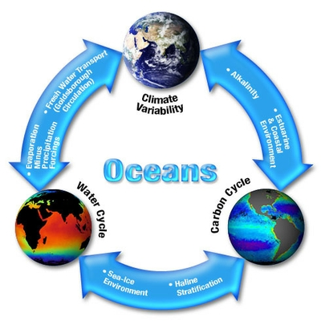
In the Earth system, changes in one part of the system will affect the other parts.
This diagram shows some of the ways that elements of the Earth system affect other elements of the Earth system.
In the Earth system, “Everything is connected to everything else.”
Image: NASA

Slide 12
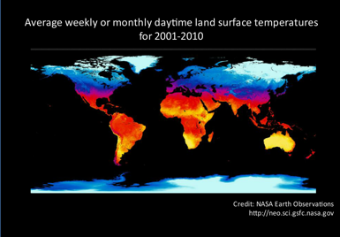
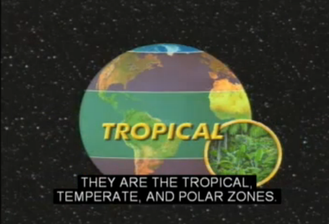
The interactions of the Earth’s system generate weather and climate. 1
Unequal heating of the Earth’s surface by the Sun, and interactions between the atmosphere, biosphere, hydrosphere and lithosphere create the Earth’s climate zones, which have characteristic weather conditions and life forms.

Slide 13
In the Earth system, changes in one part of the system will affect the other parts. 2
This diagram summarizes some of the factors that influence weather and climate and are responsible for differentiation of climate zones. Don’t worry about the details, but you should be aware that in the Earth system, “Everything is connected to everything else.” Note: Cryosphere is another term for the Earth’s ice, and in GLOBE materials, the cryosphere is treated as part of the hydrosphere.

Slide 14
So, what is the difference between weather and climate?

Slide 15
Weather and Climate Operate on Different Timescales
Image: NASA
Weather and climate are easily confused but they're not the same ... they operate on different timescales. Weather describes how the atmosphere behaves over weeks or less. Climate describes the average behavior of weather over long timescales, typically 30 years or more. So climate refers to seasonal and longer periods, out to centuries and millennia.

Slide 16
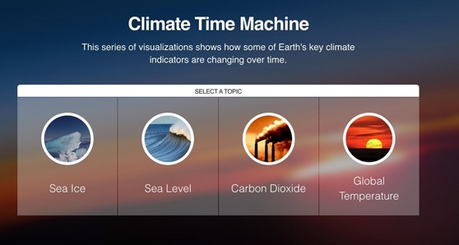
Is it Weather or is it Climate?
In most places, weather can change from minute-to-minute, hour-to-hour, day-to-day, and season-to-season. Climate, however, is the average of weather over time and space. An easy way to remember the difference is that climate is what you expect, like a very hot summer, and weather is what you get, like a hot day with pop-up thunderstorms.
To see how climate has changed over time, explore NASA’s Climate Time Machine.
Link to the Climate Time Machine

Slide 17
Let’s review our progress so far!
See if you can answer the following questions!

Slide 18
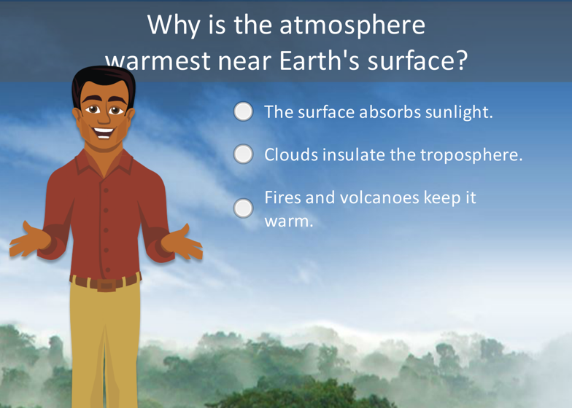
Review your Understanding! Question 1
What is your answer?

Slide 19
Answer to Question 1
Were you correct? ☺

Slide 20
Review your Understanding! Question 2
What is your answer?

Slide 21
Answer to Question 2

Slide 22
Review your understanding! Quiz Question 3
What is your answer?

Slide 23
Answer to Quiz Question 3
Were you correct? ☺ If so, go to the next question!

Slide 24
Review your Understanding: Question 4

Slide 25
Answer to Question 4

Slide 26
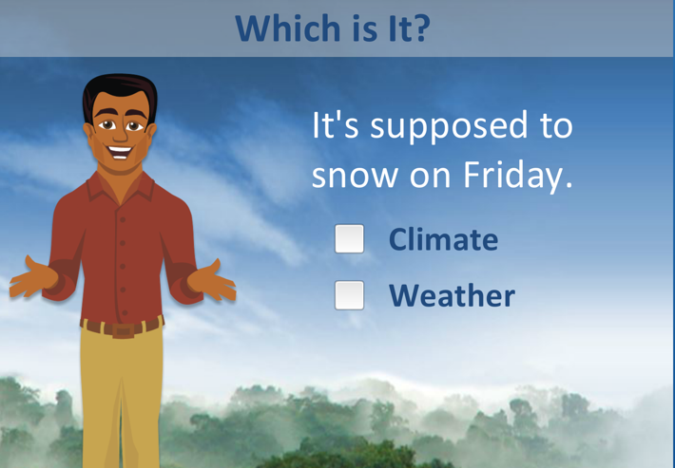
Review your Understanding! Question 5
What is your answer?

Slide 27
Answer to Question 5
Were you correct? If so, go to the next question!

Slide 28
Review your Understanding! Question 6
What is your answer?

Slide 29
Answer to Question 6
Were you correct? We have now finished the introduction to the atmosphere. Now let’s examine some of the GLOBE protocols you can use to explore the atmosphere.

Slide 30
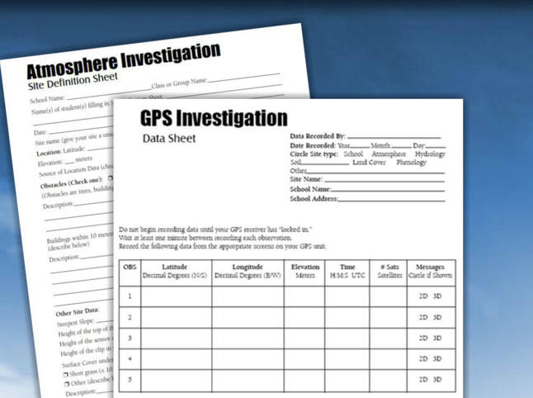
2. Overview of GLOBE Atmospheric Protocols

Slide 31
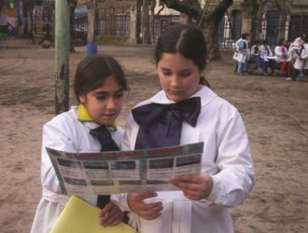
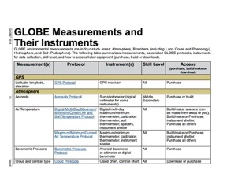
If you are a teacher, here are some things you should know about GLOBE’s Atmosphere Investigations
Grade Level: Some measurements, such as cloud and contrail type can be conducted by all students, including those in the youngest grades. When combined with concepts such as parts per billion or relative humidity, these measurements are also very appropriate for older students.
Link to GLOBE Toolkit

Slide 32
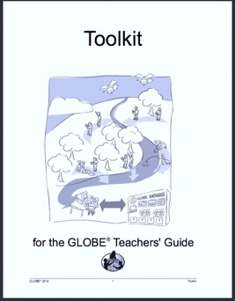
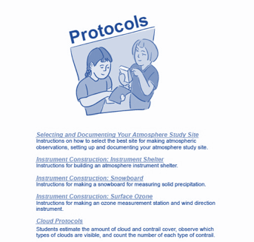
Where to find out about the instruments you need
Instrumentation: Some instruments are available on the GLOBE website, such as the Cloud Chart. Others you may already have, such as thermometers and meter sticks. There are instruments that can be made, such as instrument shelters for temperature measurements and snow boards. All instruments are available for purchase, including automated weather stations, that provide an optional way to collect atmosphere data.
To find the specifications for instruments you need, you can consult the GLOBE Toolkit.

Slide 33
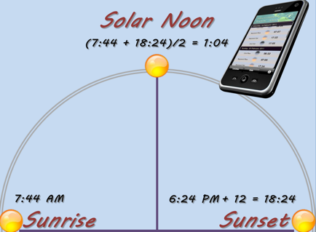
Many of your measurements should be taken at local solar noon
To ensure comparability of measurements worldwide, it’s best to take your atmospheric measurements at your local solar noon. This time is usually not 12 pm on your local clock. You can look up the real time for local solar noon, or calculate it by finding the average time between the published sunrise and sunset for your area. You will report your time as UTC, or Coordinated Universal Time. This is calculated automatically for you when you input your data to GLOBE. Note: if it is not possible to take your measurements at local solar noon, it is OK to take them at another time.

Slide 34
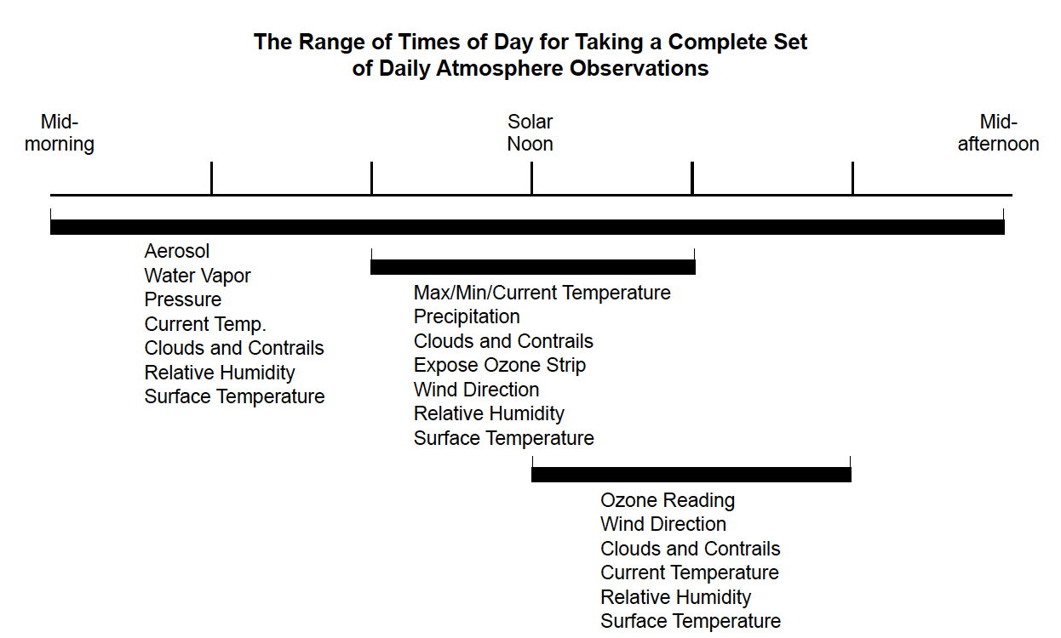
Most of the GLOBE atmosphere measurements should be taken during a two hour window surrounding your local solar noon, if possible.
Remember, you don’t have to do all the measurements! You can select the measurements that fit with the times that work with your schedule.

Slide 35
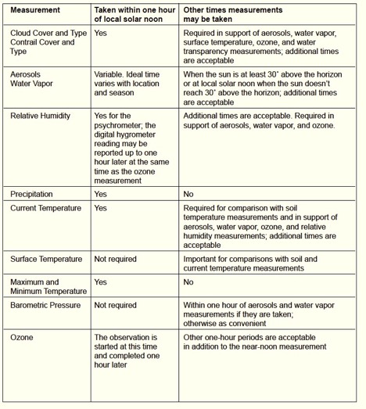
Atmospheric Protocols: When to take your measurements, and how long you will need to take them
Time: Most of the measurements take just a few minutes and can be collected at about the same time every day, within a two-hour window, one hour before or after local, solar noon (if possible, but OK to take measurements at another time). However, other data can be taken at any time of day, such as clouds or relative humidity.
Which measurements you collect may be restricted due to the time available at the atmosphere study site.

Slide 36
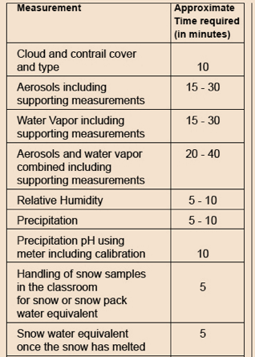
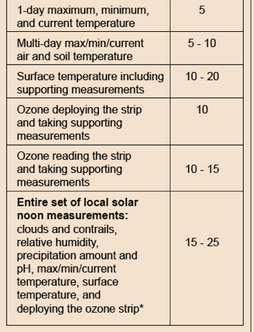
Atmospheric Protocols: How long measurements take
Most of the measurements take just a few minutes. Which measurements you collect may be restricted due to the time available at the atmosphere study site.

Slide 37
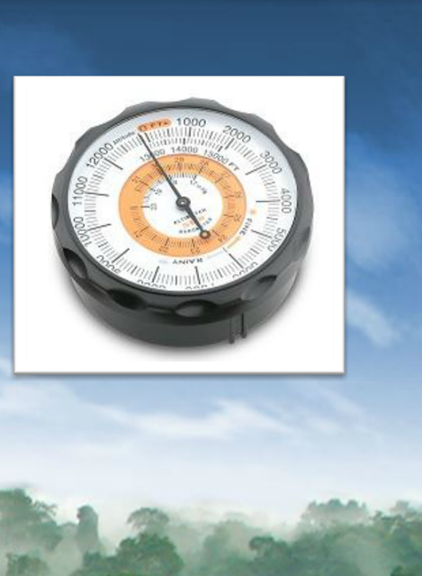
Atmospheric Pressure Protocol
Atmospheric Pressure
Use either a barometer or an altimeter to measure atmospheric/barometric pressure.
Skill Level: All
Time Required 15-25 minutes

Slide 38
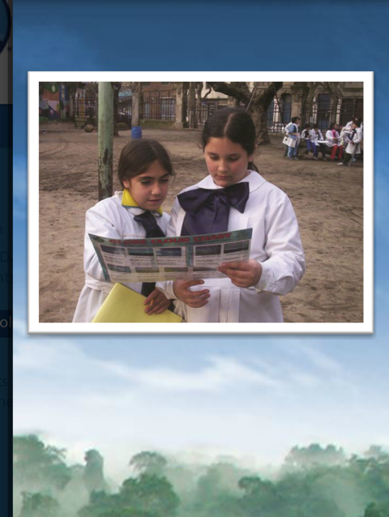
Cloud Protocol
Clouds
Use a cloud and/or contrail chart or the GLOBE Observer app to identify types of clouds and contrails.
Skill Level: All
Time Required:10 minutes

Slide 39
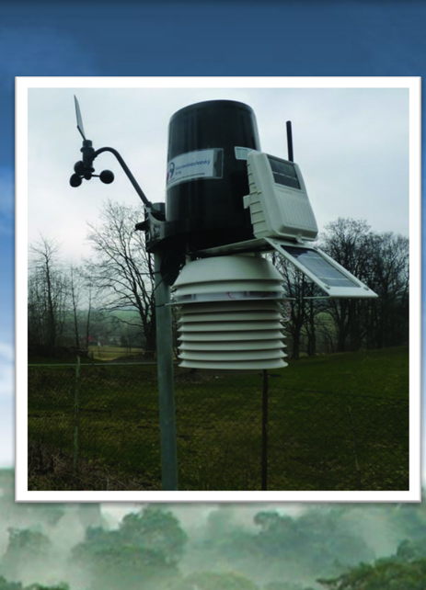
Automatic Weather Station Protocol
Automatic Weather Station
Collect various atmospheric measurements using an automatic weather station.
Skill Level: All
Time Required: 10 minutes

Slide 40
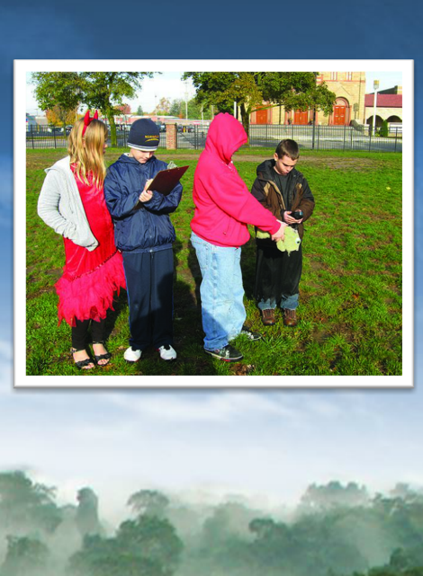
Surface Temperature
Use a handheld infrared thermometer (IRT) to measure the temperature of the ground at nine widely-spaced places at the measurement site.
Skill Level: All
Time Required: 10-15 minutes

Slide 41
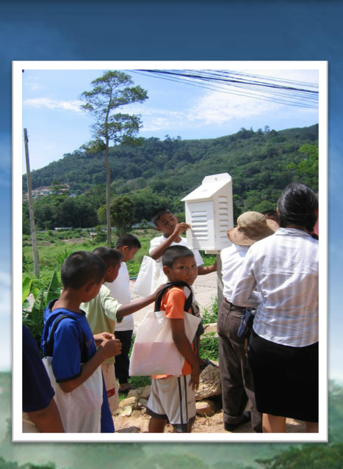
Air Temperature Protocol
Air Temperature
Use a thermometer to measure minimum and maximum air temperature over a 24-hour period. The thermometer is housed in an instrument shelter.
Skill Level: All
Time required: 5 minutes

Slide 42
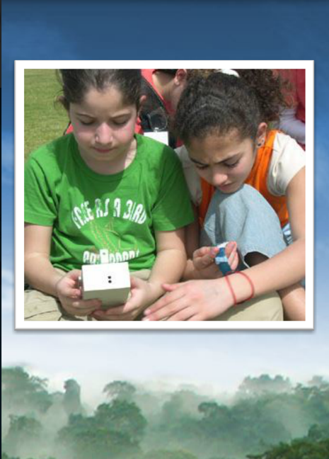
Aerosols
Use a sun photometer (and in some cases a voltmeter) to measure aerosol optical thickness.
Skill Level: Intermediate (Middle, Secondary grades)
Time Required: 15-30 minutes

Slide 43
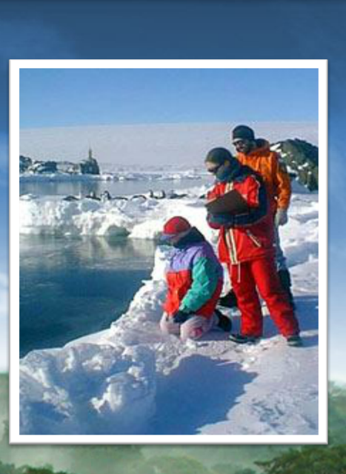
Precipitation (Solid) Protocol
Precipitation (Solid)
Use a snow board and a metric ruler to measure snowfall and snowpack. You can also measure pH.
Skill Level: All
Time Required: 10 minutes

Slide 44
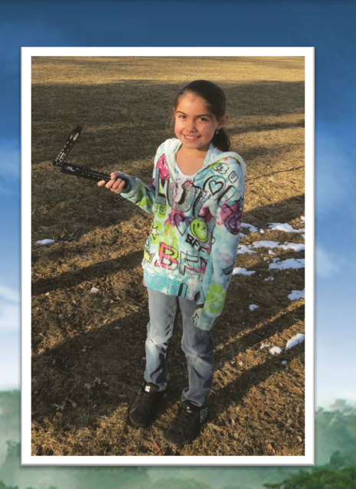
Relative Humidity
Use either a sling psychrometer or a digital hygrometer to measure relative humidity.
Skill Level: All
Time Required: 5-10 minutes

Slide 45
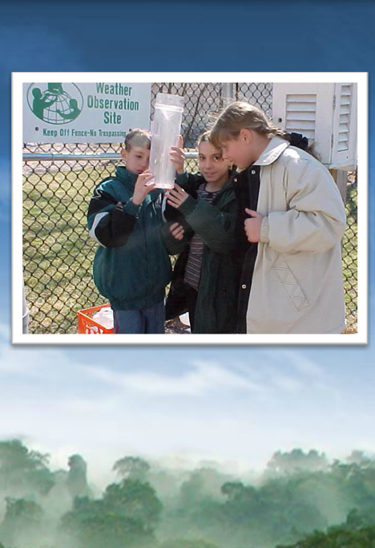
Precipitation (Liquid)
Use a rain gauge to measure rainfall. You can also measure pH.
Skill Level: All
Time Required: 5-10 minutes

Slide 46
Review your Knowledge! Question 7
Which of the following protocols requires no purchased equipment?
Aerosols
Cloud
Relative humidity
Water vapor
What is your answer?

Slide 47
Answer to Question 7
Answer to Quiz Question 7
Which of the following protocols requires no purchased equipment?
Aerosols
Cloud- ☺ correct!
Relative humidity
Water vapor
Were you correct?

Slide 48
Review your Knowledge! Question 8 (For educators)
Most Atmosphere Protocols can be conducted by student of all ages. Which is one of the protocols that may be more appropriate for older students?
Precipitation
Cloud
Air Temperature
Water vapor
What is your answer?

Slide 49
Review your Knowledge! Question 9
Most of the GLOBE atmosphere measurements should be taken (if possible) during a two hour window around
noon local time
local solar noon
dawn or sunset
Noon UTC (coordinated universal time)
What is your answer?

Slide 50
Answer to Quiz Question 9
Most of the GLOBE atmosphere measurements should be taken during a two hour window around
noon local time
local solar noon ☺ Correct!
dawn or sunset
Noon UTC (coordinated universal time)
Were you correct?

Slide 51
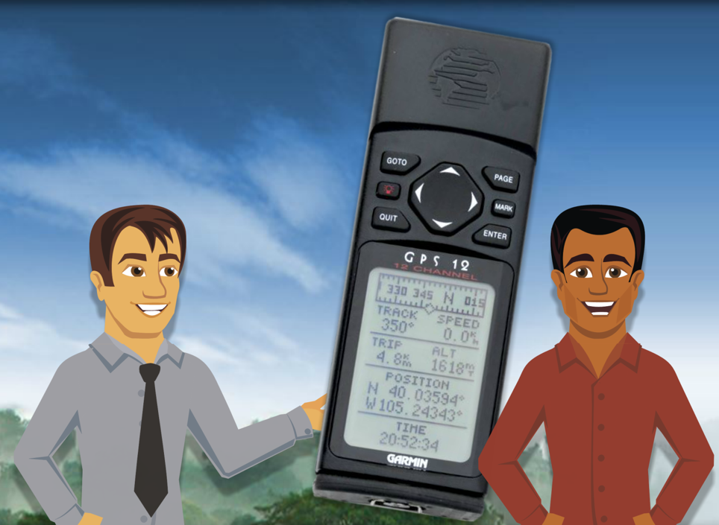
3. Setting up your Atmosphere Study Site
In this section, you will learn to
Select and describe an atmosphere study site
Understand Universal time
Document and record your atmosphere study site

Slide 52
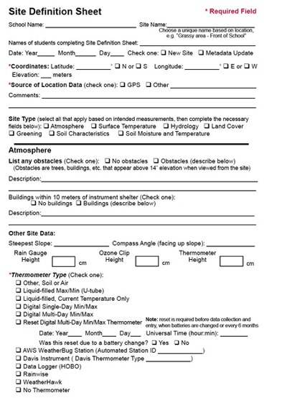
Documenting your Atmosphere Study Site
Let’s go through the steps in the next slides…
Use a GPS
Evaluate your observing site and identify any obstacles to the sky
Ensure no building is within 10 m
Use compass to determine the slope

Slide 53
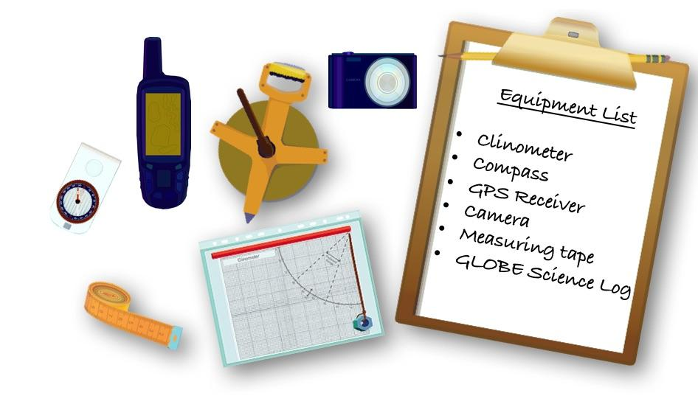
Equipment you need to document your Atmosphere Study Site

Slide 54
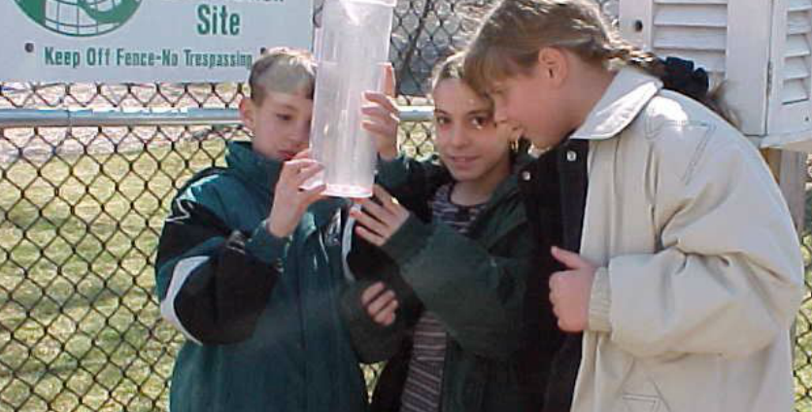
Where is a good place to locate the Atmosphere Study Site? A location near you for quick and easy access.

Slide 55
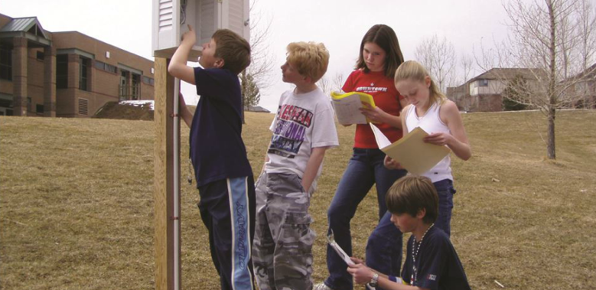
An open grass-covered area is optimal.

Slide 56
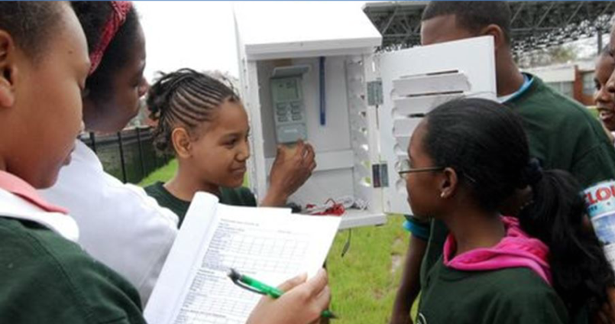
It is best to be in an open area away from buildings. An open area will prevent the blocking of precipitation.

Slide 57
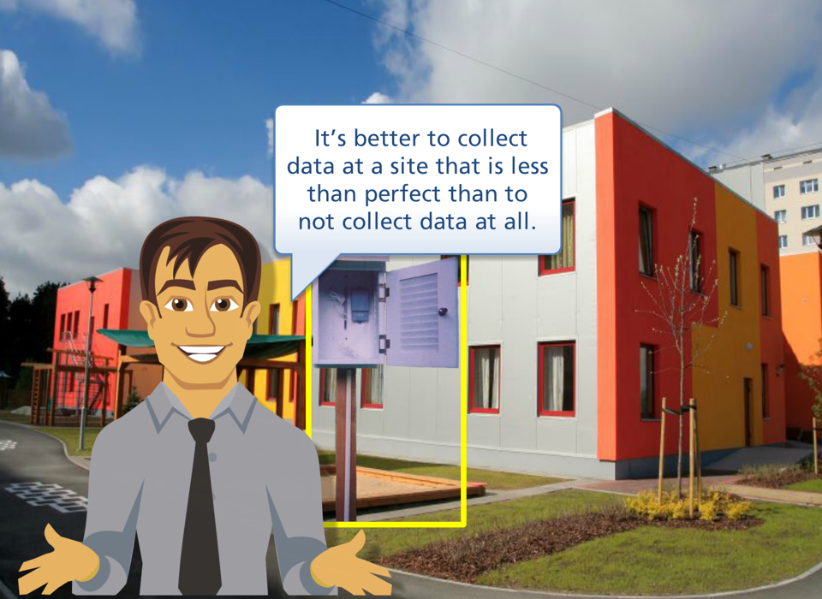
Don’t worry if you don’t have the perfect sampling site
content

Slide 58
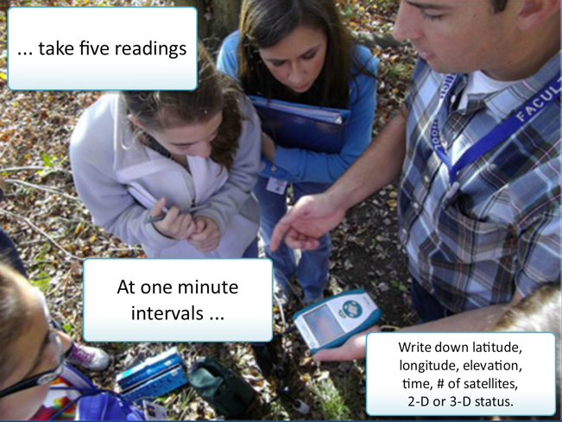
Method to determine location if using a GPS Receiver

Slide 59
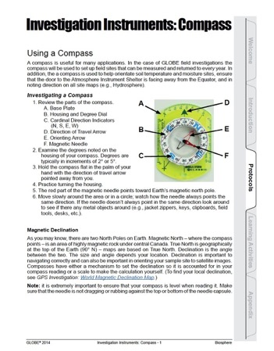
The GLOBE Teacher’s Guide tells you how to use a compass and determine the slope

Slide 60
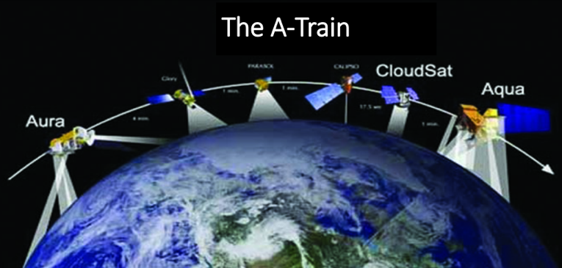
The A-Train
NASA monitors Earth’s vital signs from land, air and space with a fleet of
satellites and ground-based observation campaigns.
One of the ground-based observation campaigns is GLOBE.
Find out more here: Link to NASA article about the A-Train

Slide 61
These are some of the important ideas we have covered!

Slide 62
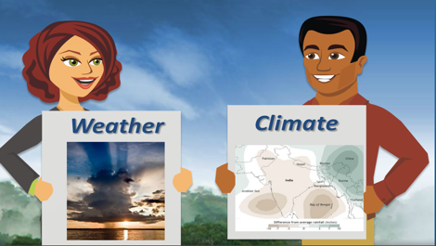
Before you end this session, review your knowledge of these important concepts! 2
What is the difference between weather and climate?
(Find the Answer: slides 14-16)

Slide 63
2. Describe the characteristics of the atmosphere
Before you end this session, review your knowledge of these important concepts! 3
(Find the Answer: Slides 4-8)

Slide 64
Before you end this session, review your knowledge of these important concepts! 4
3. What do we mean when we say that in the Earth system, “Everything is connected to everything else?”
(Find the Answer: Slides 10-13)

Slide 65
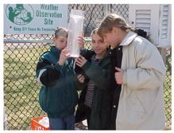
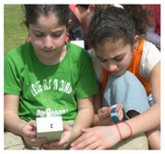
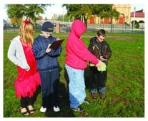
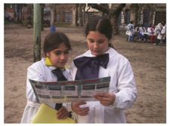
Before you end this session, review your knowledge of these important concepts! 5
4. What are some of the measurement protocols used in GLOBE Atmosphere investigation?
(Find the Answer: slides 36-46)

Slide 66
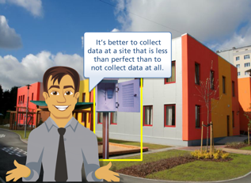
Before you end this session, review your knowledge of these important concepts! 6
5. What should you consider when determining placement of an Atmosphere Study Site?
(Find the Answer: Slides 56-59)

Slide 67
6. When do you preferably take measurements?
(Find the Answer: Slides 32-33)

Slide 68
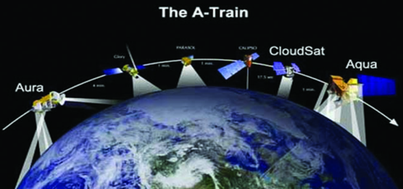
Before you end this session, review your knowledge of these important concepts!
7. What is the relationship between NASA satellite measurements such as those taken by the “A-Train” and GLOBE?
(Find the Answer: slide 62)

Slide 69
If you feel you are ready to take the Introduction to Atmosphere Quiz, you will see a link next to where you found this module.

Slide 70
Welcome to GLOBE’s Atmosphere Investigations!
Do you have Questions?
Link to the GLOBE Program

Slide 71
Please provide us with feedback about this module. This is a community project and we welcome your comments, suggestions and edits! Comment here: eTraining Feedback Questions about this module? Contact help@nasaglobe.org
For More Information:
The GLOBE Program
NASA Wavelength NASA’s Digital Library of K-16 Earth and Space Educational Resources
NASA Global Climate Change: Vital Signs of the Planet
The GLOBE Program is sponsored by these organizations:
Version 6/23/20. If you edit and modify this slide set for use for educational purposes, please note “modified by (and your name and date)“ on this page. Thank you.

