Slide 1
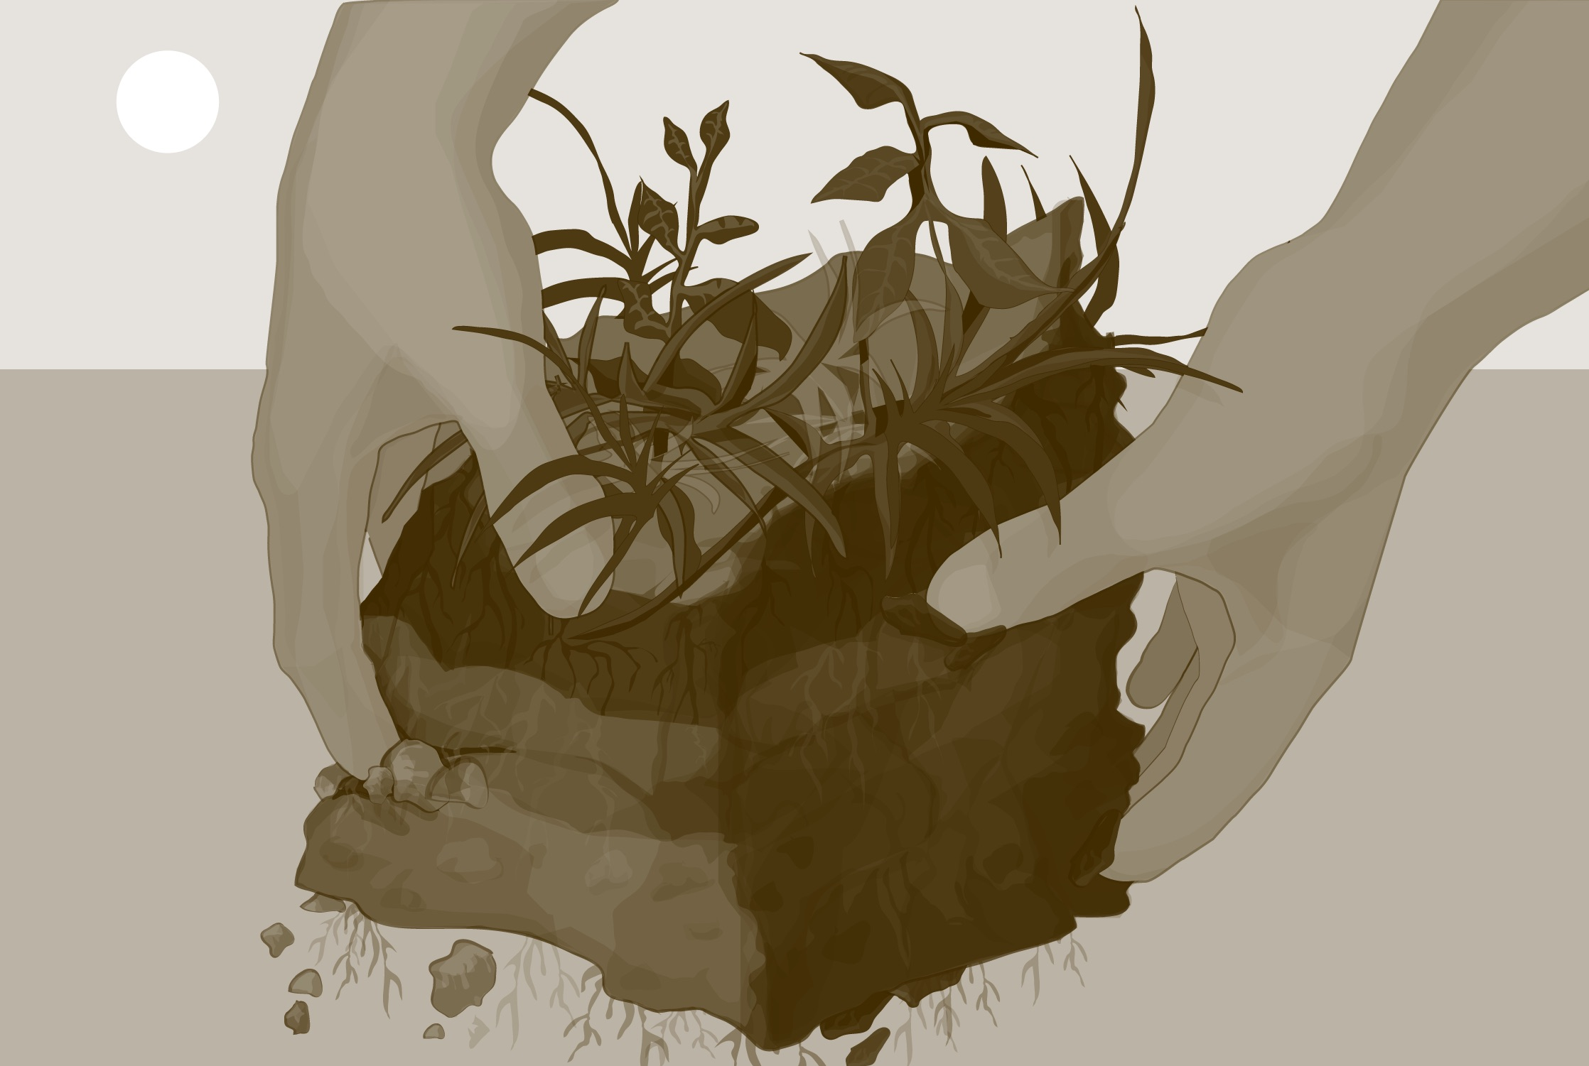

Slide 2
Overview
This module:
Introduces the Soil (Pedosphere) Investigation
Describes soil’s role in the Earth System
Explains how soils form
Provides instructions on how to define soil sites
Explains how to report soil site definitions to GLOBE
Learning Objectives:
After completing this module, you will be able to:
Explain soils important role in the Earth system
Identify soil horizons
Explain the soil forming factors
Define soil moisture and temperature sites
Define soil characterization sites
Report soil site definitions to GLOBE
Estimated Time for Completion of Module: 1.5 Hours

Slide 3
Introduction to the GLOBE Soil Investigation
This slide set supports the GLOBE Soil Investigation protocol area.
You will find all the relevant documents in the GLOBE Teacher’s Guide here.

Slide 4
Looking at Earth from Space, what do we see?

Slide 5
Let’s Zoom In!
To study soil, scientists need to be up close and personal.
That’s where you come in.
With the Pedosphere investigation, you provide the data that no one else can. You help see below the surface.
Without plant cover, most of what we see is soil.
Arabian Peninsula: NASA Sea-viewing Wide
Field-of-View Sensor (SeaWiFS) image

Slide 7
Soil and Water
The amount of water in the soil and how well the soil filters water through greatly affect plant growth, water quality, relative humidity, evaporation, and many other aspects of the Earth System.
The absorbed water is held on soil particle surfaces and in pore spaces between particles. This water is available for use by plants during times of little precipitation.
Some of this water evaporates back into the air; some is transpired by plants; some drains through the soil into groundwater, and some runs off, carrying with it surface particles, causing erosion.

Slide 8
What is a soil profile?

Slide 9
What is a soil profile? 2
This is an example of a soil profile. A soil profile is a series of soil layers below the soil surface that have certain properties because of how the soil was formed.
The layers of a soil are called horizons. Horizons differ from each other by their characteristics such as color, texture, structure, consistence, thickness, and other properties.
Because every soil forms differently, looking closely at them can help us read a story of what has happened at its location.
A Maryland Soil (Photo © Dr. Ray Weil, University of Maryland)

Slide 10
A Soil’s Story 1
If we look at the horizons in this soil profile, we can understand something about the history of what happened here. Notice that there are some layers at the top and then a dark layer called 3C3 in the middle. This soil is located near a stream and each of the horizons above the 3C3 were deposited on top of it when the stream flooded.
Question: We know from special dating techniques that the dark gray substance visible at Horizon 3C3 was deposited here approximately 150-250 years ago over a period of 100 years. What do you think it is?
Answer: It’s ash from forest fires set by farmers practicing slash and burn agriculture. The results of some of that practice of burning down forest to make room for farms were deposited in this soil.
A Maryland Soil (Photo © Dr. Ray Weil, University of Maryland)

Slide 11
A Soil’s Story 2
The nodules showing in the horizon labeled 4C4 were deposited in this stream bed about 250-350 years ago. They are clam and oyster shells.
The people living in this area caught clams, oysters, and fish. These shells were what they left behind.
By reading the horizons in this soil, we have learned that this location was a place where people fished, burned down trees and farmed, and was sometimes flooded by the nearby stream.
A Maryland Soil (Photo © Dr. Ray Weil, University of Maryland)

Slide 12
How Does Soil Form?

Slide 13
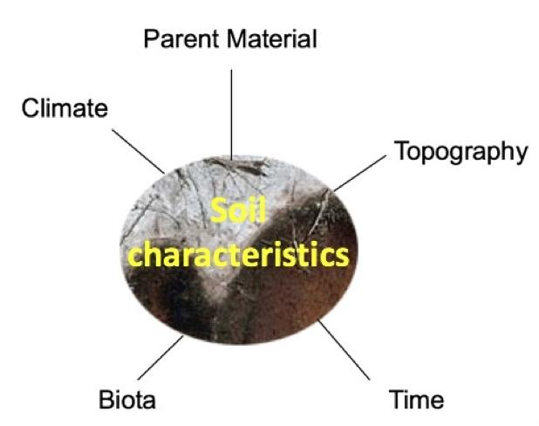
Soil Forming Factors
Forest soil, Florida USA
These five factors work together to create a unique soil profile made of layers called horizons. The characteristics of the soil profile and horizons and the story the soil tells is based on these five soil forming factors. Soil characterization is the way we measure the soil profile characteristics and this information is important to study soil moisture and each of the other parts of the ecosystem.

Slide 14
The Importance of Soil Characteristics
The way the soil forming factor interacts to create a soil profile varies greatly. Each soil profile will have different characteristics and different ways it can be used to grow food, store and filter water, retain heat, produce and exchange gases, build on, and other uses. It is important to know and understand the soil forming factors in order to study soil characterization and soil moisture.
The degree to which the various soil forming factors affect the soil produces the different soil horizons.

Slide 15
The Five Soil Forming Factors Produce Great Variations in Soils.
The degree to which each soil forming factor affects soil formation will vary greatly. That will yield a large variety of soil types. Each soil type will have different characteristics and potential to grow food, store and filter water, retain heat, and produce and exchange gases.
In GLOBE, you can measure the soil characteristics as well as measure the soil temperature, moisture, and the rate at which water infiltrates into the soil.
Courtesy of the Natural Resources Conservation Service

Slide 16
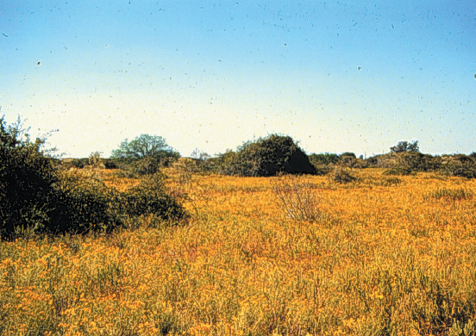
Example of a Grassland Soil Profile
These soils are common in the mid-western USA, and in the grasslands of Argentina and Ukraine. They are usually deep and dark in color, and are among the best soils for growing crops. Their dark color is caused by many years of grass roots dying, decomposing, and building up the organic matter content that allows the soil to hold the water and nutrients needed for excellent plant growth.
Grassland soils sampled in the southern part of Texas in the USA

Slide 17
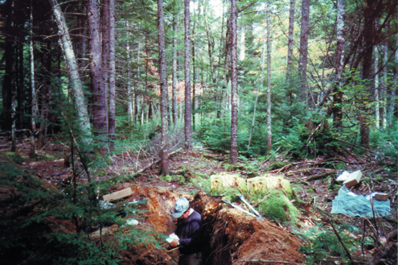
Example of a Forest Soil Profile
Most of the organic matter in this soil comes from the leaves and roots of coniferous trees that die and decompose near the surface. When this decomposed organic matter mixes with rain, acids form that leach, or remove, materials from the top horizons of the soil.
The white layer you see below the dark surface layer was caused by organic acids that removed the nutrients, organics, clays, iron, and other materials in the layer and left behind soil particles that are only mineral in composition.
Below this horizon is a dark horizon that contains materials that were leached from the horizon above and deposited or illuviated. This horizon has a dark color because of the organic matter deposited there.
The next horizon has a red color due to iron oxide brought in from the horizon above and coating the soil particles. The horizon below this one has fewer or different types of iron oxides coating the inorganic soil particles creating a yellow color.
The lowest horizon in the profile is the original parent material from which the soil formed. At this site, the parent material is a sandy deposit from glaciers. At one time, the whole soil looked like this bottom horizon, but over time, soil-forming processes changed its properties.
Soil formed under a forest in far eastern
Russia, near the city of Magadan

Slide 18
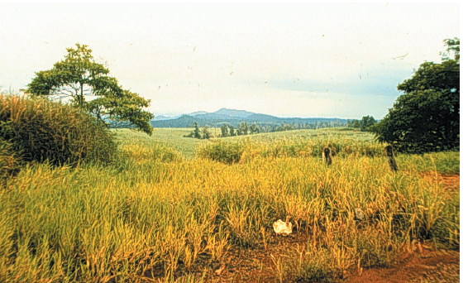
Example of a Tropical Soil Profile
Notice the bright red colors and the depth to which the soil is uniform. It is very difficult to distinguish unique horizons. Hot temperatures and lots of rain help to form weathered soils like this. In tropical climates, organic matter decomposes very quickly and transforms into inactive material that binds with clay. Most of the nutrients have been leached from this soil by intense rainfall. Left behind are weathered minerals coated by iron oxides giving the soil its bright red color.
Tropical environment in Northern Queensland, Australia

Slide 19
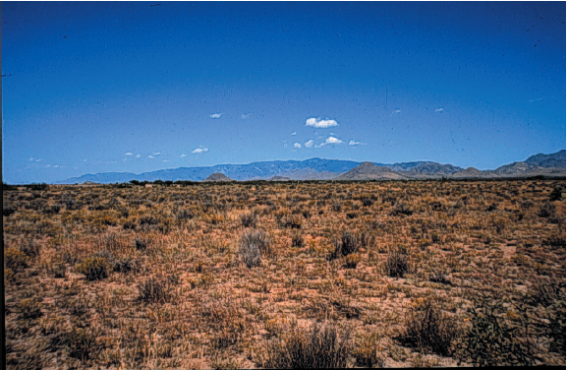
Example of a Soil Profile Formed under Very Dry Conditions
A light brown horizon at the surface is often found in environments where organic matter is limited. High amounts of organic matter form dark soils. In dry places, organic matter is not returned to the soil because very little vegetation grows there. When rainfall does occur in this environment, the sandy texture of the soils allow materials to be carried downward into the lower horizons of the profile. The white streaks near the bottom of this profile are formed from deposits of calcium carbonate that can become very hard as they accumulate over time.
Soil formed under very dry or arid conditions in New Mexico, USA

Slide 20
Example of a Soil Profile Formed under Wet Conditions
Wet soils are found in many parts of the world. The surface horizon is usually dark because organic matter accumulates when the soil is saturated with water. When these conditions occur, there is not enough oxygen for organisms to decompose the organic material.
Colors of the lower horizon are usually grayish. Sometimes, as in this picture, the gray soil color has orange or brown streaks within it, which are called mottles.
The gray colors indicate that the soil was wet for a long period of time, while the mottles show us where some oxygen was present in the soil.
Wet soil sampled in Louisiana, USA

Slide 21
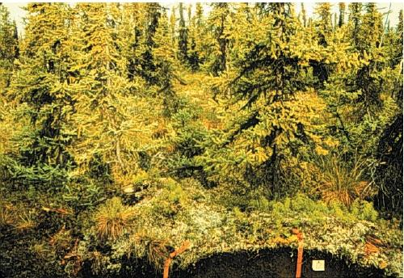
Example of a Soil Profile Formed in a Very Cold Climate
The “hummocky” or wavy surface of this soil is caused by freezing and thawing of water stored in the soil year after year. The black zones indicate places where organic materials have accumulated during freezing and thawing cycles. The process of freezing and thawing and churning of the soil is called cryoturbation. This soil is not very developed and has only slight indications of horizons that can be seen by faint color differences. At the bottom of the profile is a layer called permafrost, which consists of ice, soil, or a mixture of both. The permafrost layer stays below 0˚C throughout the year. The dark, thick organic material in this soil accumulates because decomposition is very slow in cold climates.
Soil formed under a very cold climate near Inuvik in the Northwest Territory of Canada

Slide 22
GLOBE Soil Protocols 1
The characteristics of a soil profile usually change slowly over centuries as the soil forms, but human activity can cause rapid changes.
Soil properties such as temperature and moisture content can change quickly, particularly near the surface.
GLOBE protocols are different depending on the rate at which the property being measured changes.

Slide 23
GLOBE Soil Protocols 2

Slide 24
Soil Protocols
Soil Characterization
Usually measured only once at Soil Characterization Sites with horizon definition, field observations, sample collection, and lab measurements
Soil Temperature & Soil Moisture
Measured repeatedly at Soil Moisture and Temperature Sites
Different protocols for different measurement techniques
Infiltration
Measured: Occasionally at Soil Moisture and Temperature Sites and once at Soil Characterization Sites

Slide 25
Soil Characterization Sampling Options

Slide 26
Defining a Soil Site Introduction
Before you conduct your Soil Investigation, you must define either your:
Soil Characterization Site or Soil Moisture and Temperature Site.
In both cases, in GLOBE you can provide either basic or more detailed, supplemental information describing your study site.
Image courtesy, Izolda Trakhtenberg

Slide 27
How to Define a Soil Site

Slide 28
Choosing a Location: Considerations
What is near your site?
Is the site under ground cover similar to the rest of the landscape and relatively undisturbed?
Is it at least 3 meters from buildings, roads, paths, and playing fields?
If so, good. If not, be sure to report the exceptions as part of your site definition.
Lawns, agricultural sites, or other managed landscapes are acceptable if this is the cover that is located at the atmosphere and/or soil moisture and temperature measurement sites.
Image courtesy, Izolda Trakhtenberg

Slide 29
Determine Slope of a Site
To identify the greatest slope across your site’s location use a clinometer.
Two people whose eyes are at about the same height should measure the slope.
Two people whose eyes are at about the same height standing on a horizontal plane looking at each other through the straw on a clinometer should get a 0° angle reading.
If those same people stand on the greatest slope across the Soil Sample Site, the reading on the clinometer will give the angle of slope.
Illustrations courtesy, Rich Potter

Slide 30
Defining the Aspect of a Soil Site
Aspect is the direction of the steepest slope across the soil site.
This information indicates how the sun will influence soil properties.
To determine aspect:
1. Face up the steepest slope across the exposed soil area.
Illustrations courtesy, Rich Potter

Slide 31
Reading a Compass
2. Hold the compass in your hand so that the red arrow is lined up with the North position on the compass.
3. Read the number on the edge of the compass housing (which can range from 0 to 360). This aspect is 28°.

Slide 32
Defining Soil Site Landscape Position
The Landscape position, along with slope and aspect, give information about the soil forming factor topography that greatly influences the formation of the soil.
The landscape position describes where a site is located on the contours of the land.
Landscape position, along with slope and aspect give information about the processes that formed this soil.
In your site description your will identify on which part of the landscape your soil site is located, and report this as part of your Soil Site definition.

Slide 33
Defining the Cover Type of a Soil Site
Cover type is a description of the vegetation (another important soil forming factor) or other material (such as gravel, cement, mulch, etc.) on the surface. Describe and record the cover type of the site (Bare Soil, Rocks, Grass, Shrubs, Trees, or Other).

Slide 34
Landscape Photos
Observe and describe your site. Record its characteristics and take some photos.
Take landscape photographs of the site to the North, East, South, and West of the profile.

Slide 35
Defining a Soil Characterization Site

Slide 36
Choosing a Soil Characterization Site
A Soil Characterization Study Site may be located anywhere you can safely expose the soil profile. It is useful to have a site near your Soil Moisture and Temperature Study Site and within your Land Cover study site.
Images courtesy, Izolda Trakhtenberg

Slide 37
Orienting your Site Relative to the Sun
When you choose a location for your soil profile, pick an orientation so that the sun will shine on the profile when you conduct your observations and make measurements. Check to make sure there are no shadows on the profile.

Slide 38
Describe Land Use
How is the land used? Is it a natural or wilderness environment, urban, agricultural, recreational or other?

Slide 39
Recording other Features
Measure and record the distance between the soil profile and major features at the site (such as a house or swing set or basketball court or any other feature). Any other information or metadata about the site that does not fit into any of the above categories should also be recorded as metadata.
Once you have completed the Supplemental Information, you can continue to explore and make observations about the properties of your soil profile. If you are also conducting Land Cover and/or Soil Moisture measurements, you may want to select another position to perform an additional soil profile characterization.

Slide 40
Defining a Soil Moisture and Temperature Study Site

Slide 41
Defining a Soil Moisture Study Site
Record these properties at your Soil Moisture Study Site :
Describe the surface: vegetation, plowed, etc.
Describe Canopy Cover.
Describe surface vegetation cover.

Slide 42
Soil Moisture Sampling Options

Slide 43
How to Report Data to GLOBE

Slide 44
Entering a Soil Sample Site Definition - Step 1

Slide 45
Entering a Soil Sample Site Definition - Step 2

Slide 46
Entering a Soil Sample Site Definition - Step 3

Slide 47
Entering a Soil Sample Site Definition – Step 4

Slide 48
Entering a Soil Sample Site Definition – Step 5

Slide 49
Soil Characterization Site Definition Example

Slide 50
Entering Supplementary Information

Slide 51
Entering Supplementary Information-2

Slide 52
Response to Data Entry

Slide 53
The Soils on Planet Earth
By studying the soil in your area and reporting these data to GLOBE, you will make an invaluable contribution to our knowledge of planet Earth.
As you take your soil measurements, remember that you are likely the only ones who will study your specific soil. For much of this critical information, there exists no other way to study the soil in your community. Your contribution to science will be important and unique.

Slide 54
Frequently Asked Questions (FAQs) 1
How often should I conduct the soil protocols?
It depends on which soil property you are examining. Soil properties change over time on different timescales. Properties such as temperature, moisture content, and local composition of air change over a period of minutes or hours. Other properties change over months or years, including soil pH, soil color, soil structure, bulk density, soil organic matter, soil fertility, and the microorganisms, animals and plants in the soil. Over much longer timescales, that is, tens to hundreds and thousands of years, changes in mineral content, particle size distribution, horizons and particle density take place. These last measurements you need to do only once.

Slide 55
Frequently Asked Questions (FAQs) 2
How can I use soil protocols in my classroom?
The GLOBE Implementation Guide provides an example of a classroom soil unit and many tips for using GLOBE investigations to meet your curriculum requirements.
More Information:
The GLOBE Program
NASA Wavelength NASA’s Digital Library for Earth and Space Science Education
NASA Global Climate Change: Vital Signs of the Planet

Slide 56
Please provide us with feedback about this module. This is a community project and we welcome your comments, suggestions and edits! Comment here: eTraining Feedback Questions after reviewing this module? Contact GLOBE: help@nasaglobe.org
Credits:
Slides: Izolda Trachtenberg, Dixon Butler, Russanne Low
Photographs: Izolda Trachtenberg
Soil Profile Photos: Dr. John Kimble and Sharon Waltman, USDA Natural Resources Conservation Service, National Soil Survey Center, Lincoln, Nebraska ,
Illustrations: Rich Potter
Cover Art: Jenn Glaser, ScribeArts
The GLOBE Program is sponsored by these organizations:
Version 3/6/20. If you edit and modify this slide set for use for educational purposes, please note “modified by (and your name and date)“ on this page. Thank you.

