Slide 2
Overview
This module…
teaches why carbon is an important element in ecosystems and how it cycles through ecosystems.
demonstrates how carbon is stored in and transferred between the biosphere, geosphere, atmosphere, and hydrosphere.
explains how humans have disrupted the natural carbon cycle, including rates of transfer between spheres.
explains how increases in atmospheric CO₂ impact climate.
highlights four introductory Learning Activities.

Slide 3
Learning Objectives
After completing this module, you will be able to:
diagram the major pools and fluxes of the carbon cycle at a global scale.
provide examples of the role of humans in the global carbon cycle.
explain how carbon is stored in and passed between living & non-living things in terrestrial ecosystems.
describe two ways in which environmental conditions impact carbon flows through ecosystems.
Estimated time to complete module: 2 hours

Slide 4
The Biosphere
The Biosphere is comprised of all living things on Earth. GLOBE has several ways to explore and measure components of the biosphere through investigations about one of the most fundamental elements for life on Earth – carbon. Carbon also plays a critical role in regulating the Earth's climate system.
Through the burning of fossil fuels and land use change, humans have disrupted the carbon cycle and are now the dominant cause of global climate change.
The GLOBE Carbon Cycle Project consists of four major categories:
(1) Introductory Learning Activities
(2) Classroom experiments (Plant-A-Plant)
(3) Field Measurements (Protocols)
(4) Modeling

Slide 5
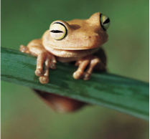
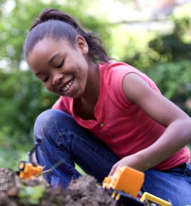
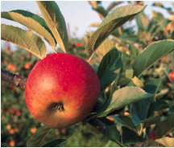
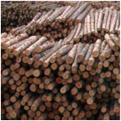
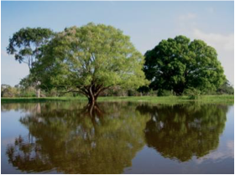
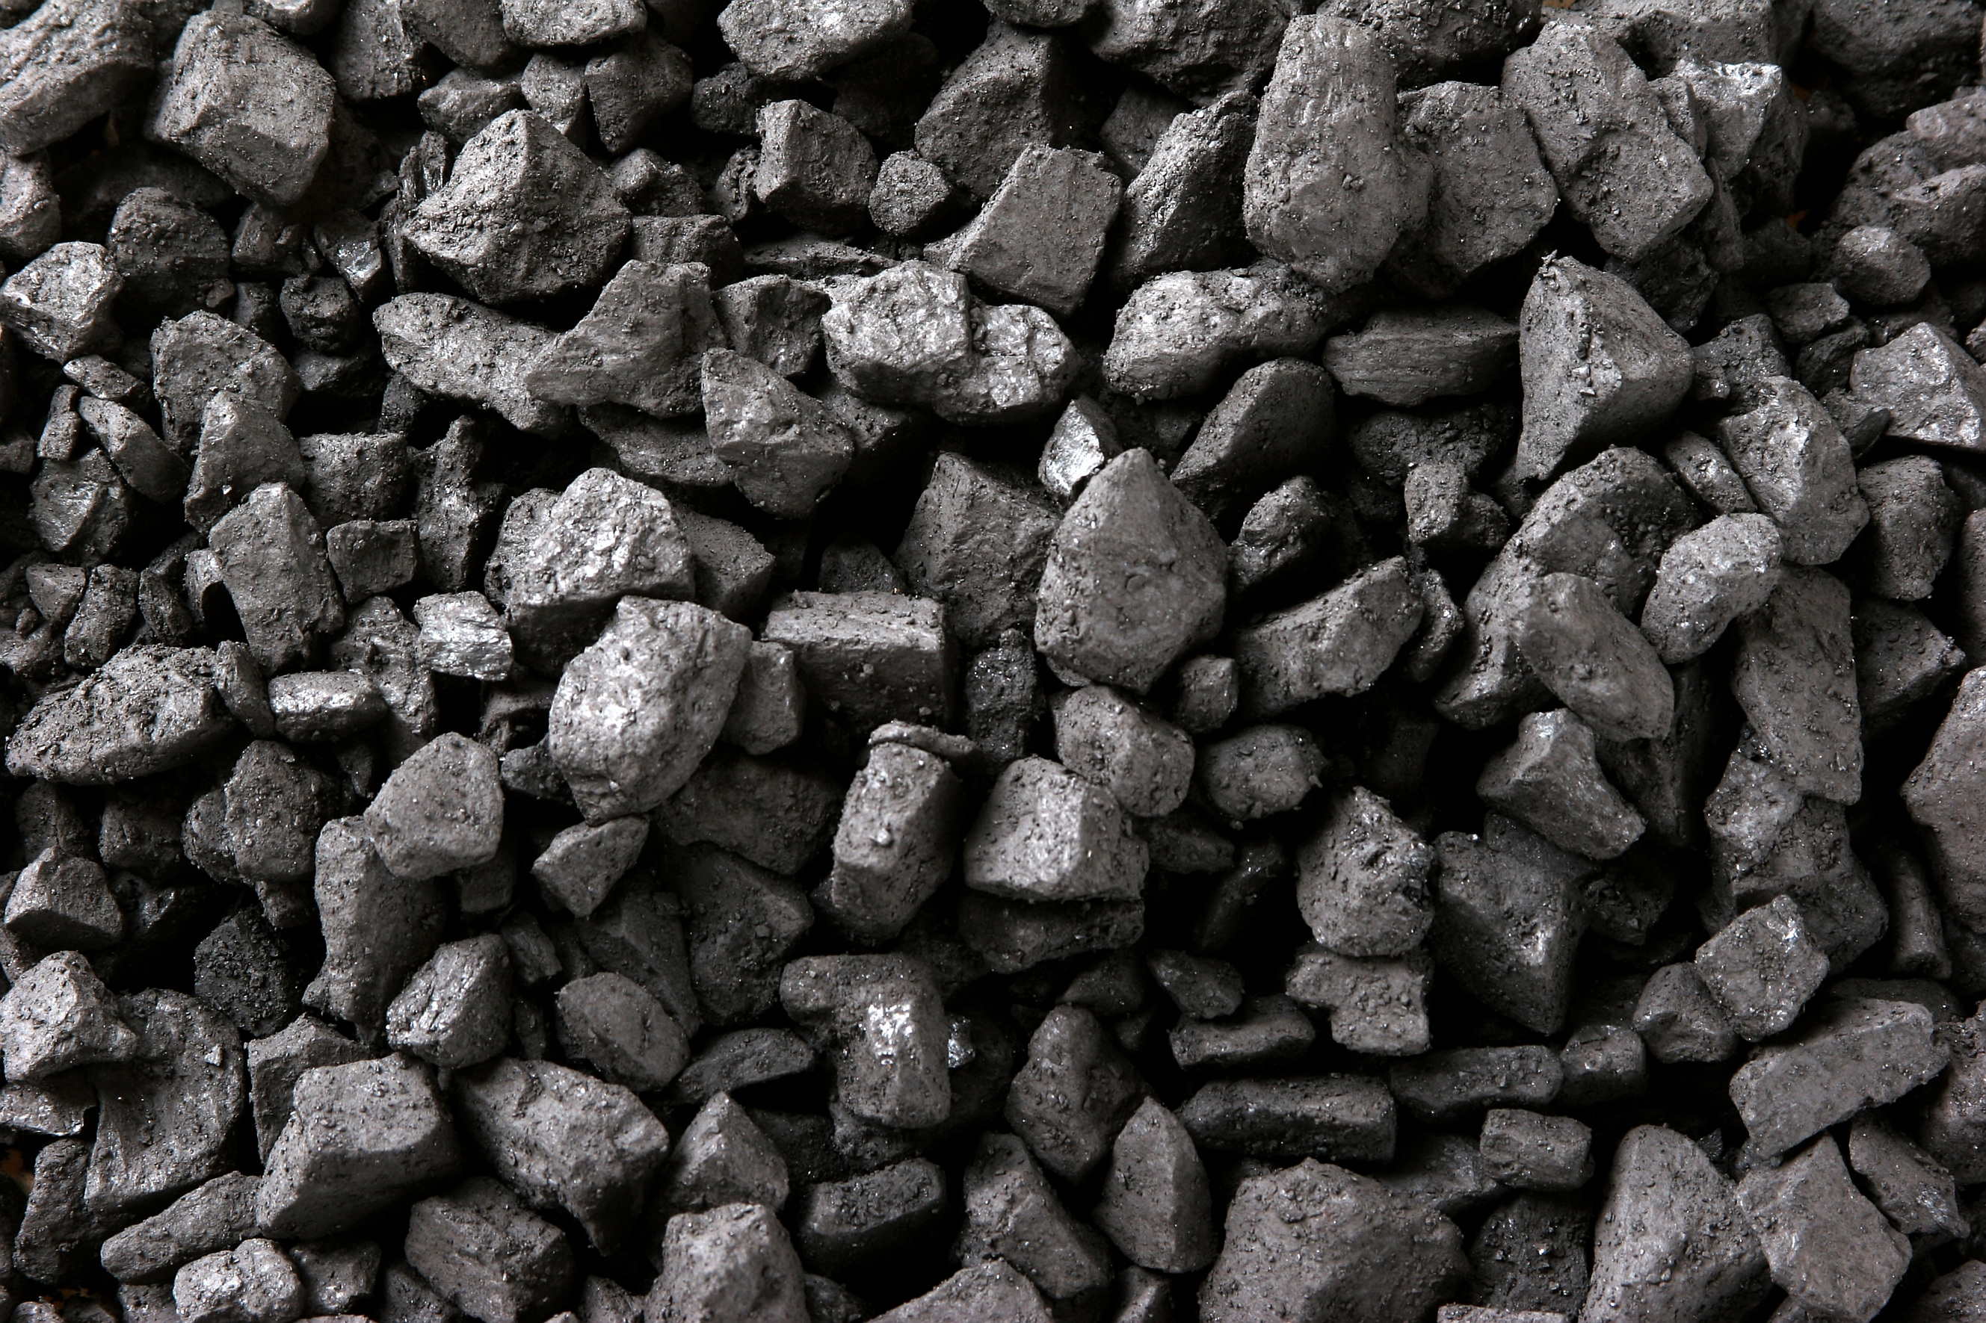
Carbon: A building block of life
The most abundant element in living things
Accounts for 45-50% of the total mass of the biosphere
Also present in the Earth’s atmosphere, soil, oceans, and crust

Slide 6
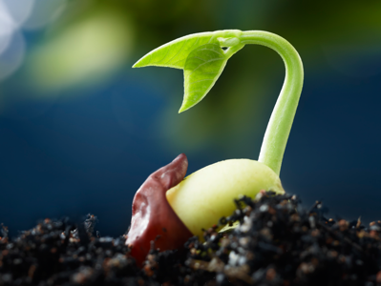
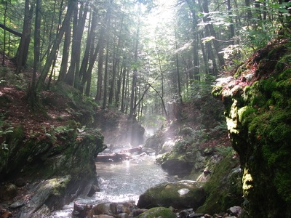
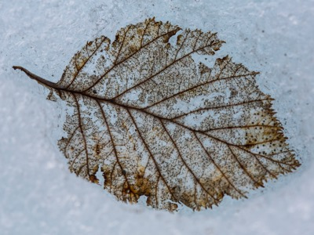
What is the Carbon Cycle?
The global carbon cycle characterizes the movement of carbon between Earth’s spheres. It is a key regulator of Earth’s climate system and is central to ecosystem function. Rising CO₂ is the dominant contributor to climate change. Understanding how ecosystems cycle and store carbon is key to understanding solutions to climate change.

Slide 7
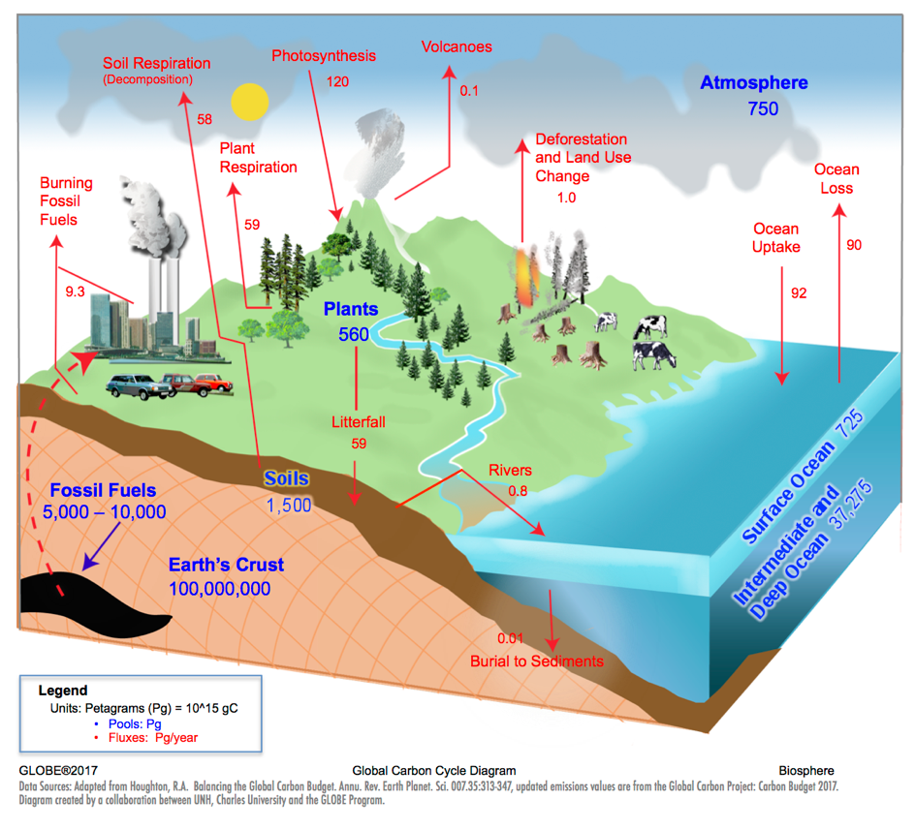
The Carbon Cycle
Carbon Pools:
A place where carbon resides, measured in Petagrams (Pg)
Carbon Fluxes:
Movement of carbon between pools, measured in Petagrams/year
(Pg/year)

Slide 8
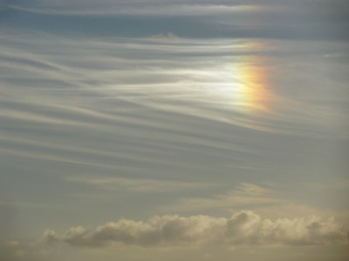
How does the biosphere affect atmospheric carbon dioxide (CO₂) concentrations?
Photosynthesis
CO₂ + H₂O → C₆H₁₂O₆ + O₂
Biosphere
Atmosphere
Respiration
C₆H₁₂O₆ + O₂ → CO₂ + H₂O

Slide 9
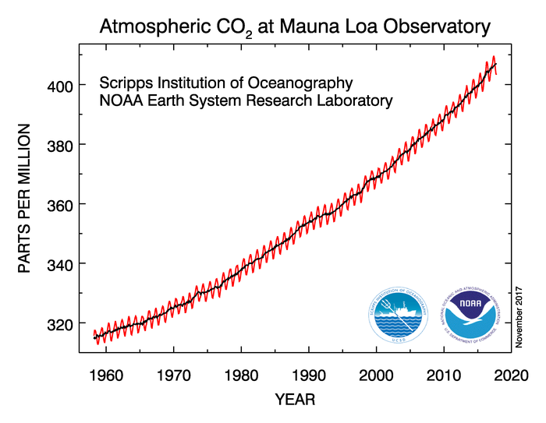
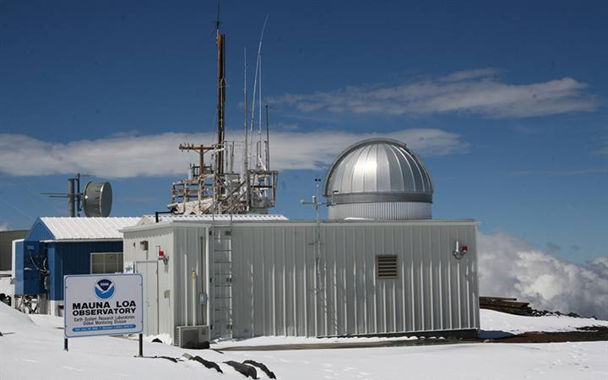
Monthly records of atmospheric CO₂ have been collected at Mauna Loa, Hawaii since 1958.
red – monthly CO₂ showing seasonal cycle
black – long-term trend, adjusted for seasonal cycle
Image: ersl.noaa.gov

Slide 10
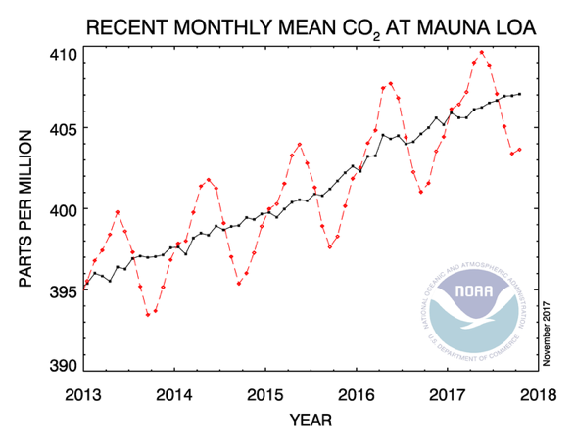
A closer look at several years of CO₂ concentrations reveals a zig-zag pattern, a seasonal cycle.
Image: ersl.noaa.gov

Slide 11

The “rising arm” of the zig-zag coincides with periods when respiration exceeds photosynthesis, in other words, the biosphere is releasing more CO₂ to the atmosphere than it is absorbing.
Respiration
C₆H₁₂O₆ + O₂→ CO₂ + H₂O
May
September
Image: ersl.noaa.gov

Slide 12
The “falling arm” of the zig-zag coincides with periods when photosynthesis exceeds respiration, in other words, the biosphere is taking up more CO₂ from the atmosphere than it is releasing.
Photosynthesis
CO₂ + H₂O → C₆H₁₂O₆ + O₂
May
September
Image: ersl.noaa.gov

Slide 13
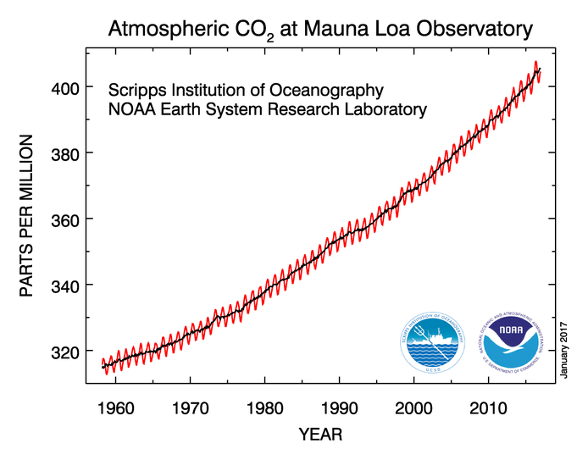
The long-term trend shows an increase in CO₂ of 1-3 parts per million per year since 1958.
increasing trend
Image: ersl.noaa.gov

Slide 14
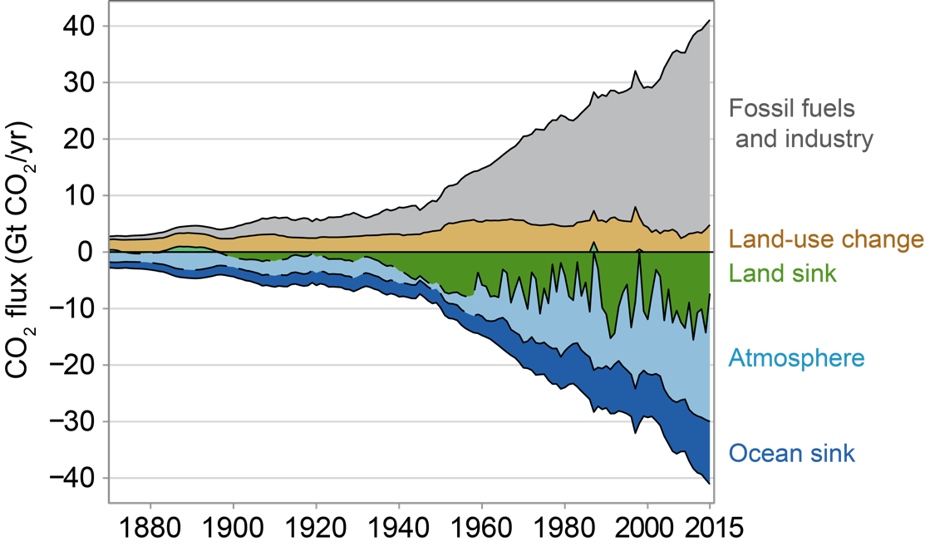
Increases in atmospheric CO₂ are primarily from the burning of fossil fuels.
Image: La Quere et al. 2016, Figure 3

Slide 15
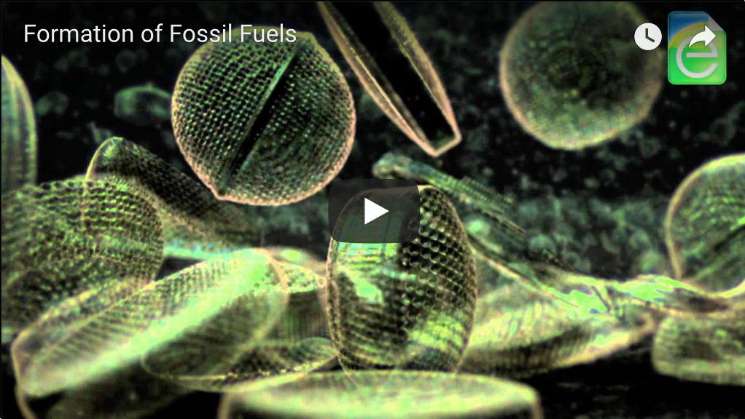
Fossil fuels come from organic material that was buried and deposited millions of years ago.
Link to video if it does not play in PowerPoint:
http://earththeoperatorsmanual.com/feature-video/earth-the-operators-manual

Slide 16
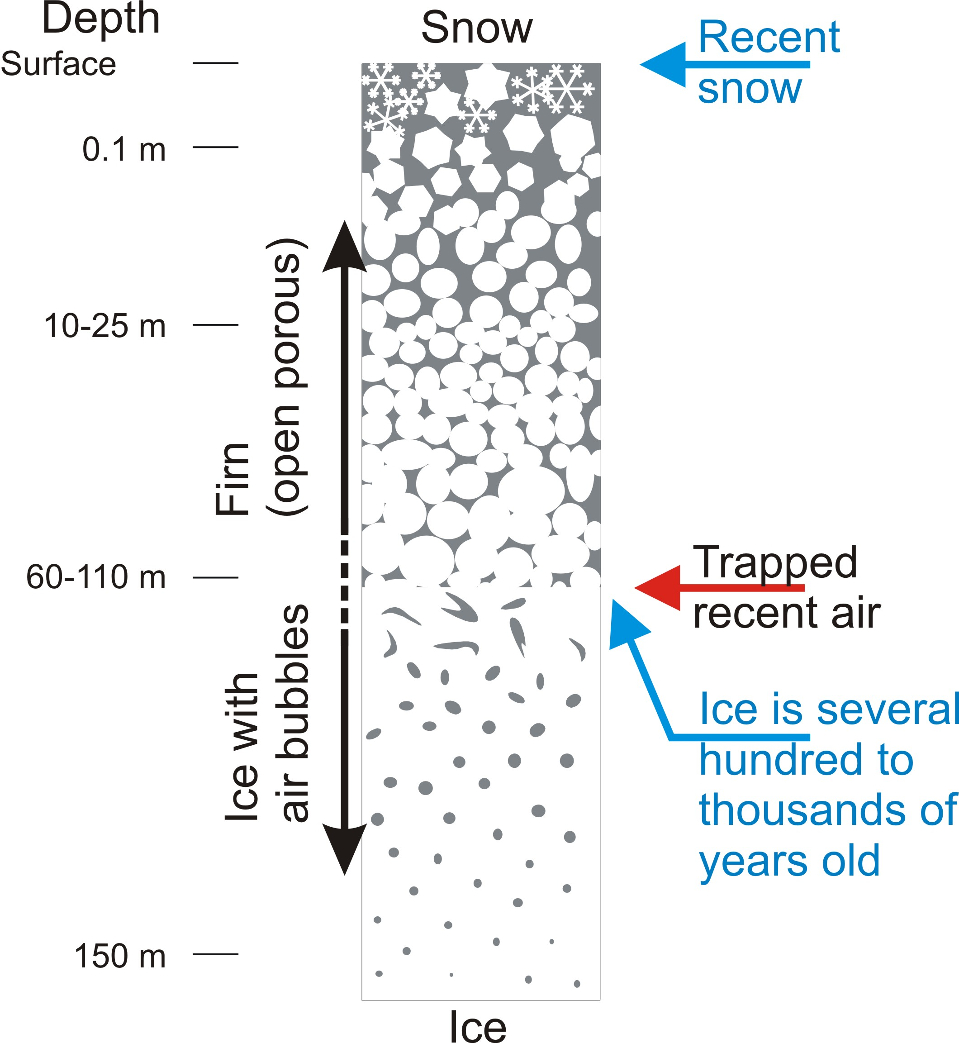
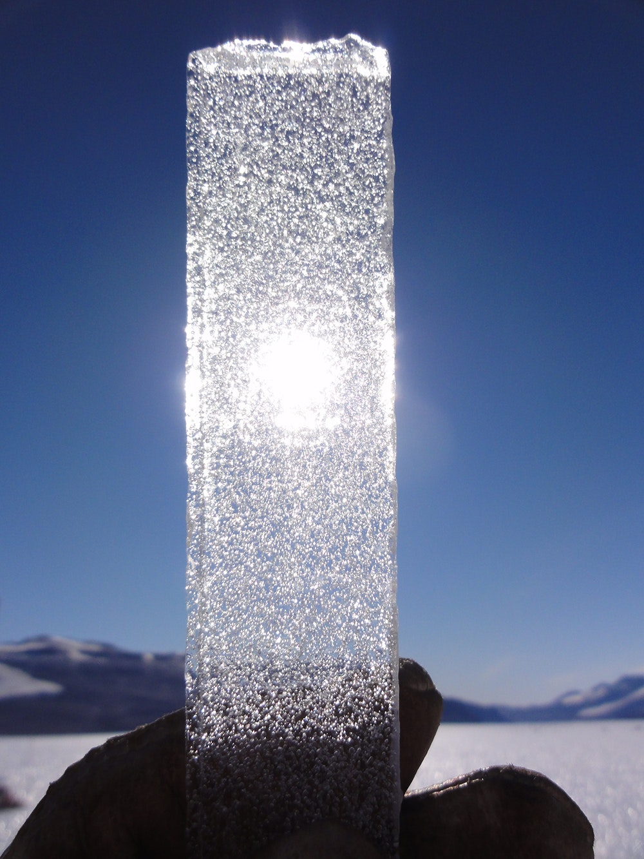
Ice cores trap ancient atmosphere in tiny bubbles.
Image: Bernhard Bereiter
Image: Niels Bohr Institute

Slide 17
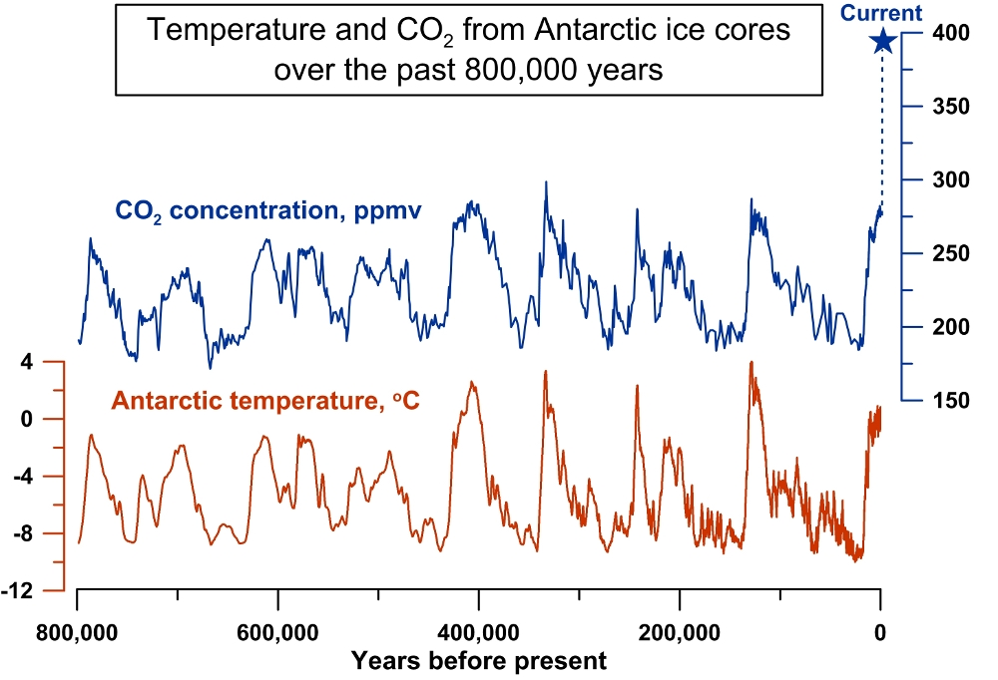
From ice cores, we know atmospheric CO₂ is higher today than it has been in the past 800,000 years.
Image: Jeremy Shakun/Harvard University

Slide 18
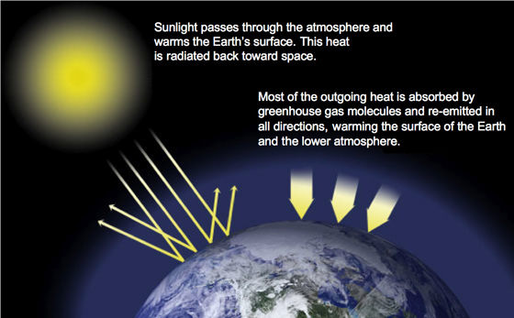
Carbon dioxide is a greenhouse gas. It traps heat in the atmosphere and warms the Earth.
Image: NASA

Slide 19
Increases in atmospheric CO₂ have contributed to a rise in Earth’s temperature.
The term
temperature anomaly
means a departure from a reference value or long-term average, in this case 1951-1980. A positive
anomaly
indicates that the observed
temperature
was warmer than the reference value.

Slide 20
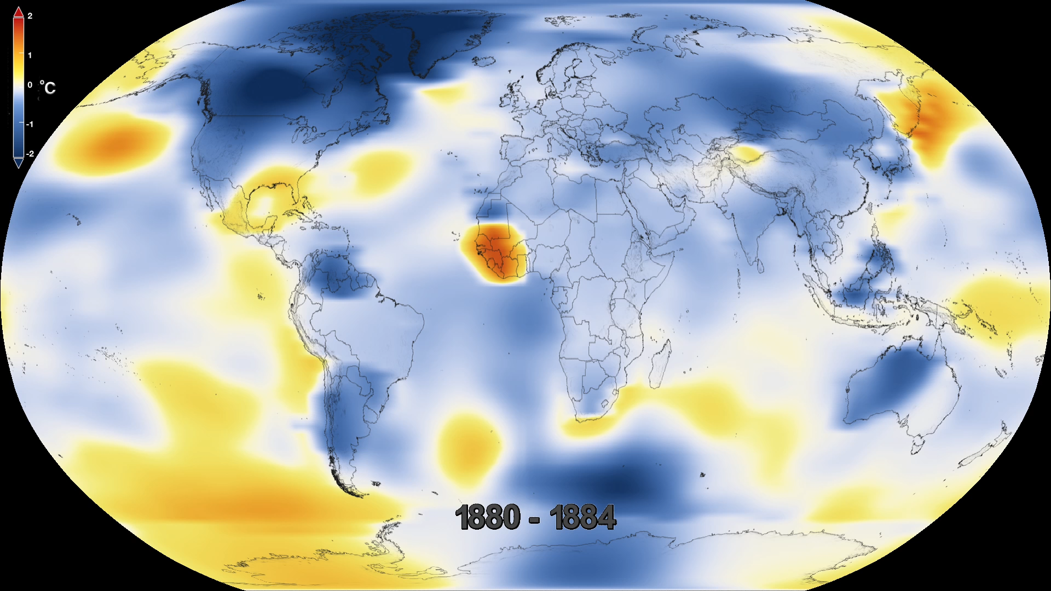
Increases in atmospheric CO₂ have contributed to a rise in Earth’s temperature.
Movie: NASA Scientific Visualization Studio

Slide 21
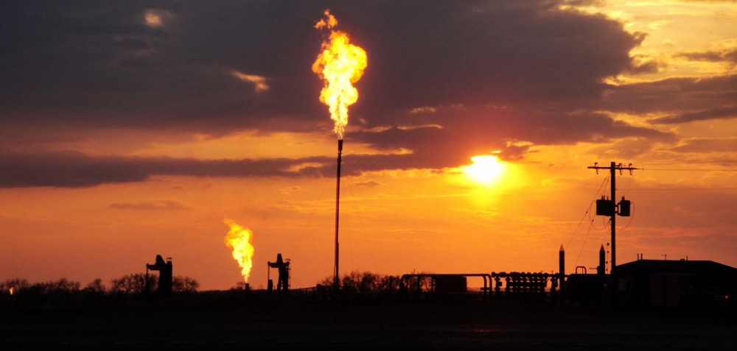
Why Collect Carbon Cycle Data?
The carbon cycle is no longer in balance due to human activities, specifically burning fossil fuels and land use change. CO₂ concentrations in the atmosphere are over 40% higher than the natural range over the past 800,000 years.

Slide 22
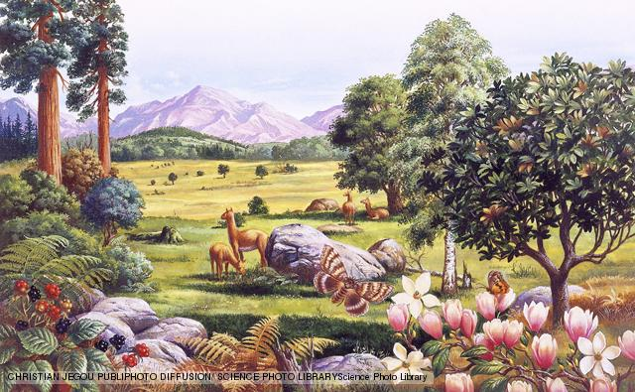
Why Collect Carbon Cycle Data?
The last time in Earth’s history CO₂ levels were this high was over
3 million years ago, during the mid-Pliocene Warm Period. The increase in atmospheric CO₂ occurred over thousands of years. Sea level was
5-20 m higher, global air temperatures were 4ºC warmer, and global sea surface temperatures were 2ºC warmer. Today, we are increasing atmospheric CO₂ at a rate faster than we’ve ever seen in the geologic record.

Slide 23
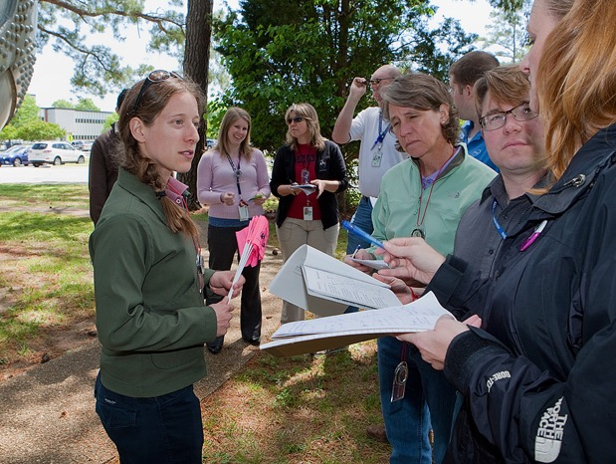
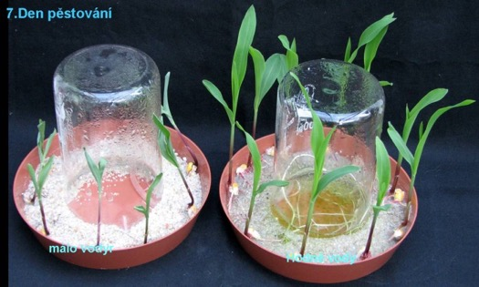
Why Collect Carbon Cycle Data?
Scientists collect carbon cycle data to understand how terrestrial ecosystems will respond to warmer temperatures and higher CO₂. Carbon cycle data collected with GLOBE will contribute to a better understanding of the relationship between carbon storage in plants and surface climate.
Photo: Czech Republic Carbon Cycle Team
Photo: GLOBE UCAR Team

Slide 24
Your measurements can help scientists! They can:
help local scientists see how changes in the landscape are affecting carbon storage in their region.
help scientists improve on the ground estimates of current carbon storage.
be used as a validation method for satellite estimates of carbon storage.

Slide 25
Introductory Activities
The GLOBE Carbon Cycle materials include learning activities that introduce students to systems thinking, carbon, and the carbon cycle.
If these concepts are new to your students, they are highly recommended prior to conducting field protocols or modeling activities. The activities include:
Paperclip Simulation: introduction to systems thinking and using the '1-box model'
Carbon Cycle Adventure Story: follow a carbon atom through the carbon cycle
Carbon Travels Game: follow a carbon atom as it travels through the Earth's carbon pools
Getting To Know Global Carbon: learn the basics of the carbon cycle through diagrams

Slide 26
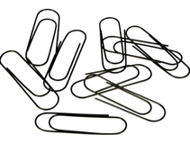
Introductory Activities
Paperclip Simulation - Introduction to Systems Thinking
(60 minutes + 30 math extension).
Student Outcomes:
Simulate a basic system
Collect, record, and analyze data
Create a 1-box model to learn modeling and system terms
Manipulate variables to obtain an expected outcome
Materials:
Simulation materials: paperclips, bell, signs, and roles
Class Data Table (paper OR .xls) and Projector AND/OR Whiteboard/large paper with markers
Student Worksheets & Paper Clip Simulation Data Table

Slide 27
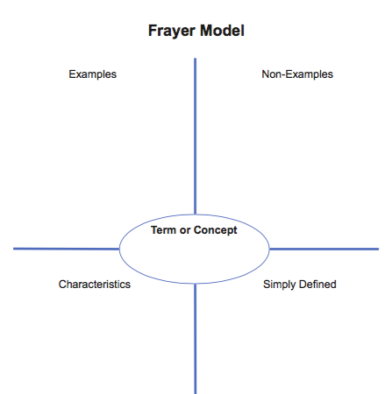
What is a System?
Definition: A collection of interconnected parts that function as a complex whole, through which matter cycles and energy flows.
Why does GLOBE use a ‘systems thinking’ approach to understand the Carbon Cycle?
1. Systems are an important unifying concept across the K-12 curriculum.
2. The actual carbon cycle is extremely complicated. Simplifying it as a system that focuses on the most important elements can help us understand why the atmosphere is changing and what it might look like in the future.
**Use the Frayer Model template to help students define the word ‘system’

Slide 28
Modeling Systems with the 1-Box Model
The 1-box model represents an individual component of a system. It introduces concepts like inputs, outputs and residence time and shows how these can produce particular patterns of change over time.
In the GLOBE Carbon Cycle Learning Activities, students use the 1-box model to diagram and manipulate movement of matter through systems.
Input Flux
(per unit time)
Pool
Output Flux
(per unit time)
*A pool can also be referred to as a stock or reservoir, a flux can also be referred to as a flow.

Slide 29
Modeling Systems with the 1-Box Model
The 1-box model can be used to represent many different systems.
In the paperclip factory simulation to understand the components of a system:
Production
Store Inventory
Purchases
Or to model parts of the Global Carbon Cycle:
Photosynthesis
Plant Pool
Respiration

Slide 30
Putting many '1-Box Models' together makes a box and arrow model that shows how individual components of an entire system are connected.
Putting together many boxes (pools) and arrows (fluxes) allows you to model the movement of matter through more complex systems. For example, the model below shows the movement of carbon through the Atmosphere, Soil and Plant Pools of the Carbon Cycle:
Atmosphere Pool
Soil Respiration
Plant Respiration
Photosynthesis
Litterfall
Soil Pool
Plant Pool

Slide 31
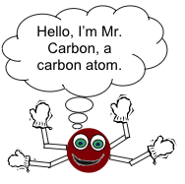
Introductory Activities
Carbon Cycle Adventure Story – Follow a carbon atom through the carbon cycle in a self-guided adventure story (60-90 minutes).
Student Outcomes:
List major pools and fluxes of the carbon cycle
Diagram the carbon cycle using box and arrow models
Describe what components of the carbon cycle make it a system
Materials:
Carbon Cycle Adventure Story booklets (one per student or pair)
Carbon Story Journey Table (one per student or pair)
White board, chalk board, large paper, or overhead projector & markers/chalk

Slide 32
Introductory Activities
Carbon Travels Game – roll the dice to determine the fate of a carbon atom as it travels through Earth’s carbon pools (60-120 min)
Student Outcomes:
Research a specific carbon pool and present to peers
List all major pools and fluxes in global carbon cycle
Define residence time
Compare and contrast the carbon cycle pre- and post-1700
Materials:
Resources about carbon cycle
Large sheets of paper
Carbon Cycle Station Instructions and Signs
Journey Table (1 per student)
1 six-sided die per student or station

Slide 33

Introductory Activities
Getting to Know Global Carbon – learn the basics of the carbon cycle through diagrams (70-100 min)
Student Outcomes:
Create diagrams of complex systems
Conceptualize 1 Pg of carbon
Describe why the carbon cycle is not in equilibrium
Materials:
White board, chalk board, large paper or overhead projector & markers/chalk
Materials for students to draw their own carbon cycle diagram
Global Carbon Cycle Diagram – student copies or projected image

Slide 34
Quiz Questions
Challenge yourself to answer these questions and check whether you have achieved the learning objectives of this module.
What is the carbon cycle?
What is the difference between pools and fluxes?
What are the major pools of carbon in the Earth System? Which contain the most carbon? The least?
Why is studying the carbon cycle important?
When atmospheric carbon dioxide concentrations increase, what happens to Earth’s temperature?
Does photosynthesis add or remove carbon from the atmosphere? Does respiration add or remove carbon from the atmosphere?
What process has caused the most recent (past 150 years) increase in atmospheric carbon dioxide?
What activity could you use to introduce students to systems thinking?
What is a system?
What is a 1-box model? What are two examples of a 1-box model?

Slide 35
NASA’s A Breathing Planet, Off Balance Article and Video:
https://www.nasa.gov/feature/goddard/carbon-climate
NASA Global Climate Change Website:
https://climate.nasa.gov/
NASA Scientific Visualization Studio
(https://svs.gsfc.nasa.gov)
Global Carbon Project
(http://www.globalcarbonproject.org)
  Global Carbon Atlas
  (http://www.globalcarbonatlas.org)

