Slide 1
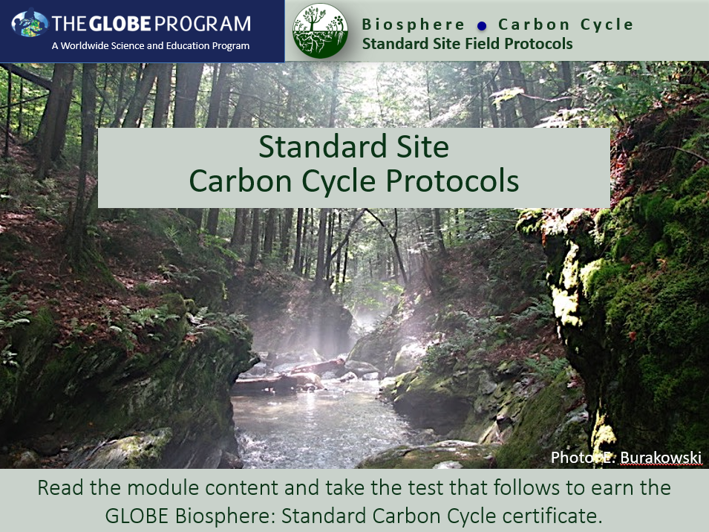
Slide One

Slide 2
Overview
This module…
Reviews why carbon is an important element in ecosystems and how it cycles through ecosystems
Shows how to determine if you have a standard or non-standard site.
Demonstrates how to set up a standard sample site
Provides step-by-step instructions for protocols
Describes how to enter data on the GLOBE website
Helps you understand your data

Slide 3
Learning Objectives
After completing this module, you will be able to:
Describe the major pools and fluxes of the carbon cycle
Perform field measurements to assess carbon storage and plant growth at a local field site and upload data to the GLOBE database
Understand resources available to help you analyze and interpret your data
Estimated time to complete module: 2 hours

Slide 4
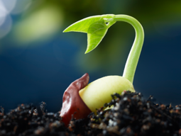
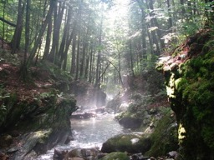
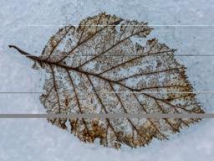
Review: What is the Carbon Cycle?
Carbon is the most abundant element in living things. It is also present in the Earth’s atmosphere, soil, oceans, and crust. The Global Carbon Cycle is the movement of carbon between the atmosphere, land, and oceans.
The global carbon cycle is a key regulator of Earth’s climate system and is central to ecosystem function. Rising CO₂ is the dominant contributor to climate change. Understanding how ecosystems cycle and store carbon is key to understanding solutions to climate change.

Slide 5
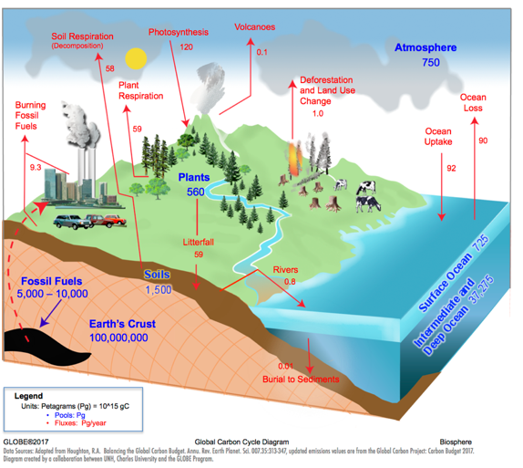
Review: The Carbon Cycle
Carbon Pools:
A place where carbon resides, measured in Petagrams (Pg)
Carbon Fluxes:
Movement of carbon between pools, measured in Petagrams/year
(Pg/year)

Slide 6
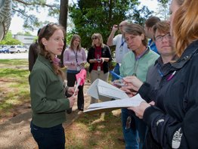
Review: Why Collect Carbon Data?
Scientists collect carbon cycle data to understand how terrestrial ecosystems will respond to warmer temperatures and higher CO₂.
Your observations are valuable contributions to the scientific community and may be used by educators, students, researchers, and the general public to increase environmental awareness and STEM literacy, as well as advance Earth system science.

Slide 7
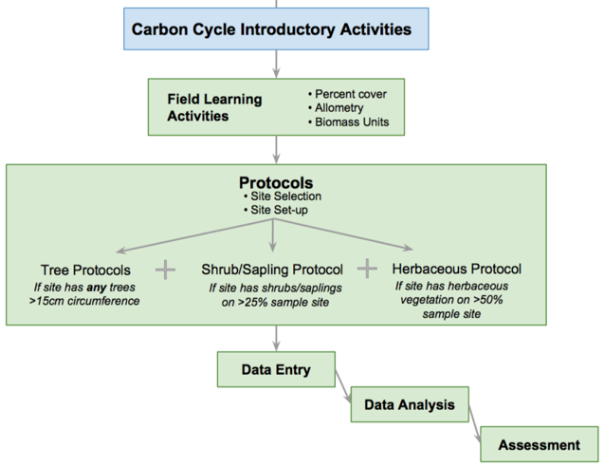
Field Protocols Flowchart

Slide 8
Example Research Questions
There are many research questions that can be explored through carbon field measurements. Below are some examples:
How much carbon is stored in the vegetation near my school?
Do different vegetation types store different amounts of carbon?
How does the uptake of carbon by schoolyard vegetation compare to the emissions of carbon by the school (carbon footprint)?
Is there more carbon stored in the global human population or trees in [MY STATE]?
What is the pattern in which biomass and carbon storage change over time in my sample site? *Multiple years of data needed*

Slide 9
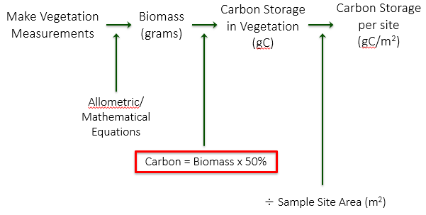
How Will You Calculate Carbon?

Slide 10
Standard Site Carbon Field Protocols
For All Sites Complete:
Field Learning Activities
Site Selection
  - Choose your field site location
Site Set-up
  - Set up your site
  - Determine which vegetation you will measure based on tree size and % cover estimates
Complete some or all of the following, depending on vegetation present:
How to Measure Trees Supporting Protocol
Tree Protocols
Shrub/Sapling Protocol
Herbaceous Protocol

Slide 11
Field Learning Activities
These activities teach important concepts and skills for understanding and conducting Carbon Protocols.
Biomass Units
Percent Cover
Allometry

Slide 12
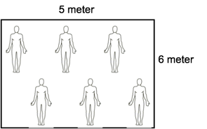
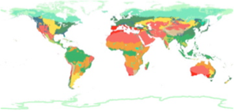
Biomass Units
Students calculate the biomass of the classroom in g/m².
Students assess how biomass would change if size or mass of a sample area were different.
Students rank global biomes from greatest to least biomass and compare their guess to available data.
Students estimate how much carbon is stored in their schoolyard (g C/m²) based on their biome classification and what they see.

Slide 13
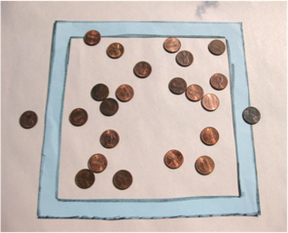
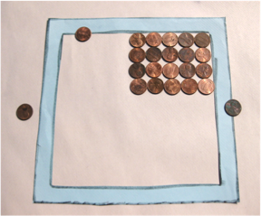
Percent Cover
Students practice estimating percent cover
Students use these to determine if shrubs/saplings and/or herbaceous vegetation should be measured in the sample site.

Slide 14
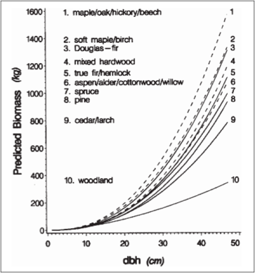
Allometry
Students measure their height, arm span, and foot length to show how living organism’s parts are related to the whole (allometry)
Students use this concept to understand how circumference/DBH of trees can be used to estimate biomass
Students view allometric relationships of tree species groups
Jenkins et al. 2003

Slide 15
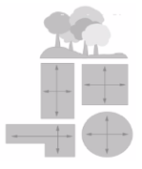
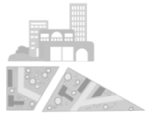
Site Selection
Site selection can be completed with or without student involvement
Determine if your site is a “Standard” or ”Non-standard” site:
Standard Site - an accessible area of at least 225 m² (15m x 15m) of contiguous vegetation (forest, shrubland, grassland). Aim for 30 m x 30 m (900 m²). A smaller or different shaped area will work; modify Tree Mapping protocol to suit your site & students.
Non-standard Site – an accessible area of 225 m² (15m x 15m) with some vegetation and some human interference (i.e. a local park, city block, or the school area itself). *Please complete Carbon Cycle Non-Standard Site Field Protocols eTraining*
.

Slide 16
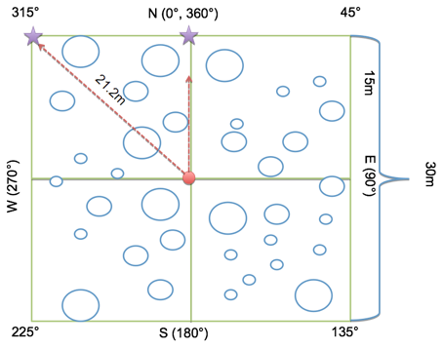
Standard Site Set-Up
Before going out in the field, students learn necessary skills for Site Set-up: pacing, compass, (and optional GPS).
Students then work in teams to set up a Carbon Cycle sample site:
1. Perimeter Team
2. Corner Team
3. Center Team

Slide 17
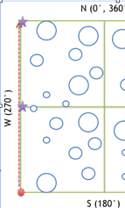
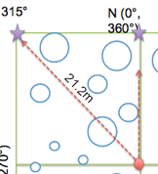

Standard Site Set-up (Cont’d)
Corner teams
Use compass to pace from plot center to each corner. Place a temporary flag. Repeat for corresponding sides.
Perimeter Team
Start at first corner completed by a Corner Team. Pace along perimeter to check flags placed by Corner Teams.
Center Team
Record the appropriate site location information on the Sample Site Data Sheet. Conduct vegetation analysis by estimating percent cover of shrubs/saplings and herbaceous cover. Take site photos.

Slide 18
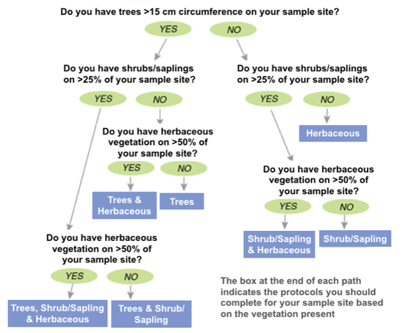
Protocol Decision Tree
Determine which vegetation you will measure.
*Not sure how big the trees are? See Supporting Protocol 'How To Measure Trees' for instructions on accurate circumference measurements

Slide 19
Trees: Protocol Overview
How to Measure Trees (Supporting Protocol) | Time: 60 minutes Instruments: tree cookies, small flexible measuring tape, calculator Prerequisites: None
Tree Mapping *This can be done simultaneously with tree circumference, shrub/sapling & herbaceous measurements (if applicable). Complete once per site. | Time: 70 minutes (only needs to be completed once per site) Instruments: 50 m flexible measuring tape, local tree ID guide, compass Prerequisites: Site Set-up, How to Measure Trees, Field Learning Activities (Biomass Units, Allometry)
Tree Circumference *This can be done simultaneously with shrub/sapling & herbaceous measurements (if applicable).Complete each year. | Time: 60 minutes Instruments: Measuring tapes (150-300 cm) Prerequisites: Site Set-up, How to Measure Trees, Tree Mapping, Field Learning Activities (Biomass Units, Allometry)

Slide 20
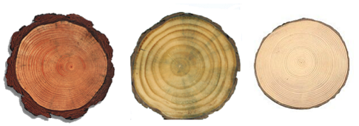
How to Measure Trees
Students measure tree cookies to understand the relationship between circumference and diameter
Students learn that circumference is measured at 1.35 meters from the tree base
Students gain understanding of concepts precision and accuracy

Slide 21
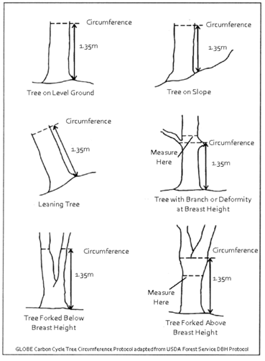
How to Measure Trees (Cont’d)
Use the 'Badly Behaving Trees Guide' at right to accurately measure trees in the field plot:
  Measure up 1.35m from the highest point around the base of the tree - this is “breast height”
  Measure around the tree at the given height in cm to find tree circumference at breast height
  This can later be converted to diameter at breast height (DBH)

Slide 22
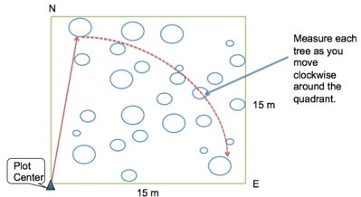
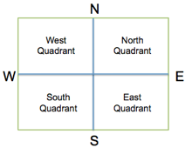
Tree Mapping
*only needs to be completed once per site*
Students divide into 4 quadrant teams and use a compass and measuring tape or pacing to map the location of each tree in the quadrant so the biomass and growth of each tree can be tracked over time.

Slide 23
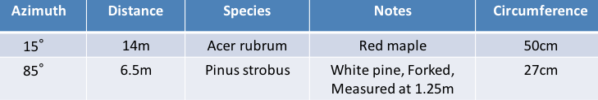
Tree Mapping (Cont’d)
*only needs to be completed once per site*
Measure and record azimuth and distance of each tree from center, and identify the genus and species.
If completing in conjunction with the Tree Circumference protocol, you will also measure circumference at this time.

Slide 24
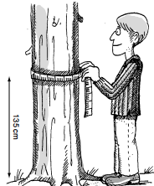
Tree Circumference
*Complete each year*
Measure circumference at breast height (CBH, 1.35m) for all mapped trees, currently living & greater than 15cm CBH on your site.
Measure CBH to the nearest tenth centimeter, e.g. 16.6cm.
In the 'notes' section of the data sheet, include:
  If the tree has died since the previous year
  The common name of the tree
  If circumference was not measured at breast height (due to tree branching or bulging- See the 'Badly Behaving Tree Guide' for more information)

Slide 25
Shrubs/Saplings: Protocol Overview
Shrub/Sapling Protocol *This can be done simultaneously with tree & herbaceous measurements (if applicable). Complete each year. | Time: 40 minutes Instruments: Compass, 2-3 m stick marked in centimeters Prerequisites: Site Set-up

Slide 26
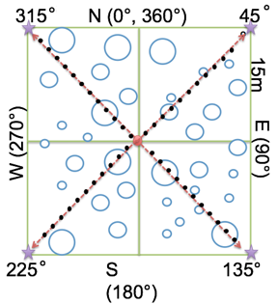
Shrub/Sapling Protocol
*Complete each year*
For each plot corner:
Pace from the center towards a corner. At each pace (two steps), place the measuring stick straight down.
Record ‘H’ (hit) if the stick is touching a shrub or sapling.
  Mark ‘E’ if the species is evergreen and measure the height of the shrub or sapling.
  Mark ‘D’ if the species is deciduous and measure the height of the shrub or sapling.
Use the measuring stick to measure a representative height of the whole shrub/sapling.
Record ‘M’ (miss) if the stick is not touching a shrub or sapling.
Repeat these steps until you reach the corner.
Repeat for each corner.
Standard Shrub/Sapling Measurements - Student Field Guide

Slide 27
Herbaceous Vegetation: Protocol Overview
Herbaceous Vegetation Protocol *This can be done simultaneously with tree & shrub/sapling measurements (if applicable). Complete each year. | Time: 40 minutes Instruments: OUTSIDE: beanbag, blindfold, measuring tape, clippers, small brown paper bags, INSIDE: balance, drying oven (optional) Prerequisites: Site Set-up

Slide 28
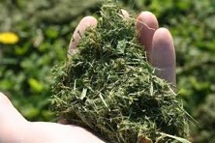
Herbaceous Protocol
*Complete each year*
Collect samples of herbaceous vegetation from the site.
Blindfold a member of the team and have him/her/them throw a beanbag somewhere in the sample site.
Mark a one-meter square around the bean bag to take a random sample.
Using grass clippers, clip all the vegetation close to the ground within the square. Do NOT collect any leaves or litter that are already dead or unattached from the ground.
Place clippings into brown paper bags and label with the site name, date, and sample number (e.g., Field Site Name, Herb Sample #1, bag 1 of 2).
Repeat steps 1-5 two more times.

Slide 29
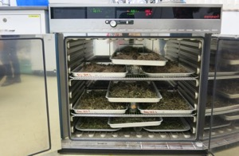
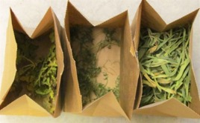
Herbaceous Protocol (Cont’d)
*Complete each year*
Dry the herbaceous samples by either:
(a) Drying oven: Set oven temp to 50-70ºF, put labeled bags in drying oven. Weigh the bag once per day after day one until sample weights the same two days in a row. Record the mass (g) of the sample + bag and the mass of the empty bag.
(b) Air drying: Select a dry, secluded area large enough for all sample bags. Open the tops of the bags for maximum airflow. Weigh once per day after day five, until sample weighs the same two days in a row. Record the mass (g) of the sample + bag, and the mass of the empty bag.
Image: censam.mit.edu
Image: iowalearningfarms

Slide 30
Data Entry at Globe.gov (1/3)
After students have returned from the field with their paper data sheets, data can be shared with the GLOBE and scientific community by entering it into the GLOBE online science database (https://data.globe.gov).
When you submit your data through GLOBE, the calculations to convert your raw data to biomass and carbon storage values will be completed for you.
*Before you enter data, review it as a class, checking for data quality including precision and typos. See the Carbon Cycle Data Entry Teachers Guide for notes and suggestions .

Slide 31
For years 2+ Data Review - Compare Data To Previous Years
Did any trees increase in circumference? Is it what you expected? Any possible errors? Compare large trees to small trees.
Any decreases in tree circumference? Have trees died? Difficult bark (wavy, bumpy)? Measured at same height?
Differences in species?
Any new trees? Factors that affected current year (ie: ice storms, insects, hurricanes).

Slide 32
Data Entry at Globe.gov (2/3)
Data can be entered to the GLOBE website in three ways:
Desktop Data Entry: Log environmental data directly on the GLOBE website.
Email Data Entry: If connectivity is an issue, data can also be entered via email.
GLOBE Observer App: The app allows users to enter data directly from an iOS or Android device for any GLOBE protocol.

Slide 33
Data Entry at Globe.gov (3/3)
To add your Carbon Cycle data to the GLOBE website, create a new site if you do not already have one.
If you already have a Carbon Cycle site, you can skip ahead to add your Carbon Cycle data.

Slide 34
Add new site at Globe.gov or on the GLOBE Observer App
Create a new site
Add site coordinates
Describe site, indicate standard or non-standard, and vegetation measured
Submit
Optional: add site photos

Slide 35
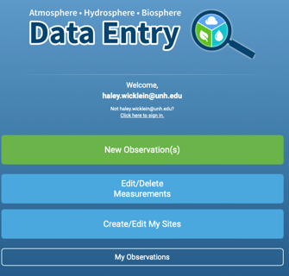

1. Create a new site
Log in to the GLOBE Data Entry webpage and click “Create/Edit My Sites”.
Then click “Add site”.

Slide 36
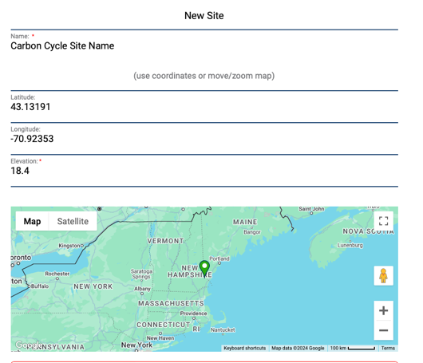
2. Add site coordinates
Choose a name for your site
Type in coordinates or move the map to add your latitude and longitude

Slide 37
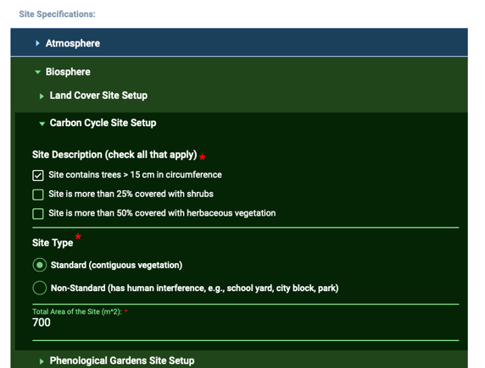
3. Describe site; indicate standard or non-standard, and vegetation types measured
Check the vegetation types you will measure
Select Standard or Non-Standard*
Add the area of the site in m²
*This will determine the data entry form you see!

Slide 38


4. Submit!
At the bottom of the screen, click the ”Save Site” button.
Your site will now appear in the list of GLOBE data collection sites under your school/organization.
To return to the data entry home page, use the home icon at the bottom of the screen.

Slide 39
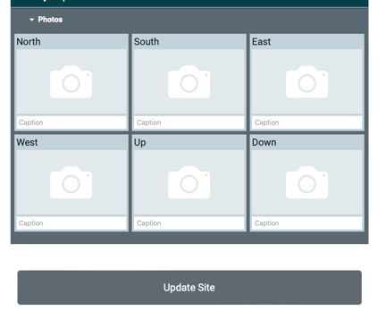
5. Optional: Add site photos
After your site is created, you can add site photos by going to “Create/Edit My Sites” from the data entry home page and clicking on your carbon site name. Scroll down to the photo section:
Click on the camera icon to upload a photo.
Optional: add a caption
Click “Update Site”
Make sure that your photos do not contain people!

Slide 40
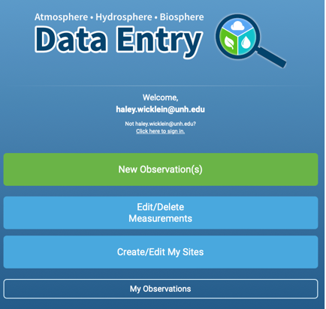
Add Carbon Cycle data
Once your site has been established in the database, you or your students are ready to upload carbon data. Learn how to manage student accounts.
From the data entry homepage. Click “New Observation”

Slide 41
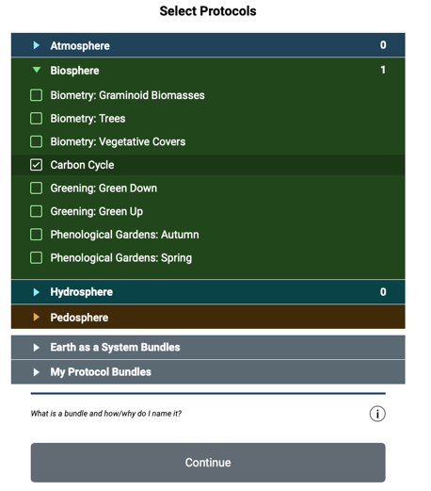
Add Carbon Cycle data (Cont’d)
Under Biosphere, select Carbon Cycle
Click Continue

Slide 42
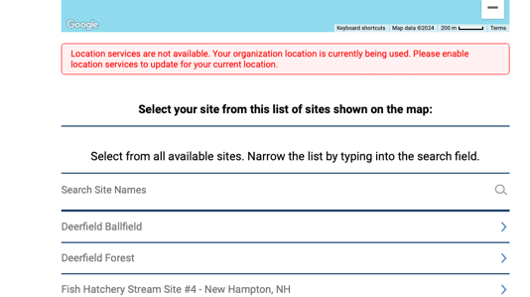
Add Carbon Cycle data (Cont’d)*
Scroll down the page and choose the Carbon site you created

Slide 43
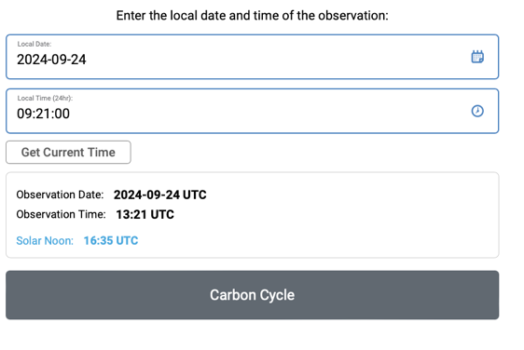
Add Carbon Cycle data (Cont’d)*
Update the date and time to when you collected your carbon data
Click “Carbon Cycle”

Slide 44
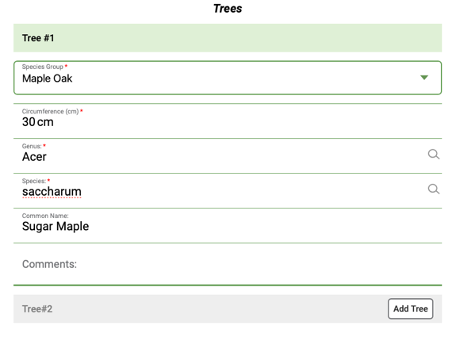
Add carbon cycle tree* data
Enter data from your data sheet for each tree.
Click “Add Tree” to enter data for each subsequent tree you measured.
* not all sites will have trees. Skip if not applicable to your site.

Slide 45
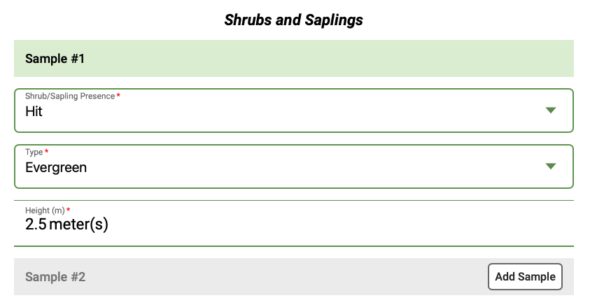
Enter shrub and sapling* data
Add shrub and sapling data from your data sheet.
Click “Add Sample” for additional shrubs or saplings as necessary.
* not all sites will have shrubs and saplings. Skip if not applicable to your site.

Slide 46
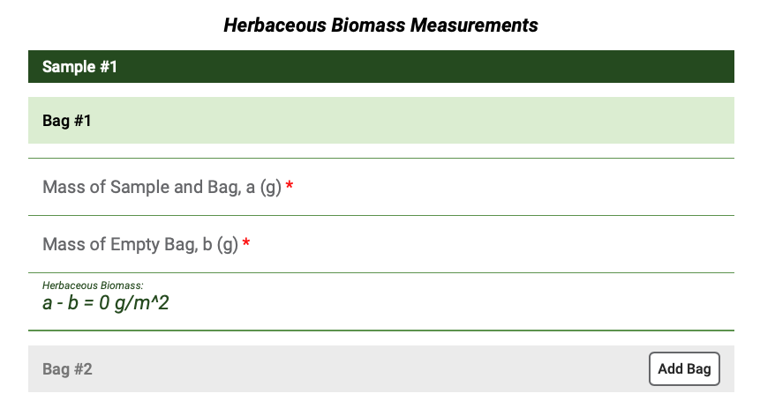
Enter herbaceous* data
Add data from your three herbaceous samples.
Biomass is automatically calculated.
Click “Add Bag” if you had multiple bags per sample.
* not all sites will have herbaceous vegetation. Skip if not applicable to your site.

Slide 47
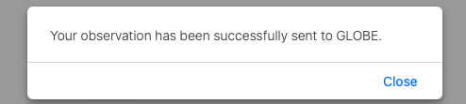
Send Data to GLOBE
Click the “Review” button at the bottom of the screen.
Open the Biosphere drop down and review the data you entered.
If it is correct, click “Send Observations”.
Wait to receive the message that your observations were successfully sent!

Slide 48
Understanding Your Data: Data Analysis
Use the Biomass & Carbon Analysis Teacher Guides (separate documents for Trees, Shrubs/Saplings, and Herbaceous vegetation) to assist students with observing and understanding patterns and trends in their field measurement data.
Requires:
Data spreadsheet downloaded from GLOBE (see instructions on following page)
Microsoft Excel (or similar spreadsheet program)
Biomass Analysis Questions

Slide 49
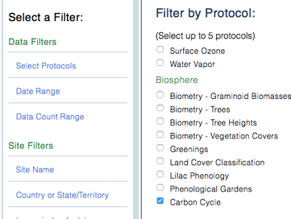
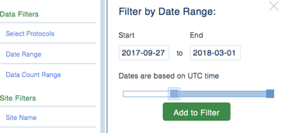
Download Data From GLOBE (1/3)
*complete with carbon and biomass estimates
Go to GLOBE’s Data Access Tool
Read through the instructions to familiarize yourself with this tool.
Under Data Filters, click ‘Select Protocols’
Scroll down to find the Biosphere section, click ‘Carbon Cycle’, and click Add to Filter.
Select a data range that includes the date in which you collected data. Click Add to Filter.

Slide 50
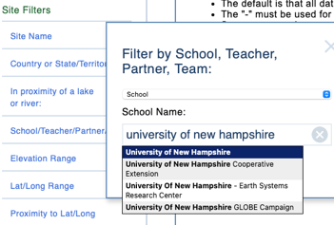
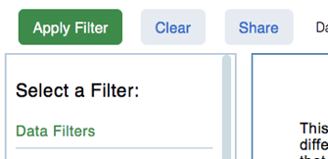
Download Data From GLOBE (2/3)
Under Site Filters, click ‘School/Teacher/Partner/Team’, and select your school.
If you have multiple Carbon Cycle field sites, select the individual site in which you are interested under ‘Site Name’.
Click the green ‘Apply Filter’ button in the top left.

Slide 51

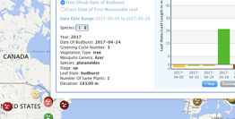
Download Data From GLOBE (3/3)
Click ‘Obtain Measurement Data’ (Note, data will be downloaded for the whole list you see, if your school is not the only one listed, redefine your filters).
The button will update, and you can click Download Measurement Data to download a .csv, which can be opened in a spreadsheet tool such as Excel. (See an example Carbon Cycle spreadsheet on the Data Analysis section of the Carbon Cycle webpage).
* Note, you can also use the GLOBE Visualization System to view your and other school’s Carbon Cycle data on a map.

Slide 52
Understanding Your Data: Data Interpretation
Use the GLOBE Carbon Cycle data interpretation teacher guides and activities to give students context for understanding their data.
Human carbon storage vs. tree carbon storage
Schoolyard area (scaling)
Net Primary Production (NPP)

Slide 53
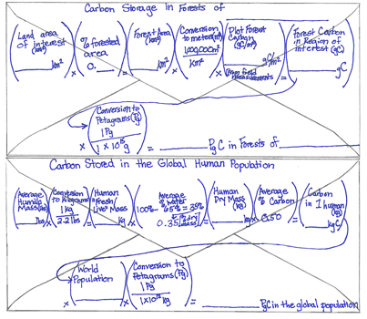
Human Carbon vs. Tree Carbon
Use a back-of-the-envelope calculation to determine whether more carbon is stored in humans or trees.
Example research question that can be answered through this activity: Is there more carbon stored in the global human population or the trees in [MY STATE]?
** This activity can help students understand why there is not a ‘human’ pool on the Global Carbon Cycle Diagram.

Slide 54
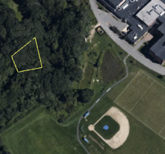
Schoolyard area scaling
The Determining Scale & Calculating Area Teacher Guide describes how to use an aerial photo/map to scale your sample site carbon measurements to larger areas of similar vegetation.
Example research question that can be answered through this activity: How much carbon is stored in the vegetation near my school?
*Note the teacher will need Google Earth Pro (a free application) to create the map image.

Slide 55
Calculating Net Primary Productivity
Use the Calculating Net Primary Productivity Teacher Guide to understand the change in carbon storage over time. *Needs multiple years of carbon data*
Example research question that can be answered through this activity: What is the pattern in which biomass and carbon storage change over time in my sample site?
Net Primary Productivity (NPP), or the production of plant biomass, is equal to all of the carbon taken up by the vegetation through photosynthesis minus the carbon that is lost to respiration. NPP can be calculated with this equation:
$$NPP=Carbon stored for Year 2 −Carbon Stored for Year 1$$

Slide 56
Quiz Questions
Challenge yourself to answer these questions and check whether you have achieved the learning objectives of this module.
Name two carbon cycle field learning activities.
What are some research questions you could ask using GLOBE carbon cycle data at your site?
What is the minimum area for a Standard site?
If your site has trees, what data will you record for each tree?
At what height do you measure tree circumference?
If a tree is on a steep slope, what guide could you use to accurately measure tree circumference?
What is the percent cover needed to take herbaceous vegetation measurements? Shrub/sapling measurements?
How are tree measurements converted to biomass? To carbon storage?
If you measure shrub/saplings, what data will you record?
How might someone calculate carbon storage of vegetation over the entire town based on your field measurements?

Slide 57
Additional Information
Additional Resources:
NASA’s A Breathing Planet, Off Balance Article and Video:
https://www.nasa.gov/feature/goddard/carbon-climate
NASA Global Climate Change Website:
https://climate.nasa.gov/
NASA Scientific Visualization Studio
https://svs.gsfc.nasa.gov
Global Carbon Project
http://www.globalcarbonproject.org
  Global Carbon Atlas
  http://www.globalcarbonatlas.org

Slide 58
Additional Information
Questions about this module?
Contact GLOBE: training@nasaglobe.org
eTraining Authors:
Dr. Elizabeth Burakowski, University of New Hampshire
Haley Wicklein, University of New Hampshire
Jennifer Bourgeault, University of New Hampshire
This work was supported by NASA (Grant no. 80NSSC18K0135). Any opinion, findings and conclusions or recommendations expressed in this material are those of the authors(s) and do not necessarily reflect the views of NASA.

