Slide 1
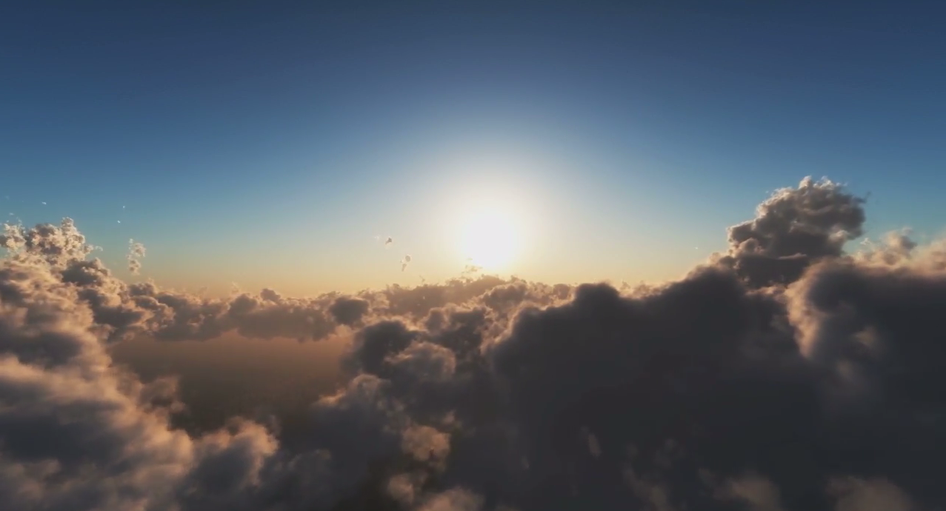
NASA GLOBE Clouds:
Making Cloud Observations
By Marilé Colón Robles
Marile.ColonRobles@nasa.gov
GLOBE Clouds Lead / Education Specialist
NASA Langley Research Center

Slide 2
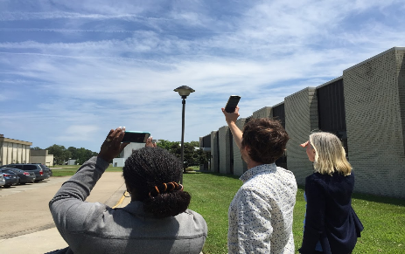
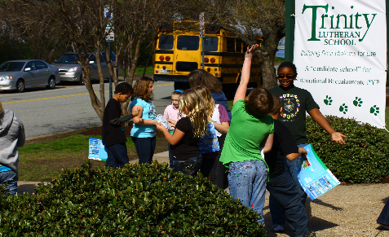
Making Cloud Observations
Why does NASA studies clouds?
How do satellites see clouds?
Review cloud types and how to report your observations.
Submit your observations to NASA.

Slide 3
Making Cloud Observations
Why does NASA studies clouds?
How do satellites see clouds?
Review cloud types and how to report your observations.
Submit your observations to NASA.

Slide 4
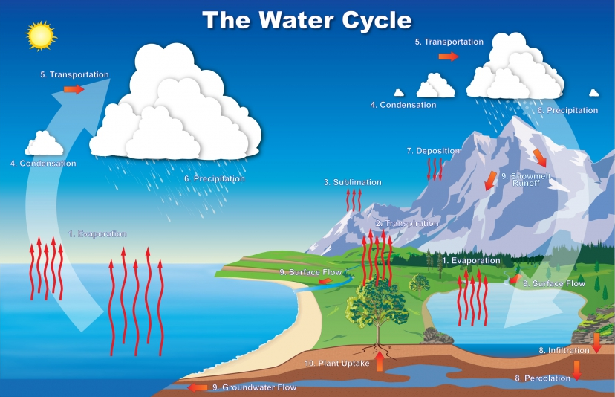
Notes:
NASA studies clouds because they are part of the water cycle, as you can see in this diagram. NASA also studies clouds because it lets scientists know which parts of the world is raining and where it is not, helping farmers and people, especially those in the path of storms. Remember, the water we drink today was around when dinosaurs roamed the earth!

Slide 5
Making Cloud Observations
Why does NASA studies clouds?
How do satellites see clouds?
Review cloud types and how to report your observations.
Submit your observations to NASA.

Slide 6
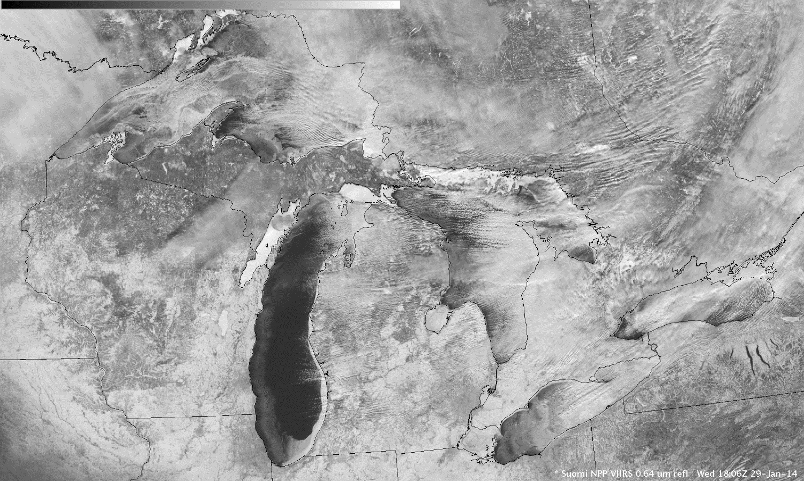
Notes:
Here is an image of a satellite looking down at Earth. Dark areas are water or forests. Note that big dark area, that is Lake Michigan. Does this area of the US receive lots of snow or very little snow in the winter time? Lots, that is right. So, this image has clouds and snow. It also has ice. Can you tell them apart? Make your best guess. How much cloud cover do you think there is on this particular day?

Slide 7
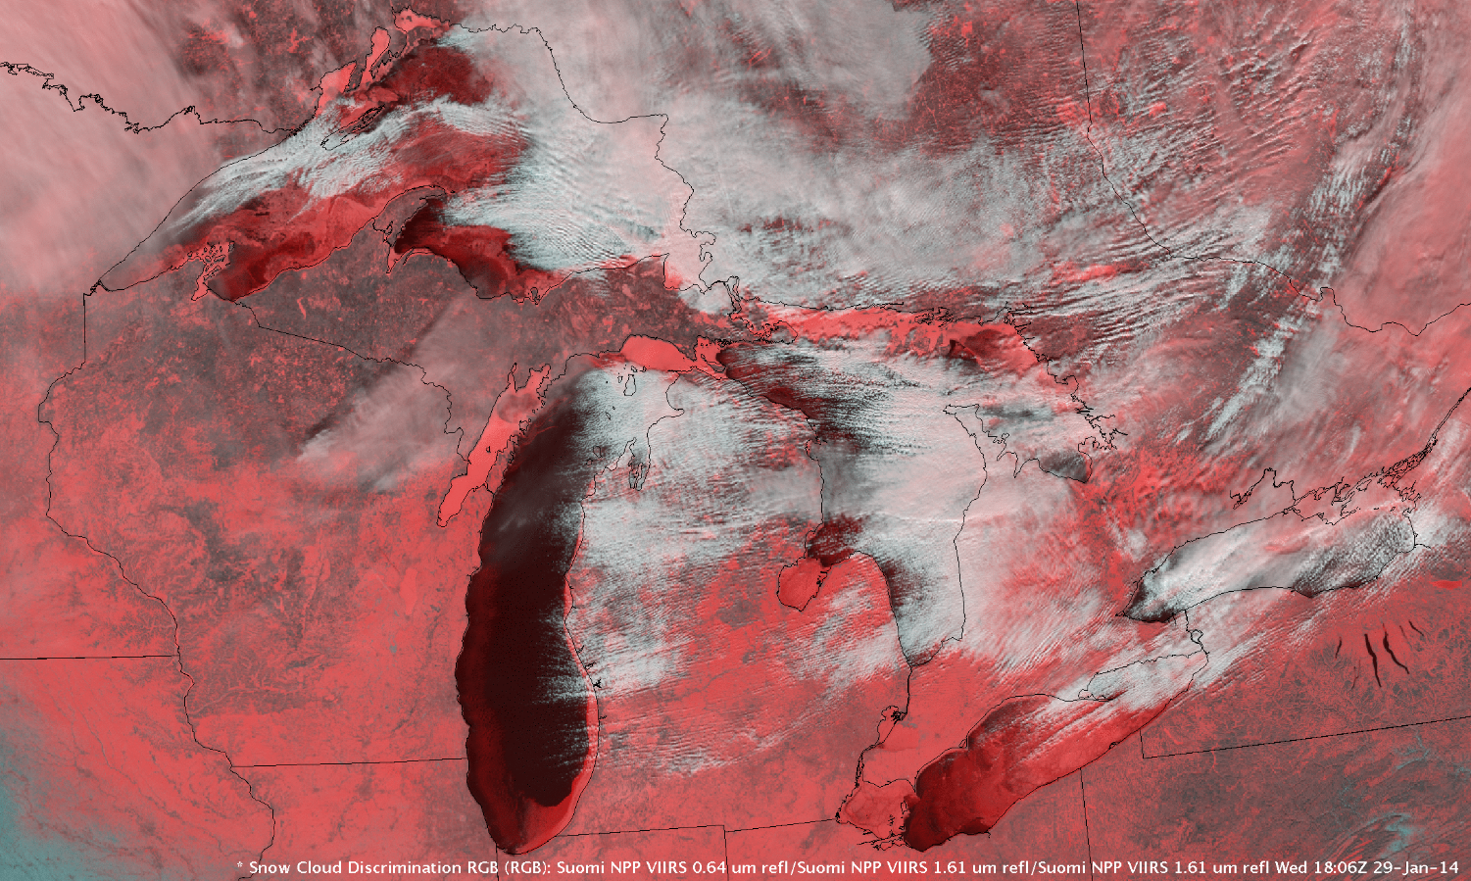
Notes:
Now, lets look at this image. The red portions are areas identified as snow or ice. The white portions are clouds. Was your estimate of cloud cover correct? Did you guess correctly where clouds or snow/ice where? It can be tricky for satellites as well.

Slide 8
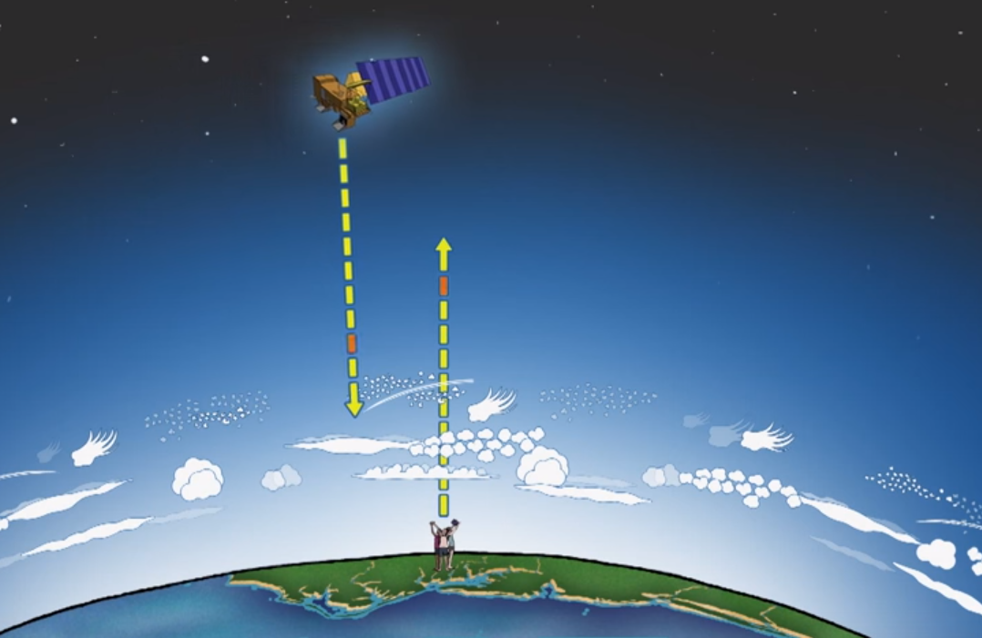
Notes:
We need your ground observations (see cartoon of people) looking up at clouds and at the ground, to better our observations from satellites looking down. Your observations are very valuable to NASA.

Slide 9
Making Cloud Observations
Why does NASA studies clouds?
How do satellites see clouds?
Review cloud types and how to report your observations.
Submit your observations to NASA.

Slide 10
Work with a partner and make a list of all the cloud type names you know.
Notes:
What cloud types do you know? What are their names? How would you describe/paint/draw them?

Slide 11
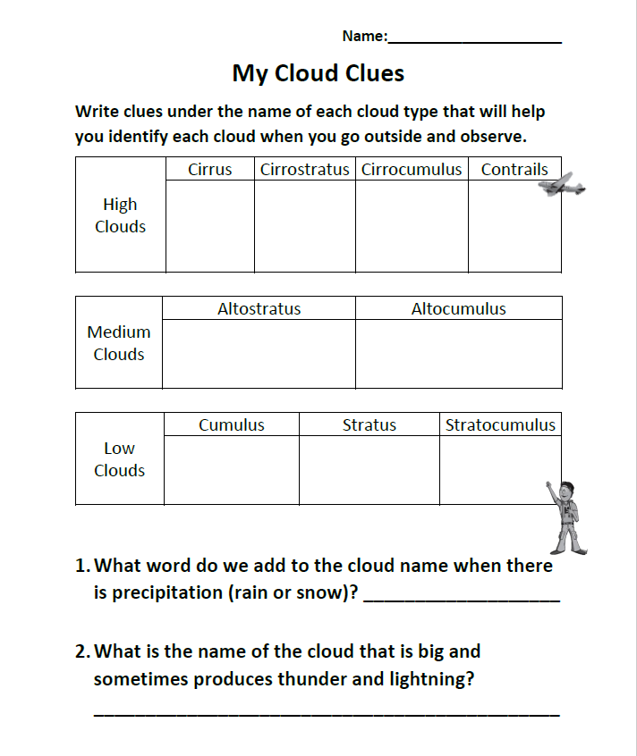
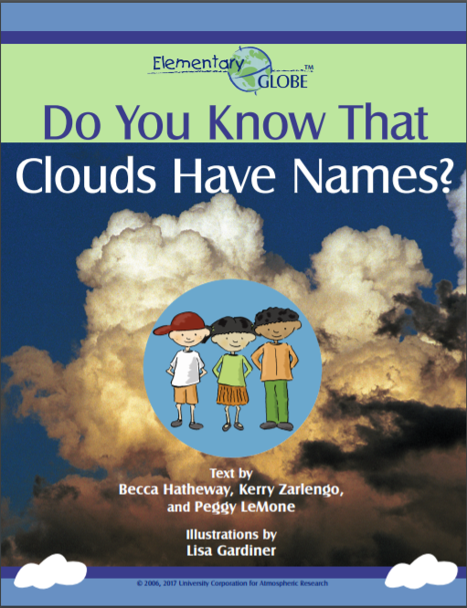
Notes:
It is your opportunity to write down some clues for you to know what type of cloud you are looking at when you look up at the sky. Remember never to look directly at the sun with your eyes. You can get seriously hurt. Use the page to write down your clues. You can use the GLOBE Elementary book – Do you know that clouds have names? – to write down clues.

Slide 12
Making Cloud Observations
Why does NASA studies clouds?
How do satellites see clouds?
Review cloud types and how to report your observations.
Submit your observations to NASA.

Slide 13
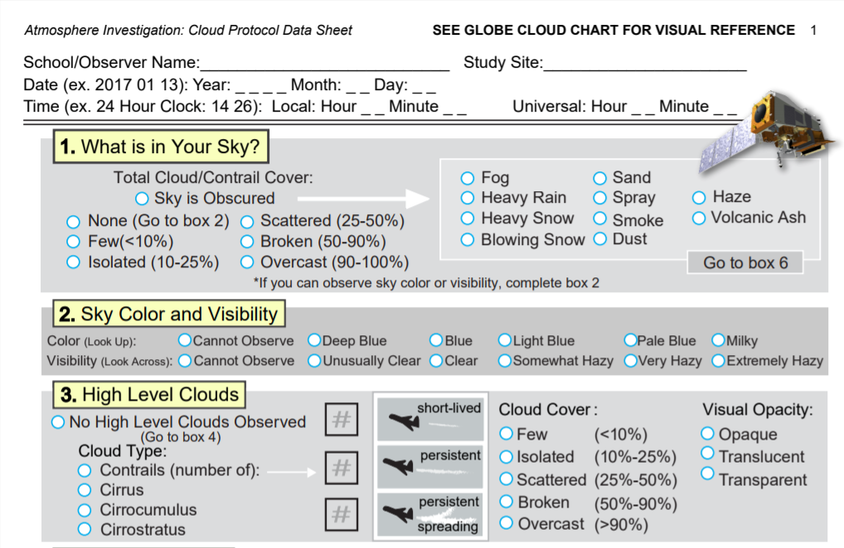
Notes:
Be sure to report your observations. Even a day with no clouds is a valuable one to report!

Slide 14
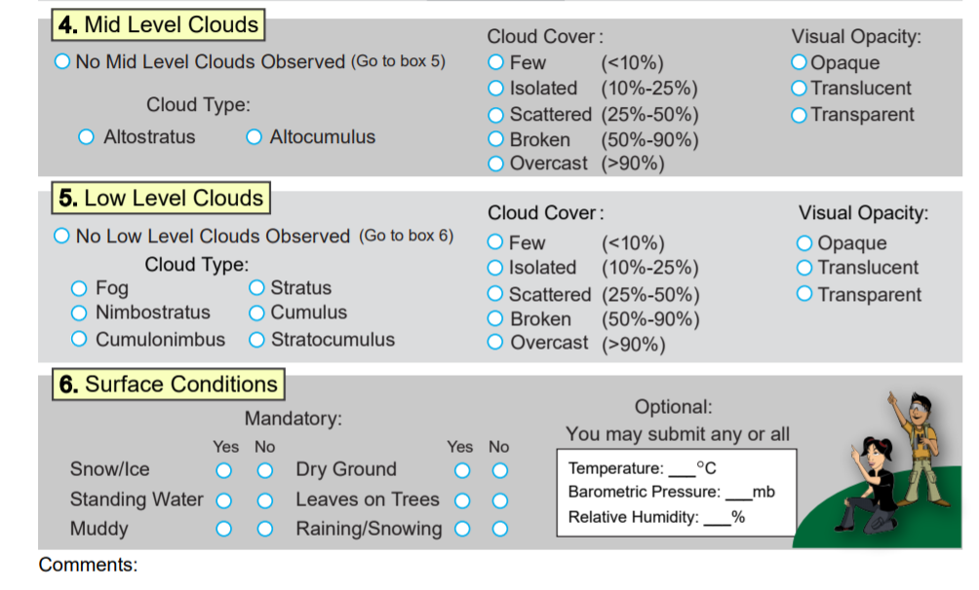
Notes:
Please, please, please, be sure to write down your surface conditions.

Slide 15
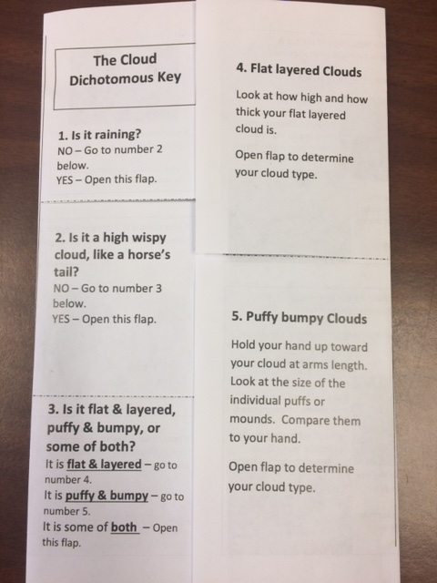
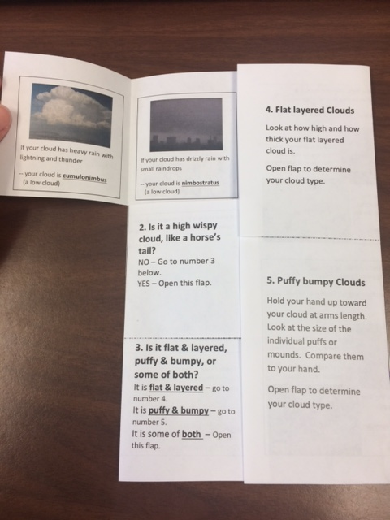
Cloud Dichotomous Key
Notes:
When you go outside, you can use a dichotomous key to know what clouds you are looking at when you look up at the sky. Go step by step and answer the questions. Make sure to write down your answers in the data sheet or use the app.

Slide 16
Making Cloud Observations
Why does NASA studies clouds?
How do satellites see clouds?
Review cloud types and how to report your observations.
Submit your observations to NASA.

Slide 17
Notes:
Once you submit your data, NASA will match your observations to satellites that were looking down at your area. You may get an email like this one showing your observations on the left-hand side, and satellite data on the right hand side! Thank you for observing!

