Slide 1
Intro Slide
Graminoid, Tree and Shrub Height (Five Methods)

Slide 2
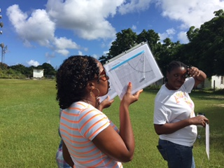
What is Graminoid, Tree and Shrub Height?
To describe your Land Cover Sample Site and identify the MUC code, you may need to measure the average height of the vegetation. For low-lying vegetation, such as grasses, and medium height vegetation, such as shrubs, you will take a random sample of plants, measure them, and calculate the average plant height.
To measure tree height, you will need to use a Clinometer to make the measurements. You will find instructions for building a clinometer in this tutorial.

Slide 3
Mapping
An important objective of the land cover investigation is to assess the accuracy of maps created by satellite images and aerial photographs.
Remote sensing simply means learning about something without making direct contact with it. We use remote sensing every day by hearing, smelling, and seeing.
With satellites and aircraft, we use machines to be our “eyes” in the sky or in orbit. Remote sensing in space has the great advantages of being able to cover very large areas quickly and to revisit the same area frequently. However, some of the detail that can be seen at ground level may not be detected by a remote sensing system. Therefore, it is beneficial to collect data at sample sites on the ground to accompany remotely sensed data about an area. GLOBE land cover data can contribute to making better, more accurate maps.
Terra’s five instruments provide measurements of plant (vegetation) composition, structure, extent, and change. Image: NASA.

Slide 4
Example: Canopy Height Map Created Using Satellite Data
Here are maps of canopy height derived from satellite data. Overall, the maps show that forest canopy heights are highest near the equator and decrease the closer forests are to the poles. The tallest forests, shown in dark green in the map above, tower higher than 40 meters and are found in a band in the tropics that includes the rainforests of the Amazon, central Africa, and Indonesia.
Both maps are based on data from the Geoscience Laser Altimeter System (GLAS) from the ICESAT satellite and the Moderate Resolution Imaging Spectroradiometer (MODIS) on NASA’s Terra and Aqua satellites, but the close-up incorporates additional elevation data from the Shuttle Radar Topography Mission (STRM) and climatology information from both the Tropical Rainfall Measuring Mission (TRMM) and the Worldclim database.
Ground validation of tree height by GLOBE participants can support a range of analyses, including those developed using satellite data.
Source: NASA Earth Observatory. Research team led by Marc Semard, JPL.

Slide 5
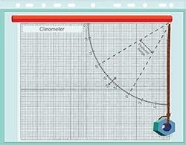
Instructions to Build a Clinometer
A clinometer measures angles to determine the heights of objects without directly measuring them. It is a simplified version of the quadrant (a medieval measuring instrument), and the sextant (an instrument used to locate the positions of ships). Like these instruments, the clinometer has an arc with graduated degree markings that go from 0 to 90 degrees.
Required Material:
Clinometer Sheet and Table of Tangents (located in Biosphere Appendix)
Pieces of stiff cardboard at least the size
of the sheets referenced above
Drinking straw
Metal nut or washer
15 cm of thread or dental floss
Glue
Scissors
Something to punch one small hole
Tape

Slide 6
Instructions to Build a Clinometer: Steps
Gather the materials.
Glue a copy of the Clinometer Sheet onto one side of a piece of cardboard of the same size.
Glue a copy of the Table of Tangents to the other side of the cardboard.
Punch a hole through the marked circle on the Clinometer Sheet.
Push one end of the thread or dental floss through the hole and tie or tape it on the Table of Tangents side of the cardboard. Colored thread or floss will allow it to be seen more easily.
Tie a metal nut or washer to the other end of the thread so that it hangs in front of the Clinometer Sheet.
Tape a drinking straw along the designated line on the Clinometer Sheet, to use as a sighting device.
The cardboard and both the clinometer and table of tangents sheets can be placed in a sheet
protector or laminated to ensure longer life. The straw would then be placed on the outside of
the plastic and the hole for the thread with the washer would be punched through the entire
instrument (plastic cover, cardboard and sheets).

Slide 7
To Measure Graminoid, Tree and Shrub Height, You Will Need the Following Documents
To be prepared, bring the following documents with you in the Field:
Graminoid, Tree and Shrub Height Field Guide
Measure Tree Height on Level Ground Data Sheet
Measure Tree Height on Level Ground: Simplified Clinometer Technique Field Guide
Measure Tree Height on Level Ground: Simplified Clinometer Technique Data Sheet
Measure Tree Height on a Slope: Two-Triangle with Eyes Higher than Tree Base Technique Field Guide
Measure Tree Height on a Slope: Two-Triangle with Eyes Lower than Tree Base Field Guide
Measure Tree Height on a Slope: Two-Triangle with Eyes Higher or Lower than Tree Base Technique Data Sheet
Measure Tree Height on a Slope: Stand by Tree Technique Field Guide
Measure Tree Height on a Slope: Stand by Tree Data Sheet

Slide 8
Selecting the Appropriate Method
There are different techniques to measure tree and shrub height. You need to select the one that best suits your situation, and follow the corresponding field guide and data sheet.

Slide 9
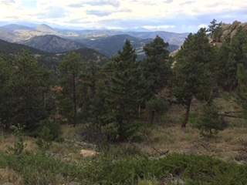
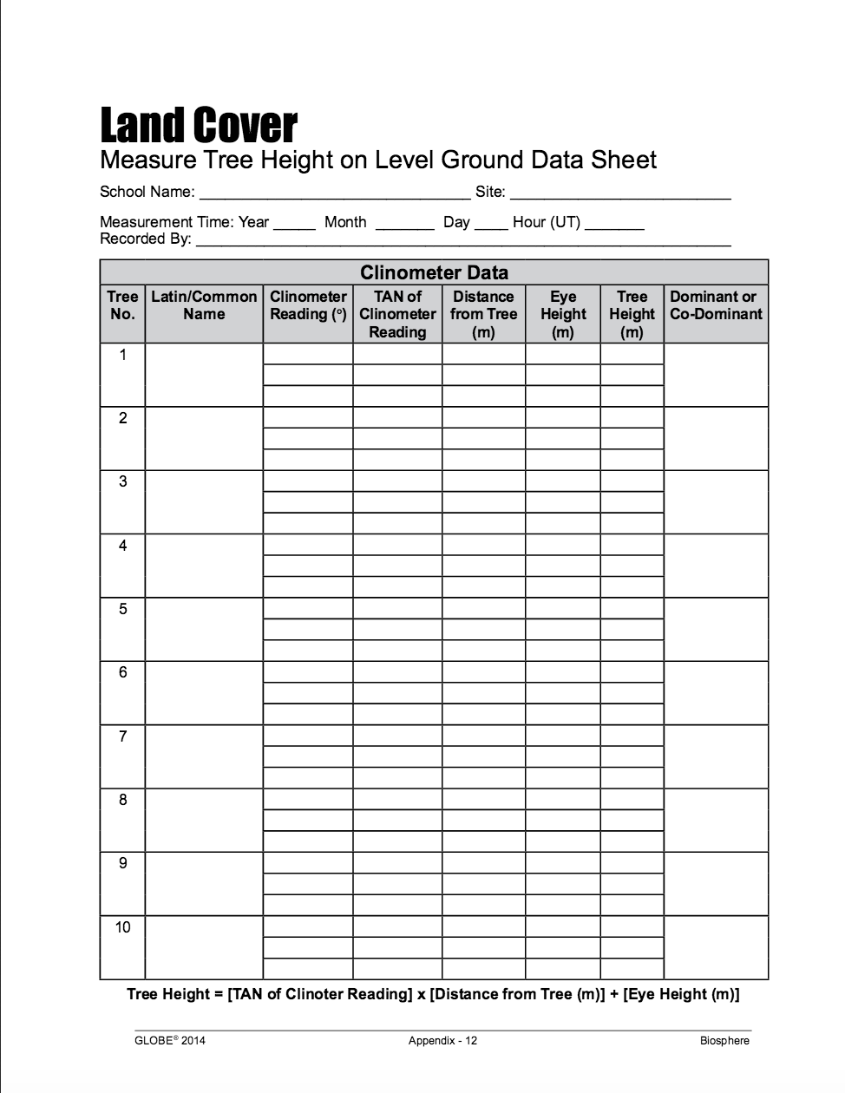
C. Measuring Tree Height- Determine Dominant Species
Determine your dominant (most common) and co-dominant (second-most common) tree species by counting the number of times each tree species was recorded on the Canopy and Ground Cover Data Sheet. Record the names of the species on the Graminoid, Tree and Shrub Height Data Sheet.
Dominant tree species in this photo is Ponderosa Pine (Colorado, USA).

Slide 10
C. Measuring Tree Height- Choose Your Trees
Select 5 trees to sample, including:
The tallest tree of the dominant species.
The shortest tree of the dominant species that still reaches the canopy.
Three trees that have heights in between the tallest and shortest of the dominant species.
Permanently mark number and label the trees if you plan to return to this site to take measurements over time.
Adjust your distance from the tree so that you are at least as far away from the tree
as the tree is tall. For the most accurate measurement, adjust your distance so that the
angle of the clinometer is as close to 30 degrees as possible.

Slide 11
C. Measuring Tree Height – Method I: Standard Clinometer
The method you use will depend on the topography of your site. This is the Standard Clinometer Technique with Feet Level with Tree Base.

Slide 12
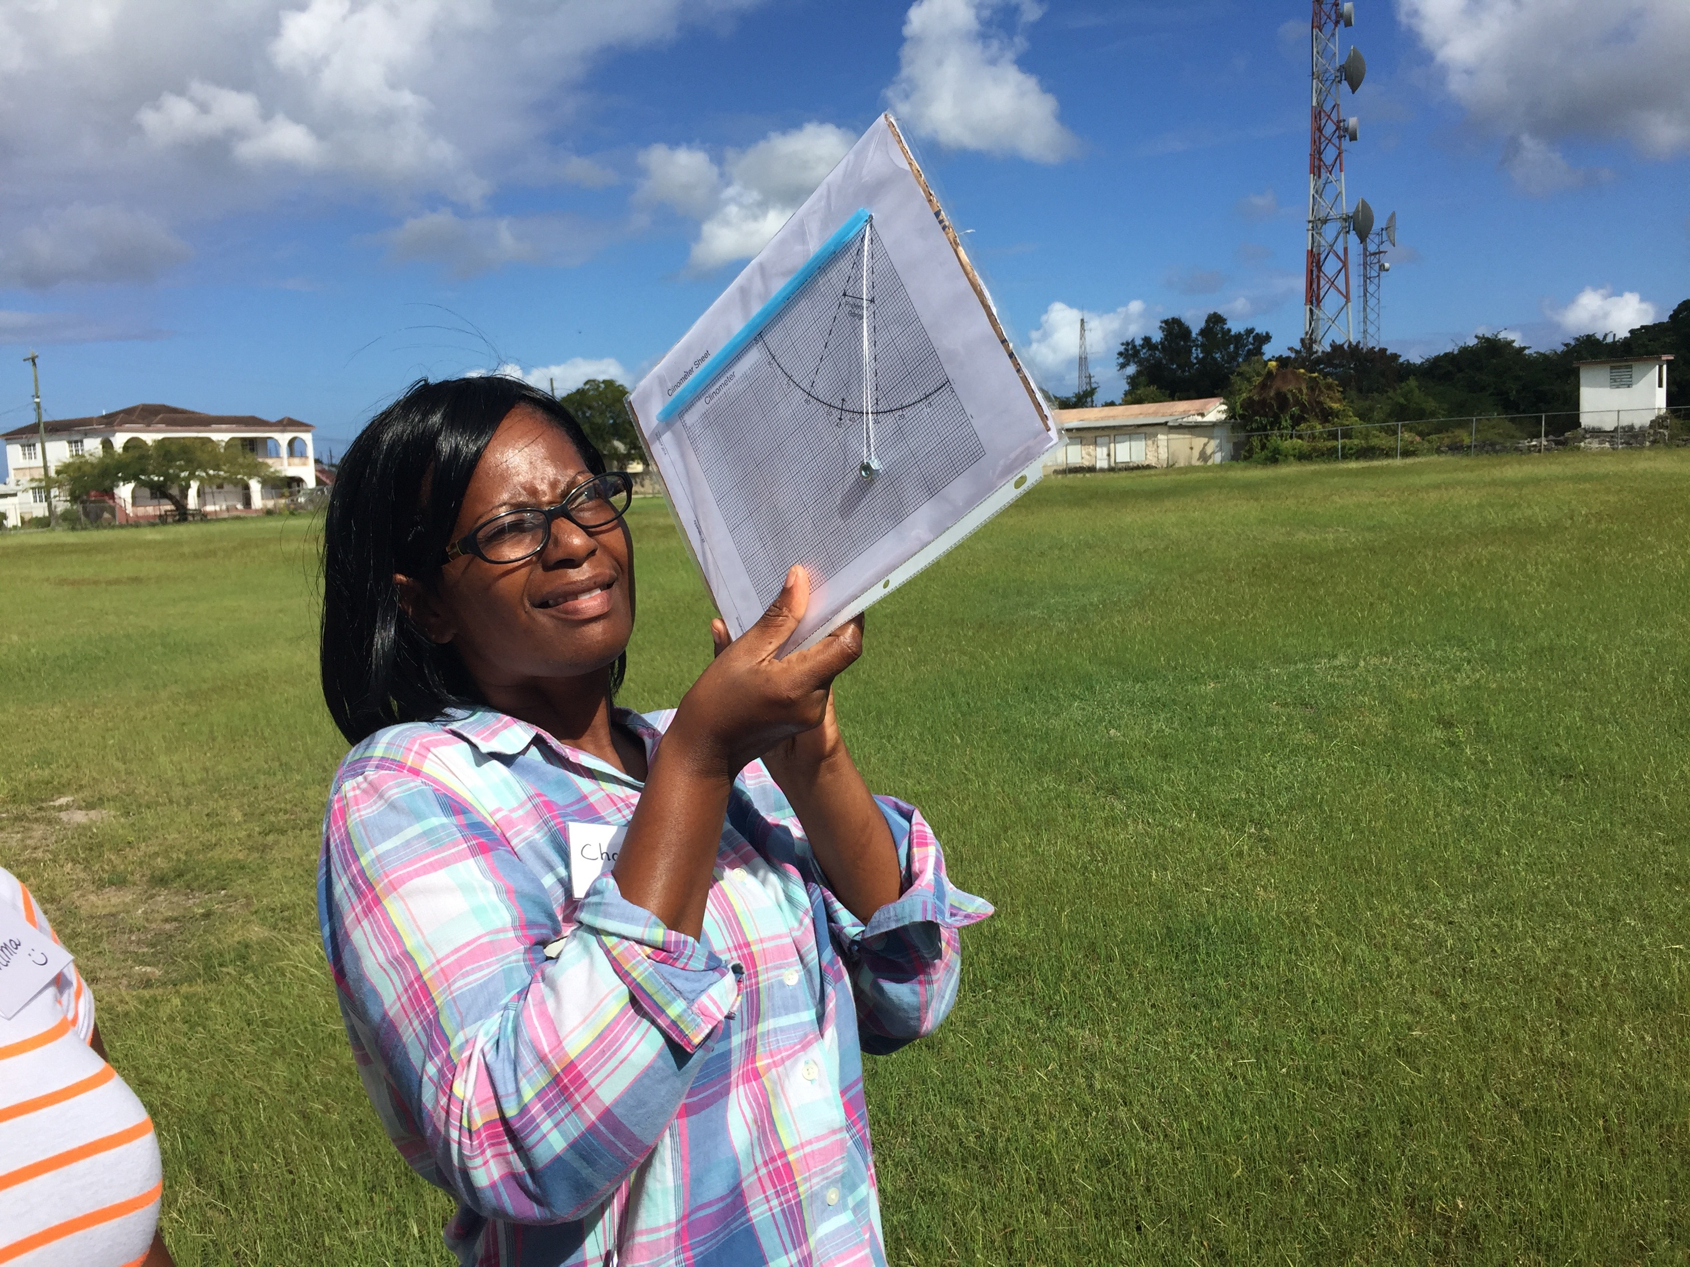
C. Measuring Tree Height when the Ground is Level: Standard Clinometer Technique - 1
For this situation, use the Graminoid, Tree and Shrub Height Field Guide.
Move away from the base of the tree until you can see the top of the tree through the drinking straw of the clinometer.
For the best results, adjust your distance from the base of the tree so that the clinometer reads as close to 30 ̊ as possible and you are at least as far from the tree as it is tall.
Be sure to be on level ground so that your feet are at the same elevation as the base of the tree. Remember, if you are not on the same level with the tree, you need to use one of the alternative methods for measuring tree height.
Have your partner read and record the number of degrees of the angle.

Slide 13
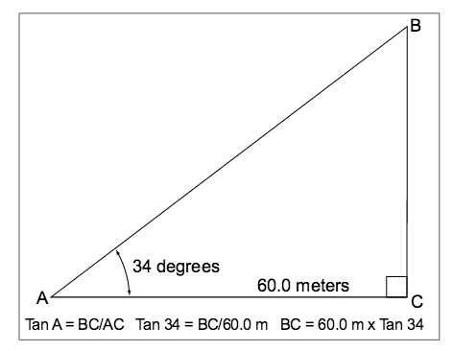
C. Measuring Tree Height when the Ground is Level: Standard Clinometer Technique - 2
Using the Table of Tangents, record the TAN of the angle on the Data Sheet.

Slide 14
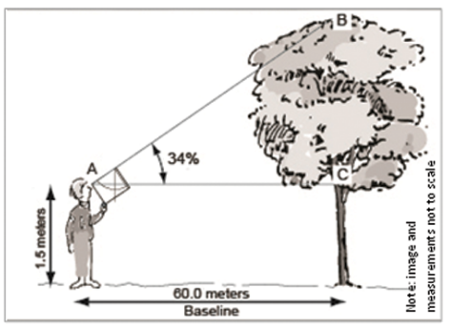
C. Measuring Tree Height when the Ground is Level: Standard Clinometer Technique - 3
Measure the distance between you and the tree. Have your partner help you using the 50 m tape. Record this in the table on your Data Sheet.
Measure the height from the ground to your eye level. (You only need to do this step once!) Record this in the table.

Slide 15
C. Measuring Tree Height when the Ground is Level: Standard Clinometer Technique - 4
Calculate the tree height using the following formula:
Tree height=[TAN (Angle of Clinometer) x (Distance to Tree)] + (Height to 0 degree on tree)
Record on your Data Sheet.
Measure the height of each tree three times and calculate the average of the three heights. If they are within one meter, record the average on your Data Sheet. If not, repeat the measurements until they are within one meter.
Repeat the step above for the other four trees and you are done!
If your co-dominant species is a tree, repeat steps b-e for the co-dominant tree
species. If you do not have five co-dominant species trees on your site, include other
tree species to make a total of five. Note that you are using other species in the
Metadata.

Slide 16
C. Measuring Tree Height – Method II: Simplified Clinometer Technique
The method you use will depend on the topography of your site. This is the Measuring Tree Height on Level Ground: Simplified Clinometer Technique.

Slide 17
C. Measuring Tree Height when the Ground is Level: Simplified Clinometer Technique - 1
For this situation, use the Measure Tree Height on Level Ground: Simplified Clinometer Technique Field Guide.
In the Field
Work in a team of two or three. Move away from the base of the tree until the clinometer reads 45 degrees when you see the top of the tree through the straw.
Have your partner stretch the 50 m measuring tape from the base of the tree to your toes. Your partner should then step on the tape at the ground and then run it up to your eye level.
Add together the length of the tape from the observer to the tree, and the height of the observer’s height from the ground. This is the tree (or shrub) height.

Slide 18
C. Measuring Tree Height when the Ground is Level: Simplified Clinometer Technique - 2
Record data on the Measure Tree Height on Level Ground: Simplified Clinometer Technique Data Sheet.
Repeat steps 1-3 two more times for each tree (a total of 5 trees) and report the average value and you are done!
If your co-dominant species is a tree, repeat steps 1-5 for the co-dominant tree species. If you do not have five co-dominant species trees on your site, include other tree species to make a total of five. Note that you are using other species in your form.

Slide 19
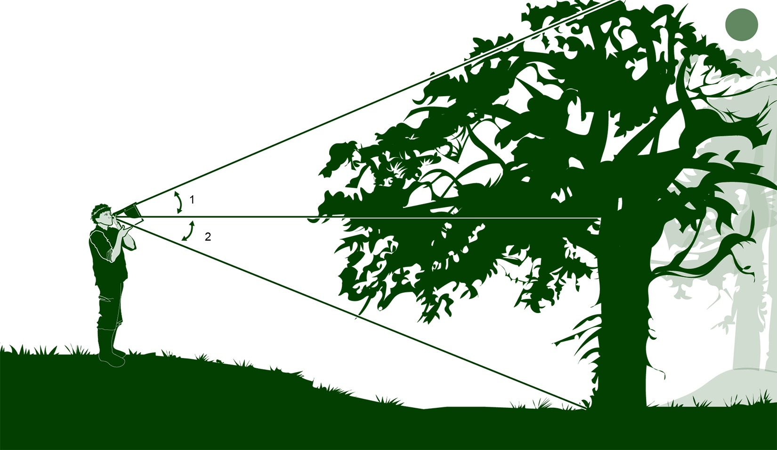
C. Measuring Tree Height – Method III: Two Triangles with Eyes Higher than the Tree Base
The method you use will depend on the topography of your site. This is the Two Triangles with Eyes Higher than the Tree Base.

Slide 20
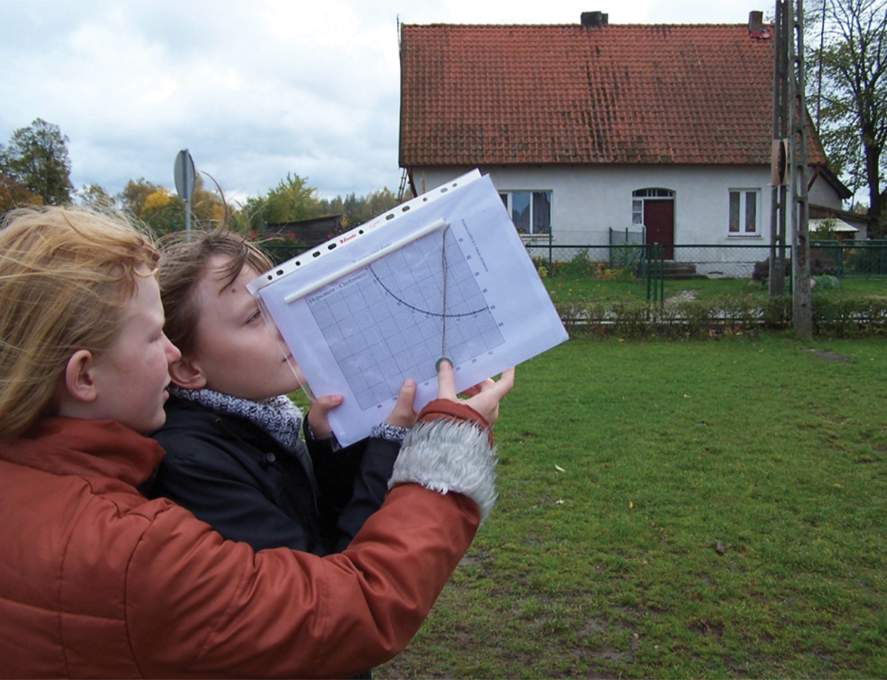
C. Measuring Tree Height When Tree is on a Slope: Two-Triangle and Eyes Higher than the Tree Base - 1
For this situation, use the Measure Tree Height on a Slope: Two-Triangle with Eyes Higher than Tree Base Technique Field Guide.
In the Field
Work in a team of two. You and your partner move away from the base of the tree until you can see the top of the tree through the drinking straw of the clinometer.
For the best results, adjust your distance so that the clinometer is as close to 30 degrees as possible and you are further from the tree than it is tall.

Slide 21
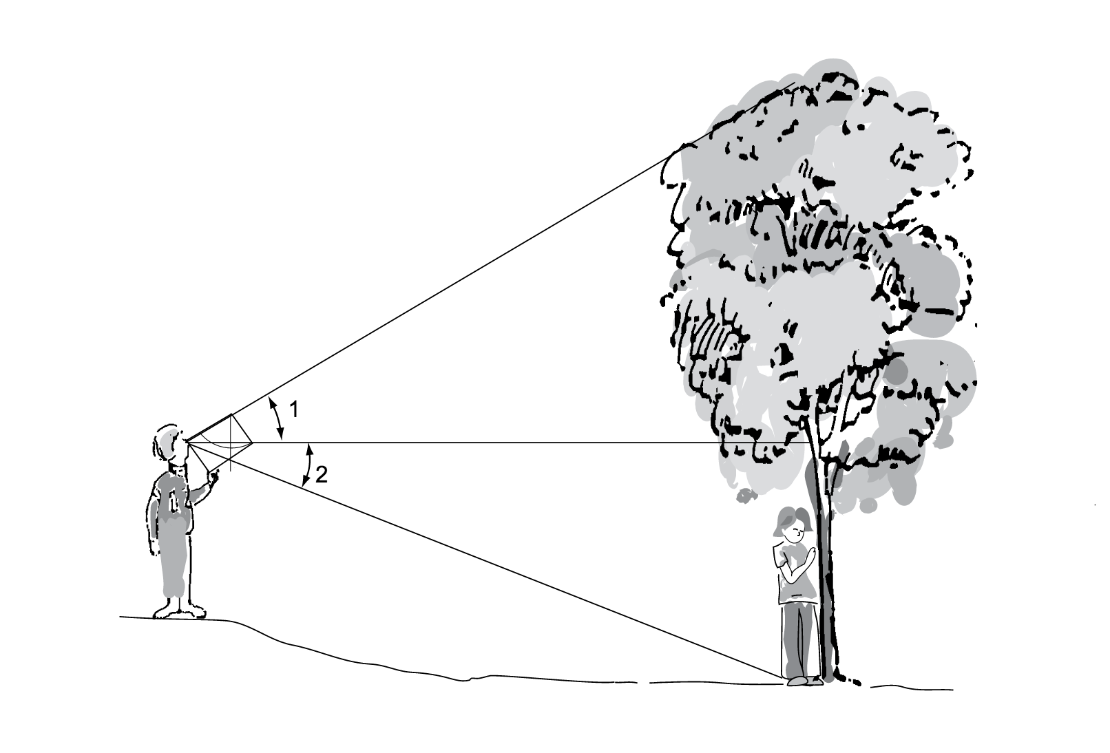
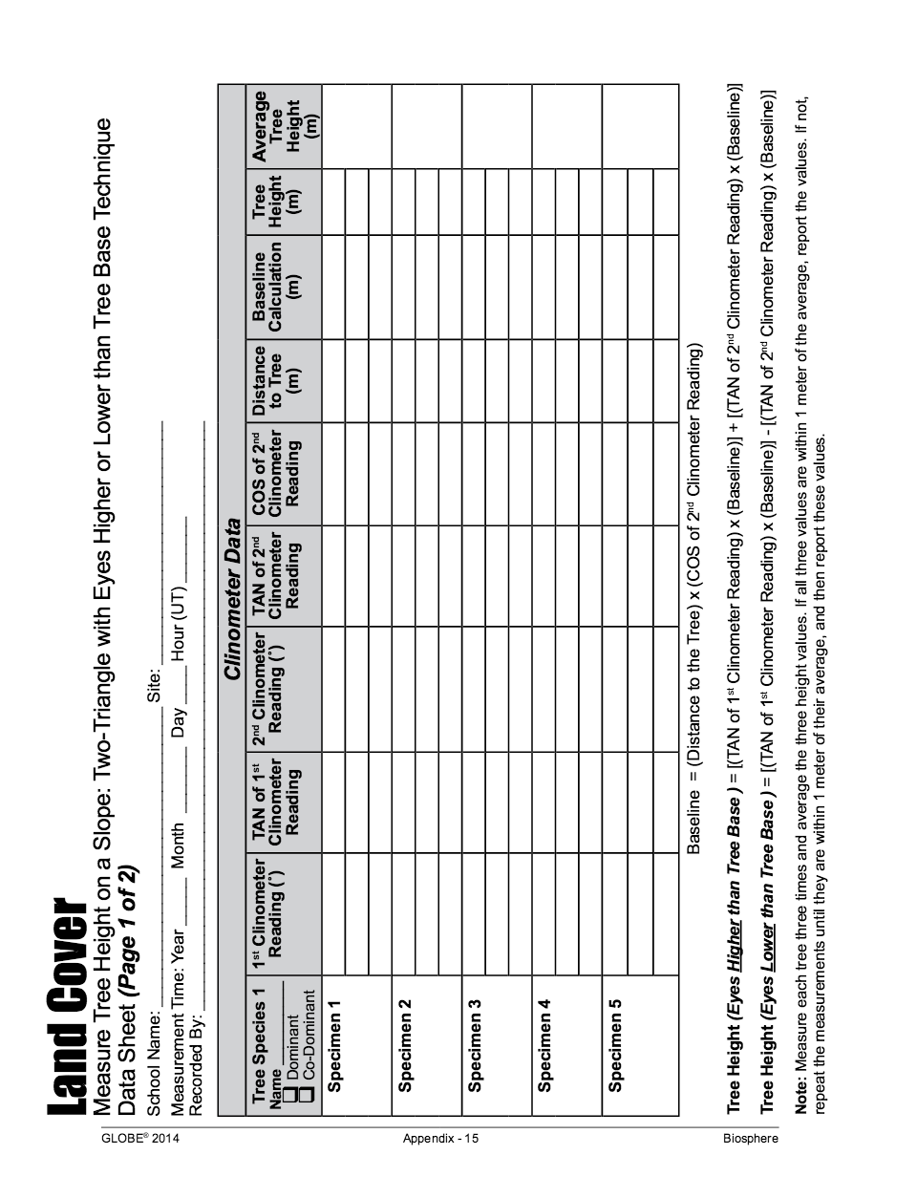
C. Measuring Tree Height When Tree is on a Slope: Two-Triangle and Eyes Higher than the Tree Base - 2
Site the top of the tree using the clinometer. Have your partner read and record the clinometer angle. This is the 1st Clinometer Reading.

Slide 22
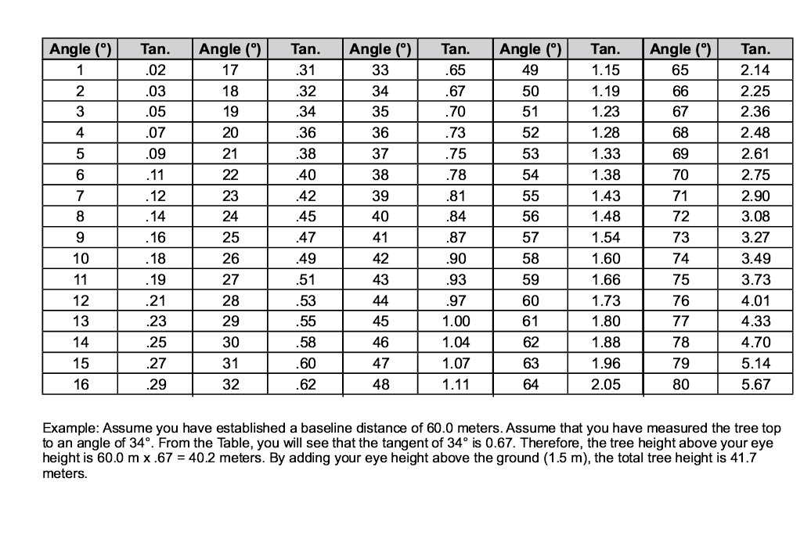
C. Measuring Tree Height When Tree is on a Slope: Two-Triangle and Eyes Higher than the Tree Base - 3
Using the Table of Tangents record the TAN of the angle on the data sheet.

Slide 23
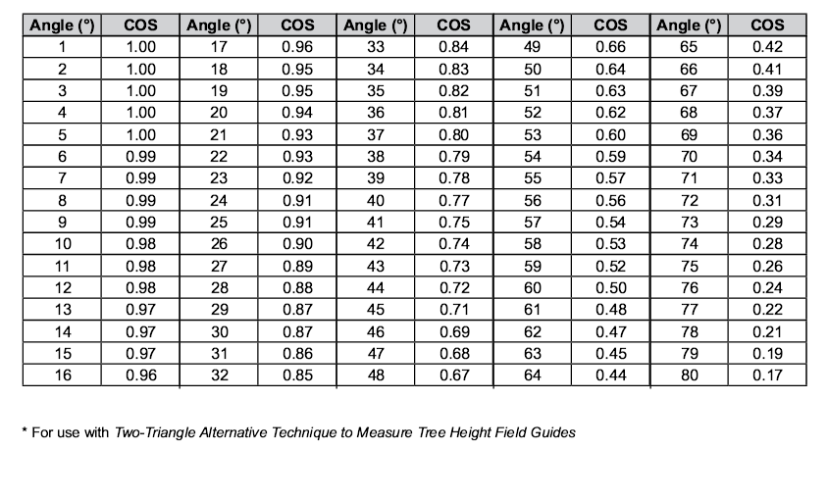
C. Measuring Tree Height When Tree is on a Slope: Two-Triangle and Eyes Higher than the Tree Base - 4
Turn the clinometer around and look through the straw through the opposite end. Site the base of the tree. Have your partner read and record this clinometer angle. This is the 2nd Clinometer Reading.
For the 2nd clinometer reading, use the Table of Tangents, and record the TAN of the angle on the data sheet.
Using the Table of Cosines, record the COS of the 2nd Clinometer Reading on the data sheet.

Slide 24
C. Measuring Tree Height When Tree is on a Slope: Two-Triangle and Eyes Higher than the Tree Base - 5
Measure the horizontal distance from your eyes to the base of the tree. Have your partner help you using the 50 m tape. Record this in the Measure Tree Height on a Slope: Two-Triangle with Eyes Higher than Tree Base Technique Data Sheet.
Calculate the Baseline using the following formula:
(Distance to the Tree) x COS (2nd Clinometer reading)
Calculate the tree height using the following formula:
TAN (1stAngle of Clinometer) x (Baseline) + TAN (2ndAngle of Clinometer) x (Baseline)
Record the tree height on the data sheet.
Repeat steps 1-11 two more times for each tree (for a total of 5 trees) and report the average value. You are done!

Slide 25
C. Measuring Tree Height – Method IV: Two Triangles with Eyes Lower than the Tree Base
The method you use will depend on the topography of your site. This is the Two Triangles with Eyes Lower than Tree Base.
To make the calculations for this method, note that the data sheets will step you through looking up cosine and tangent values from the appropriate tables and guide your calculations- just follow the directions!

Slide 26
C. Measuring Tree Height When Tree is on a Slope: Two-Triangle and Eyes Lower than the Tree Base - 1
For this situation, use the Measure Tree Height on a Slope: Two-Triangle with Eyes Lower than Tree Base Field Guide
In the Field
Work in a team of two. You and your partner move away from the base of the tree until you can see the top of the tree through the drinking straw of the clinometer.
For the best results, adjust your distance so that the clinometer is as close to 30 degrees as possible and you are further from the tree than it is tall

Slide 27
C. Measuring Tree Height When Tree is on a Slope: Two-Triangle and Eyes Lower than the Tree Base - 2
Site the top of the tree using the clinometer. Have your partner read and record the clinometer angle. This is the 1st Clinometer Reading. Your data sheet will instruct you for which measurements you need to identify the tangents and cosines, and keep all your data in order.

Slide 28
C. Measuring Tree Height When Tree is on a Slope: Two-Triangle and Eyes Lower than the Tree Base - 3
Using the Table of Tangents, record the TAN of the angle on the Measure Tree Height on a Slope: Two-Triangle with Eyes Lower than Tree Base Data Sheet.

Slide 29
C. Measuring Tree Height When Tree is on a Slope: Two-Triangle and Eyes Lower than the Tree Base - 4
Sight the base of the tree using the clinometer. Have your partner read and record this clinometer angle. This is the 2nd Clinometer Reading.

Slide 30
C. Measuring Tree Height When Tree is on a Slope: Two-Triangle and Eyes Lower than the Tree Base - 5
Using the Table of Tangents record the TAN of the angle of the second reading on the Measure Tree Height on a Slope: Two-Triangle with Eyes Lower than Tree Base Data Sheet.
Using the Table of Cosines, record the COS of the 2ndClinometer Reading on the Measure Tree Height on a Slope: Two-Triangle with Eyes Lower than Tree Base Data Sheet.

Slide 31
C. Measuring Tree Height When Tree is on a Slope: Two-Triangle and Eyes Lower than the Tree Base - 6
Measure the horizontal distance from your eyes to the base of the tree. Have your partner help you using the 50 m tape. Record this in the Measure Tree Height on a Slope: Two-Triangle with Eyes Lower than Tree Base Data Sheet.

Slide 32
C. Measuring Tree Height When Tree is on a Slope: Two-Triangle and Eyes Lower than the Tree Base - 7
Calculate the Baseline using the following formula:
(Distance to the Tree) x COS (2nd Clinometer Reading)
Calculate the tree height using the following formula:
TAN (1stAngle of the Clinometer) x (Baseline) – TAN (2nd Angle of the Clinometer) x (Baseline)
Record the tree height in the Measure Tree Height on a Slope: Two-Triangle with Eyes Lower than Tree Base Data Sheet.
Repeat steps 1-11 two more times for each tree and report the average value. You are done!

Slide 33
C. Measuring Tree Height on a Slope - Method V : Stand by Tree Technique
The method you use will depend on the topography of your site. This is the Measure Tree Height on a Slope: Stand by Tree Technique.

Slide 34
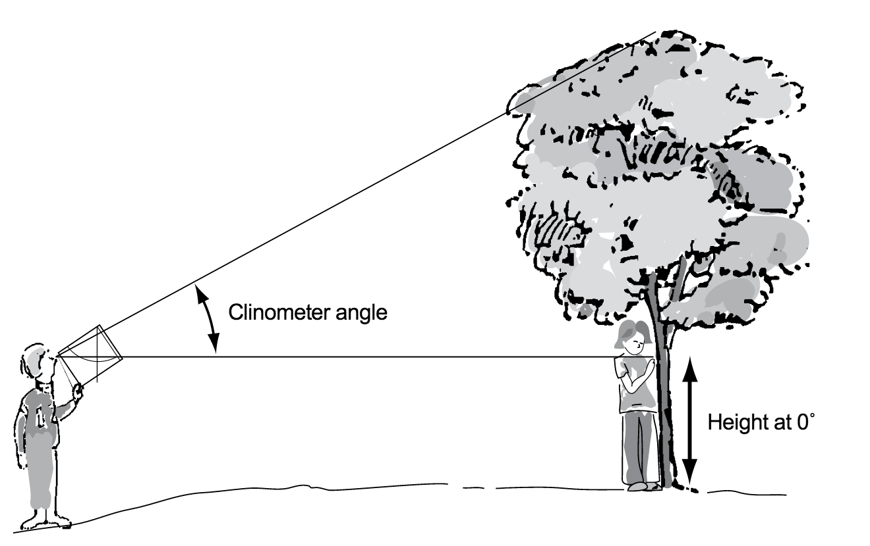
C. Measuring Tree Height on a Slope: Stand by Tree Technique - 1
For this situation, use the Measure Tree Height on a Slope: Stand by Tree Technique Field Guide.
In the Field
1. Work in a team of three. One person stays by the tree. You and another partner move away from the base of the tree until you can see the top of the tree through the drinking straw of the clinometer.
2. Site the top of the tree using the clinometer. Have your partner read and record the clinometer angle.
For the best results, adjust your distance so that the clinometer is as close to 30 degrees as possible and you are further from the tree than it is tall.

Slide 35
C. Measuring Tree Height on a Slope: Stand by Tree Technique - 2
3. Using the Table of Tangents, record the TAN of the angle on the Measure Tree Height: Stand by Tree Technique Data Sheet.
4. Keeping the clinometer at 0 degrees, look through the straw and have your partner by the tree locate the position on the tree that you see.

Slide 36
C. Measuring Tree Height on a Slope: Stand by Tree Technique - 3
5. Measure the height from the base of the tree to the position on the tree that you see when the clinometer reads 0 degrees.
6. Measure the distance between you and the tree. Have your partner help you using the 50 m tape. Record this in the Measure Tree Height: Stand by Tree Technique Data Sheet.

Slide 37
C. Measuring Tree Height on a Slope: Stand by Tree Technique - 4
7. Calculate the tree height using the following formula:
[TAN (Angle of the Clinometer) x (Distance to Tree)] + (Height to 0 Degrees on Tree)
8. Record the tree height on the data sheet.
9. Repeat steps 1-8 two more times for each tree and report the average values. You are are done!

