Slide 1


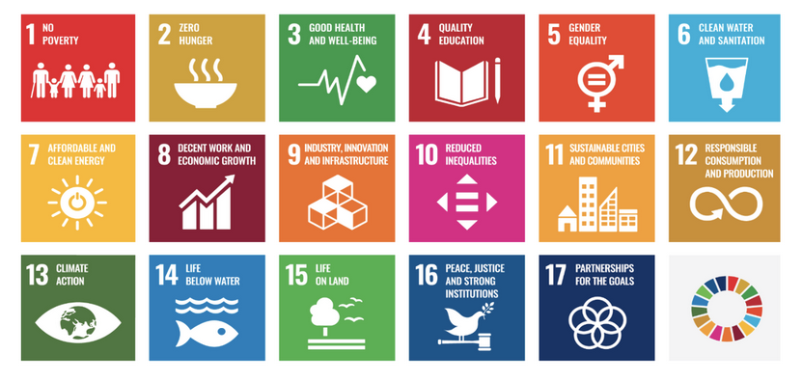
Fostering the Next Generation of STEM Professionals and Science Diplomacy
Science Summit at UNGA77
15 September 2022

Slide 2


GLOBE is one of the world leaders in environmental science diplomacy through education
Environmental Science Diplomacy through education – is a joint effort to strengthen collaborations among nations in science and engineering education to address common problems and build strong international partnerships to achieve the UN Sustainable Development Goals.
Environmental Science Diplomacy education is making a great progress in primary, secondary, post-secondary education/higher education around the world
“Science diplomacy is the use of scientific collaborations among nations to address common problems and to build constructive international partnerships”*
* Source: https://en.wikipedia.org/wiki/Science_diplomacy
Notes:
Larisa and Mike slide

Slide 3
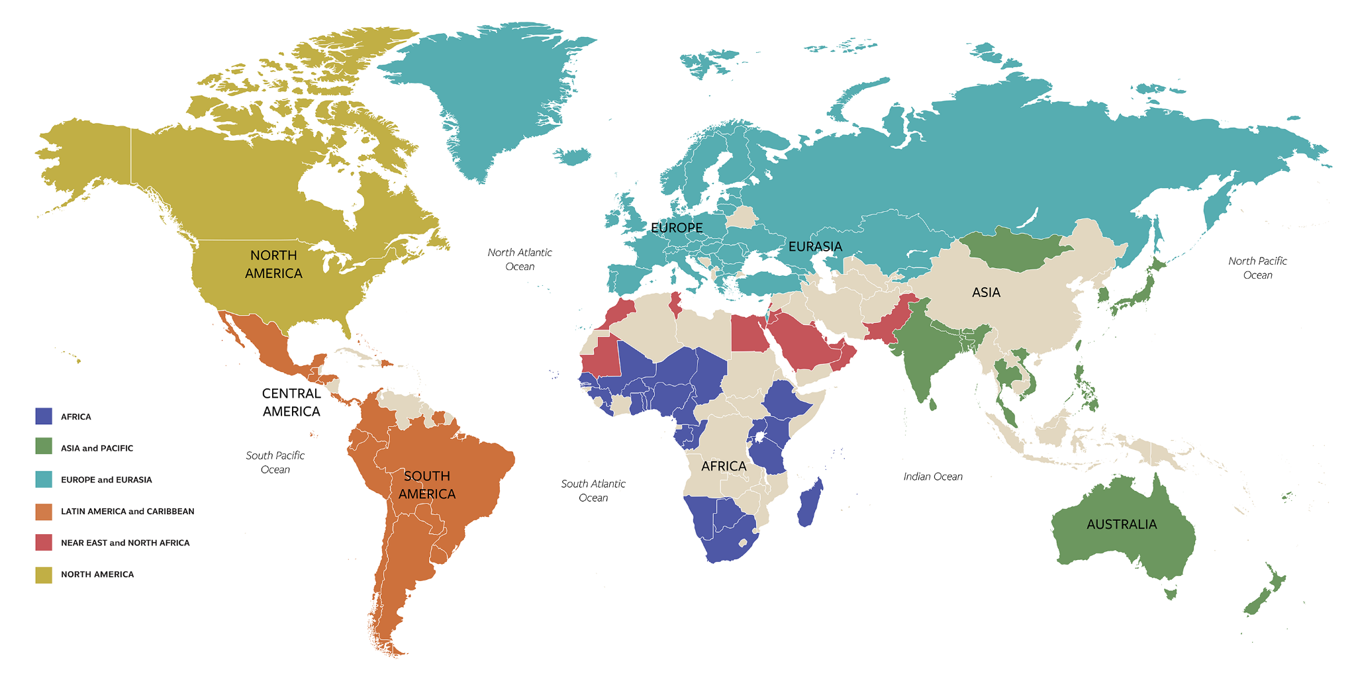
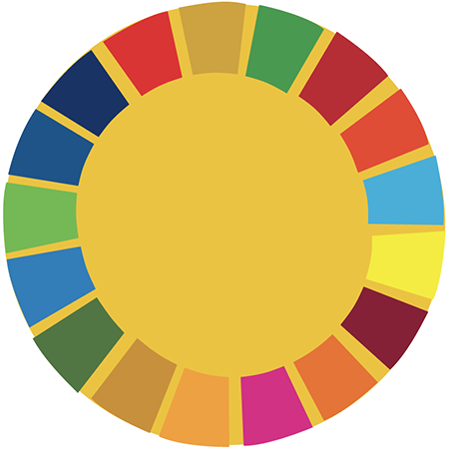
Notes:
Mike and Larisa introduce themselves and the panel; and comment on the diversity:
1 rep from each region

Slide 4
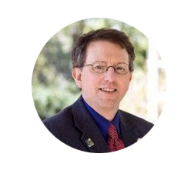
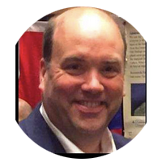
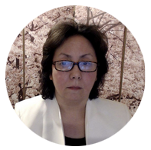
Presenter
Tony P. Murphy
Director, GLOBE Implementation Office, The GLOBE Program, North America Region
Moderators
Michael Jabot
SUNY Distinguished Professor, State University of New York, North America Region
Larisa Schelkin
CEO, Global STEM Education Center, Inc., Shrewsbury, Massachusetts, North America Region

Slide 5
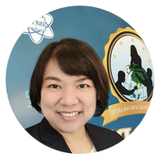
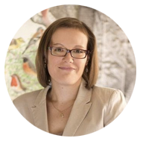
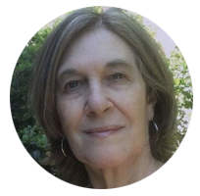
Speakers
Tony P. Murphy
Director, GLOBE Implementation Office, The GLOBE Program, North America Region
Yupaporn Laplai
Institute for the Promotion of Teaching Science and Technology, (IPST), Thailand, Asia and Pacific Region
Ela Woloszynska-Wisniewska
UNEP/GRID-Warsaw Centre, Europe and Eurasia Region
Marta Kingsland
Professor, Universidad de Ciencias Empresariales y Sociales, Latin America and Caribbean Region

Slide 6
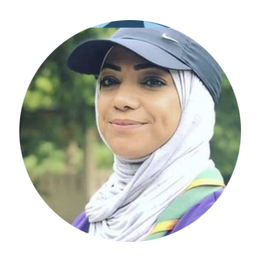
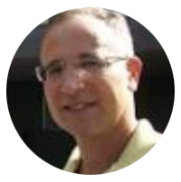
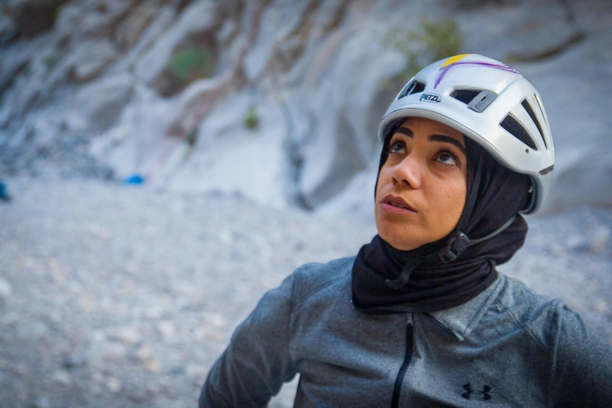
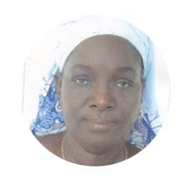
Speakers
Nadhira Ahmed Alharthy
Ministry of Education, Oman, Near East and North Africa Region
Kevin Czajkowski
Professor, University of Toledo, North America Region
Ngosse Fall Bousso
Professeur de SVT, Lycee Seydina Limamoulaye, Senegal, Africa Region

Slide 7
Dr. Tony Murphy
Director, GLOBE Implementation Office
USA
GLOBE Region North America
tmurphy@ucar.edu

Slide 8
Notes:
The current ‘GLOBE, 127 Counties in 6 regions’

Slide 9
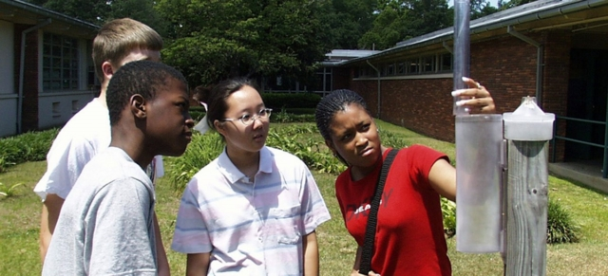
What is The GLOBE Program?
The Global Learning and Observations to Benefit the
Environment (GLOBE) Program is an international science
and education program that
provides students and the public worldwide with the opportunity to participate in data collection and the scientific process, and
contribute meaningfully to our understanding of the Earth system and global environment.
Announced in 1994, GLOBE began operations on Earth Day 1995. Today, this international network has grown to include representatives from 127 countries coordinating GLOBE activities that are integrated into their local and regional communities.
The GLOBE Program infrastructure and management is funded by NASA with additional support from NOAA, NSF, and the Dept. of State. When a country joins GLOBE, it gets access to this infrastructure and in turn funds the implementation of the program in its country.

Slide 10

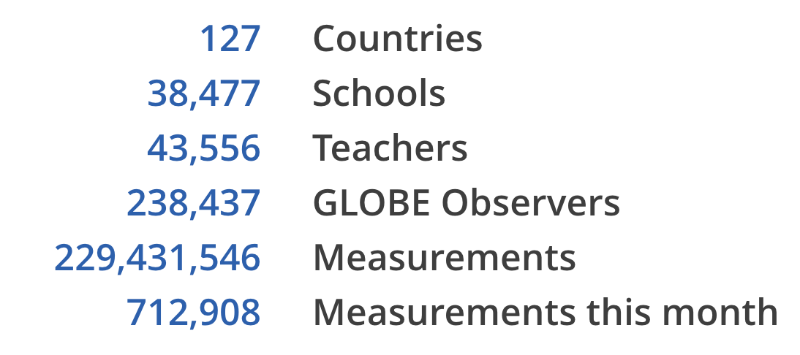
Current State of GLOBE
6 GLOBE Learning Expeditions
Kilimanjaro Expeditions
Campaigns
Student Research Projects
5 Working Groups
1 US Partner Forum
100s Star and STEM Stories
Data retrieved on Sept 12, 2022

Slide 11
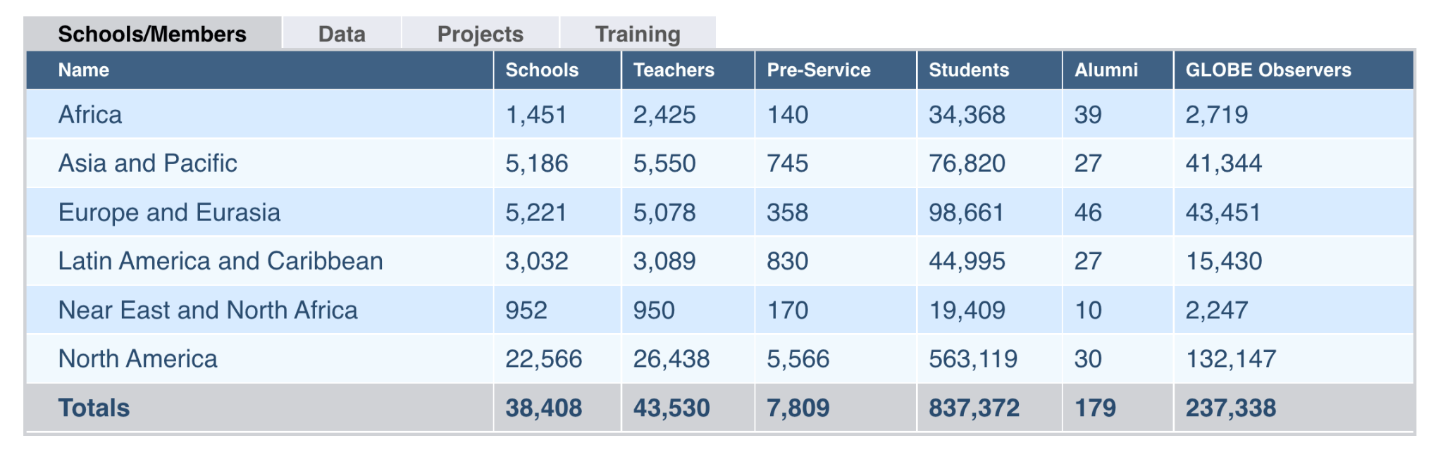
Current State of GLOBE
Data retrieved on Sept 12, 2022

Slide 12


GLOBE & Key Partnerships
The GLOBE Program and United Nations Environment Programme (UNEP) share
a common commitment to the environment, capacity building, and cultural understanding.
NASA and UNEP announced an agreement to work together on the promotion and implementation of GLOBE and UNEP activities in August 2019.
Both will cooperate on E.E and training, citizen science, and the collection and distribution of data.
They will also work together to increase awareness of, and promote the use of, GLOBE data by the international science community by leveraging the UNEP’s Global Resource Information Database (GRID) Centers and publications
GLOBE and UNEP will share education and training resources for distribution to their networks and promote closer collaboration of UNEP Regional Offices with GLOBE countries and the RCOs

Slide 13
Recognition and Awards
2021: GLOBE won American Geophysical Union’s (AGU) 2021 Excellence in Earth and Space Science Education Award! The award is given annually to an individual, or group/team demonstrating a sustained commitment to excellence in geophysical education. Successful candidates have made long-lasting, positive impacts in the Earth and space sciences at any education level from kindergarten through postgraduate studies.
2004: GLOBE receives the Goldman Sachs Award for being an “outstanding program that makes use of media/technology to educate students or teachers about other world regions and cultures, or international issues.”
Recognition for GLOBE Estonia
“Keskkonnakäpp 2021” – for involving youth, environmental award Cover picture attribution: Daria Lehmann, Scientific Assistant, GLOBE Switzerland -
Swedbank recognition - GLOBE 25, involving youth in scientific projects - “
Aasta haridustegu 2021” – “Act of the year, GLOBE 25 years in Estonia”,
education award, (1) national finalist,
(2) winner in Tartu -
National Science Communication Award, 2nd prize

Slide 14
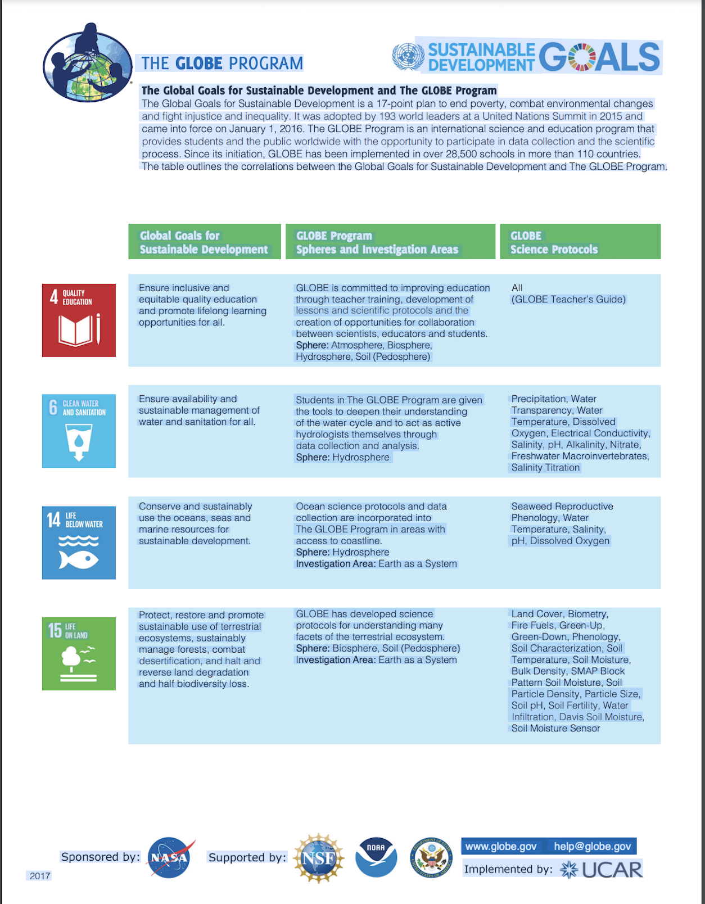
GLOBE & Sustainable Development Goals
Each region representative tells the story of how GLOBE helped to achieve the SDGs in their countries with strong and diverse cases.
These vary from collecting data on numbers and species of mosquito larvae to urban temperatures. Then analyzing the data to investigate numbers of adult mosquitoes with vector borne diseases to increasing urban temps as part of the Urban Heat Island effect.
In addition, GLOBE is finalizing a video series called ‘Agents of Change’ which shows the impact the program has on students around the world. A clip from one of the videos is shown in the NENA region presentation, examining the use of GLOBE to encourage girls in science, and helps meet SDG #5 (Gender Equality: Support girl/female participation in GLOBE).
So, sit back and learn about and from these great GLOBE examples

Slide 15
Yupaporn Laplai
Specialist in Science Education
Thailand
GLOBE Region Asia and Pacific
globethailand@ipst.ac.th

Slide 16




ABOUT IPST & GLOBE THAILAND
The Institute for the Promotion of Teaching Science and Technology
was established by the support of the United Nations Development Programme (UNDP).
Under the Ministry of Education, Thailand
By virtue of The Institute for the Promotion of Teaching Science and Technology Act B.E. 2541 (1998), amended in B.E. 2548 (2005) (second issue).
An autonomous agency in accordance with the regulations of the Public Administration and the Budgetary Procedures.
Thailand jointed the GLOBE Program in September 30, 1999 (23th GLOBE Thailand)
Notes:
IPST established in January 16, 1972

Slide 17

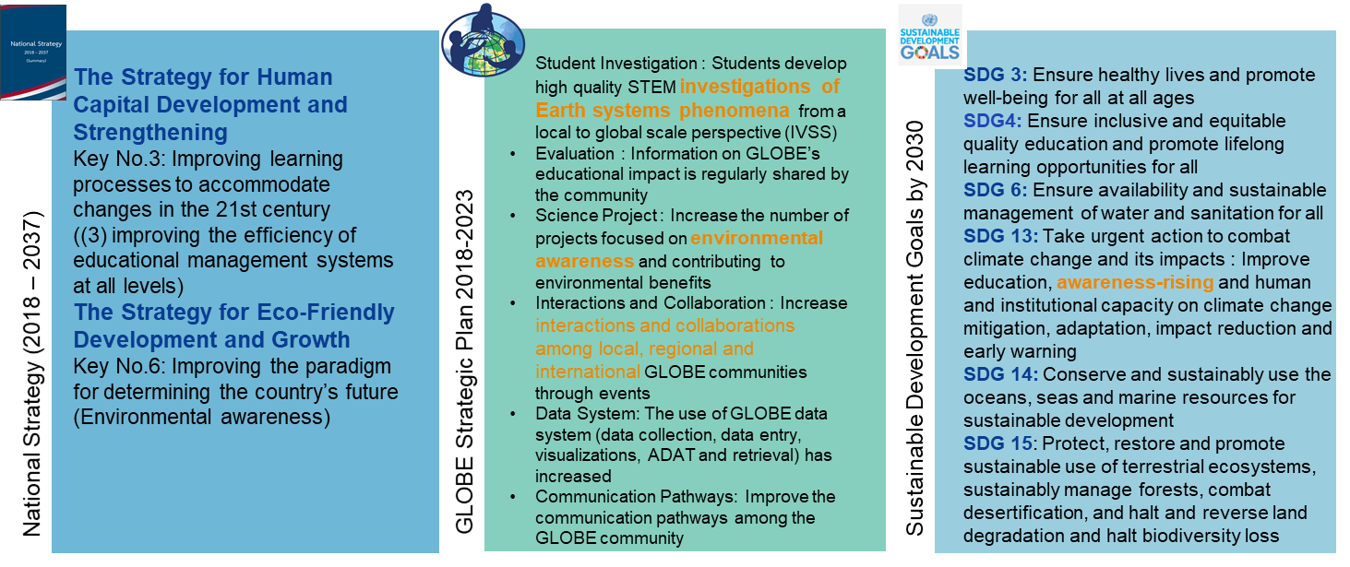
GLOBE National, International Goals

Slide 18
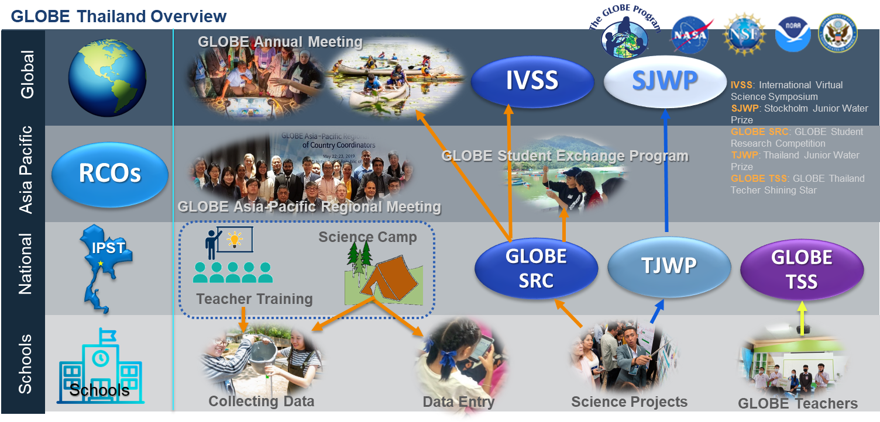

Slide 19
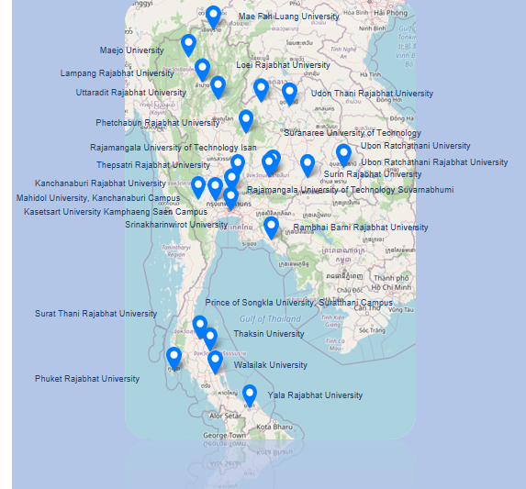
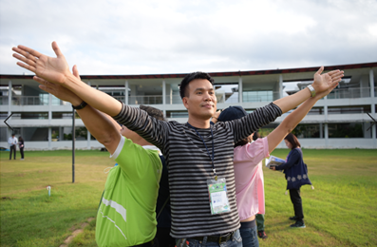
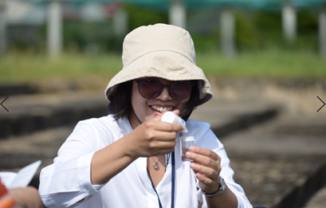
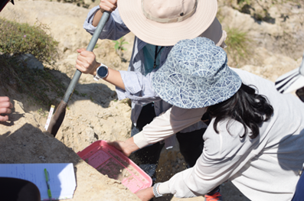
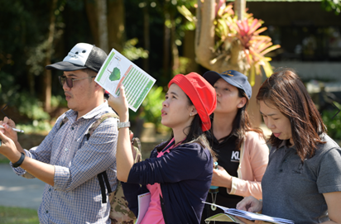
GLOBE Train-the-Trainer Workshop - GLOBE Thailand Network
2005 – 2020, IPST organized 6 GLOBE Train-The-Trainer Workshops
To promote common understanding of GLOBE Protocols among teachers, researchers, scientists, and educators.
To encourage networking among university professors, relevant organization and staff of GLOBE Thailand.

Slide 20


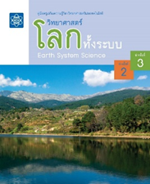

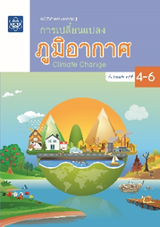

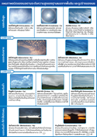
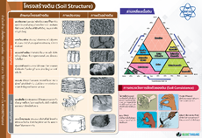
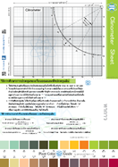
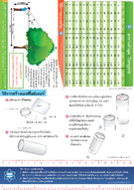

GLOBE Instruction Media
#SDG3
#SDG13
GLOBE Medias
Earth System Science: ESS
To promote the learning about the environment in a scientific manner by doing research in their local. The students will develop a body of knowledge, analytical thinking process and holistic systematic thinking, problem solving and decision making skills, information technology, communication and team work skill.
GLOBE Protocols: Atmosphere, Hydrosphere, Pedosphere and Biosphere
Climate Change Learning Activity
To promote student learning about Climate, Impact of Climate Change and Adaptation and Mitigation of Climate Change
Student Book and Teacher guide
Upper primary level and Lower secondary level
GLOBE Protocols: Air Temperature, Cloud, Mosquito

Slide 21


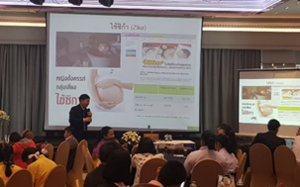
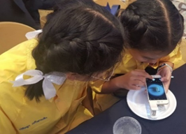
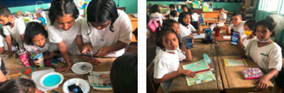
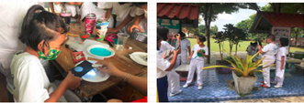
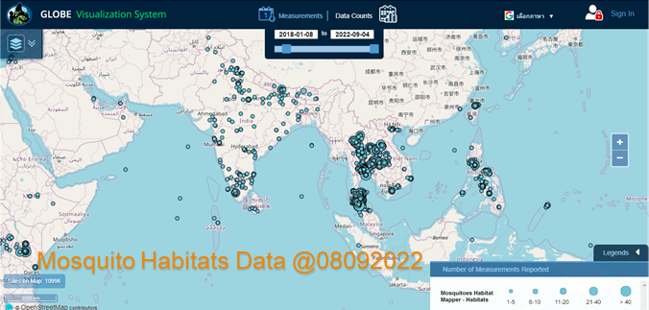
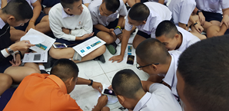
ZIKA EDUCATION AND PREVENTION PROJECT IN THAILAND
Fiscal year 2018- 2020, received partial grant from GIO
#SDG 3
Mosquito Habitat Mapper Observation
Training Workshop
Collecting Data & GLOBE Data Entry
9,257 participants
(Student, Teacher, Parent)
IPST & 13 Universities

Slide 22

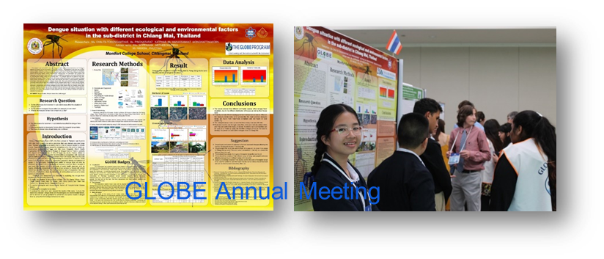
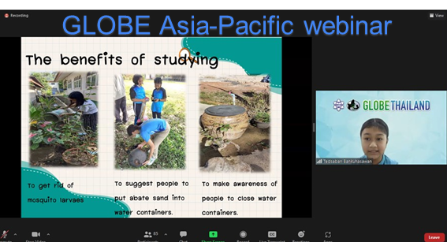
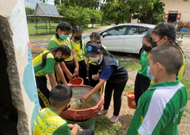
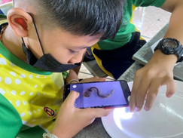
ZIKA EDUCATION AND PREVENTION PROJECT IN THAILAND
Fiscal year 2018- 2020, received partial grant from GIO
Student Research & Implementation to Local Community
31 researches related mosquito submitted to GLOBE SRC 2018 – 2022
3 researches won the IVSS prize
Share their research to local, regional and global community
Collaborate with Village Health Volunteer (Ministry of Public Health) to monitor and eliminate the mosquito breeding site and support SDG3
Notes:
Student shared their research to the community and collaborate with Public Health officer to monitor and eliminate the mosquito breeding site. These activity will support SDG3 and decrease number of case from mosquito borne disease.

Slide 23
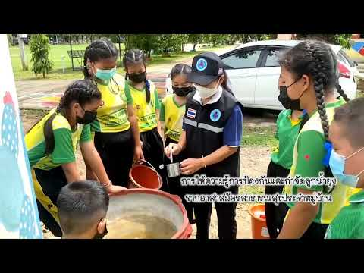

Slide 24


Ela Wołoszyńska-Wiśniewska
Director of Education and Geoinformation at UNEP/GRID-Warsaw Centre
GLOBE Country Coordinator for Poland
GLOBE Region Europe and Eurasia
ela@gridw.pl

Slide 25
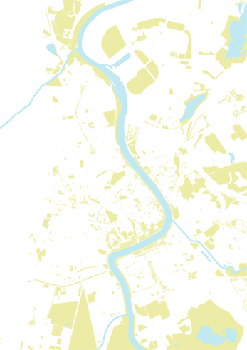
UNEP/GRID-Warsaw
An NGO affiliated by the United Nations Environment
Program, UNEP (United Nations [UN] Environment Program).
Part of the Science Division of the UNEP global group of the environmental
information centres, the Global Resource Information Database (GRID) network.
Since 1991 we’ve been implementing the mission of UNEP
in Poland. We support and inspire our partners on their way
towards sustainable development.
In July 1997 we were assigned by the Ministry of Education
as the Country Coordinator of GLOBE Program in Poland.

Slide 26
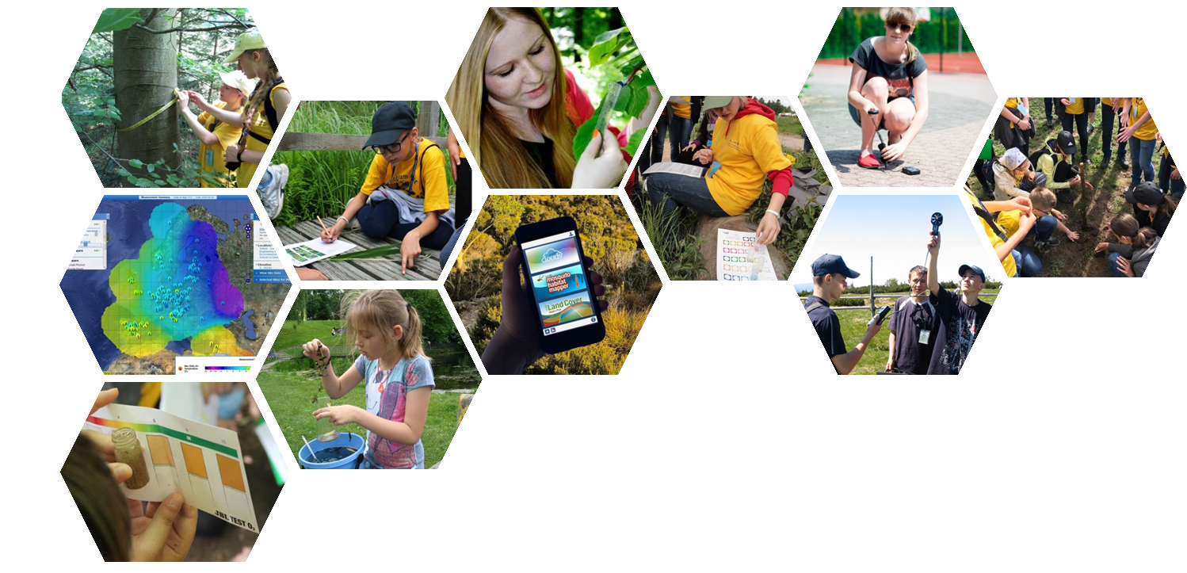
GLOBE
in Poland
Over 200 schools
About 250 teachers
More than
4500 students
Almost 3,7 million data collected
Almost 2400 active GLOBE Observers
Young people, teachers, scientists,
members of the local communities…
We’ve been acting together for the green future
within the GLOBE Poland for 25 years!

Slide 27
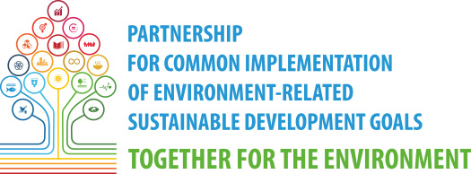
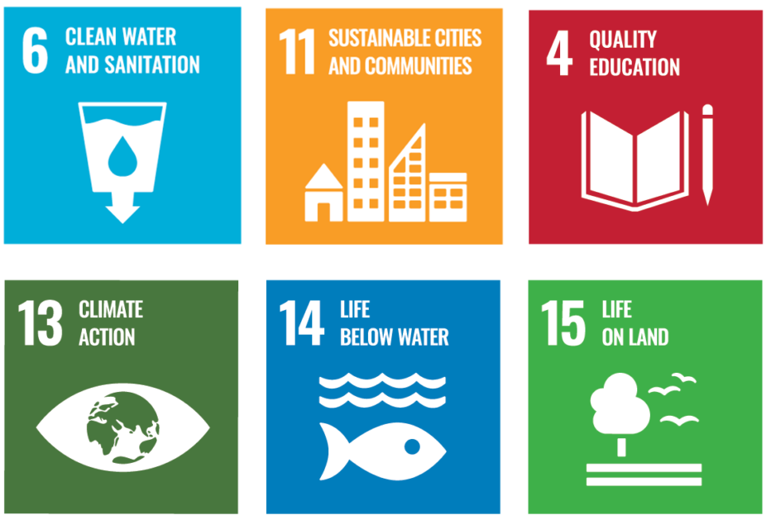
Partnership was established in order to create the best possible conditions to implement SDGs in Poland, especially those related to the environment. We link partners from different sectors, incl.: business, administration and education.

Slide 28
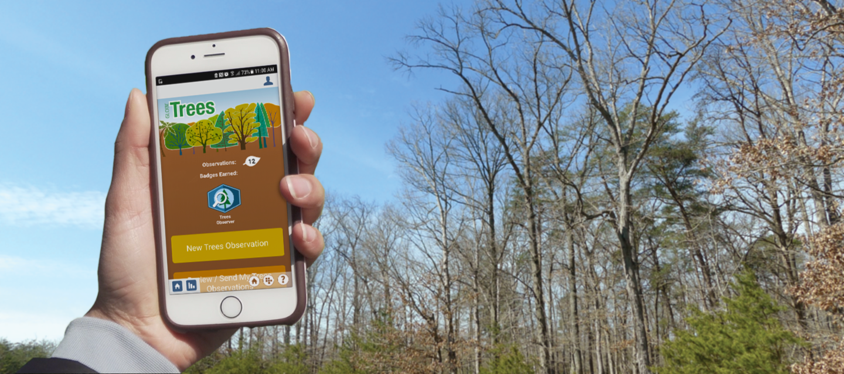
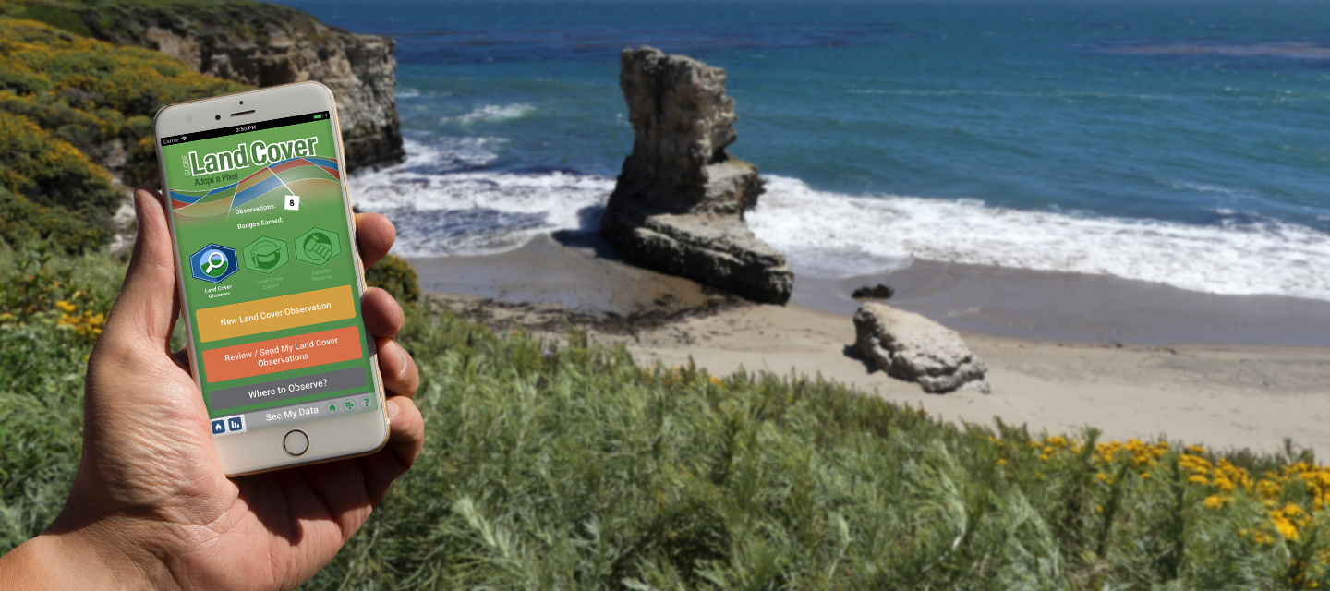
Spring 2022 Tree Height and Land Cover Intensive Observation Period within GLOBE Program
Initiated by UNEP/GRID-Warsaw and The Trees Around the GLOBE Student Research Campaign team.
Open to everyone: from students to educators to citizen scientists.
Participants collect tree data (height, perimeter) and land cover observations, using the traditional GLOBE protocols and/or the NASA GLOBE Observer App.
Data can be used by scientists and researchers focused on, for example, climate change and ecosystem research.
IOP supported celebrations of the 50th anniversary of UNEP.

Slide 29
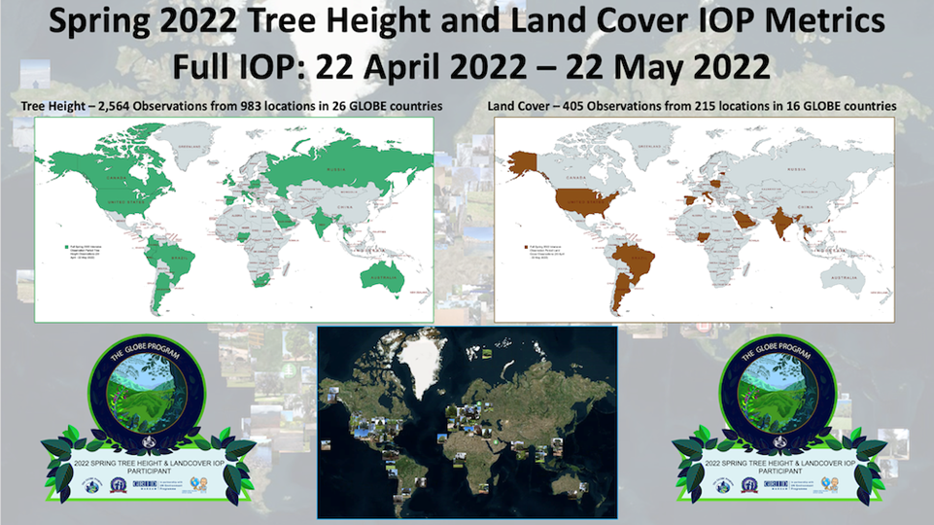
323 tree height observations
from 174 sites
in Poland!

Slide 30

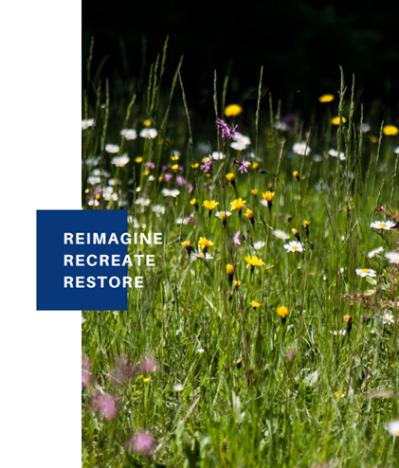
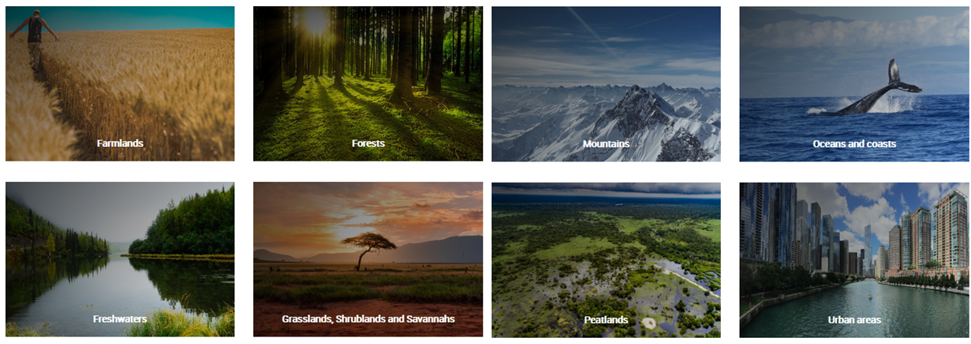
IOP supported
UN Decade on Ecosystem Restoration
Ecosystem restoration means assisting in the recovery of ecosystems that have been degraded or destroyed, as well as conserving the ecosystems that are still intact – on every continent and in every ocean.
https://www.decadeonrestoration.org

Slide 31

GLOBE community contributes to the Ecosystem Restoration
and achievement of the SDGs, including SDG 15
Work with GLOBE Bundle Protocols (https://www.globe.gov/web/earth-systems/community) to get to know environmental challenges and actual state of ecosystems.
Continuous data collection and
research projects with the use
of current and archival GLOBE data
to help observe/monitor ecosystem
changes (effectiveness of the
restoration activities).
Participation in the restoration
activities on local level.

Slide 32


Marta Kingsland
Argentine GLOBE Country Coordinator
Mentor Trainer
GLOBE Region Latin America and Caribbean
Geography Teacher, Specialist in Education and New Technologies
programaglobe.mk@gmail.com

Slide 33

1995
The GLOBE Program begun in Argentina with the signing of the agreement with the Ministry of Education.
Since this year, teachers are invited to participate in workshops at least once a year.

Slide 34


Total Number of:
Schools 202
Teachers 518
Students 9164
Data entries 538.691
Citizen scientists

Slide 35
Aligned to the GLOBE Program, our goals are:
Generate the possibility for students to understand science at an early age.
To teach science from the practice.
Promote activities in collaboration with other students and schools from different countries on inquiring-based investigations
Participate in various scholarly activities( sciences fairs- virtual meetings-scientific campings

Slide 36

Sustainable Development Goals
SDG 4 Quality Education: GLOBE improves STEM skills
“Developing and supporting activities for teachers and trainers, inquiry- focused and based on Earth system science and Science, Technology, Engineering and Mathematics (STEM)”
GLOBE Strategic Plan 2018-2023
To teach and learn science from the practice.

Slide 37

Why SDG 4 Quality Education: GLOBE improves STEM skills and how the GLOBE Program from Argentina works on it?
Organizing collaborative activities with the participation of different subject´s teachers.
Cooperative learning
Understanding topics related to STEM applying different GLOBE protocols
Some examples

Slide 38



Integrating STEAM into the curriculum
Projects based on learning

Slide 39



A learning model in the real world

Slide 40





GLOBE Program + UN’s Sustainable Development Goals + STEM is a journey to have the skills to understand through education some problems in the local and global world

Slide 41

Nadhira Ahmed Alharthy
Deputy General Manager for Oman Scouts and Guides
Ministry of Education
Athlete-mountaineer
Oman
GLOBE Region Near East and North Africa (NENA)
nadhirah.alharthy@gmail.com

Slide 42

Oman joined The GLOBE Program in September 8, 2009
Ministry of Education message
The Ministry of Education (MOE) is working to prepare a generation to achieve economic and social development of society through optimizing educational and learning processes in school administration.
MOE seeks to provide a distinguished human resources, curricula, buildings, assessment tools for different students.
This could happen by implement technology to cope with Oman digital society, and to activate a larger role of the local society and the private sector in the promotion of educational service.
signing of the agreement with the Ministry of Education.

Slide 43

How we are working ?
Under Secretary for Education
The Country Coordinator
Central team 8 members
Supervisores
Teachers all over the country
Students

Slide 44


Slide 45



Slide 46


Implement SDGs by doing GLOBE

Slide 47


Implement SDGs by doing GLOBE

Slide 48
We would like to close our presentation with a short extract from a film about girls in science and leadership what was recently produced by The GLOBE Program.
This film follows a team of 3 girls who used their knowledge about hydrology and soil gained from their involvement with The GLOBE Program to develop a project to help local farmers improve their crop yield in an area faced with high water and soil salinity.
The girls are developing a liquid fertilizer from the roots and stems of a local wild plant, freely and widely available and proving to be a sustainable solution for local farmers.

Slide 49


Slide 50

Kevin Czajkowski
Professor, University of Toledo, Ohio, USA,
Director of University of Toledo GLOBE Partnership
GLOBE Region North America
kevin.czajkowski@utoledo.edu

Slide 51


Slide 52


Slide 53


Slide 54


GLOBE Urban Heat Island Effect (UHIE) Intensive Observation Period addresses SDG 11 - Sustainable Cities and Communities
Mitigation of UHIE
Using sustainable building materials
Planting trees and creating green space

Slide 55

High School Student Research Project: Will Guth, Urbana, IL - NASA N3 Program
The Impact of Pavement Materials on the Urban Heat Island Effect:
Urbana, Illinois

Slide 56


Slide 57


Slide 58


Slide 59

Ngosse Fall Bousso
Inspector sciences
Country Coordinator GLOBE SENEGAL
GLOBE Region Africa
fallngosse@yahoo.fr

Slide 60



Our Achievements

Slide 61





Slide 62


Slide 63


Slide 64



Slide 65



Slide 66



Slide 67



Slide 68


GLOBE helps meet the Sustainable Development Goals
With the active participation of the community in the Zika Project, GLOBE achieves SDG 3, Good health and Well Being.
Through experimentation and data collection, GLOBE improves STEM teaching and strengthens the participation of girls in STEM, SDG 4, Quality Education and SDG 5, Gender Equality respectively
Raising awareness on environmental phenomena and floods, GLOBE contributes to
SDG 11, Sustainable Cities and Communities, and SDG 15, Life on Land
By sending data to the GLOBE website for research purposes, GLOBE strengthens collaboration between researchers and participates in SDG 13, Climate Action
Notes:
Tony will tie it together
Q&A

Slide 69

GLOBE helps meet the Sustainable Development Goals
GLOBE students can conduct scientific research on local issues and inform their communities of possible solutions and actions.
Through this process and because of the international nature of GLOBE, where students can communicate, meet, learn about each other and their countries, as well as collaborate on research, they learn many of the valuable skills required in Science Diplomacy. (see Figure 1.)
Ultimately, GLOBE is an essential lever helping achieve the Sustainable Development Goals, and should be supported all over the world.
Figure 1. Skills Map for Evidence-Informed Policymaking, Adapted from: Framework for Skills for Evidence-Informed Policy-Making, JRC (2017) (https://www.s4d4c.eu/topic/6-2-1-science-and-diplomacy-two-different-worlds/)
Notes:
Tony will tie it together
Q&A

Slide 70

www.globe.gov
Proud recipient of the
2021 Excellence in Earth and Space Science Education Award
from the American Geophysical Union

