Slide 1
GLOBE IN XV. GIMNAZIJA
ZAGREB, CROATIA

Slide 2
ABOUT OUR SCHOOL XV. GIMNAZIJA
A grammar school dedicated to math and natural sciences
located in Zagreb, the capital of Croatia
National programme + international IB Programme
About 1200 students
ALSO called MIOC

Slide 3
About our GLOBE group
In The GLOBE program since 1996
15 active members
4 globe classes
1 professor mentor and 1 GLOBE alumni
Attended The GLOBE national competition 9 times (2015 - 2nd place, 2016 & 2017 – 1st place)
Active in our school and local community

Slide 4
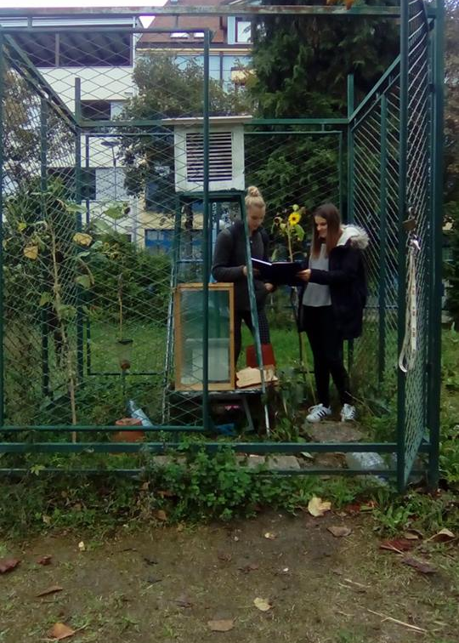
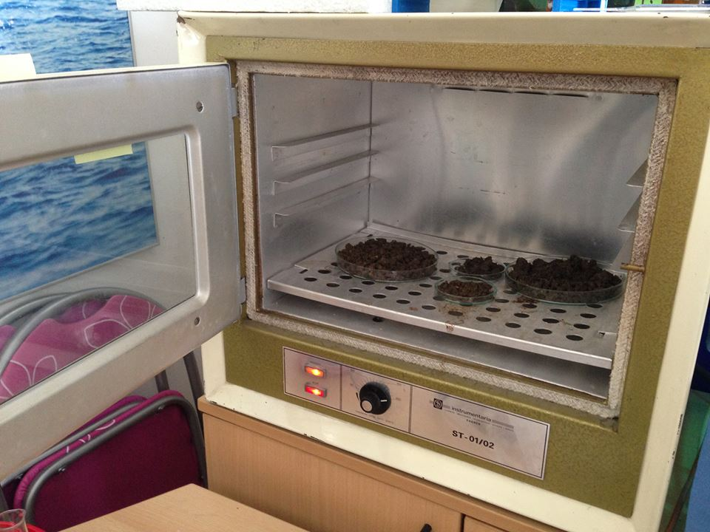
Measurements
we regularly conduct measurements in:
Atmosphere (school atmosphere station)
Water (Maksimir and Jarun lakes)
Soil
Phenology
Biometry

Slide 5
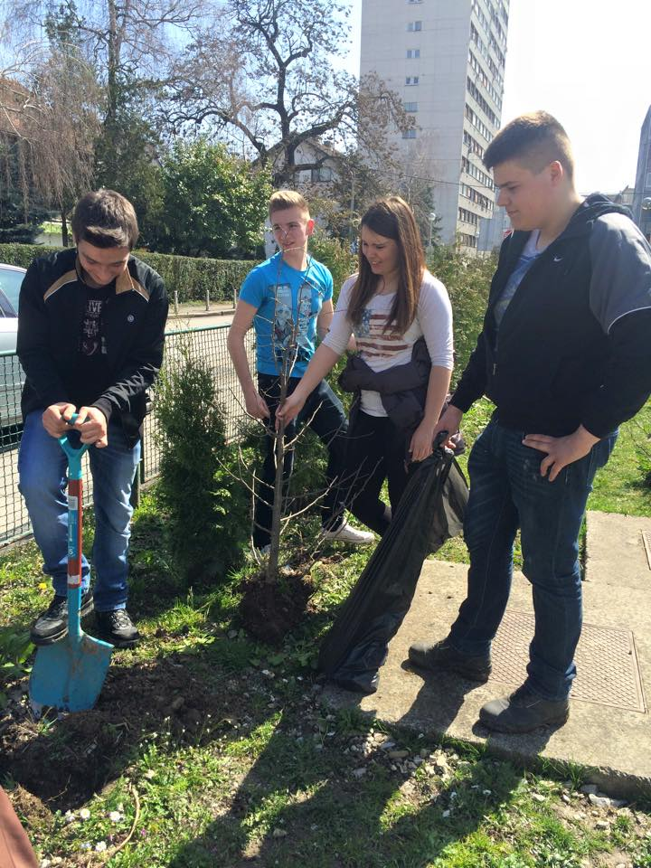
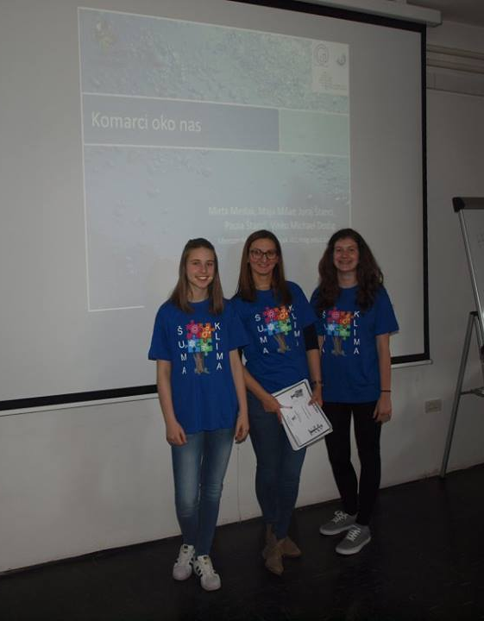
Activity in our school and local community
‘Kids to kids’, informing primary school students about water pollution and preserving water
Making our school district more green by planting trees
Presenting our research project at the Forestry Institute in Zagreb

Slide 6
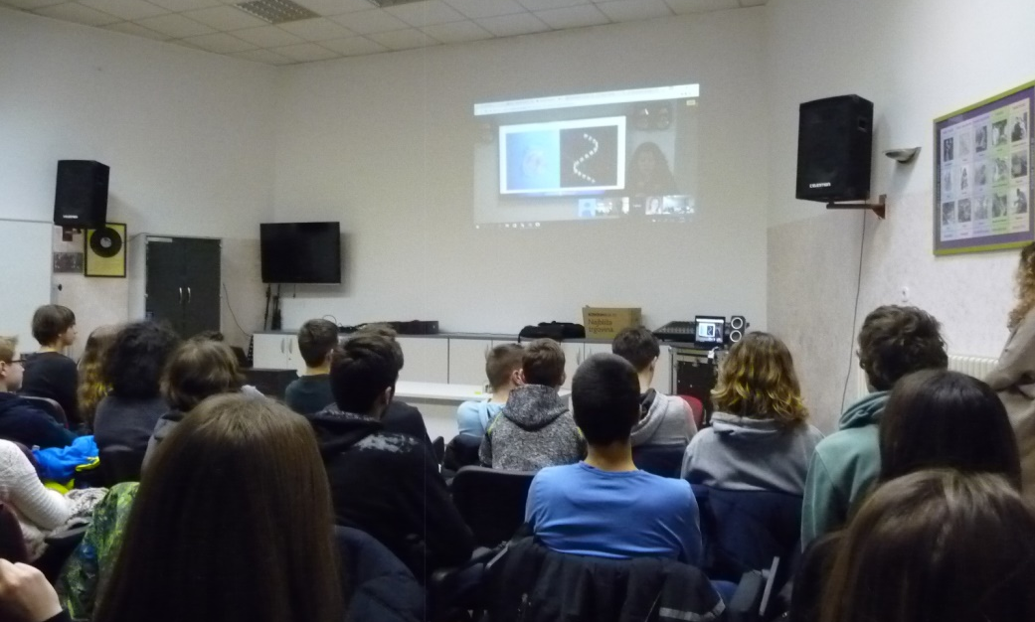
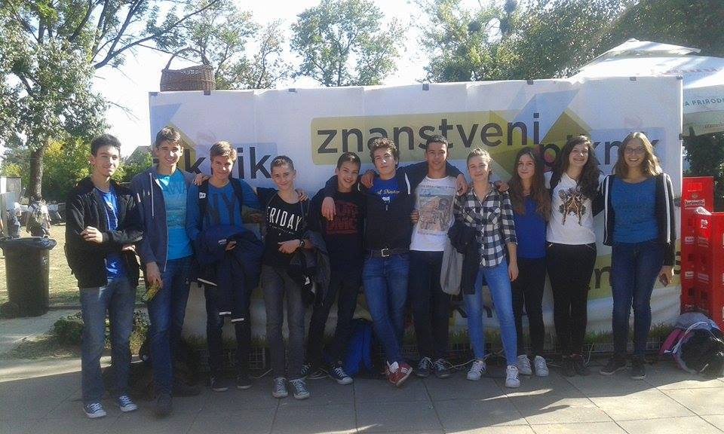
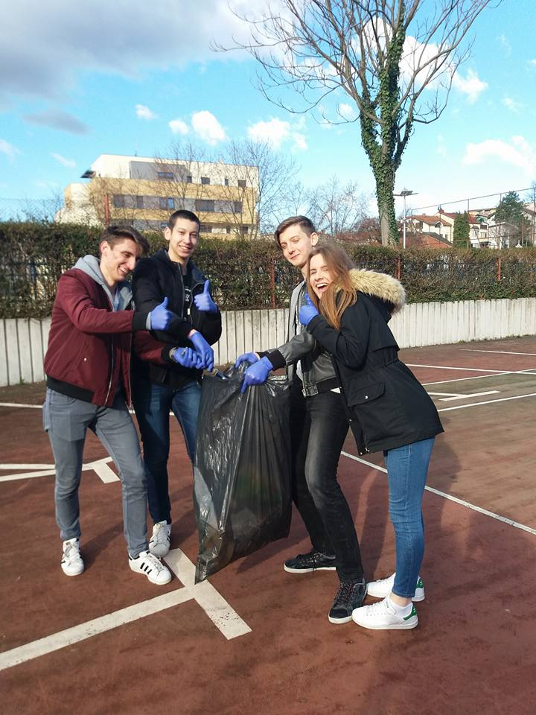
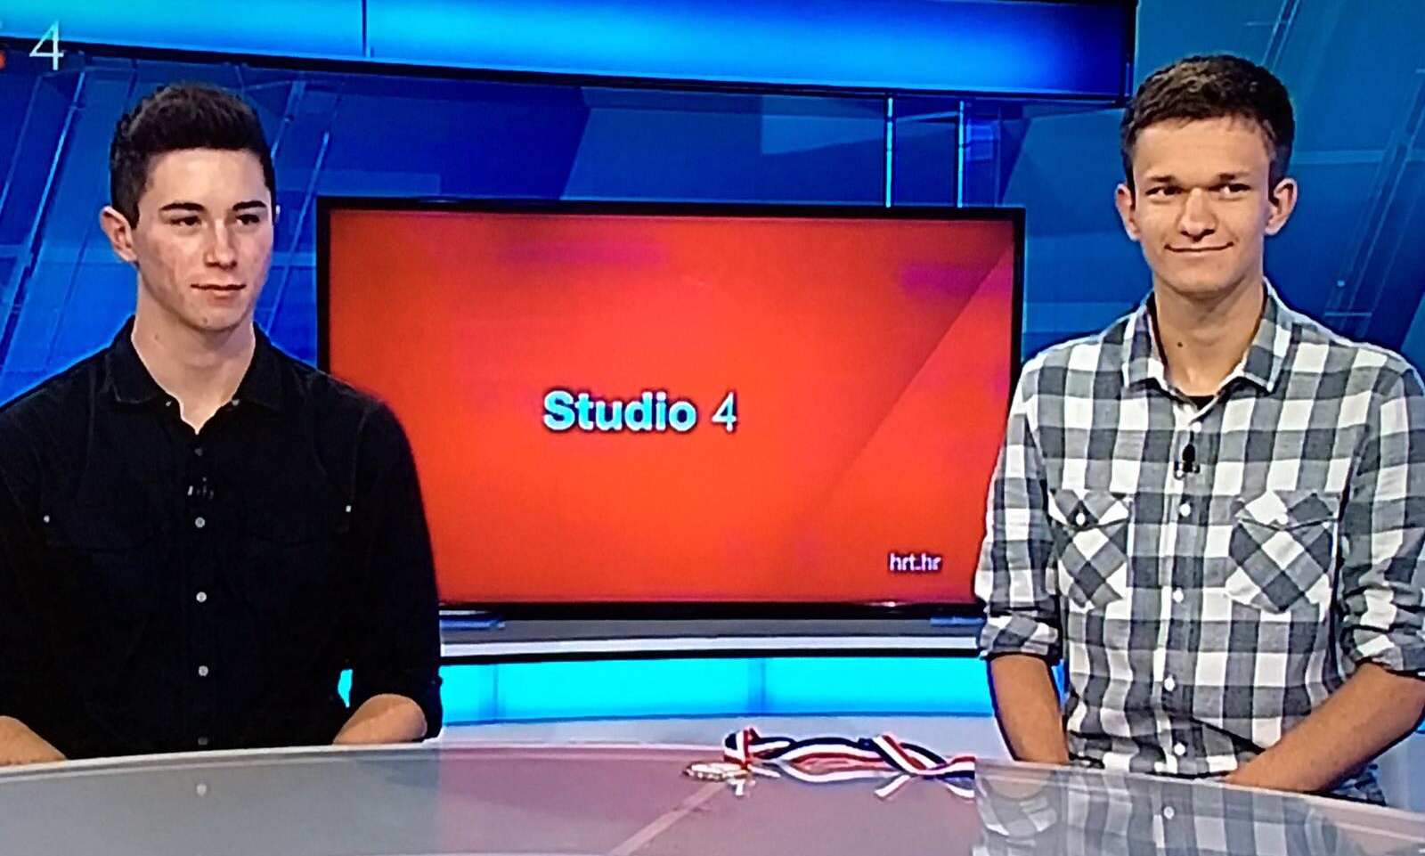
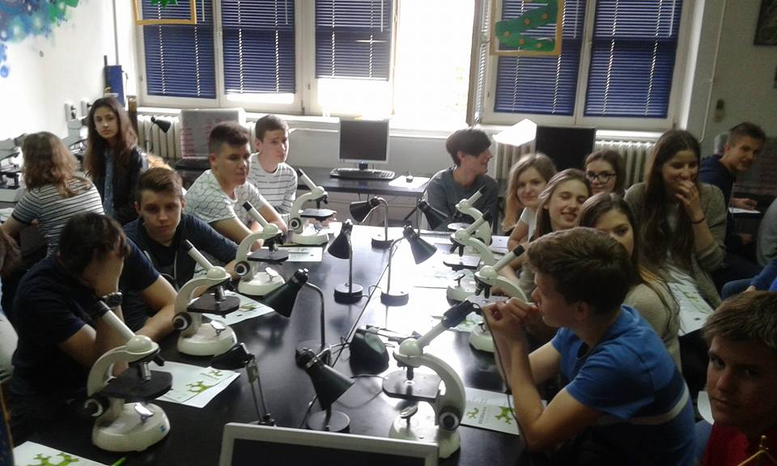
Activity in our school and local community
A webinar which we organised in collaboration with Schmidt Ocean Institute & NASA
Participating in the ‘Scientific Picnic’ and collaborating with GLOBE alumni
We annually organise cleaning of the school district
Talking about our recent project and GLOBE on a Croatian national TV channel
Visiting an collaborating with Faculty of Science in Zagreb

Slide 7
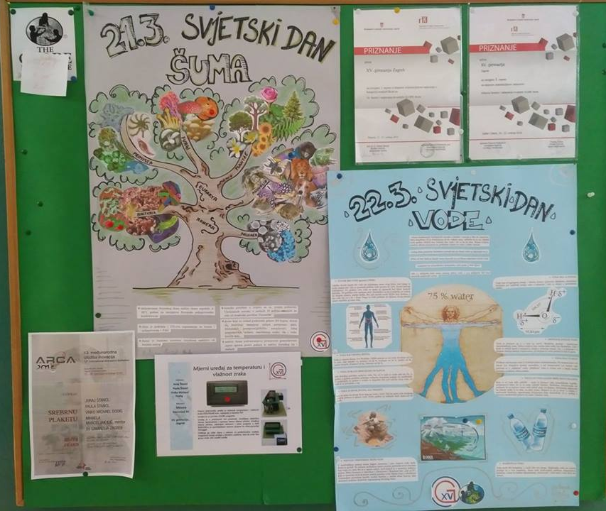
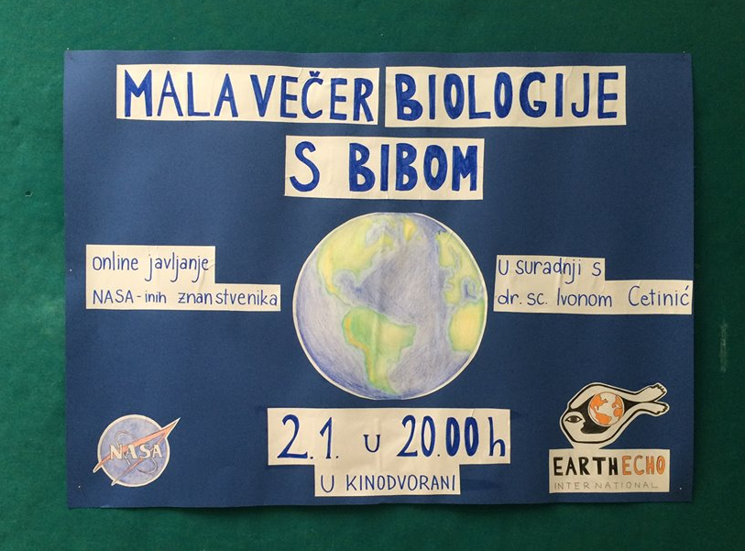
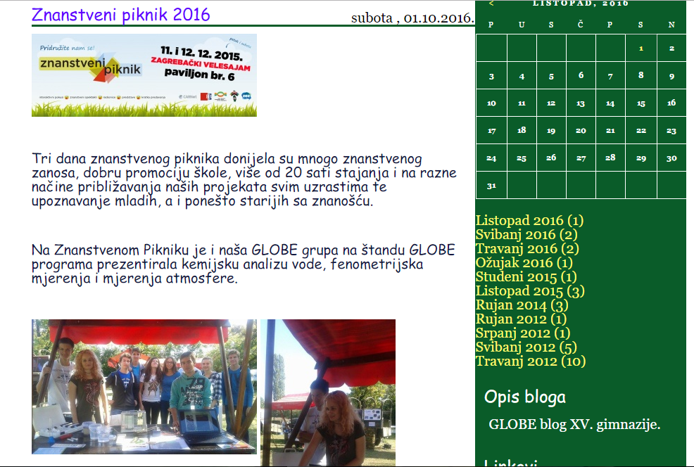
Globe in our school
We inform our students about important eco-days, our activities and our projects using posters which are displayed around our school
We write about our activities on our school web page and GLOBE blog

Slide 8
Globe national competition 2017 in zadar, Croatia
Every years the best globe schools in croatia meet somewhere in croatia
The schools which pass the regional competition send out at least three students who participate in the competitions
Students present their scientific research projects
Students are also tasked with solving problems, tests and orienting themselves on unknown grounds
Our school was awarded 1st place

Slide 9
INESPO 2017
International Environment and sustainability project olympiad in the Netherlands
Croatia participated with two projects (both from our school)
‘The effect of colours and different materials on physico-chemical properties of water and on the appearance of mosquitos’ – gold medal, GLOBE project
‘Effects of CO2 on Apis mellifera L. behavior’ – gold medal

Slide 10
Thank you for your attention!
School web page: www.mioc.hr
Mentor: prof. mihaela marceljak ilić, mag. educ. Biol.
Mentor contact: mmarceljak@mioc.hr

