Slide 1
Our country and we

Slide 2
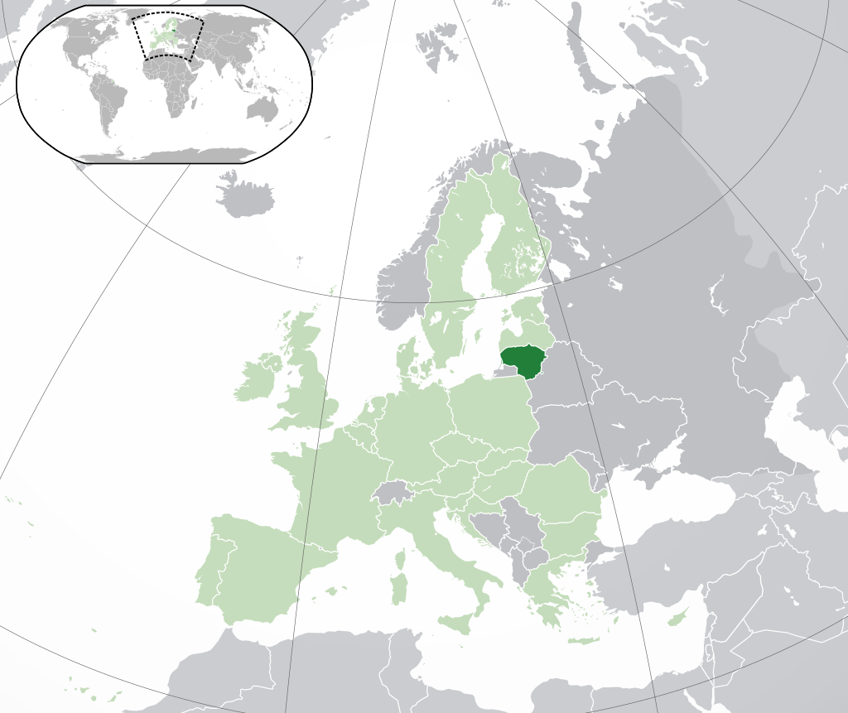
Lithuania is a country in Eastern Europe
https://www.youtube.com/watch?v=18LV28Rkldc

Slide 3
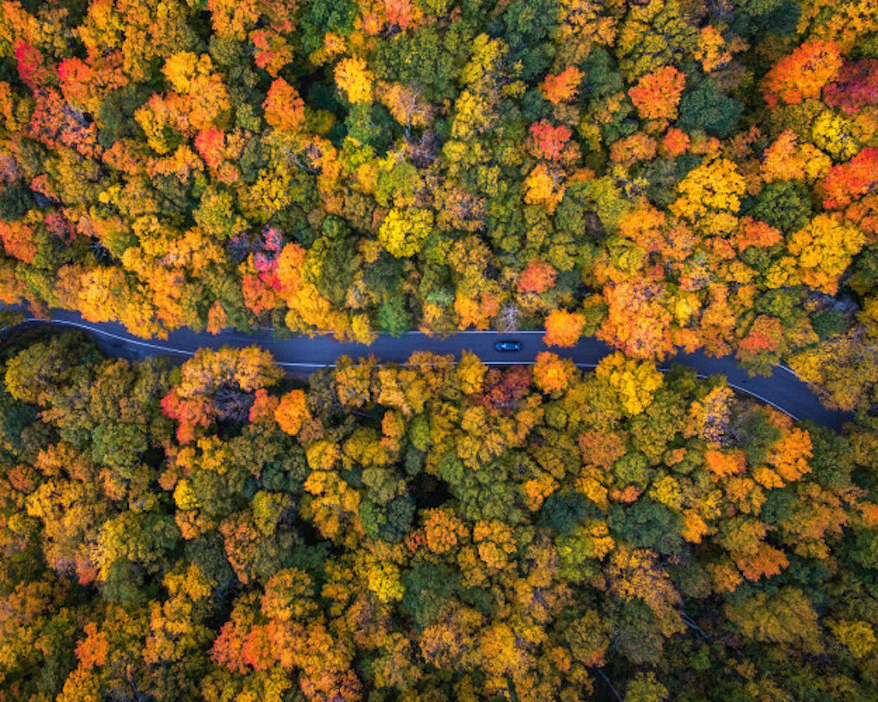
Lithuanian sightseeing places

Slide 4
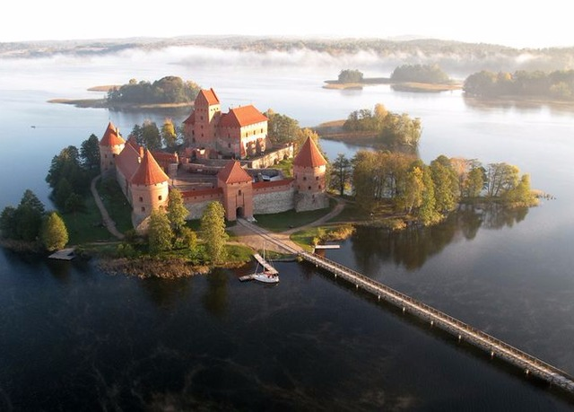
Trakai Island Castle
Trakai Island Castle is a Gothic castle in the city of Trakai, to which the pedestrian bridge has been built. is one of the most popular tourist attractions in Lithuania; There are various holidays in the castle, archeological and historical exhibitions, and hunting museum.

Slide 5
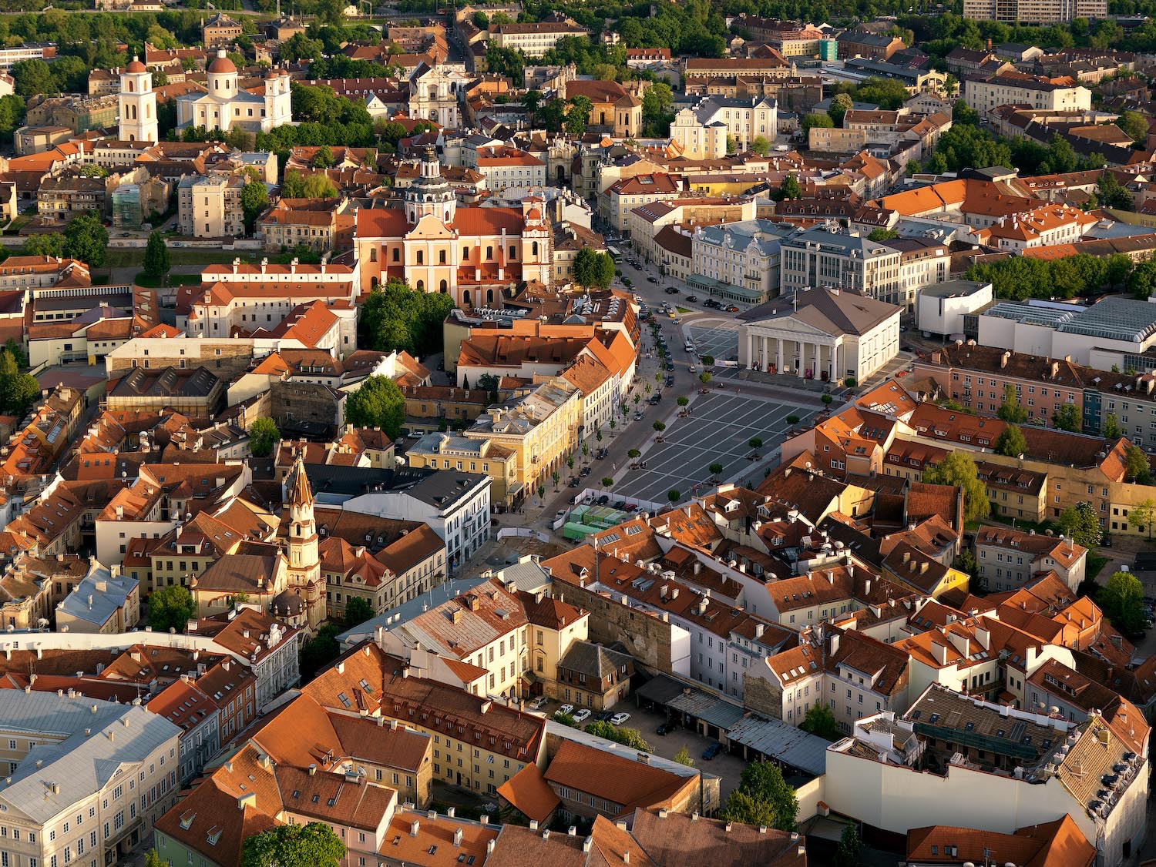
Old Town of Capital Vilnius
https://www.youtube.com/watch?v=GI7JgGkbJUk

Slide 6
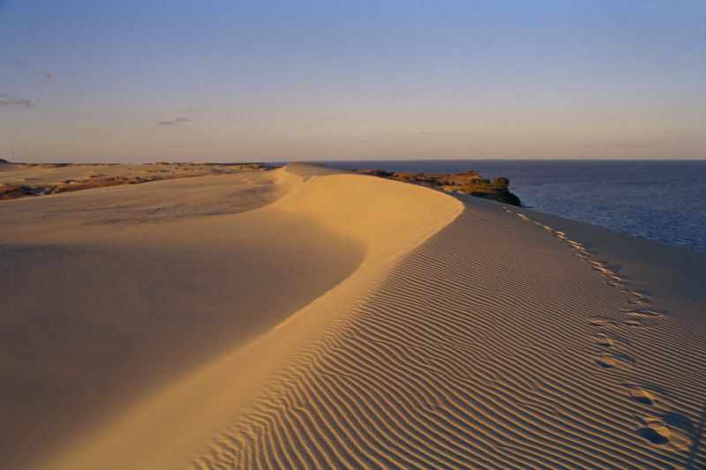
Kuršių Nerija
https://www.youtube.com/watch?v=7TEWaiKaXgk

Slide 7
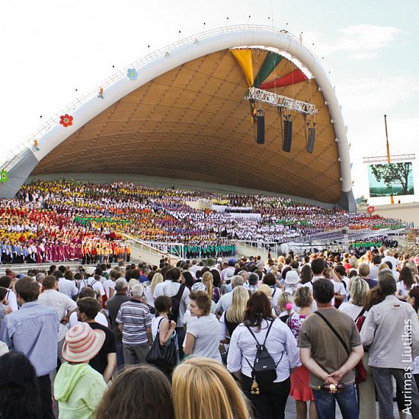
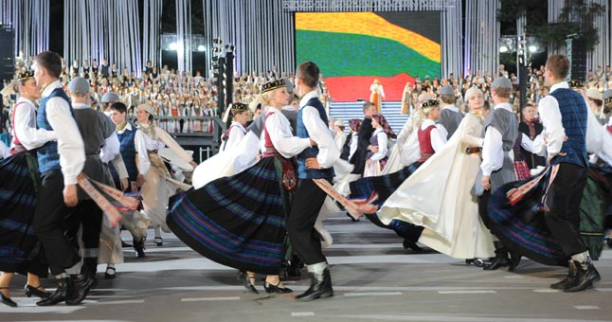
Song and dances festival
https://www.youtube.com/watch?v=hnoybfQ7xcg

Slide 8
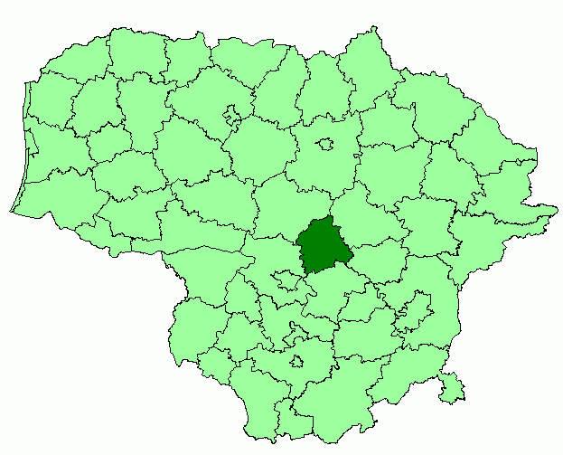
Our city - Jonava
https://www.youtube.com/watch?time_continue=694&v=HXCczxoB4T4

Slide 9
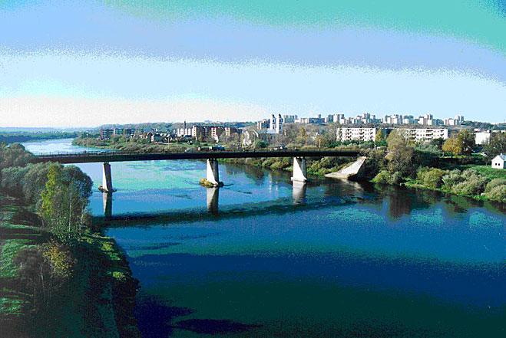
Jonava is in the center of Lithuania.
There live about 30 thousand people.
Where are in oure city
2 elementary schools
2 progymnasiums
2 basic schools
2 gymnasiums.

Slide 10
Our school
Our school is Jonavos Raimundas Samulevičius' progymnasium.
The school will celebrate the 30th anniversary of the coming year.
804 pupils study at the school. Students from 6 to 15 years old attend this school.

Slide 11
R.Samulevičius progymnasium
https://www.facebook.com/Jonavos-Raimundo-Samulevi%C4%8Diaus-progimnazija-992697164124751/?fref=ts

Slide 12
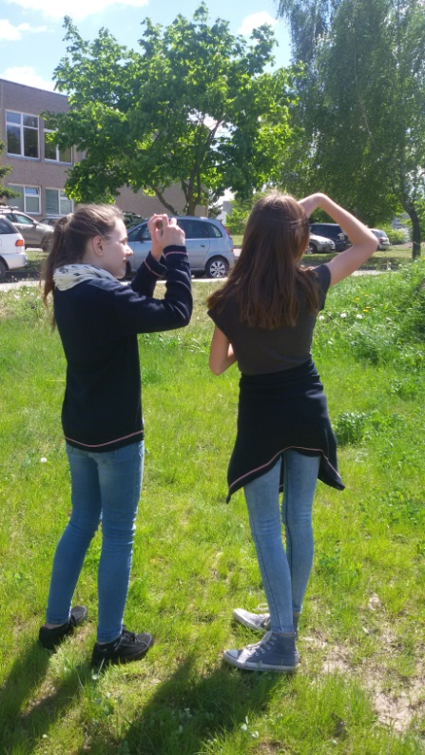
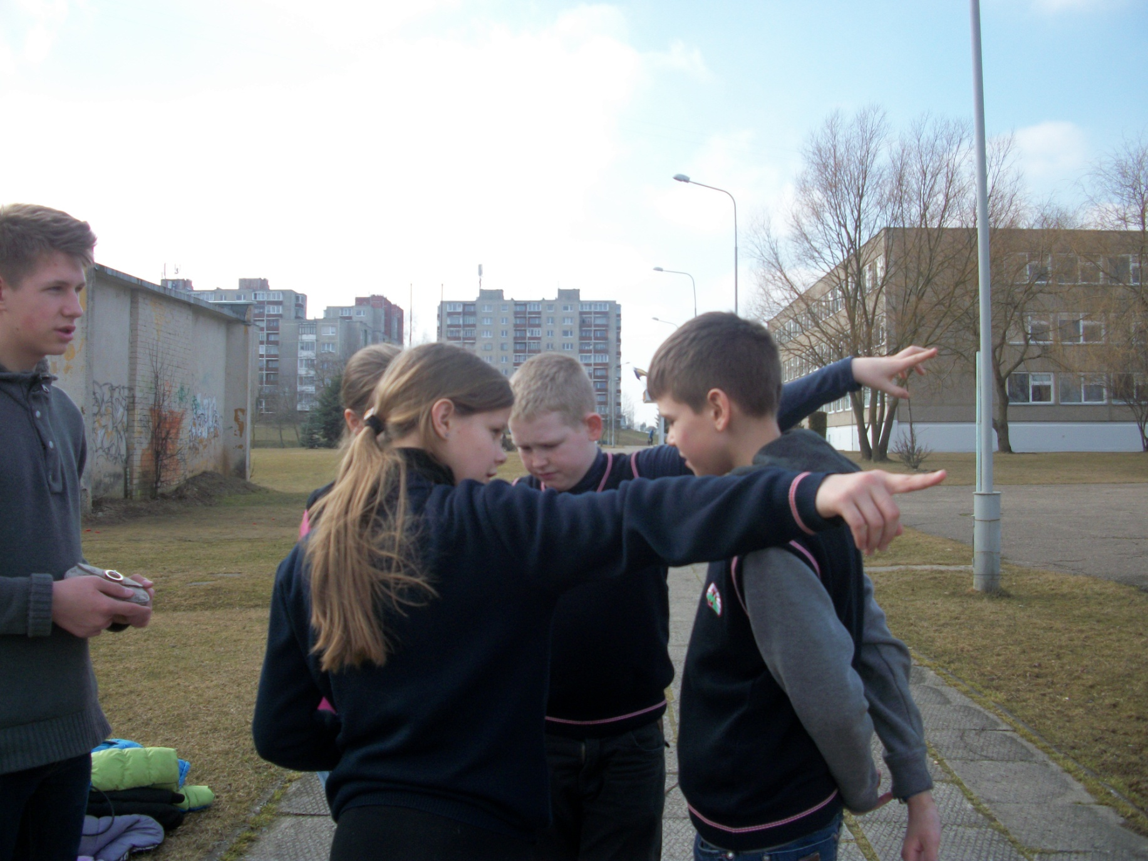
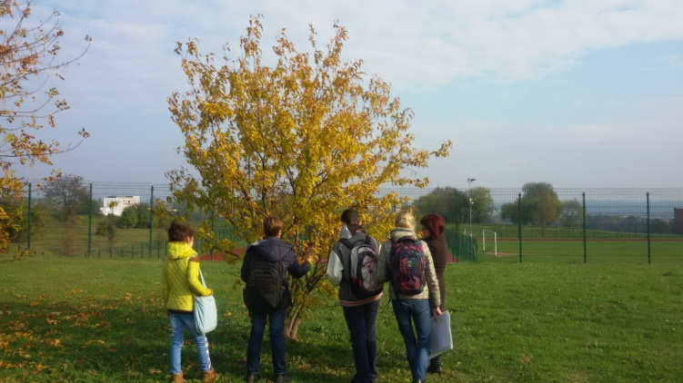
Our school students have been involved in the GLOBE program for over 5 years.
Participants: 5-8 class students.
We perform atmospheric, phenological research.

Slide 13
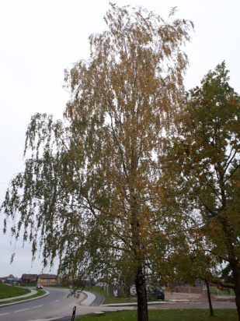
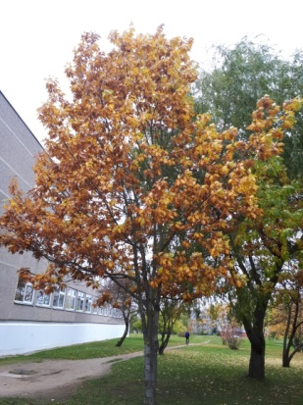
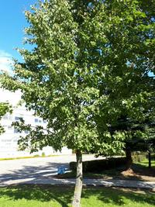
Observed Trees
# birch
＃oak
＃lime

Slide 14
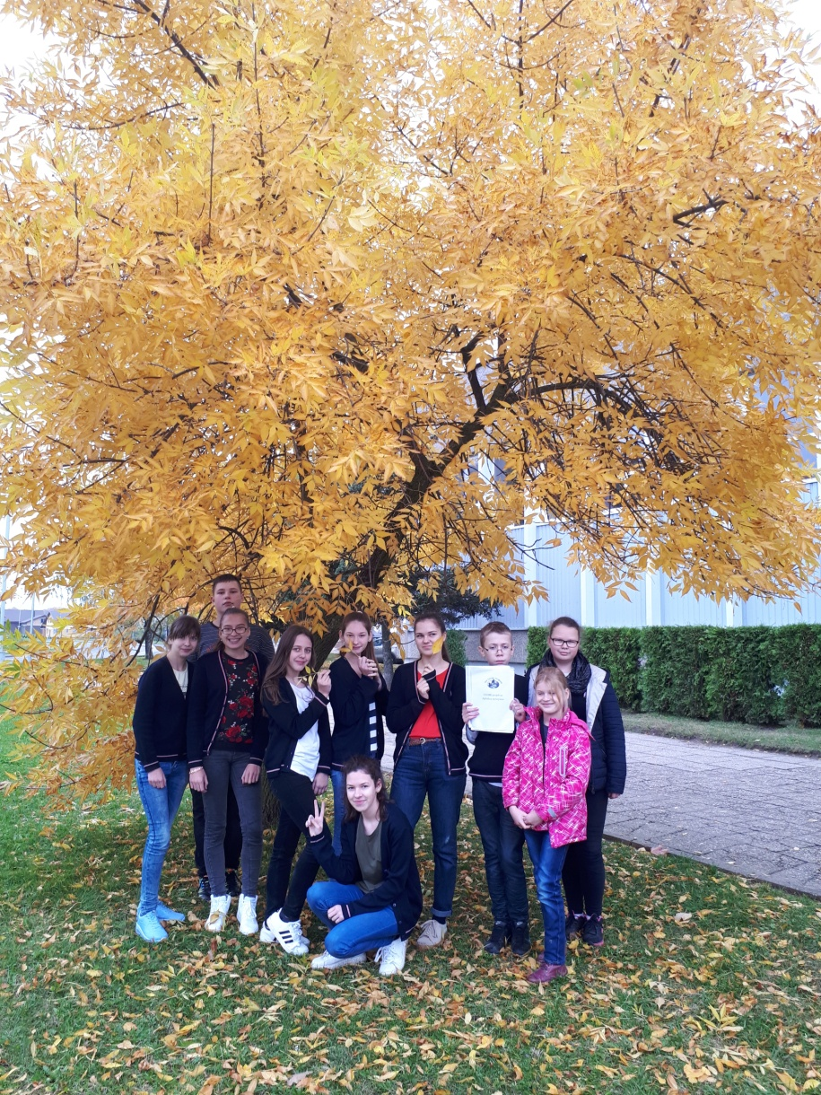
Best regards from Lithuania!

