Slide 1
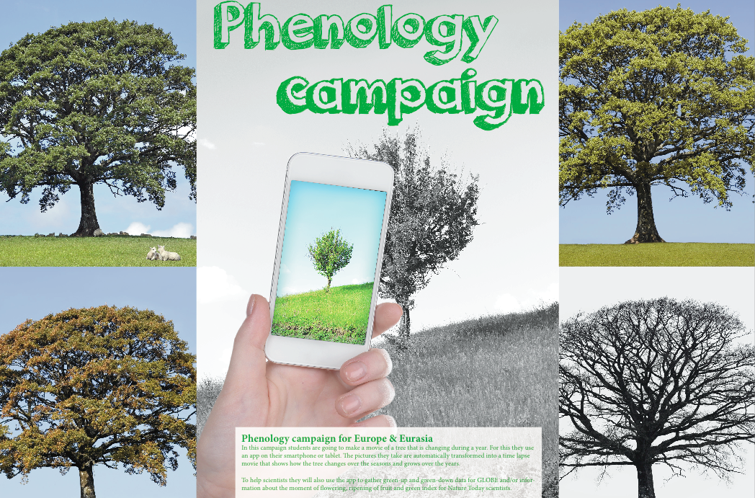
Phenology app
www.globe.gov/web/european-phenology-campaign

Slide 2
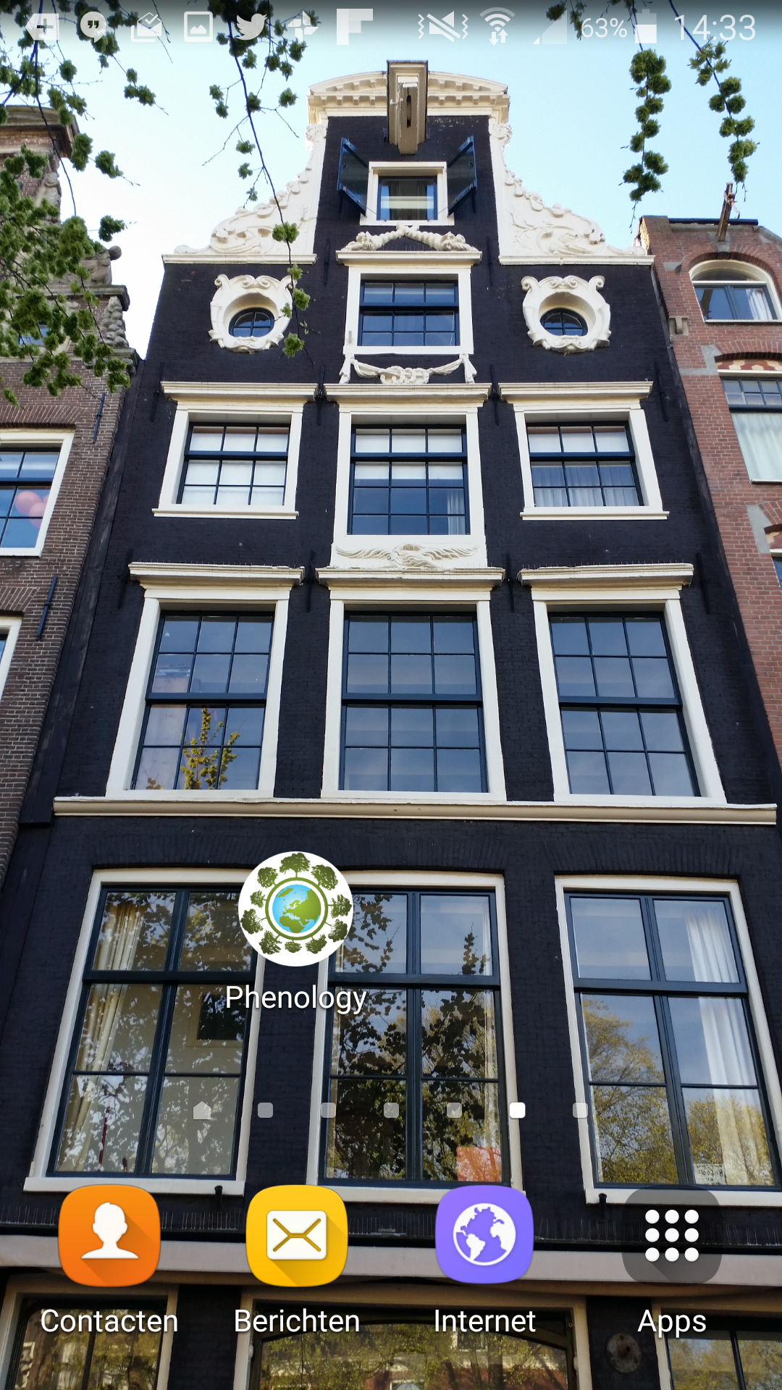
Download GrowApp at:
www.growapp.today
www.globe.gov/web/european-phenology-campaign

Slide 3
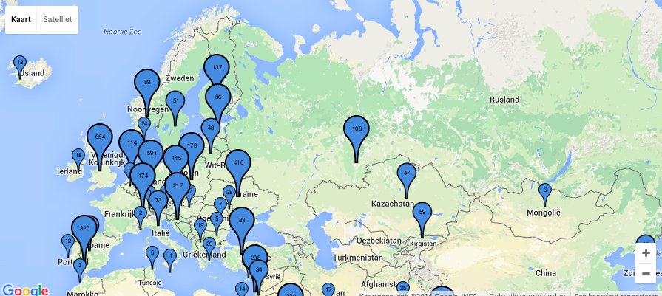
European campaign
Investigate 6 species with a Europe wide distribution

Slide 4
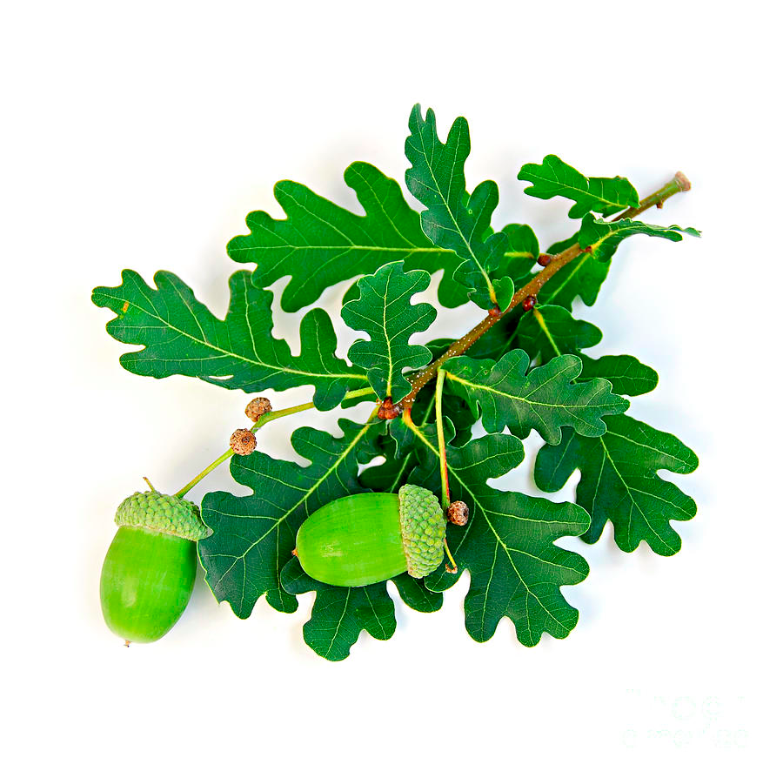
Oak (Quercus robur) #Oak

Slide 5
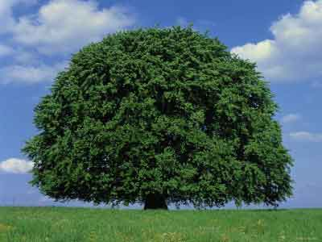
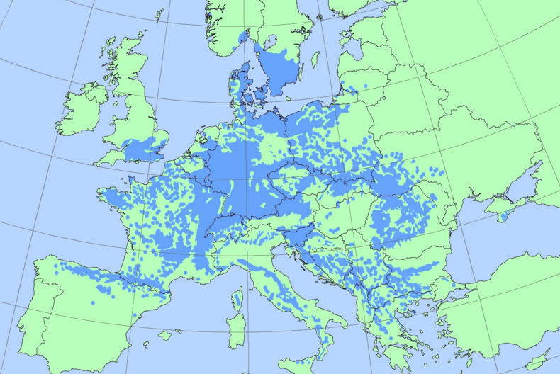
Beech (Fagus sylvatica) #Beech

Slide 6
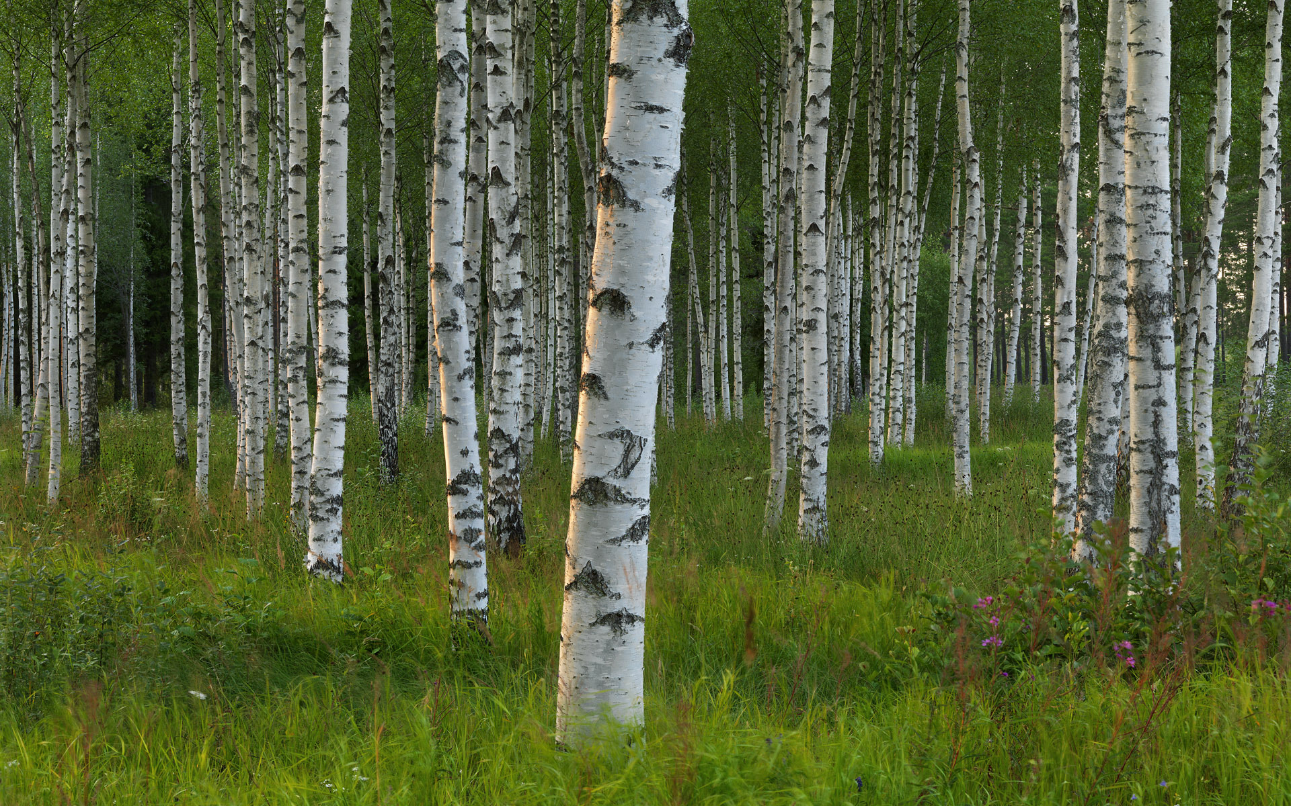
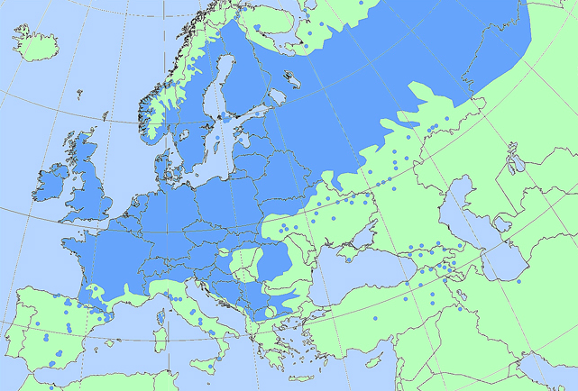
Birch (Betula pendula) #Birch

Slide 7
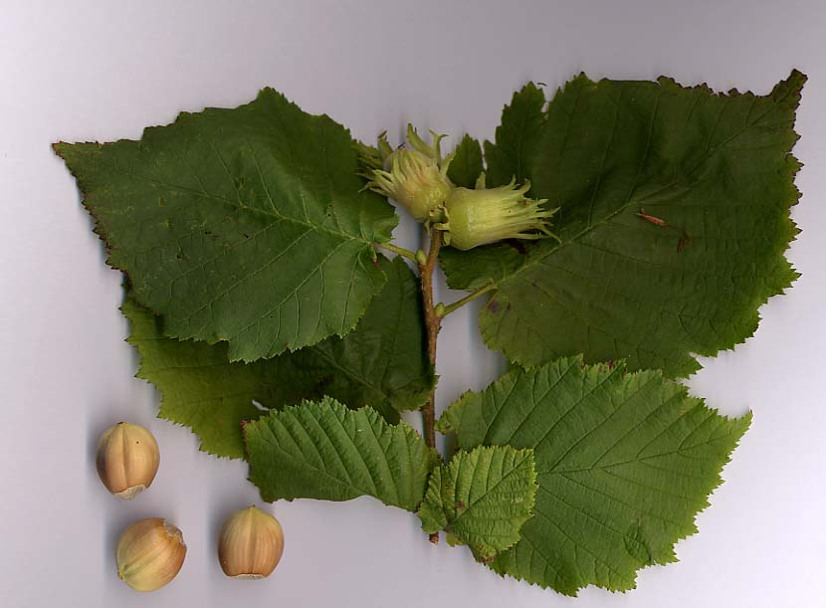
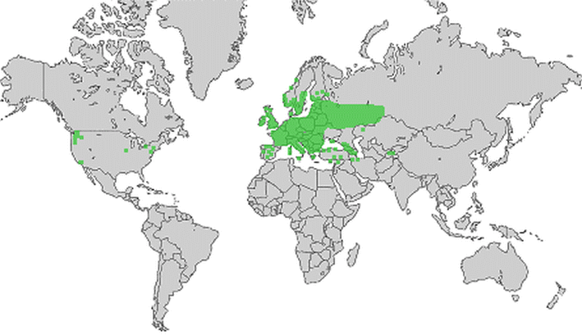
Hazel (Corylus avellana) #Hazel

Slide 8
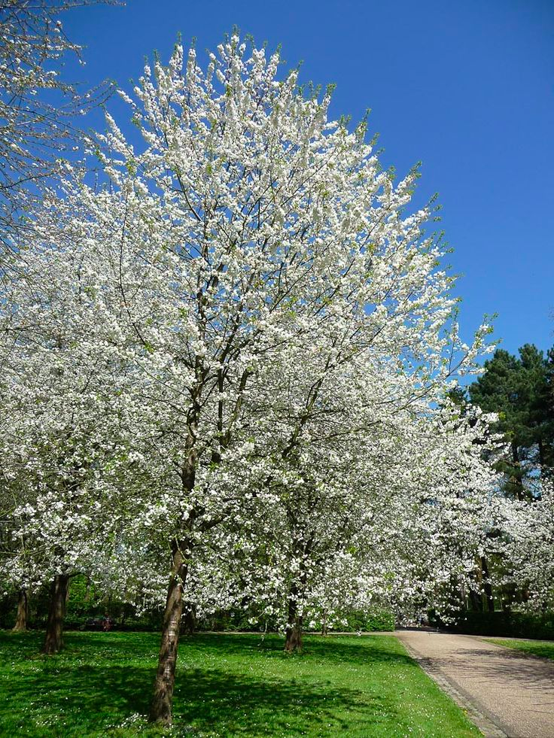
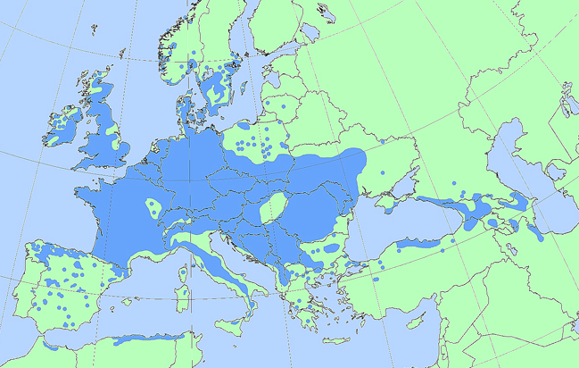
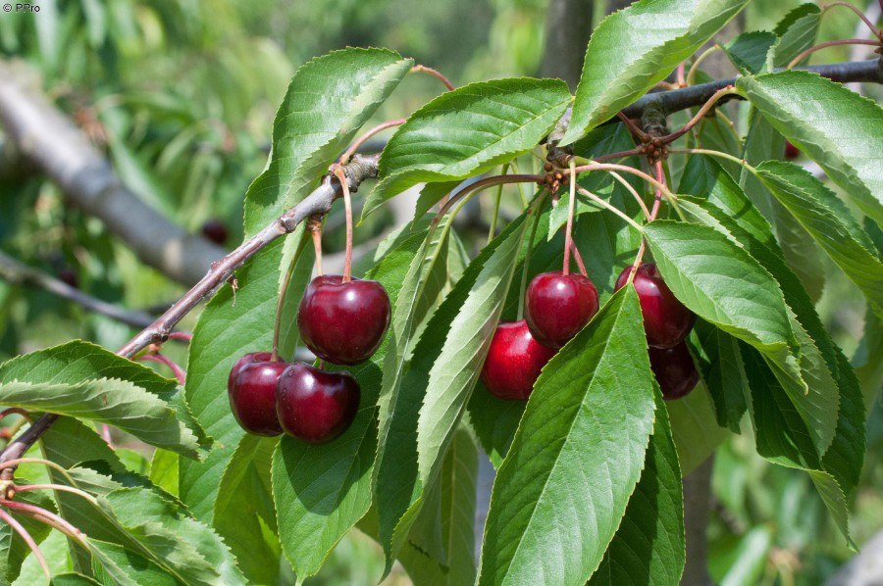
Sour cherry (Prunus cerasus) #Cherry

Slide 9
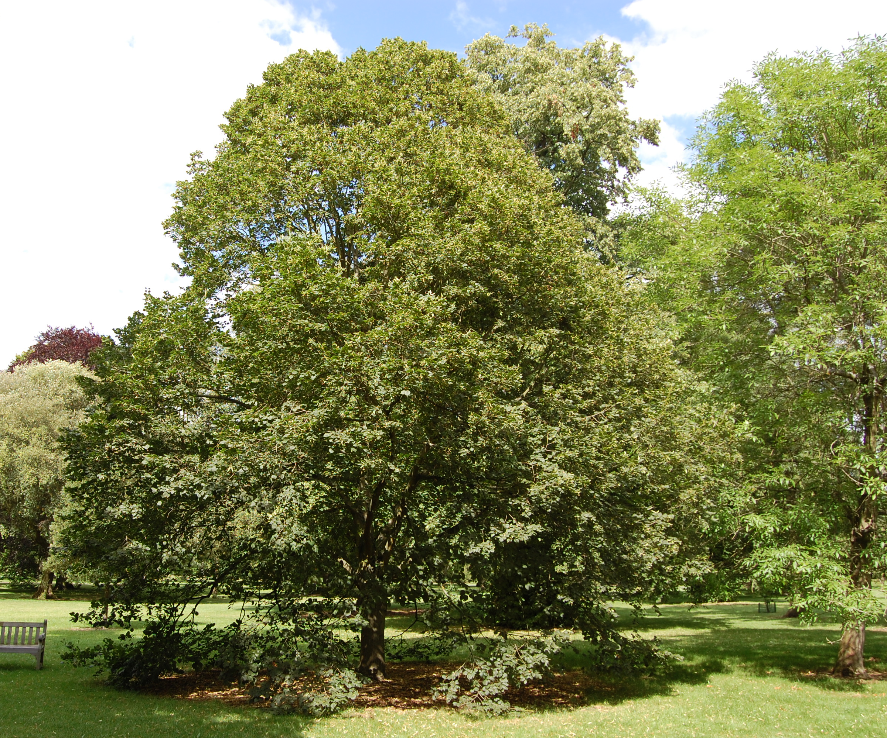
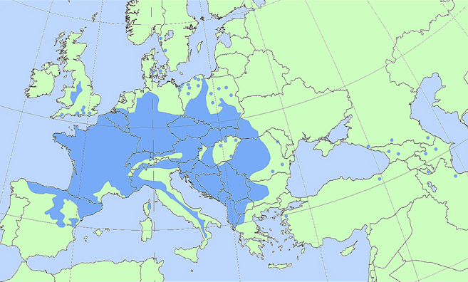
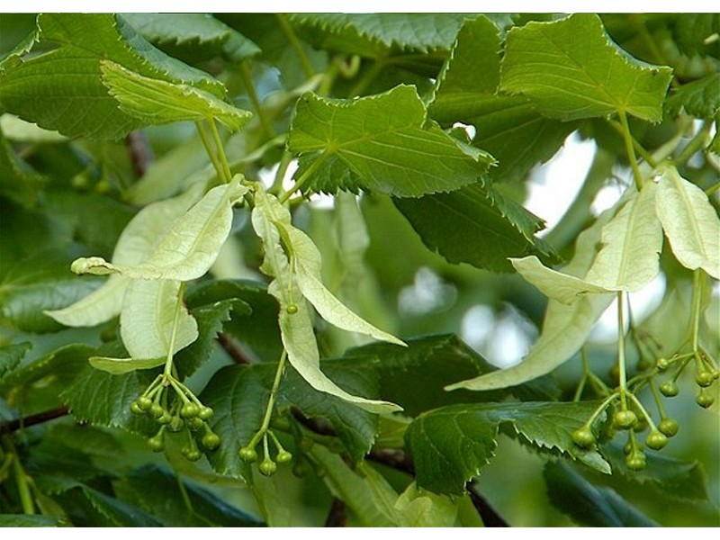
Small-leaved lime (Tilia cordata) #Lime

Slide 10
School project (1)
Pick one or more (of the 6) species and consider:
Is it common in your area;
When is greening-up and greening-down to be expected
Identify different individuals of the chosen species in your area.
Make sure that they are in a location that you see (almost) every day.
Try to pick individuals in different habitats in order to find out what influences the phenology events. Think about:
Shade/sun
Dry/wet
In the city / out of the city
Temperature
Soil type

Slide 11
School project (2)
Make sure to take a first picture when the tree is still completely bare. In the description field give it the following hashtags: #species (see pictures above), #GLOBE, #Name of the school
As soon as you see that the tree is starting to green-up:
Enter the green up information by following the GLOBE green up protocols
At the same time add pictures to the first picture you took with the GrowApp by opening the previous picture and adding a new one with the Camera+ icon.
When the tree is completely green you don’t need to take so many pictures anymore. Take a picture if the tree is changing! This might be less then once a month. You also don’t need to add GLOBE data.
As soon as the tree is starting to green down:
Follow the GLOBE green down protocols
At the same time take pictures with the GrowApp
When the tree is completely bare again, you don’t need to take so many pictures anymore. When it is snowing or there is another event that looks pretty, take pictures again.

Slide 12
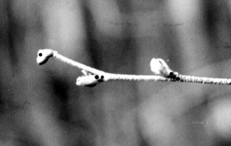
GLOBE protocols: Green-up
Determine whether there are more than one green down cycles
Select a healthy and relatively large branch
south side of the plant in the Northern Hemisphere
north side of the plant in the Southern Hemisphere
Mark the branch with flagging tape (beginning at least two weeks prior to the anticipated start of green-up)
Label 4 buds closest to the end of branch
Examine each bud and record (at least twice a week,):
“dormant” if the bud is unchanged.
“swelling” if the bud is getting bigger.
“budburst” the first day you see the green tips of leaves.
“lost” if something happens to the bud and you cannot continue observations.
After each budburst measure the length of the leaf or leaves.

Slide 13
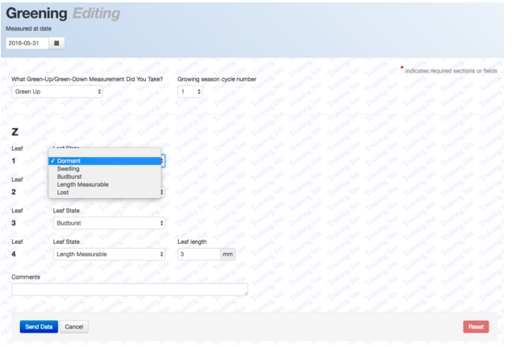
Data entry Green up

Slide 14
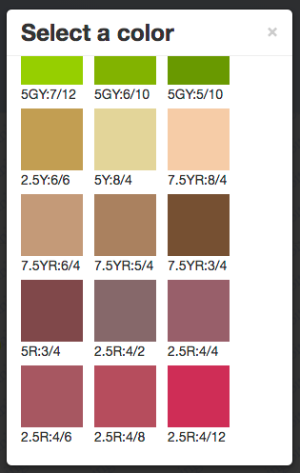
GLOBE protocol: Green down
Find a tree of one of the 5 species
Tag a branch with flagging tape
Determine whether there are more than one green down cycles
Label the 4 leafs at the end of the branch with 1,2,3 or 4 dots
Check the colour of the leafs at least twice a week until they have fallen of
Start at least 2 weeks prior to the expected start of green down
Use the GLOBE Plant Color Guide to estimate the dominant color of each leaf

Slide 15
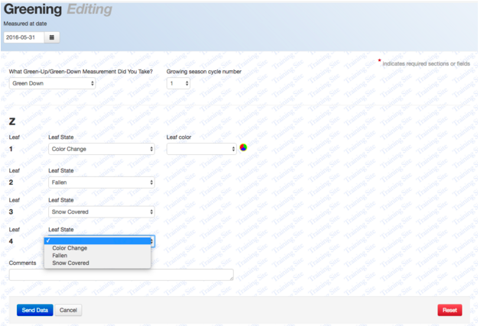
Data entry Green down

Slide 16
Using the GrowApp

Slide 17
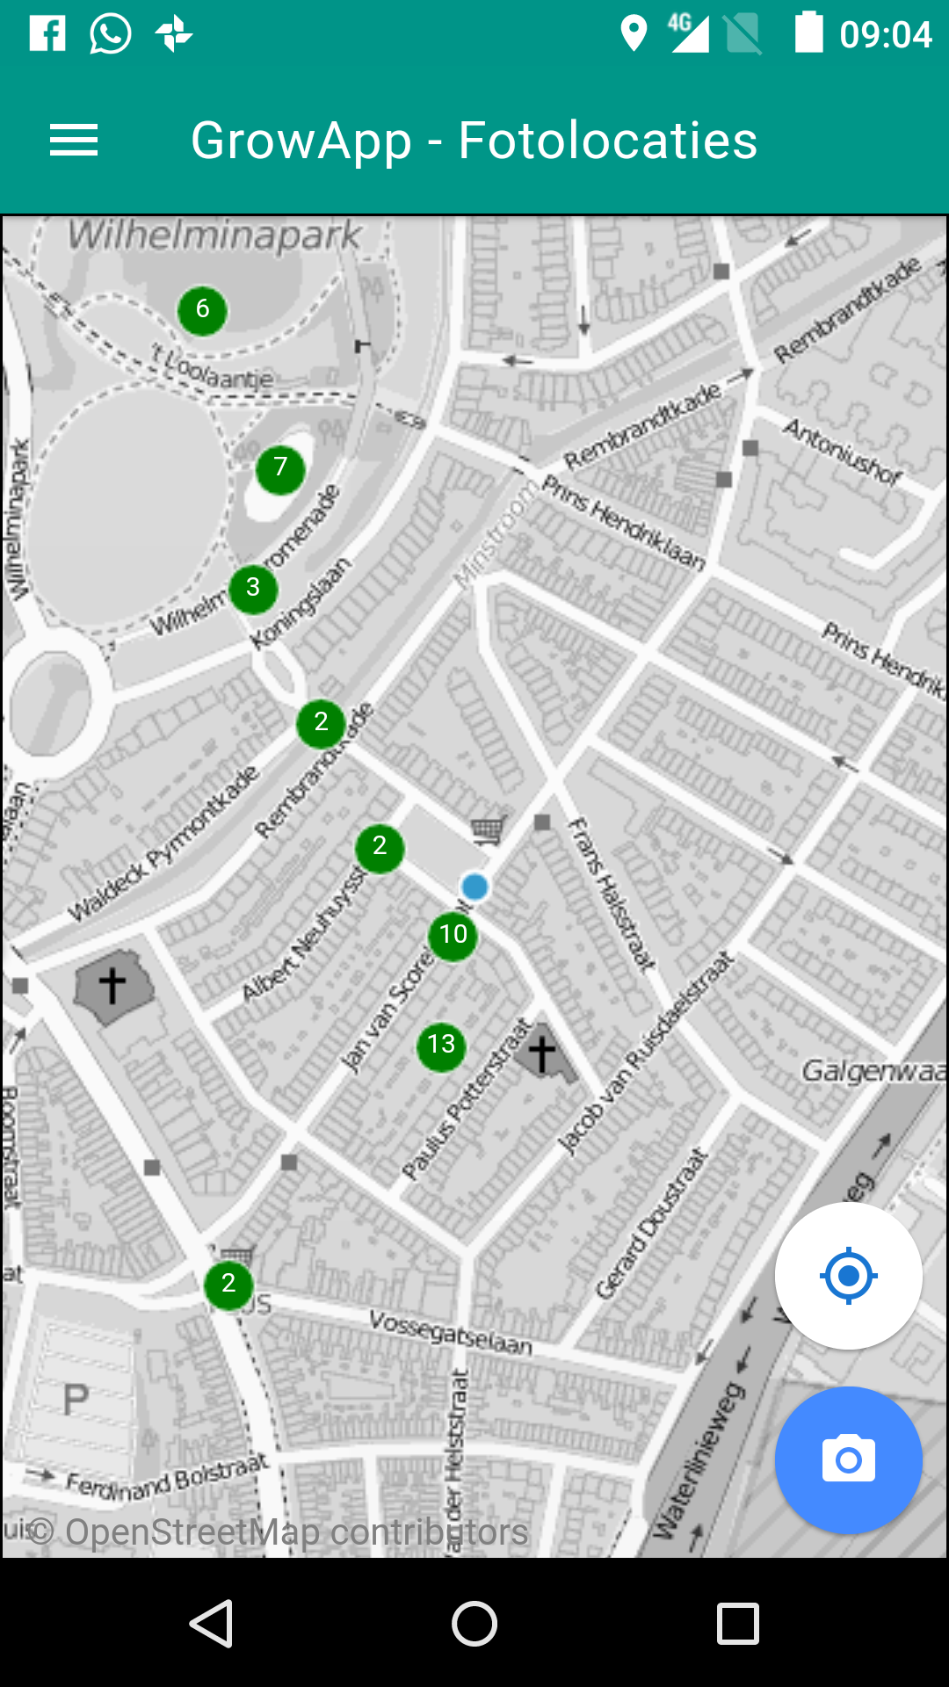
Open app
Put on GPS
Make sure you have internet connection
Take a picture of a tree (everyone take another tree)

Slide 18
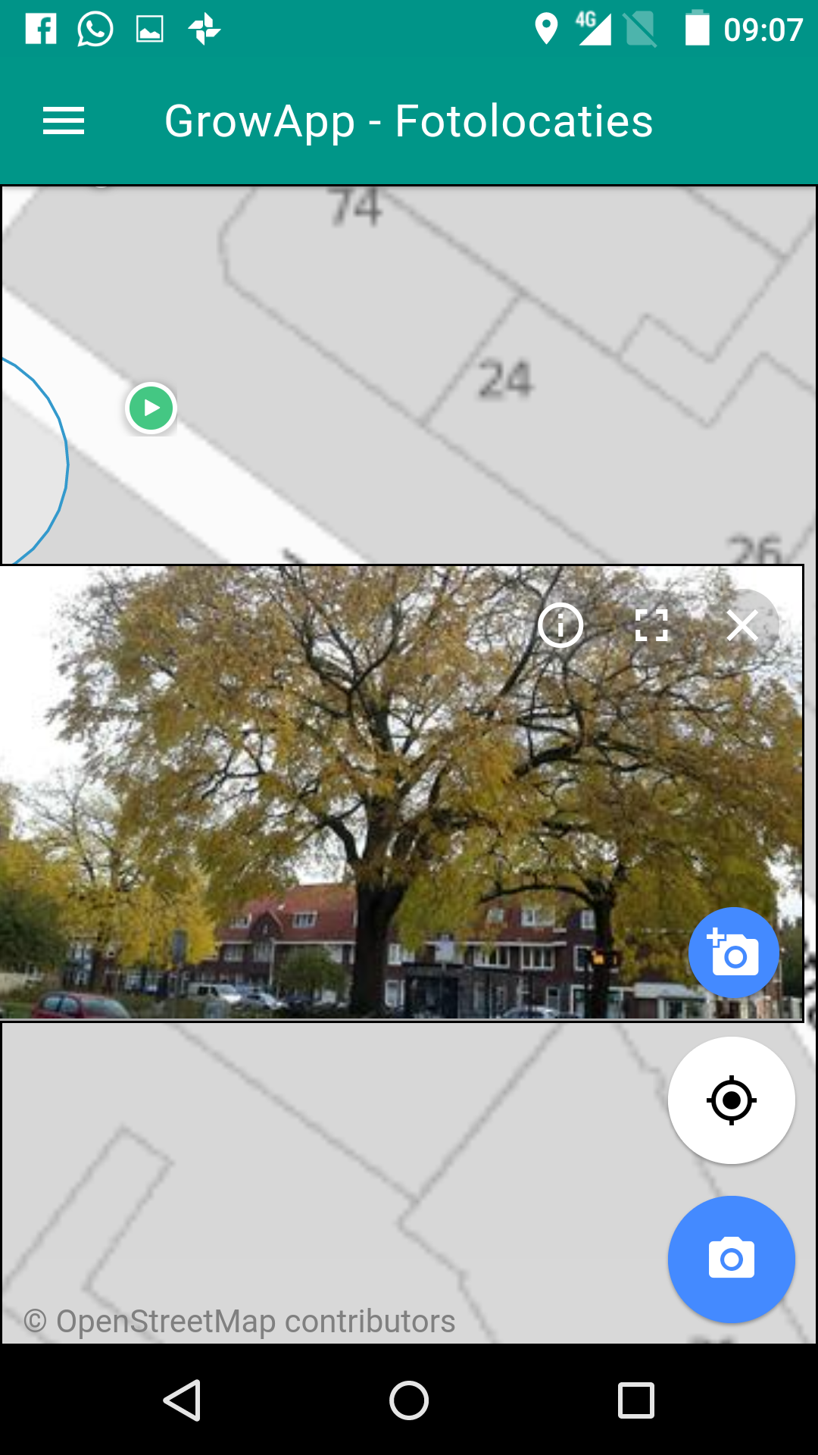
Add a picture to a picture location (of somebody else)
Add picture to existing picture location
Create new picture location (first picture in an animation)

Slide 19
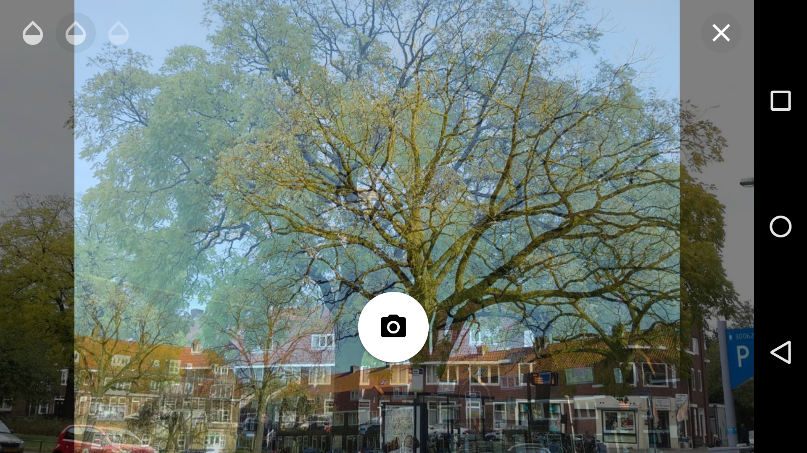
Show camera preview on top of picture
'Onion Skinning'
Adjust transparency
Close

Slide 20
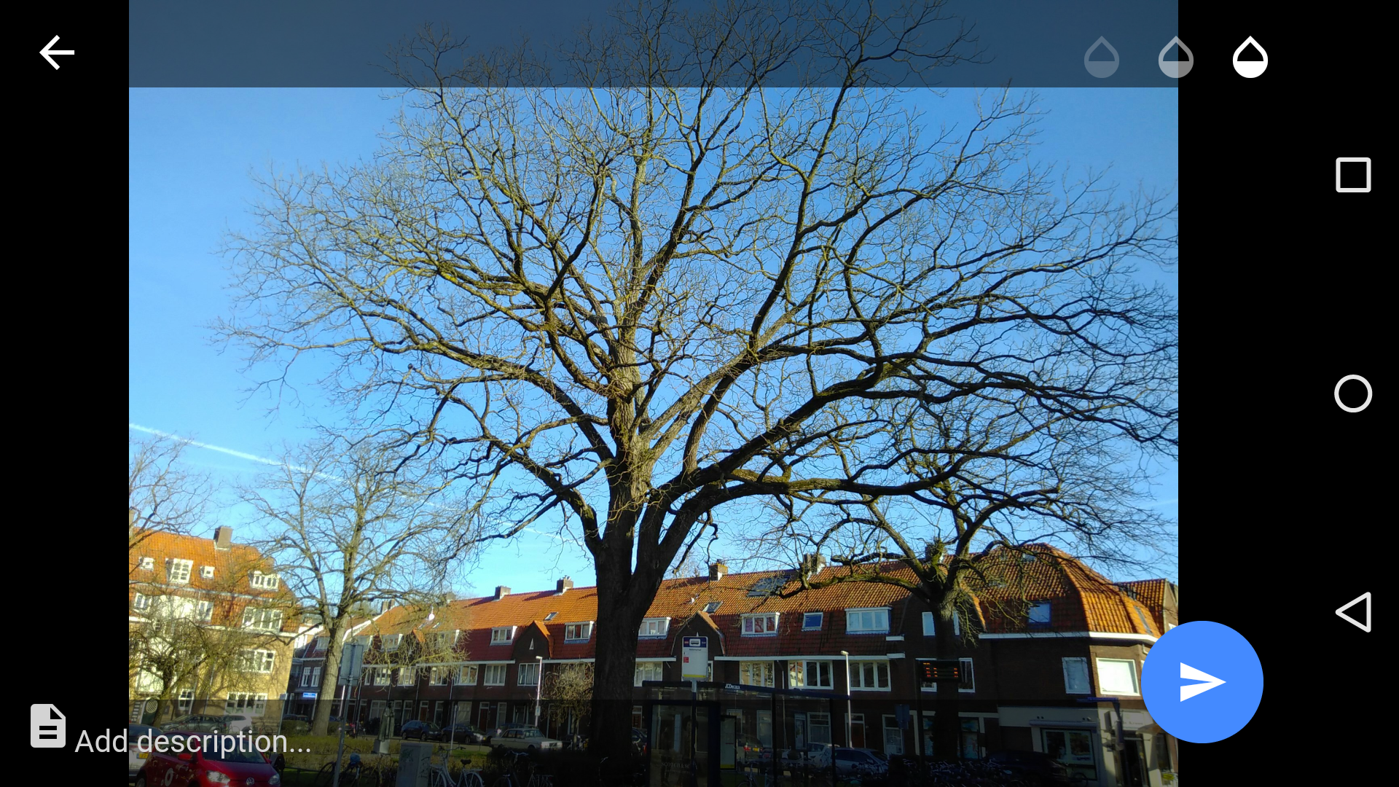
Picture taken!
Adjust transparency to check picture overlay
Cancel (try again)
Optionally add description
Send picture to be shown publicly on the map

Slide 21
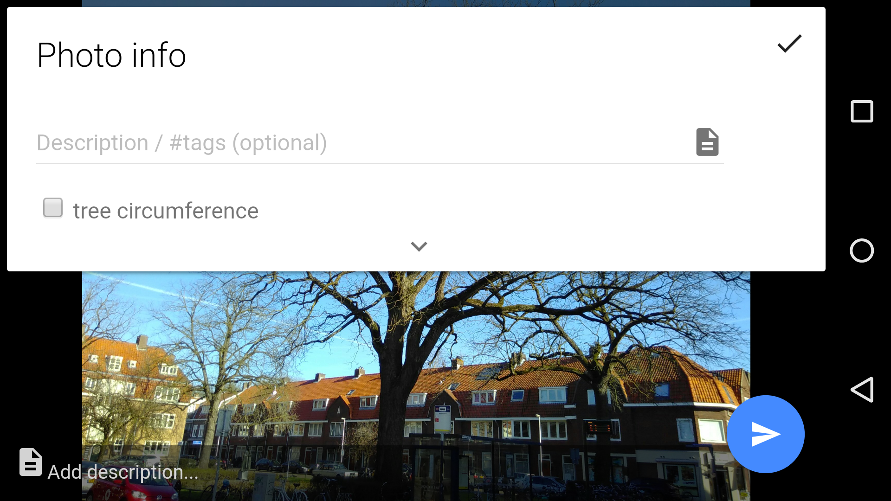
Add information and #tags Tags make it possible to filter photo’s on www.growapp.today. In the European campaign use the # for the 6 species

Slide 22
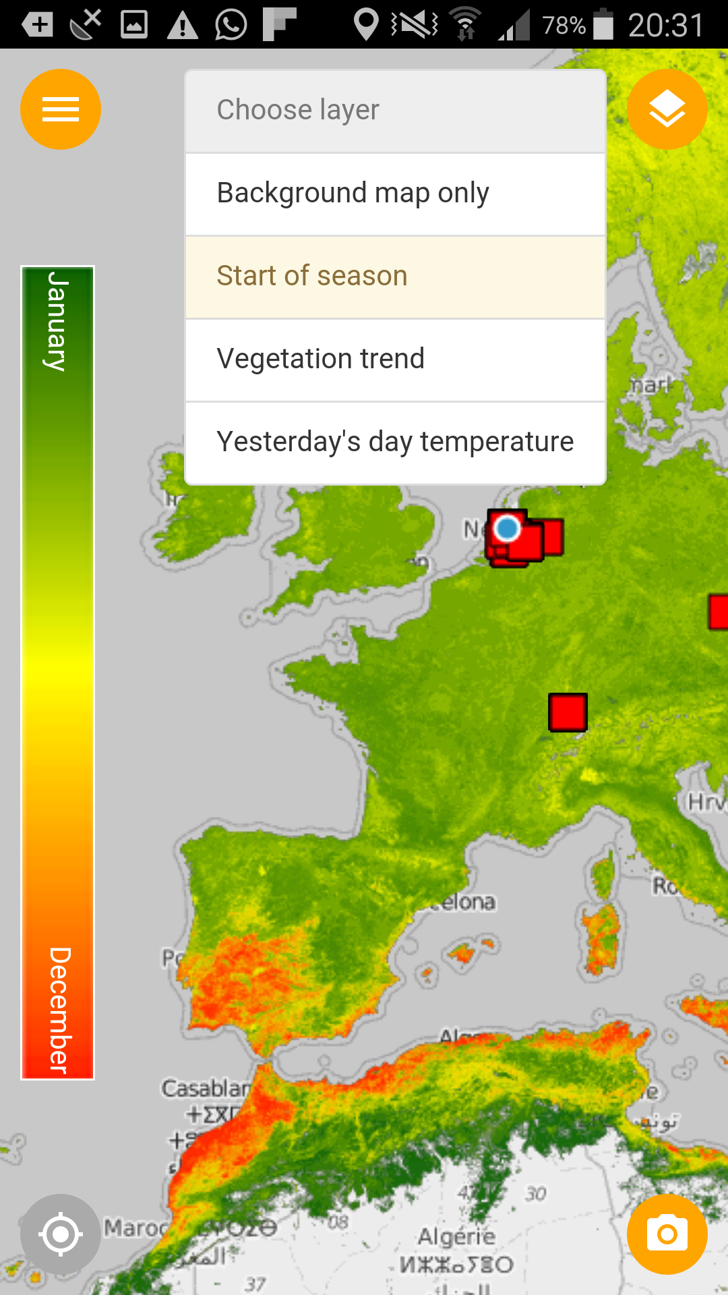
Extra reference map layers:
start of vegetation season

Slide 23
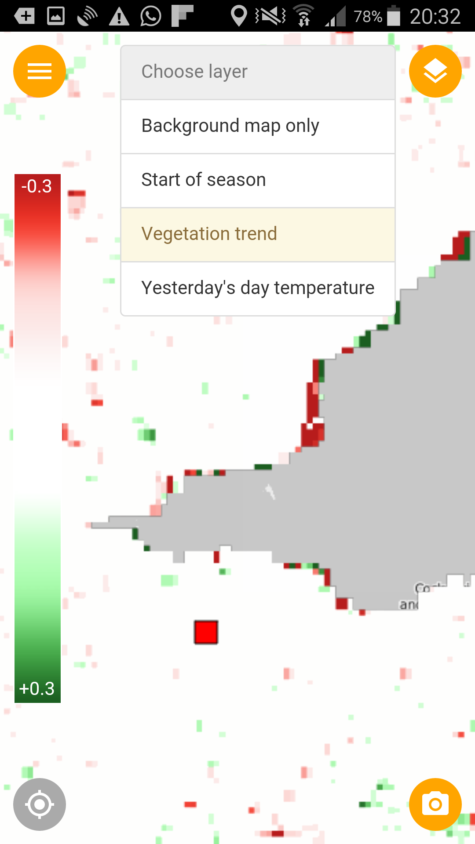
Extra reference map layers:
vegetation trend

Slide 24
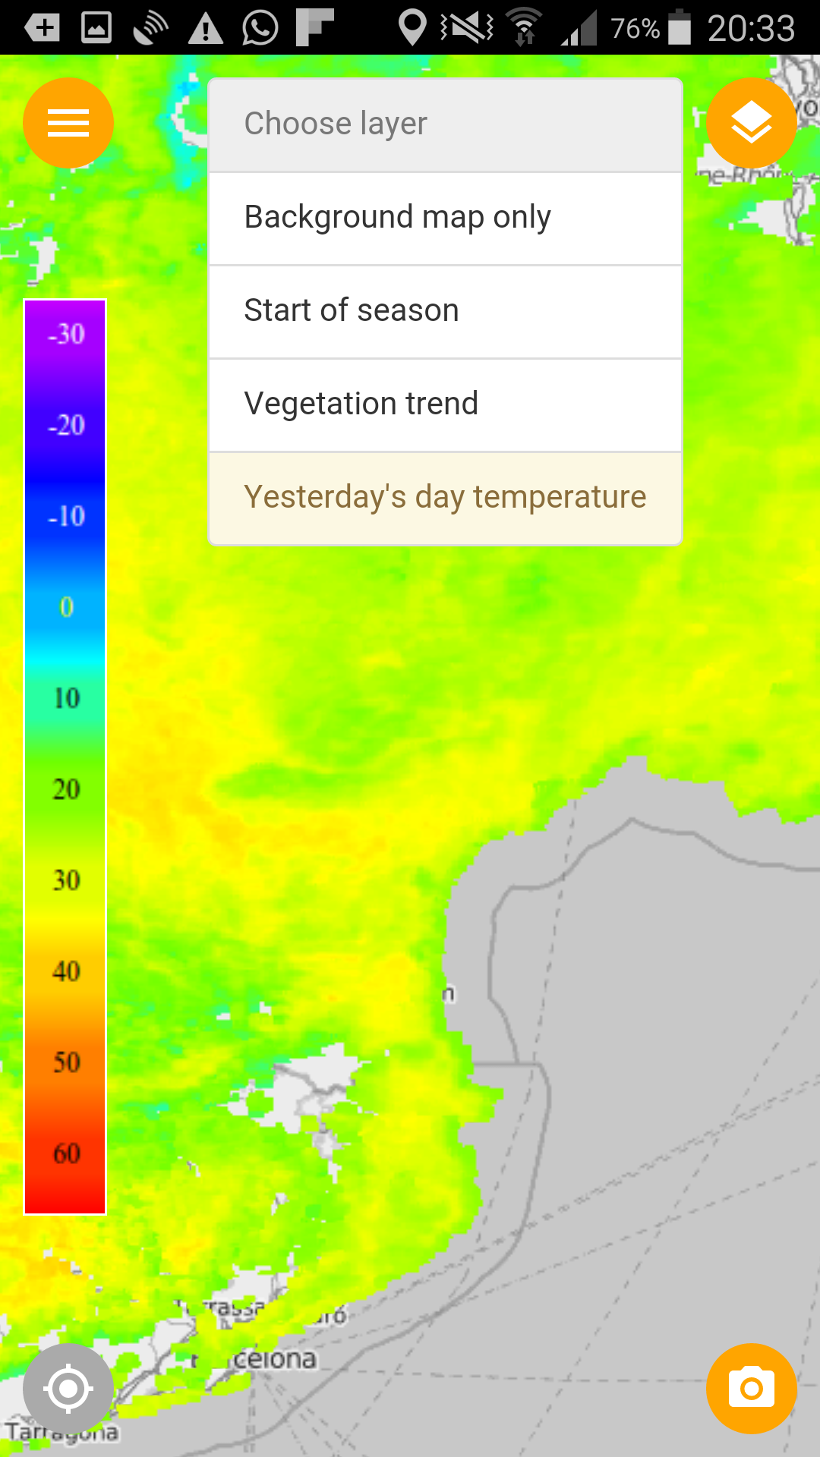
Extra reference map layers:
yesterday's surface temperature

Slide 25
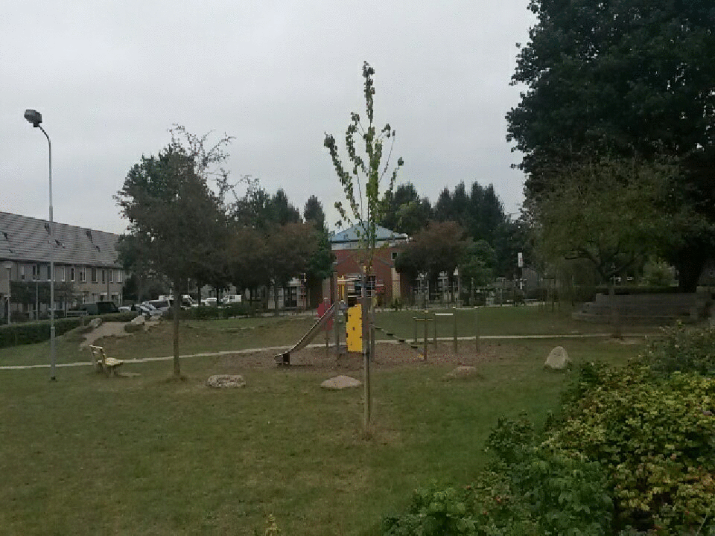
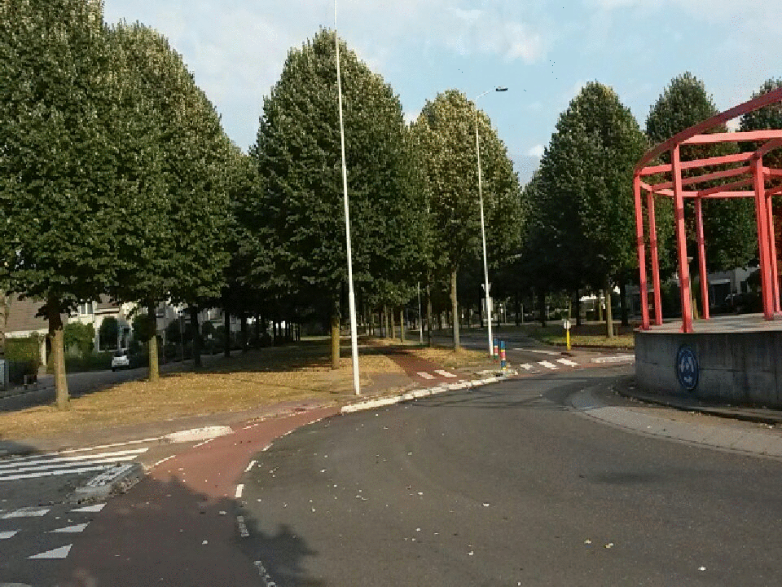
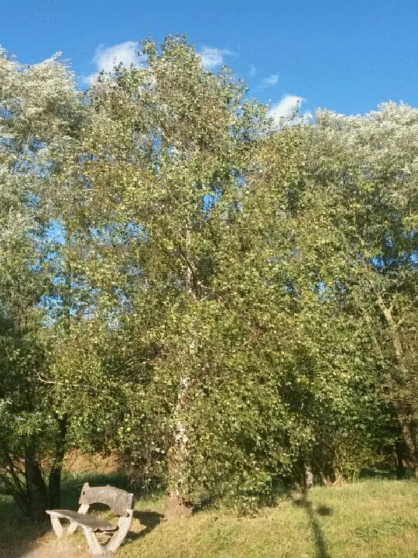
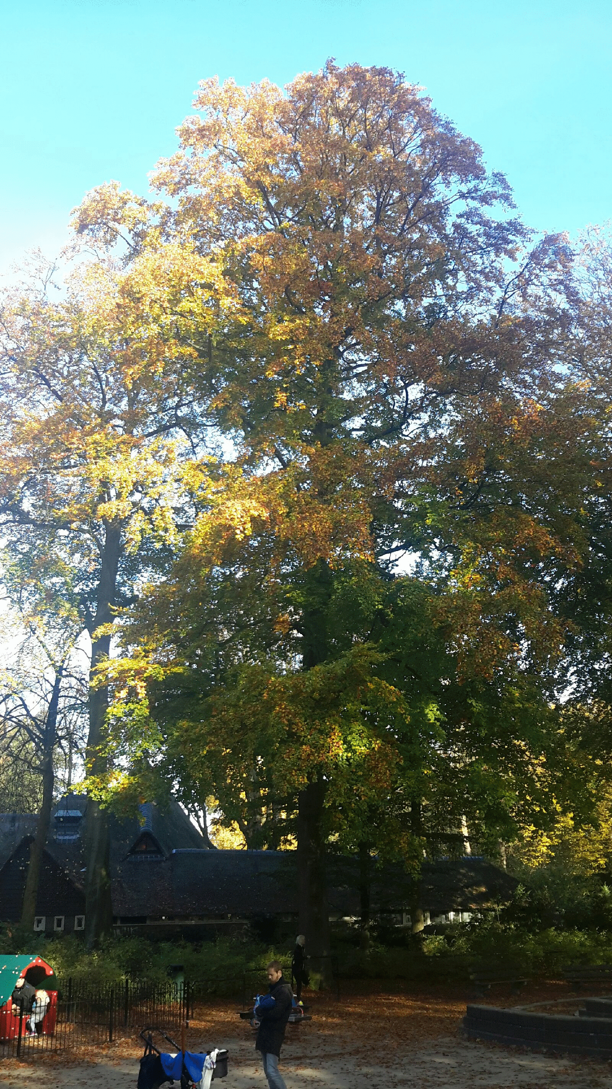
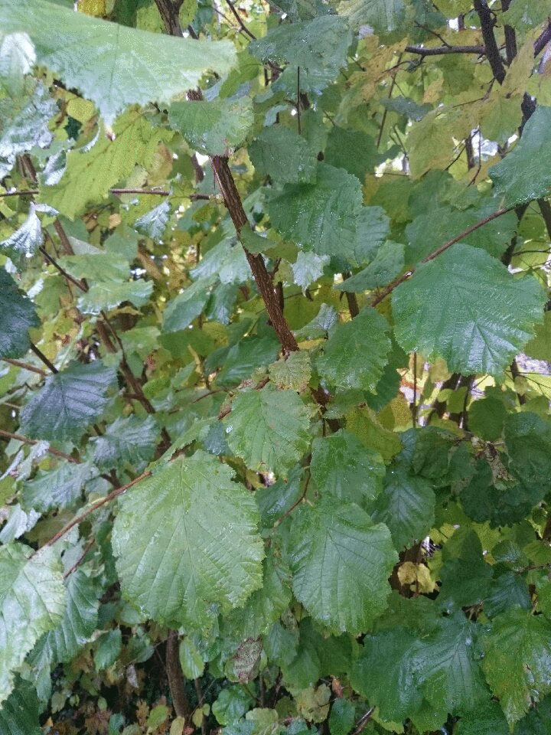
Animations of trees
Made with GrowApp

Slide 26
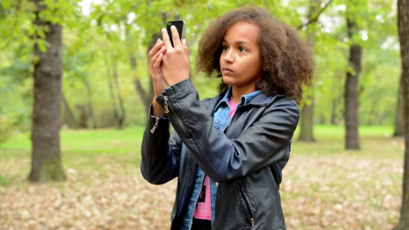
Let’s go outside!

Slide 27
How to join?
Go to www.globe.gov/web/european-phenology-campaign
Sign in to your account and click on
Download app and learning materials

Slide 28
We look forward to your movies!

Slide 29
Partners
EU (MYGEOSS)| funding building app
Ministry of environment Netherlands | funding learning materials & outreach
GLOBE Europe & Eurasia board | organisation and outreach
Wageningen University | science
Leiden University | strategy app development
Geodan | development app
GLOBE Program | connection to database (API) and visualisation
GLOBE Netherlands foundation | coordination
Forget the fish | website development

